Slide 1

Detection of freezing of gait in Parkinson’s disease using machine learning
Project by :
Altaf Ahmad (230350125008)
Mayank Jain (230350125044)
Swapnil Devidas Chavan (230350125081)
Ninad Inamdar Bhirdikar ( 230350125051)
Project Guide:-
Mr. Jitendra Kumar

Slide 2
Contents
Contents
Aim
Dataset
FOG
Introduction to Parkinson’s
Accelerometer
Cause of Parkinson’s disease
Machine learning pipeline
Machine learning Algorithm
Sensor Plot

Slide 3
Aim :
Our work will help researchers better understand when and why FOG episodes occur. This will improve the ability of medical professionals to optimally evaluate, monitor, and ultimately, prevent FOG events.

Slide 4
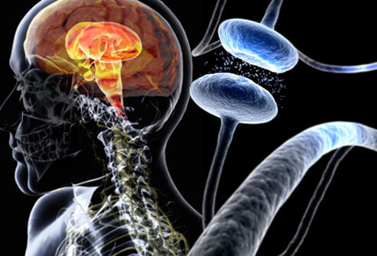
Introduction
What is Parkinson’s Disease?
Age-related and progressive disease of brain cells that affect movement, loss of muscle control, and balance
Source: http://http:/.medicinenet.com/parkinsons_disease_pictures_slideshow/article.htm

Slide 5
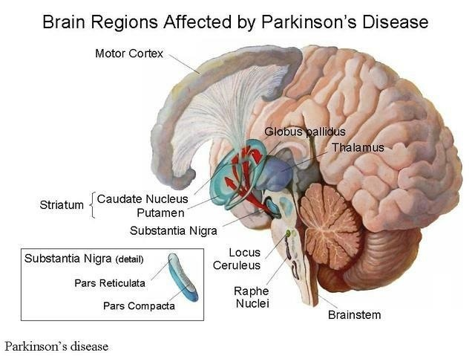
Cause of Parkinson’s Disease
Greatly reduced activity of dopamine secreting cells
Brain cell death in substantia nigra
Source: https://en.wikipedia.org/wiki/Parkinson%27s_disease

Slide 6

Parkinson's freezing of gait(FOG)
Brief, episodic absence or marked reduction of forward progression of the feet despite the intention to walk

Slide 7
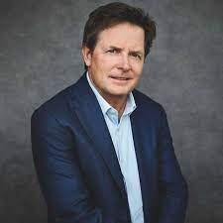
The Michael J. Fox Foundation
Established in 2000 by Canadian actor Michael J. Fox,the foundation has since become the largest non-profit funder of Parkinson's disease research in the world, with more than $1 billion of research projects to date

Slide 8
Dataset
The tDCS FOG (tdcsfog) dataset, comprising data series collected in the lab, as subjects completed a FOG-provoking protocol.
The DeFOG (defog) dataset, comprising data series collected in the subject's home, as subjects completed a FOG-provoking protocol
The DeFOG (defog) dataset, comprising data series collected in the subject's home, as subjects completed a FOG-provoking protocol

Slide 9
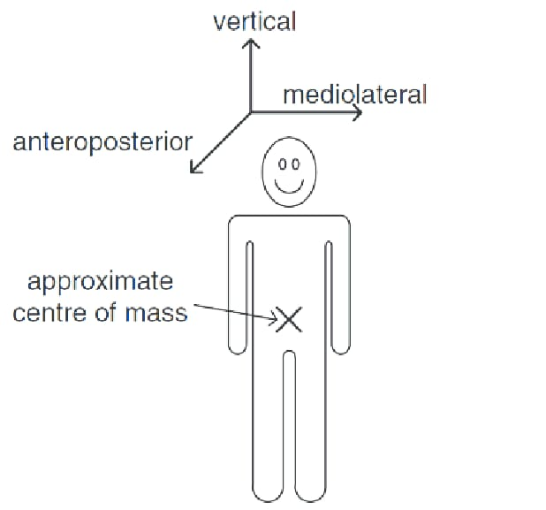
Accelerometer
3D lower back sensor
AccV, AccML, and AccAP Acceleration from a lower-back sensor on three axes: V - vertical, ML - mediolateral, AP - anteroposterior.

Slide 10
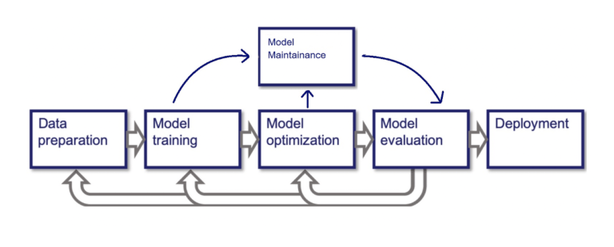
Machine learning Pipeline

Slide 11
Machine learning Algorithm ‘s
Decision Trees - We use this algorithm for DeFOG (defog) dataset, comprising data series collected in the subject's home.
XGBoost - We use this algorithm for tDCS FOG (tdcsfog) dataset, comprising data series collected in the lab.

Slide 12

Decision Tree

Slide 13
Decision Trees:
They represent a tree-like structure where each internal node represents a feature or attribute, each branch represents a decision rule, and each leaf node represents an outcome or class label.
Decision trees are simple to understand and interpret. They can handle both numerical and categorical data

Slide 14
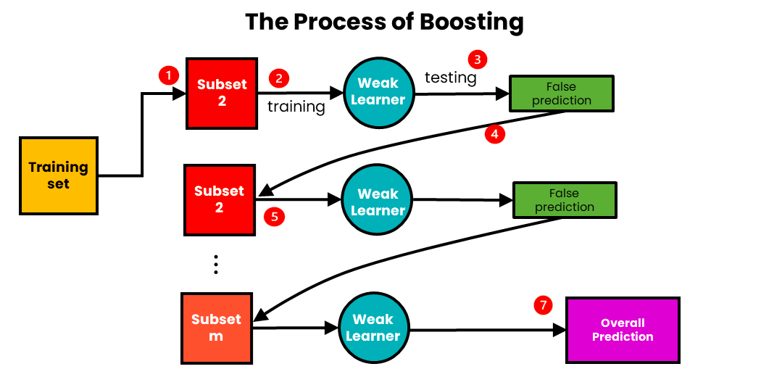
Boosting Process

Slide 15
Boosting Algorithms
XGBoost is a powerful machine learning algorithm that utilizes gradient boosting for improved predictive accuracy and performance
LightGBM is a high-performance gradient boosting framework that focuses on efficiency and speed, making it well-suited for large datasets
CatBoost is a gradient boosting library designed to handle categorical features seamlessly, reducing the need for extensive data preprocessing

Slide 16
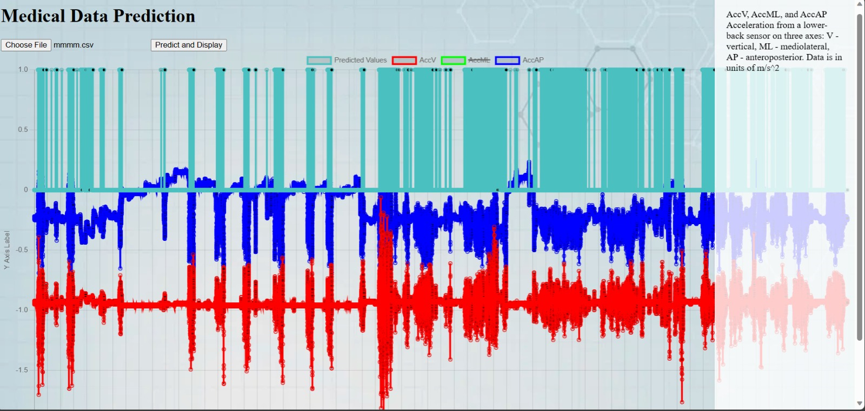
Sensor Plots(balanced data)

Slide 17
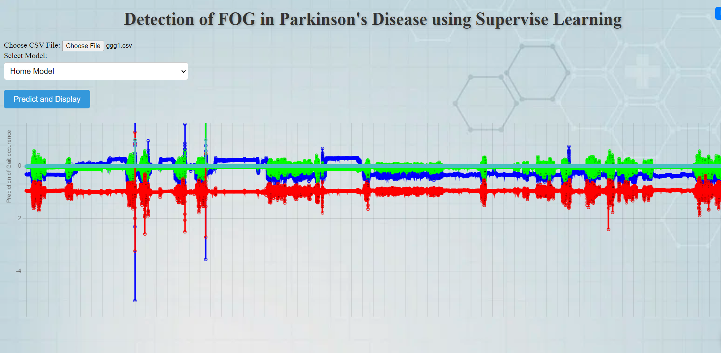
Sensor Plots(unbalance data)

Slide 18
Conclusion
In conclusion, this project has successfully addressed the problem of Detection of FOG in Parkinson’s disease by developing and implementing a machine learning model.
However, there are areas that could be further explored or enhanced.
Our work will help researchers better understand when and why FOG episodes occur. This will improve the ability of medical professionals to optimally evaluate, monitor, and ultimately, prevent FOG events.

Slide 19
Thank You

