Slide 1
P1 Chapter 8: Binomial Expansion Binomial Coefficients

Slide 2
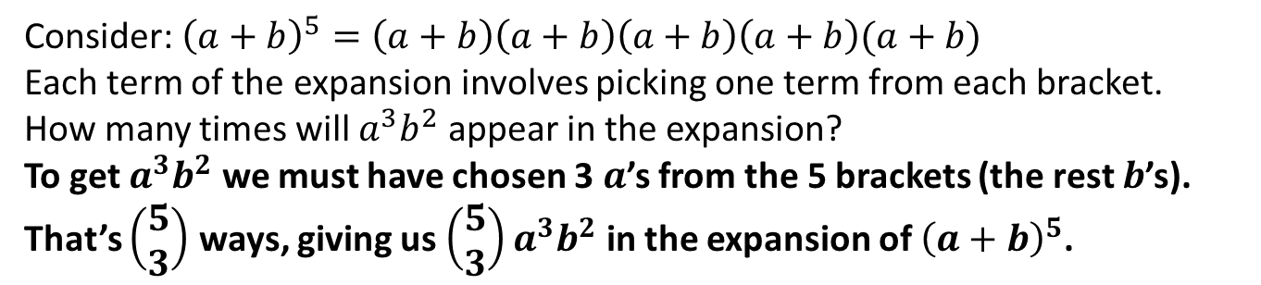
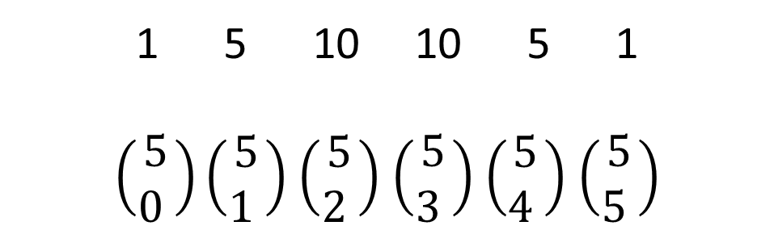
Using Binomial Coefficients to Expand
In the previous section we learnt about the ‘choose’ function and how this related to Pascal’s Triangle.
1 5 10 10 5 1
$\left(\begin{matrix}5 \\ 0 \end{matrix}\right)\left(\begin{matrix}5 \\ 1 \end{matrix}\right)$ $\left(\begin{matrix}5 \\ 2 \end{matrix}\right)$ $\left(\begin{matrix}5 \\ 3 \end{matrix}\right)$ $\left(\begin{matrix}5 \\ 4 \end{matrix}\right)$ $\left(\begin{matrix}5 \\ 5 \end{matrix}\right)$
Why do rows of Pascal’s Triangle give us the coefficients in a Binomial Expansion?
One possible selection of terms from each bracket.
Consider: ${\left(a+b\right)}^{5}=\left(a+b\right)\left(a+b\right)\left(a+b\right)\left(a+b\right)(a+b)$
Each term of the expansion involves picking one term from each bracket.
How many times will $a^{3}b^{2}$ appear in the expansion?
To get $a^{3}b^{2}$ we must have chosen 3 $a$’s from the 5 brackets (the rest $b$’s). That’s $\left(\begin{matrix}5 \\ 3\end{matrix}\right)$ ways, giving us $\left(\begin{matrix}5 \\ 3\end{matrix}\right)a^{3}b^{2}$ in the expansion of ${\left(a+b\right)}^{5}$.
?

Slide 3

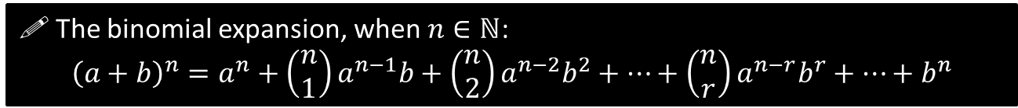
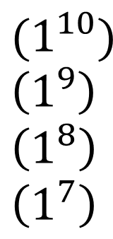


Using Binomial Coefficients to Expand
$ℕ$ is the set of natural numbers, i.e. positive integers. This formula is only valid for positive integers $n$. In Year 2 you will see how to deal with fractional/negative $n$.
! The binomial expansion, when $n∈ℕ$:
$${\left(a+b\right)}^{n}=a^{n}+\left(\begin{matrix}n \\ 1\end{matrix}\right)a^{n−1}b+\left(\begin{matrix}n \\ 2\end{matrix}\right)a^{n−2}b^{2}+…+\left(\begin{matrix}n \\ r\end{matrix}\right)a^{n−r}b^{r}+…+b^{n}$$
Find the first 4 terms in the expansion of ${\left(3x+1\right)}^{10}$, in ascending powers of $x$.
?
$$\left(\begin{matrix}10 \\ 0\end{matrix}\right) \\ +\left(\begin{matrix}10 \\ 1\end{matrix}\right) \\ +\left(\begin{matrix}10 \\ 2\end{matrix}\right) \\ +\left(\begin{matrix}10 \\ 3\end{matrix}\right)$$
This is exactly the same method as before, except we’ve just had to calculate the Binomial coefficients ourselves rather than read them off Pascal’s Triangle.
$${\left(3x+1\right)}^{10}=$$
$$(1^{10}) \\ \left(1^{9}\right) \\ \left(1^{8}\right) \\ \left(1^{7}\right)$$
$${\left(3x\right)}^{1} \\ {\left(3x\right)}^{2} \\ {\left(3x\right)}^{3}+…$$
$$=1+30x+405x^{2}+3240x^{3}+…$$

Slide 4

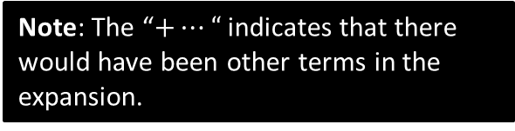
Test Your Understanding
Find the first 3 terms in the expansion of ${\left(2−\frac{1}{3}x\right)}^{7}$, in ascending powers of $x$.
?
$${\left(2−\frac{1}{3}x\right)}^{7}=\left(\begin{matrix}7 \\ 0\end{matrix}\right)\left(2^{7}\right) \\ +\left(\begin{matrix}7 \\ 1\end{matrix}\right)\left(2^{6}\right)\left(−\frac{1}{3}\right) \\ +\left(\begin{matrix}7 \\ 2\end{matrix}\right)\left(2^{5}\right){\left(−\frac{1}{3}\right)}^{2}+… \\ =128−\frac{448}{3}x+\frac{224}{3}x^{2}+…$$
Note: The “$+…“$ indicates that there would have been other terms in the expansion.

Slide 5
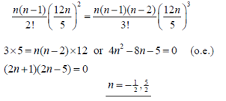
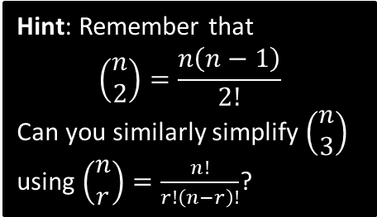
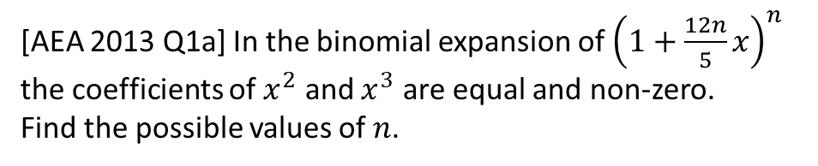
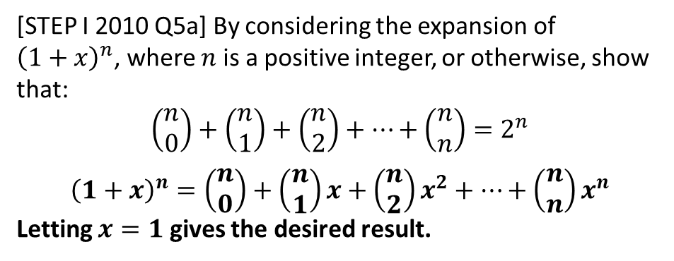
Exercise 8.3
Pearson Pure Mathematics Year 1/AS
Page 63
Extension
[AEA 2013 Q1a] In the binomial expansion of ${\left(1+\frac{12n}{5}x\right)}^{n}$ the coefficients of $x^{2}$ and $x^{3}$ are equal and non-zero.
Find the possible values of $n$.
Hint: Remember that $$\left(\begin{matrix}n \\ 2\end{matrix}\right)=\frac{n\left(n−1\right)}{2!}$$
Can you similarly simplify $\left(\begin{matrix}n \\ 3\end{matrix}\right)$ using $\left(\begin{matrix}n \\ r\end{matrix}\right)=\frac{n!}{r!\left(n−r\right)!}$?
1
?
Note: This means that the sum of each row in Pascal’s Triangle gives successive powers of 2. S
2
[STEP I 2010 Q5a] By considering the expansion of ${\left(1+x\right)}^{n}$, where $n$ is a positive integer, or otherwise, show that:
$$\left(\begin{matrix}n \\ 0\end{matrix}\right)+\left(\begin{matrix}n \\ 1\end{matrix}\right)+\left(\begin{matrix}n \\ 2\end{matrix}\right)+…+\left(\begin{matrix}n \\ n\end{matrix}\right)=2^{n}$$
$${\left(1+x\right)}^{n}=\left(\begin{matrix}n \\ 0\end{matrix}\right)+\left(\begin{matrix}n \\ 1\end{matrix}\right)x+\left(\begin{matrix}n \\ 2\end{matrix}\right)x^{2}+…+\left(\begin{matrix}n \\ n\end{matrix}\right)x^{n}$$
Letting $x=1$ gives the desired result.
?

Slide 6
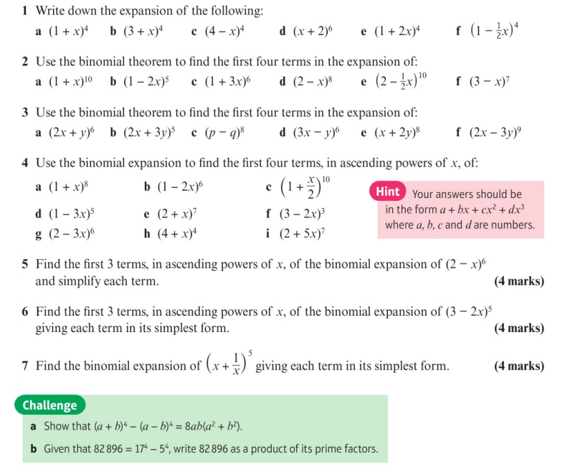
Homework Exercise

Slide 7
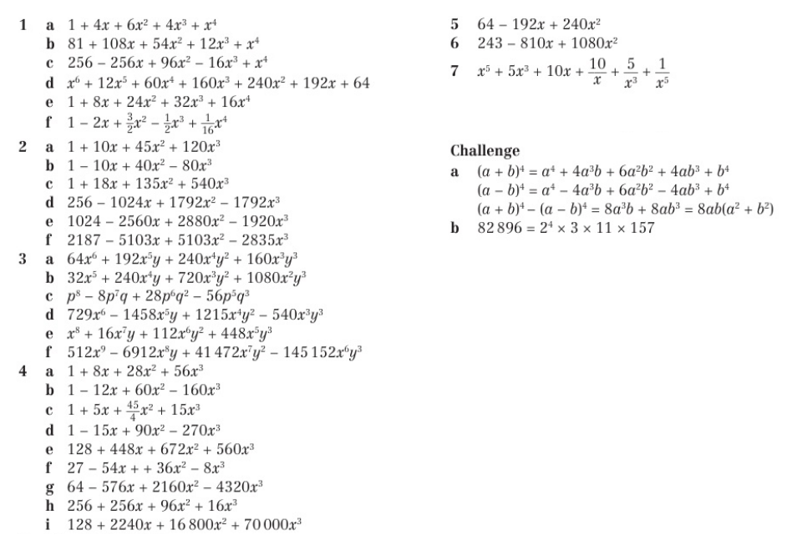
Homework Answers

