Slide 1
P2 Chapter 7: Trigonometric Equations
Proving Identities

Slide 2


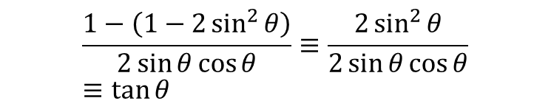
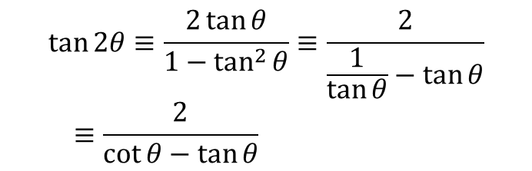
Proving Trigonometric Identities
Just like Chapter 6 had ‘provey’ and ‘solvey’ questions, we also get the ‘provey’ questions in Chapter 7. Just use the appropriate double angle or addition formula.
Prove that $\tan{2θ}≡\frac{2}{\cot{θ}−\tan{θ}}$
?
$$\tan{2θ}≡\frac{2\tan{θ}}{1−\tan^{2}{θ}}≡\frac{2}{\frac{1}{\tan{θ}}−\tan{θ}} \\ ≡\frac{2}{\cot{θ}−\tan{θ}}$$
Prove that $\frac{1−\cos{2θ}}{\sin{2θ}}≡\tan{θ}$
?
$$\frac{1−\left(1−2\sin^{2}{θ}\right)}{2\sin{θ}\cos{θ}}≡\frac{2\sin^{2}{θ}}{2\sin{θ}\cos{θ}} \\ ≡\tan{θ}$$

Slide 3


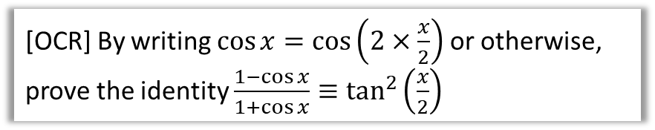
Test Your Understanding
[OCR] Prove that $\cot{2x}+cosec 2x≡\cot{x}$
?
$$\frac{\cos{2x}}{\sin{2x}}+\frac{1}{\sin{2x}} \\ ≡\frac{\cos{2x}+1}{\sin{2x}}≡\frac{2\cos^{2}{x}−1+1}{2sin{x}\cos{x}} \\ ≡\frac{2\cos^{2}{x}}{2\sin{x}\cos{x}}≡\frac{\cos{x}}{\sin{x}}≡\cot{x}$$
[OCR] By writing $\cos{x}=\cos\left(2×\frac{x}{2}\right)$ or otherwise, prove the identity $\frac{1−\cos{x}}{1+\cos{x}}≡\tan^{2}\left(\frac{x}{2}\right)$
?
$$\cos{x}≡\cos\left(2×\frac{x}{2}\right)≡2\cos^{2}\left(\frac{x}{2}\right)−1 \\ ∴ \frac{1−\cos{x}}{1+\cos{x}}≡\frac{1−\left(2\cos^{2}\left(\frac{x}{2}\right)−1\right)}{1+\left(2\cos^{2}\left(\frac{x}{2}\right)−1\right)} \\ ≡\frac{2\left(1−\cos^{2}\left(\frac{x}{2}\right)\right)}{2\cos^{2}\left(\frac{x}{2}\right)}≡\frac{\sin^{2}\left(\frac{x}{2}\right)}{\cos^{2}\left(\frac{x}{2}\right)}≡\tan^{2}\left(\frac{x}{2}\right)$$

Slide 4
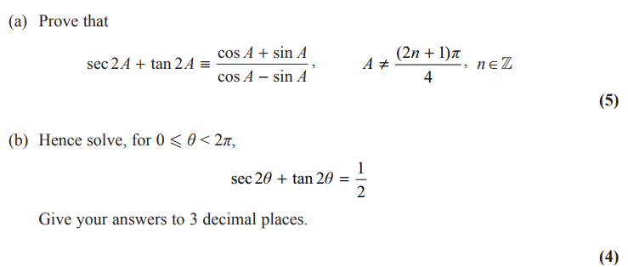
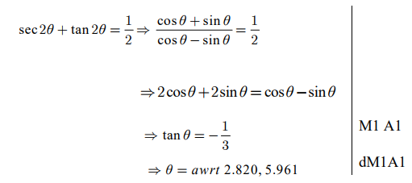
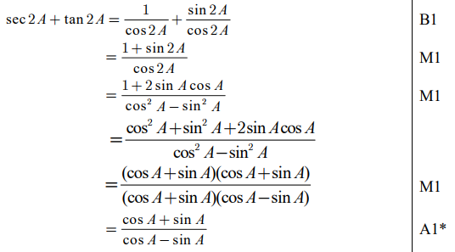

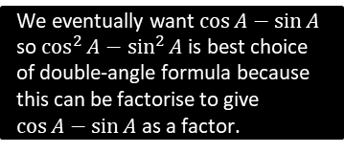
Very Challenging Exam Example
Edexcel C3 June 2015 Q8
? b
? a
We eventually want $\cos{A}−\sin{A}$ so $\cos^{2}{A}−\sin^{2}{A}$ is best choice of double-angle formula because this can be factorise to give $\cos{A}−\sin{A}$ as a factor.
This is even less obvious. Knowing that we’ll have $\left(\cos{A}−\sin{A}\right)\left(\cos{A}+\sin{A}\right)$ in the denominator and that the $\cos{A}+\sin{A}$ will cancel, we might work backwards from the final result and multiply by $\cos{A}+\sin{A}$! Working backwards from the thing we’re trying to prove is occasionally a good strategy (provided the steps are reversible!)

Slide 5
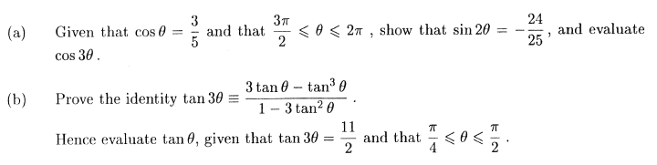

Exercise 7.6
Pearson Pure Mathematics Year 2/AS
Page 53
Extension:
[STEP I 2005 Q4]
?
?
(a) $−\frac{117}{125}$ (b) $tan θ=8+\sqrt{75}$

Slide 6
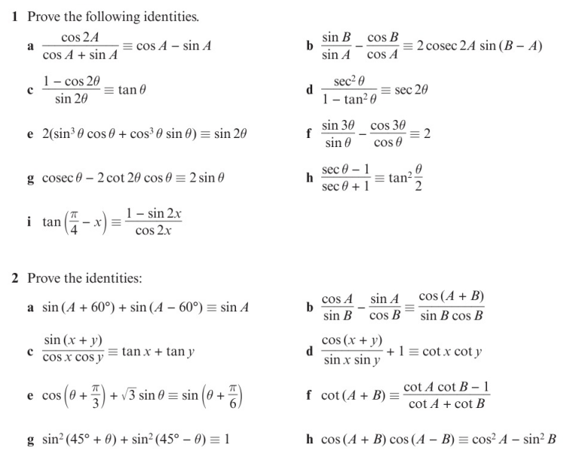
Homework Exercise

Slide 7
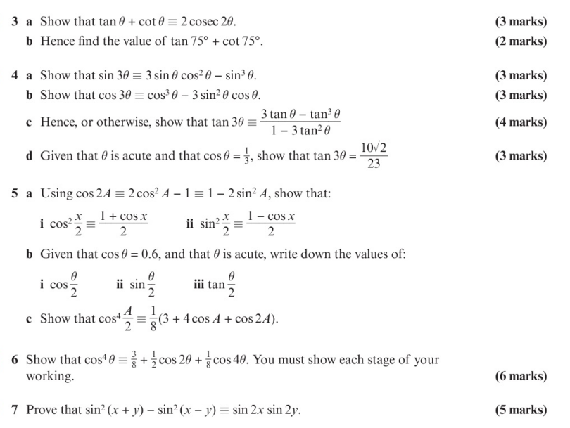
Homework Exercise

Slide 8
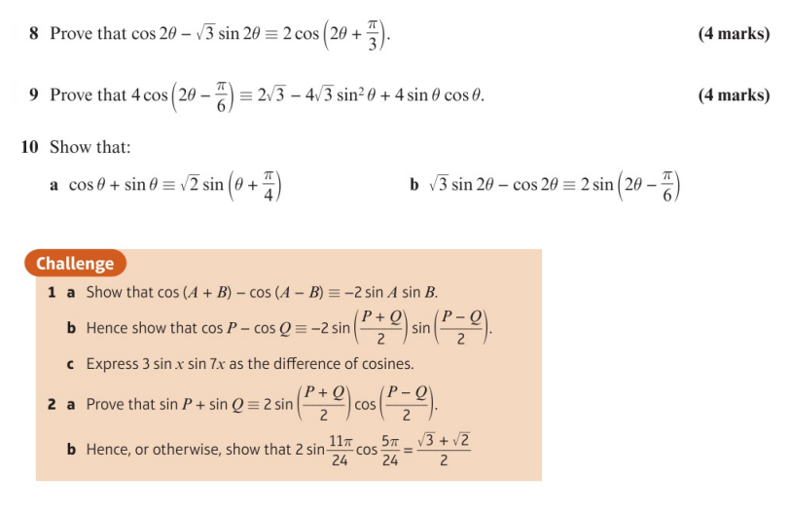
Homework Exercise

Slide 9
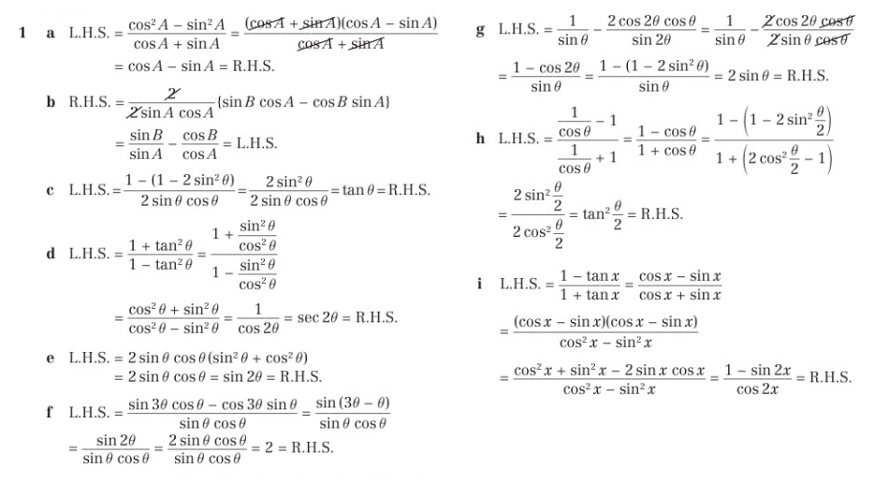
Homework Answers

Slide 10
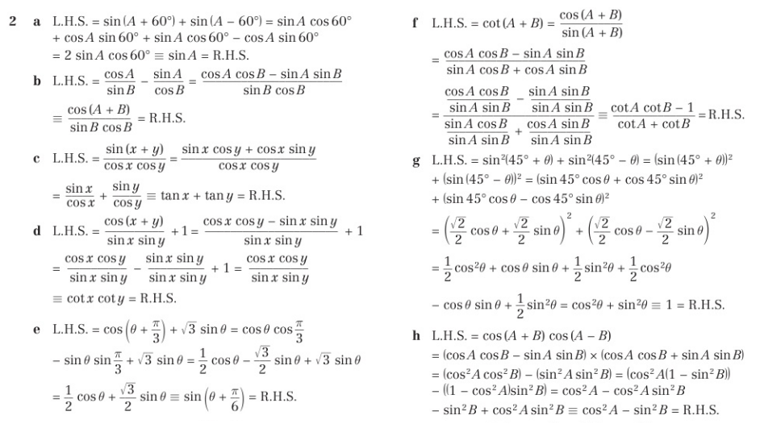
Homework Answers

Slide 11
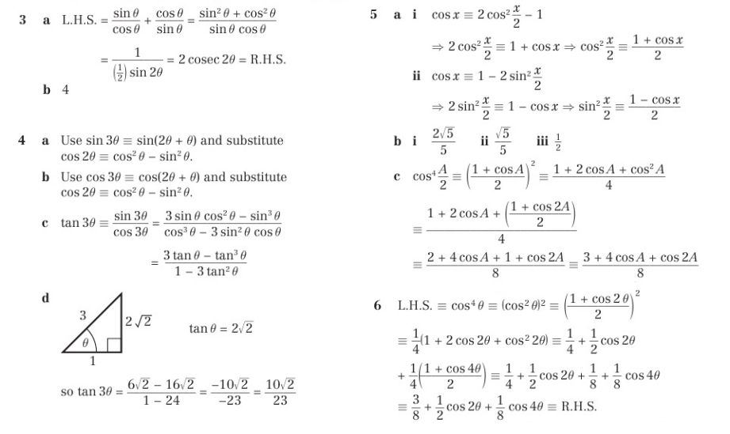
Homework Answers

Slide 12
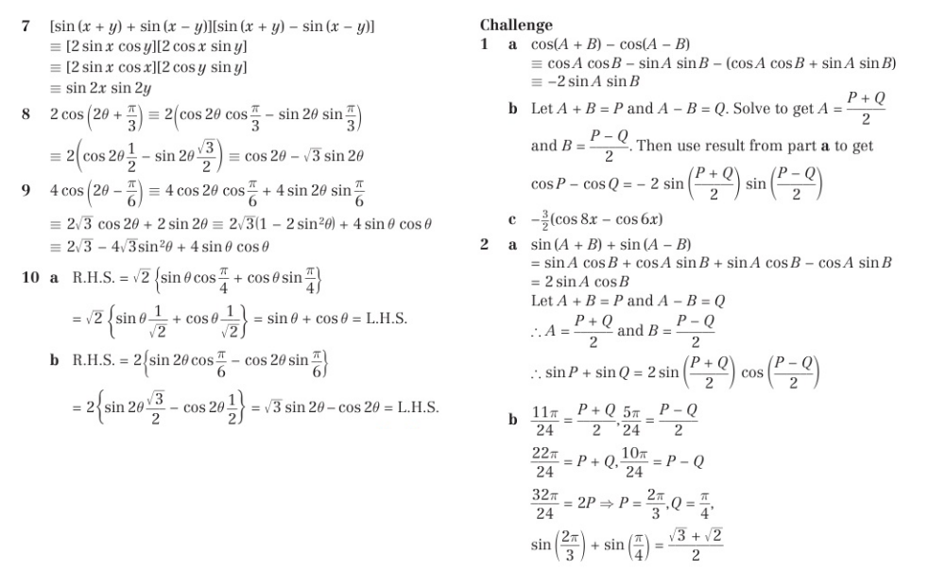
Homework Answers

