Slide 1
P2 Chapter 5: Radians
Arc Length

Slide 2





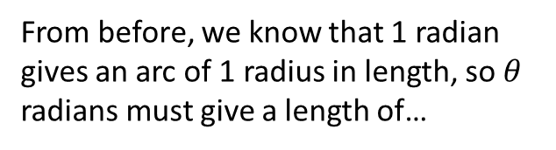
Arc length
$$l$$
$$r$$
$$θ$$
Arc length in degrees:
Arc length in radians
From before, we know that 1 radian gives an arc of 1 radius in length, so $θ$ radians must give a length of…
?
$$l=\frac{θ}{360}×2πr$$
?
$$l=rθ$$

Slide 3




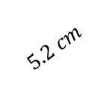
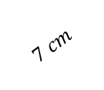

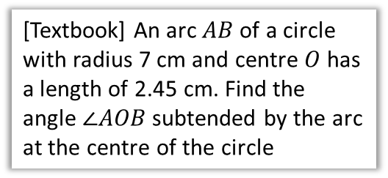



Examples
[Textbook] Find the length of the arc of a circle of radius 5.2 cm, given that the arc subtends an angle of 0.8 radians at the centre of the circle.
[Textbook] An arc $AB$ of a circle with radius 7 cm and centre $O$ has a length of 2.45 cm. Find the angle $∠AOB$ subtended by the arc at the centre of the circle
?
?
$$A$$
$$5.2 cm$$
$$7 cm$$
$$2.45 cm$$
$$0.8$$
$$O$$
$$θ$$
$$0.8×5.2=4.16 cm$$
$$B$$
$$θ×7=2.45 \\ θ=\frac{2.45}{7}=0.35 rad$$
Fro Note: Whether your calculator is in degrees mode or radians mode is only relevant when using sin/cos/tan – it won’t affect simple multiplication!
Terminology: ‘Subtend’ means opposite or extending beneath.

Slide 4


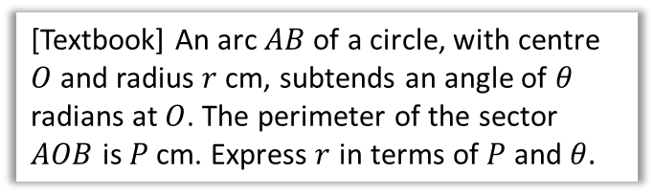










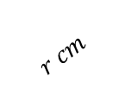

Further Examples
[Textbook] An arc $AB$ of a circle, with centre $O$ and radius $r$ cm, subtends an angle of $θ$ radians at $O$. The perimeter of the sector $AOB$ is $P$ cm. Express $r$ in terms of $P$ and $θ.$
[Textbook] The border of a garden pond consists of a straight edge $AB$ of length 2.4m, and a curved part $C$, as shown in the diagram. The curve part is an arc of a circle, centre $O$ and radius 2m.
Find the length of $C$.
?
$$A$$
$$r cm$$
$$C$$
$$O$$
$$θ$$
$$r cm$$
$$B$$
$$θ$$
$$2 cm$$
$$2 cm$$
$$P=2r+θr \\ P=r\left(2+θ\right) \\ r=\frac{P}{2+θ}$$
$$A$$
$$2.4 cm$$
$$B$$
?
$$2 cm$$
Fro Tip: Trigonometry on right-angled triangles is always simpler than using sine/cosine rule.
$$x$$
$$1.2 cm$$
$$x=\sin^{−1}\left(\frac{1.2}{2}\right)=0.6435…rad \\ θ=2π−2x=4.9961…rad$$
$$∴C=2×4.9961=9.99 m (3sf)$$
Angles round a point add to $2π$.

Slide 5
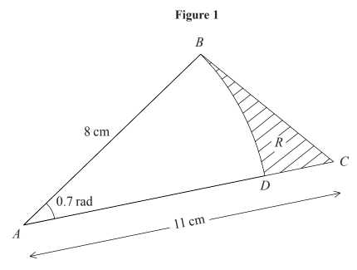
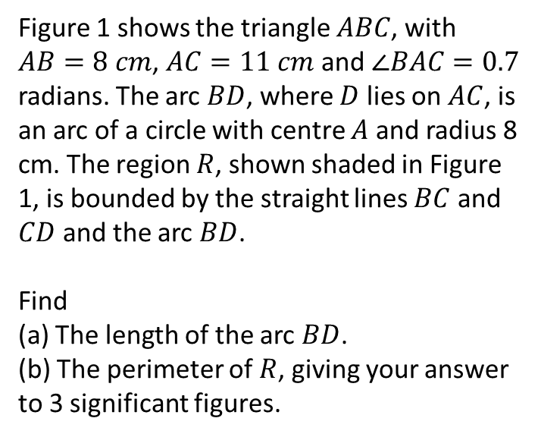
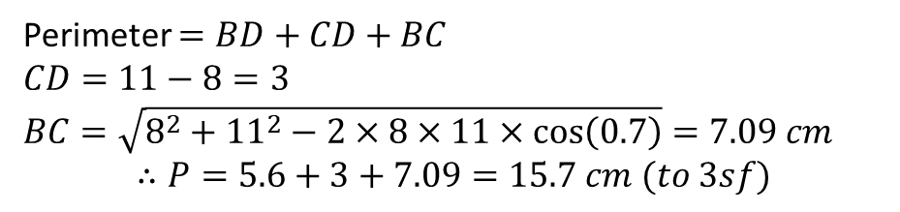

Test Your Understanding
Edexcel C2 Jan 2005 Q7
Figure 1 shows the triangle $ABC$, with $AB=8 cm$, $AC=11 cm$ and $∠BAC=0.7$ radians. The arc $BD$, where $D$ lies on $AC$, is an arc of a circle with centre $A$ and radius 8 cm. The region $R$, shown shaded in Figure 1, is bounded by the straight lines $BC$ and $CD$ and the arc $BD$.
Find
(a) The length of the arc $BD$.
(b) The perimeter of $R$, giving your answer to 3 significant figures.
a
Length of arc $BD=0.7×8=5.6 cm$
?
?
b
Perimeter $=BD+CD+BC$
$CD=11−8=3$
$BC=\sqrt{8^{2}+{11}^{2}−2×8×11×\cos\left(0.7\right)}=7.09 cm$
$$∴P=5.6+3+7.09=15.7 cm (to 3sf)$$

Slide 6
Exercise 5.2
Pearson Pure Year 2
Page 36

Slide 7
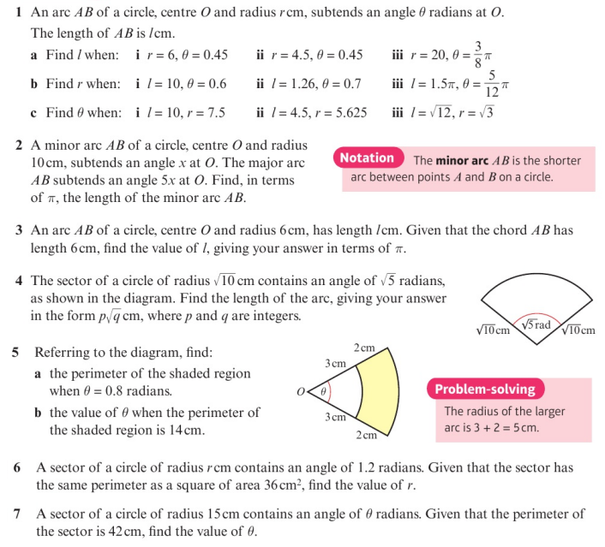
Homework Exercise

Slide 8
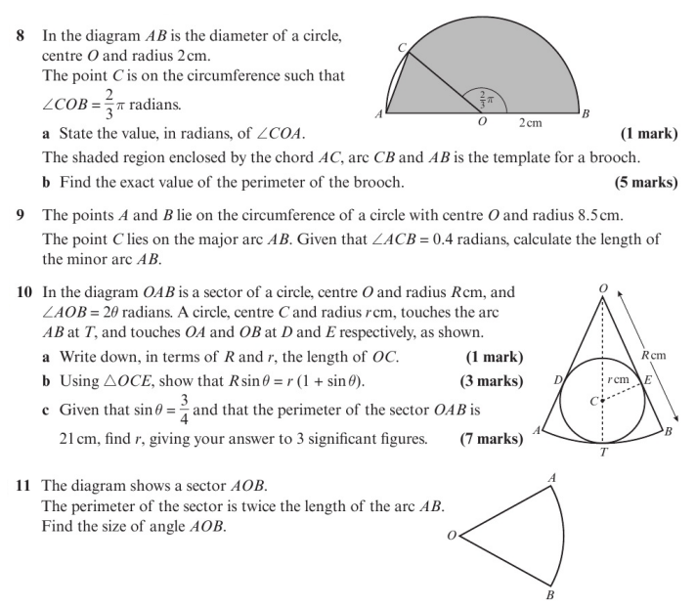
Homework Exercise

Slide 9
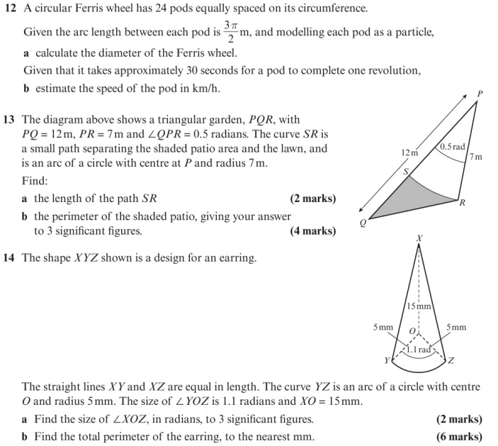
Homework Exercise

Slide 10
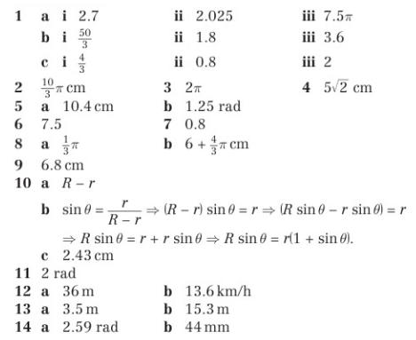
Homework Answers

