Slide 1
P1 Chapter 13: Integration
The Anti-Derivative

Slide 2


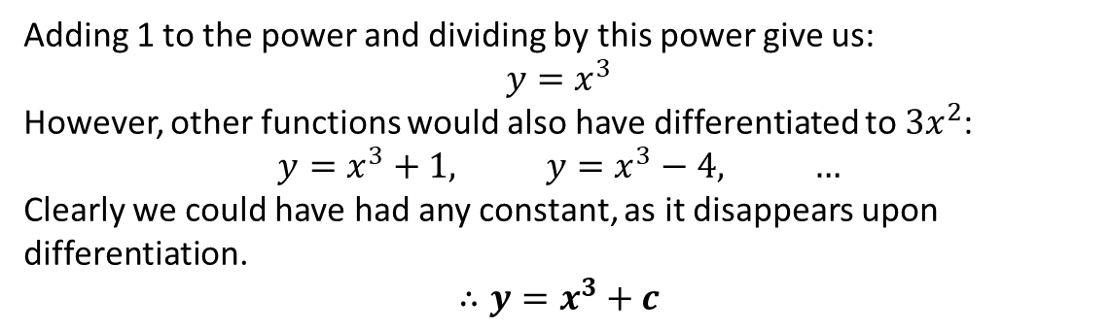


Integrating $x^{n}$ terms
Integration is the opposite of differentiation.
Integrals are also called the ‘anti-derivative’.
Gradient Function
Function
multiply by power
reduce power by 1
$$15x^{2}$$
$$5x^{3}$$
?
?
divide by new power
increase power by 1
However, there’s one added complication…
Find $y$ when $\frac{dy}{dx}=3x^{2}$
?
Adding 1 to the power and dividing by this power give us:
$$y=x^{3}$$
However, other functions would also have differentiated to $3x^{2}$:
$$y=x^{3}+1, y=x^{3}−4, …$$
Clearly we could have had any constant, as it disappears upon differentiation.
$$∴y=x^{3}+c$$
$c$ is known as a constant of integration

Slide 3
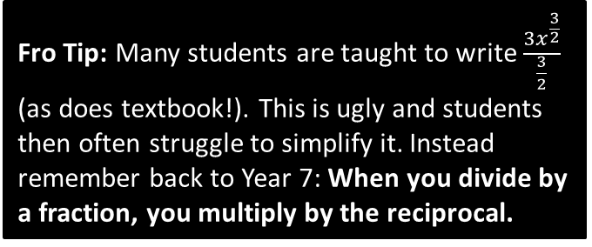
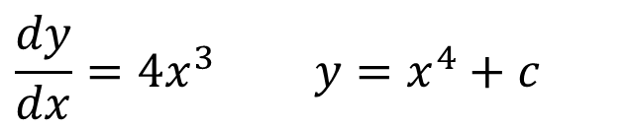
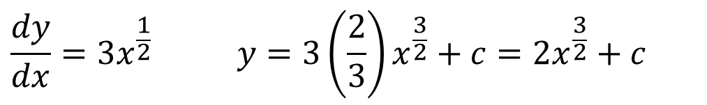


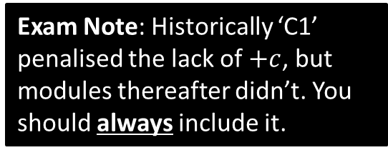
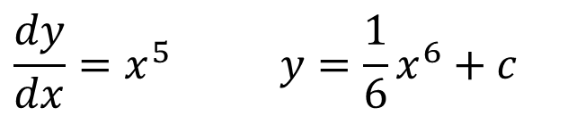
Examples
Find $y$ when:
Exam Note: Historically ‘C1’ penalised the lack of $+c$, but modules thereafter didn’t. You should always include it.
?
$$\frac{dy}{dx}=4x^{3} y=x^{4}+c$$
$$\frac{dy}{dx}=x^{5} y=\frac{1}{6}x^{6}+c$$
?
You could also write as $\frac{x^{6}}{6}$. It’s a matter of personal preference.
?
$$\frac{dy}{dx}=3x^{\frac{1}{2}} y=3\left(\frac{2}{3}\right)x^{\frac{3}{2}}+c=2x^{\frac{3}{2}}+c$$
Fro Tip: Many students are taught to write $\frac{3x^{\frac{3}{2}}}{\frac{3}{2}}$ (as does textbook!). This is ugly and students then often struggle to simplify it. Instead remember back to Year 7: When you divide by a fraction, you multiply by the reciprocal.
Textbook Error on Pg289: “When integrating polynomials”, but Example 3 is not a polynomial because it has negative and fractional powers.

Slide 4
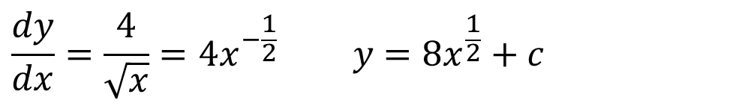
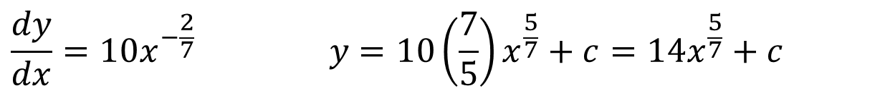
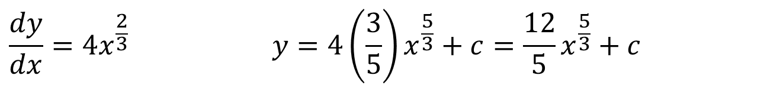
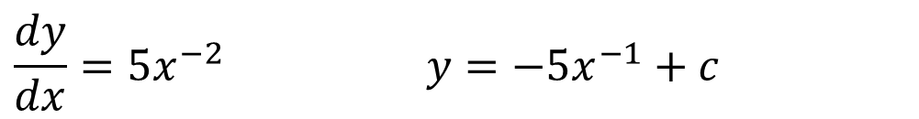
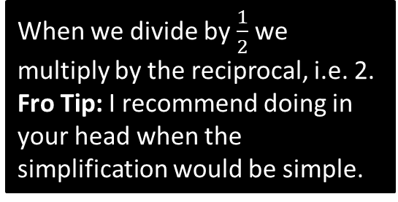
More Fractional Examples
Find $y$ when:
When we divide by $\frac{1}{2}$ we multiply by the reciprocal, i.e. 2.
Fro Tip: I recommend doing in your head when the simplification would be simple.
?
?
$$\frac{dy}{dx}=\frac{4}{\sqrt{x}}=4x^{−\frac{1}{2}} y=8x^{\frac{1}{2}}+c$$
?
$$\frac{dy}{dx}=5x^{−2} y=−5x^{−1}+c$$
?
$$\frac{dy}{dx}=4x^{\frac{2}{3}} y=4\left(\frac{3}{5}\right)x^{\frac{5}{3}}+c=\frac{12}{5}x^{\frac{5}{3}}+c$$
?
$$\frac{dy}{dx}=10x^{−\frac{2}{7}} y=10\left(\frac{7}{5}\right)x^{\frac{5}{7}}+c=14x^{\frac{5}{7}}+c$$

Slide 5

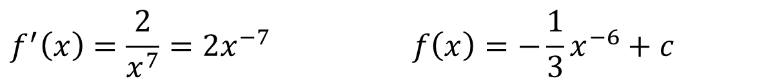
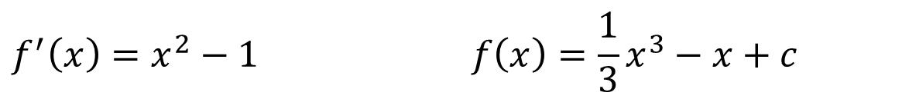

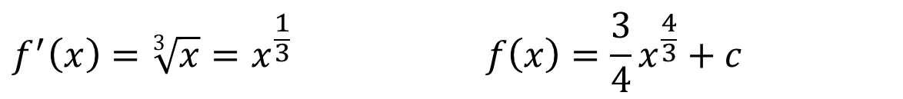
Test Your Understanding
Find $f(x)$ when:
?
$$f^{′}\left(x\right)=2x+7 f\left(x\right)=x^{2}+7x+c$$
$$f^{′}\left(x\right)=x^{2}−1 f\left(x\right)=\frac{1}{3}x^{3}−x+c$$
?
?
?
$$f^{′}\left(x\right)=\frac{2}{x^{7}}=2x^{−7} f\left(x\right)=−\frac{1}{3}x^{−6}+c$$
?
?
$$f^{′}\left(x\right)=\sqrt[3]{x}=x^{\frac{1}{3}} f\left(x\right)=\frac{3}{4}x^{\frac{4}{3}}+c$$
$$f^{′}\left(x\right)=33x^{\frac{5}{6}} f\left(x\right)=18x^{\frac{11}{6}}+c$$
?
Note: In case you’re wondering what happens if $\frac{dy}{dx}=\frac{1}{x}=x^{−1}$ , the problem is that after adding 1 to the power, we’d be dividing by 0. You will learn how to integrate $\frac{1}{x}$ in Year 2.

Slide 6
Exercise 13.1
Pearson Pure Mathematics Year 1/AS
Page 104

Slide 7
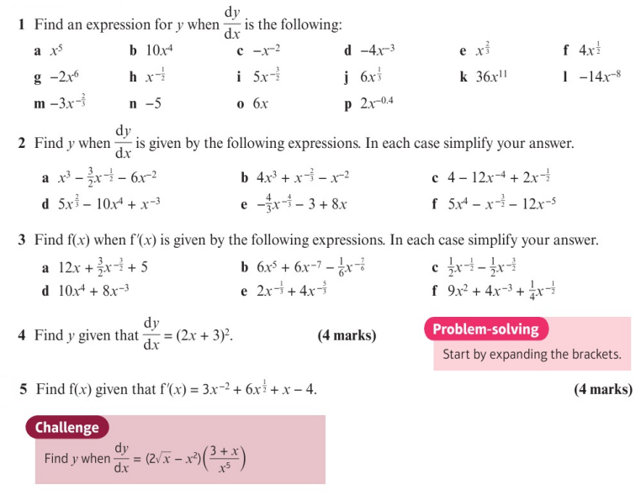
Homework Exercise

Slide 8
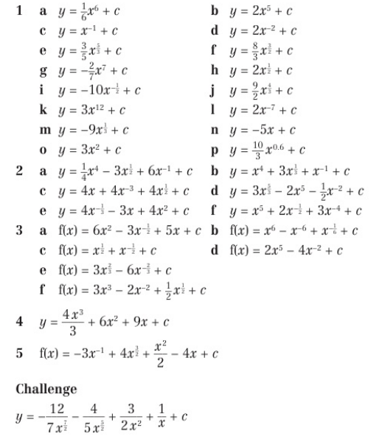
Homework Answers

