Slide 1
Stats Yr2 Chapter 3: Distribution-N The Standard Normal

Slide 2
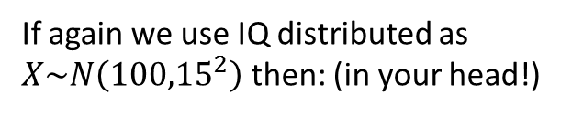
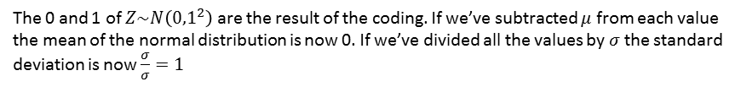
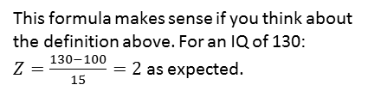
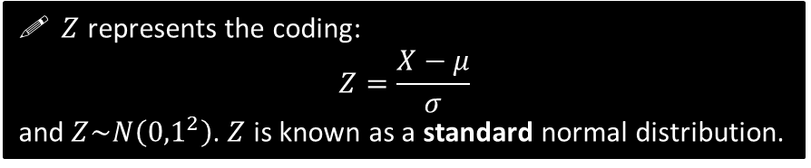
Standard Normal Distribution
! $Z$ is the number of standard deviations above the mean.
If again we use IQ distributed as $X\sim N\left({100,15}^{2}\right)$ then: (in your head!)
This formula makes sense if you think about the definition above. For an IQ of 130:
$Z=\frac{130−100}{15}=2$ as expected.
IQ | Z
100 | 0
130 | 2
85 | -1
165 | 4.333
62.5 | -2.5
?
$Z$ represents the coding:
$$Z=\frac{X−μ}{σ}$$ and $Z\sim N\left({0,1}^{2}\right)$. $Z$ is known as a standard normal distribution.
?
?
?
?
The 0 and 1 of $Z\sim N\left({0,1}^{2}\right)$ are the result of the coding. If we’ve subtracted $μ$ from each value the mean of the normal distribution is now 0. If we’ve divided all the values by $σ$ the standard deviation is now $\frac{σ}{σ}=1$

Slide 3
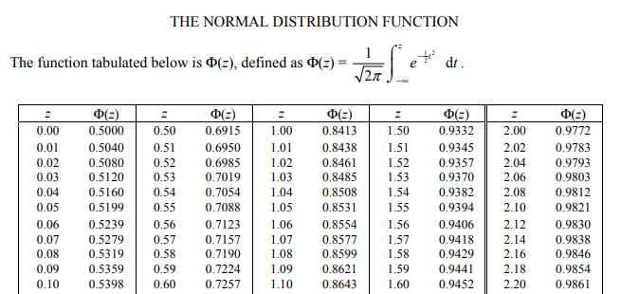
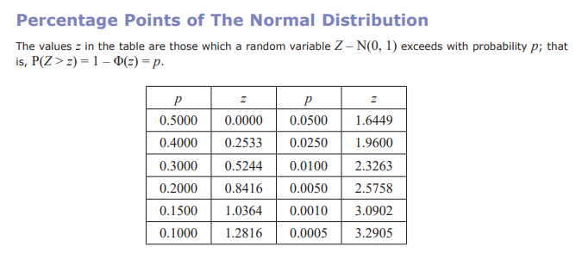

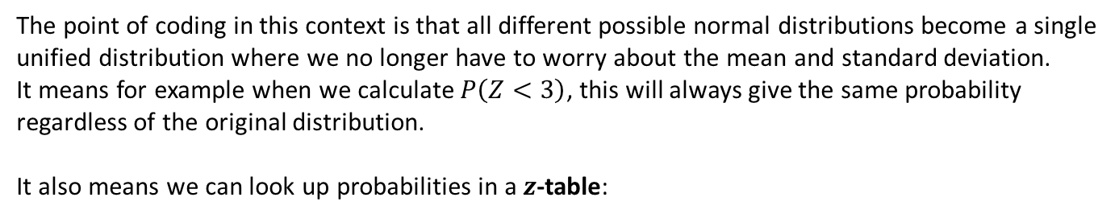
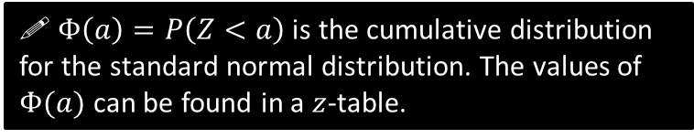

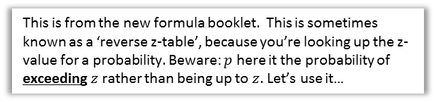
Standard Normal Distribution
The point of coding in this context is that all different possible normal distributions become a single unified distribution where we no longer have to worry about the mean and standard deviation.
It means for example when we calculate $P\left(Z<3\right)$, this will always give the same probability regardless of the original distribution.
It also means we can look up probabilities in a $z$-table:
$$φ\left(a\right)=P\left(Z<a\right)$$
! $Φ\left(a\right)=P\left(Z<a\right)$ is the cumulative distribution for the standard normal distribution. The values of $Φ(a)$ can be found in a $z$-table.
This is a traditional z-table in the old A Level syllabus (but also found elsewhere). You no longer get given this and are expected to use your calculator.
This is from the new formula booklet. This is sometimes known as a ‘reverse z-table’, because you’re looking up the z-value for a probability. Beware: $p$ here it the probability of exceeding $z$ rather than being up to $z$. Let’s use it…
$$a$$
0

Slide 4
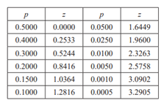


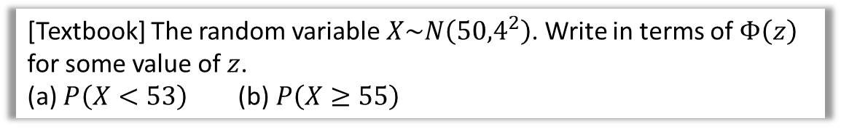


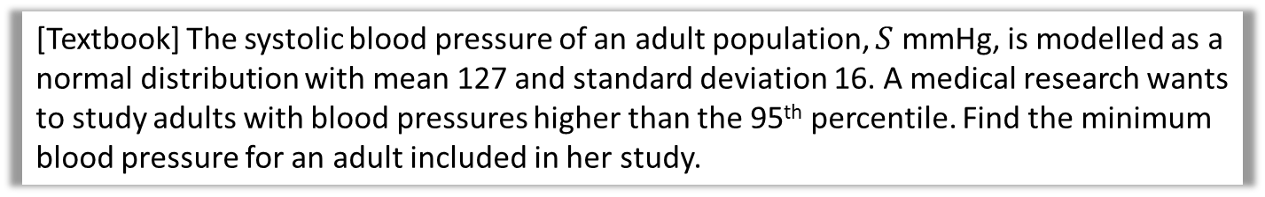
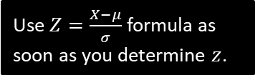


Examples
[Textbook] The random variable $X\sim N\left({50,4}^{2}\right)$. Write in terms of $Φ\left(z\right)$ for some value of $z$.
(a) $P\left(X<53\right)$ (b) $P\left(X≥55\right)$
$$P\left(X<53\right) \\ =P\left(Z<\frac{53−50}{4}\right)=P\left(Z<0.75\right) \\ =Φ\left(0.75\right)$$
b
$$P\left(X≥55\right) \\ =P\left(Z≥\frac{55−50}{4}\right)=P\left(Z≥1.25\right) \\ =1−P\left(Z<1.25\right) \\ =1−Φ\left(1.25\right)$$
a
?
?
‘Standardise’ to turn $X$ into $Z$.
[Textbook] The systolic blood pressure of an adult population, $S$ mmHg, is modelled as a normal distribution with mean 127 and standard deviation 16. A medical research wants to study adults with blood pressures higher than the 95th percentile. Find the minimum blood pressure for an adult included in her study.
?
A sketch will help you visualise whether you expect a positive or negative value of $z$.
$$S\sim N\left({127,16}^{2}\right)$$
Looking at the table, we see that the top 5% corresponds to a $z$-value of 1.6449.
$$\frac{s−127}{16}=1.6449 \\ s=153 (3sf)$$
Use $Z=\frac{X−μ}{σ}$ formula as soon as you determine $z$.
5%
$$z$$
0

Slide 5





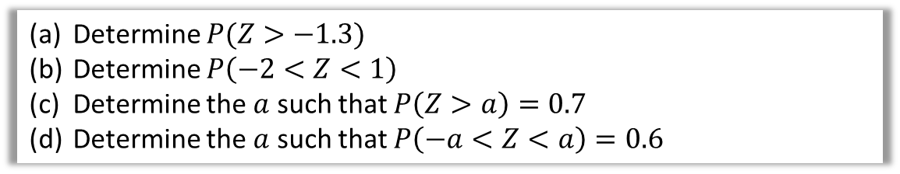
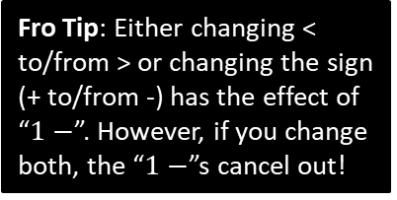







Further Examples
Determine $P(Z>−1.3)$
Determine $P\left(−2<Z<1\right)$
Determine the $a$ such that $P\left(Z>a\right)=0.7$
Determine the $a$ such that $P\left(−a<Z<a\right)=0.6$
a
?
Fro Tip: Either changing < to/from > or changing the sign (+ to/from -) has the effect of “$1−$”. However, if you change both, the “$1−$”s cancel out!
$$P\left(Z>−1.3\right)=P\left(Z<1.3\right) \\ =0.9032$$
$$P\left(−2<Z<1\right)=P\left(Z<1\right)−P\left(Z<−2\right) \\ =P\left(Z<1\right)−\left(1−P\left(Z<2\right)\right) \\ =0.8413−\left(1−0.9772\right) \\ =0.8185 (4dp)$$
$$−1.3$$
$$1.3$$
b
?
0
$$P\left(a<Z<b\right)=P\left(Z<b\right)−P\left(Z<a\right)$$
c
?
From the second sketch we can see that our $z$ value is in the bottom half, so it is negative. However, our table only gives positive values of $z$.
From the graphs on the left, we can see by symmetry that the $z$ value for the top 30% must be the negation of the $z$-value for the bottom 30% (i.e. top 70%).
0.7
By symmetry, if 0.6 at the centre, must be 0.2 at each tail.
$$P\left(Z>a\right)=0.2 \\ a=0.8416$$
d
?
$$0.5244$$
0
0.6
0.7
$$P\left(Z>a\right)=0.7 \\ a=−0.5244$$
0.2
0.2
$$−a$$
$$a$$
0
$$−0.5244$$
0

Slide 6
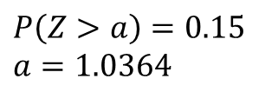


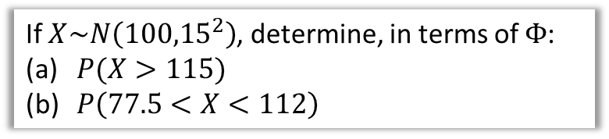
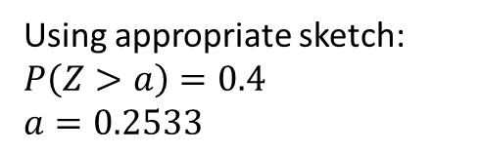

Test Your Understanding
1
IQ is distributed with mean 100 and standard deviation 15. Using an appropriate table, determine the IQ corresponding to the
top 10% of people.
bottom 20% of people.
$$X\sim N\left({100,15}^{2}\right) \\ 1.2816=\frac{x−100}{15} \\ x=119.24$$
$$−0.8416=\frac{x−100}{15} \\ x=87.376$$
a
?
2
If $X\sim N\left({100,15}^{2}\right)$, determine, in terms of $Φ$:
$P(X>115)$
$P\left(77.5<X<112\right)$
a
$$P\left(X>115\right)=P\left(Z>\frac{115−100}{15}\right)=P\left(Z>1\right)=1−P\left(Z<1\right)=1−Φ\left(1\right)$$
$$P\left(77.5<X<112\right)=P\left(X<112\right)−P\left(X<77.5\right) \\ =P\left(Z<0.8\right)−P\left(Z<−1.5\right) \\ =Φ\left(0.8\right)−\left(1−Φ\left(1.5\right)\right) \\ =Φ\left(0.8\right)+Φ\left(1.5\right)−1$$
b
?
?
b
?
3
Find the $a$ such that:
$P\left(−a<Z<a\right)=0.2$
$P\left(0<Z<a\right)=0.35$
Using appropriate sketch:
$$P\left(Z>a\right)=0.4 \\ a=0.2533$$
$$P\left(Z>a\right)=0.15 \\ a=1.0364$$
a
?
b
?

Slide 7
Exercise 3.4
Pearson Stats/Mechanics Year 2
Page 25-26

Slide 8
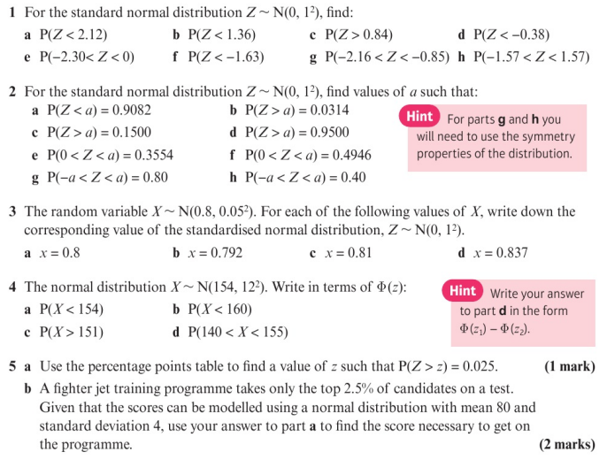
Homework Exercise

Slide 9
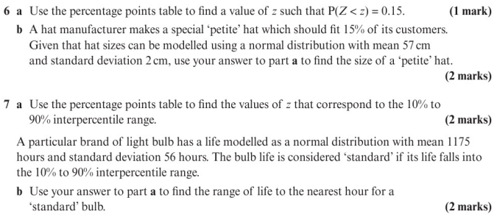
Homework Exercise

Slide 10
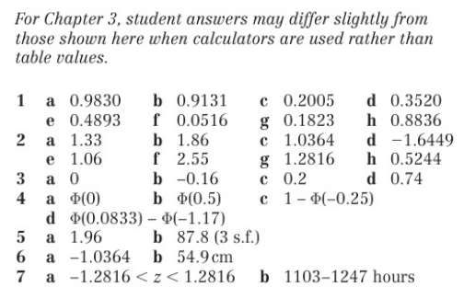
Homework Answers

