Slide 1
P1 Chapter 4: Transforming Graphs Cubic Graphs

Slide 2
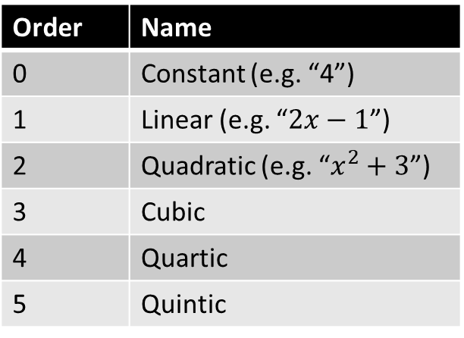
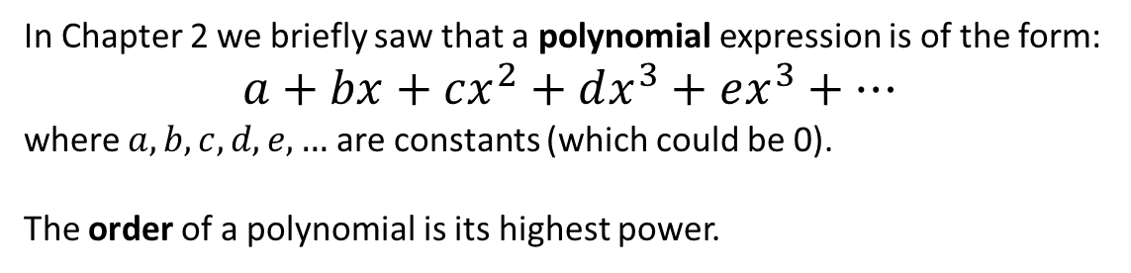
Polynomial Graphs
In Chapter 2 we briefly saw that a polynomial expression is of the form:
$$a+bx+cx^{2}+dx^{3}+ex^{3}+…$$
where $a,b,c,d,e,…$ are constants (which could be 0).
The order of a polynomial is its highest power.
Order | Name
0 | Constant (e.g. “4”)
1 | Linear (e.g. “$2x−1$”)
2 | Quadratic (e.g. “$x^{2}+3$”)
3 | Cubic
4 | Quartic
5 | Quintic
These are covered in Chapter 5.
?
Chapter 2 explored the graphs for these.
?
?
We will cover these now.
?
?
While these are technically beyond the A Level syllabus, we will look at how to sketch polynomials in general.

Slide 3
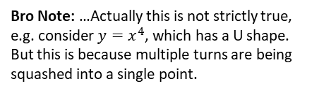

Polynomial Graphs
What property connects the order of the polynomial and the shape?
The number of ‘turns’ is one less than the order, e.g. a cubic has 2 ‘turns’, a quartic 3 ‘turns’.
Order:
?
2
Bro Note: …Actually this is not strictly true, e.g. consider $y=x^{4}$, which has a U shape. But this is because multiple turns are being squashed into a single point.
In Chapter 2 how did we tell what way up a quadratic is, and why does this work?
For a quadratic $y=ax^{2}+bx+c$, i.f. $a>0$, we had a ‘valley’ shape. This is because if $x$ was a large positive value, $ax^{2}$ would be large and positive, thus the graph’s $y$ value tends towards infinity.
We would write:
“As $x→∞, y→∞$” where “$→$” means “tends towards”.
?
3
4

Slide 4



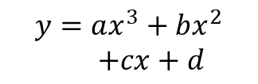




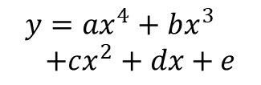

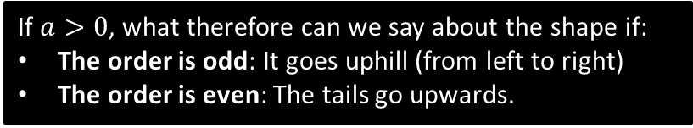




Polynomial Graphs
e.g. If $y=2x^{2}+3$, try a large positive value like $x=1000$. We can see we’d get a large positive $y$ value. Thus as $x→∞$, $y→∞$
Resulting Shape
Resulting Shape
Equation
If $a>0$
If $a<0$
$$y=ax^{2}+bx+c$$
As $x→∞, y→∞$
As $x→−∞, y→∞$
As $x→∞, y→−∞$
As $x→−∞, y→−∞$
?
?
$$y=ax^{3}+bx^{2}$$ $+cx+d$
As $x→∞, y→∞$
As $x→−∞, y→−∞$
As $x→∞, y→−∞$
As $x→−∞, y→∞$
$$y=ax^{4}+bx^{3} \\ +cx^{2}+dx+e$$
?
?
As $x→∞, y→∞$
As $x→−∞, y→∞$
As $x→∞, y→−∞$
As $x→−∞, y→−∞$
?
?
As $x→∞, y→−∞$
As $x→−∞, y→∞$
$$y=ax^{5}+bx^{4}+…$$
As $x→∞, y→∞$
As $x→−∞, y→−∞$
If $a>0$, what therefore can we say about the shape if:
The order is odd: It goes uphill (from left to right)
The order is even: The tails go upwards.
?
(And we have the opposite if $a<0$)
?

Slide 5



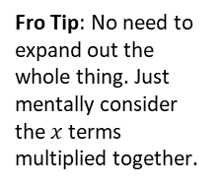

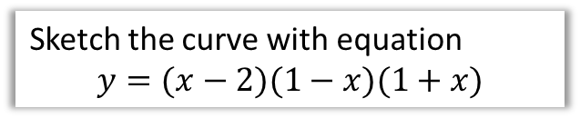

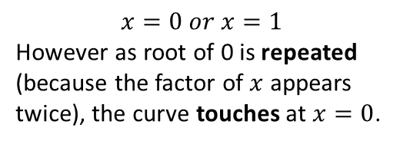

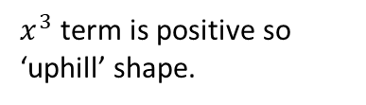



Cubics
Sketch the curve with equation
$$y=(x−2)(1−x)(1+x)$$
Sketch the curve with equation
$$y=x^{2}(x−1)$$
Features you must consider:
Shape?
$x^{3}$ term is positive so ‘uphill’ shape.
Fro Tip: No need to expand out the whole thing. Just mentally consider the $x$ terms multiplied together.
?
Shape?
?
If we expanded, $x^{3}$ term would be negative, so ‘downhill’ shape.
Roots?
$$x=0 or x=1$$
However as root of 0 is repeated (because the factor of $x$ appears twice), the curve touches at $x=0$.
?
Roots?
If $y=0$, $x=2, 1 or −1$
?
This is sort of because the curve crosses at 0 then immediately crosses at 0 again!
$y$-intercept?
?
If $x=0,$ $y=−2$
$y$-intercept?
?
If $x=0, y=0$
$$y$$
? Final sketch
$$y$$
? Final sketch
-1
1
2
$$x$$
1
$$x$$
-2
Fro Tip: It’s incredibly easy to forget to write in one of the intercepts. So don’t!

Slide 6







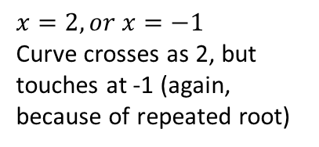
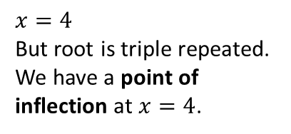
Cubics
Sketch the curve with equation
$$y=\left(2−x\right){\left(x+1\right)}^{2}$$
Sketch the curve with equation
$$y={\left(x−4\right)}^{3}$$
Downhill.
Shape?
?
Uphill.
Shape?
?
Roots?
$$x=2, or x=−1$$
Curve crosses as 2, but touches at -1 (again, because of repeated root)
?
Roots?
$$x=4$$
But root is triple repeated.
We have a point of inflection at $x=4$.
?
?
$y$-intercept?
2
?
$y$-intercept?
-64
? Final sketch
? Final sketch
$$y$$
$$y$$
Exam Notes: You might be able to see we get this shape at $x=4$ because as the root is triple repeated, the curve crosses at 4, then crosses again, then crosses again, hence ending up in the same direction and the line becoming momentarily horizontal.
A point of inflection is where the curve goes from ‘convex’ to ‘concave’ (or vice versa), i.e. curves in one direction before and curves in another direction after. You might have encountered these terms in Physics.
2
-1
2
$$x$$
$$x$$
4
-64

Slide 7


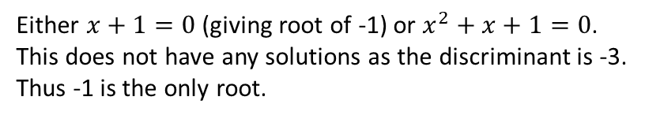
Cubics with Limited Roots
Sketch the curve with equation
$$y=\left(x+1\right)\left(x^{2}+x+1\right)$$
Uphill.
Shape?
?
Either $x+1=0$ (giving root of -1) or $x^{2}+x+1=0$.
This does not have any solutions as the discriminant is -3.
Thus -1 is the only root.
Roots?
?
?
$y$-intercept?
1
? Final sketch
We don’t have enough information to determine the exact shape. It could for example have been:
$$y$$
However, in Chapter 12, we’ll be able to work turning points using ‘differentiation’, and hence conclude that it doesn’t have any!
1
$$y$$
-1
$$x$$
1
-1
$$x$$

Slide 8
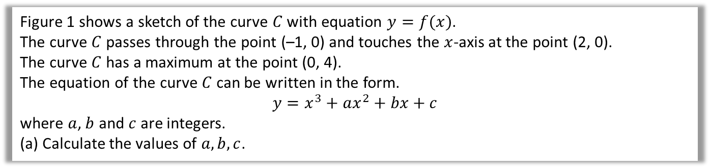

Finding the equation yourself
Edexcel C1 May 2013(R) Q9
Figure 1 shows a sketch of the curve $C$ with equation $y=f(x)$.
The curve $C$ passes through the point (–1, 0) and touches the $x$-axis at the point (2, 0).
The curve $C$ has a maximum at the point (0, 4).
The equation of the curve $C$ can be written in the form.
$$y=x^{3}+ax^{2}+bx+c$$
where $a$, $b$ and $c$ are integers.
(a) Calculate the values of $a,b,c$.
?
If it crosses at $\left(−1,0\right)$ we must have $(x+1)$.
If it touches at $\left(2,0\right)$ we must have ${\left(x−2\right)}^{2}$
$$∴ y={\left(x−2\right)}^{2}\left(x+1\right) \\ =\left(x^{2}−4x+4\right)\left(x+1\right) \\ =x^{3}+x^{2}−4x^{2}−4x+4x+4 \\ =x^{3}−3x^{2}+4 \\ ∴a=−3, b=0, c=4$$

Slide 9
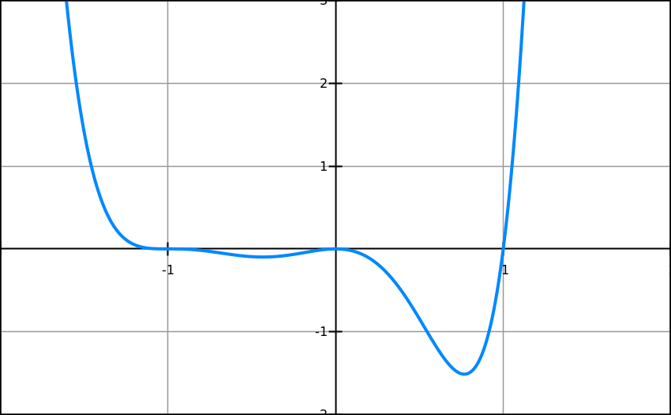



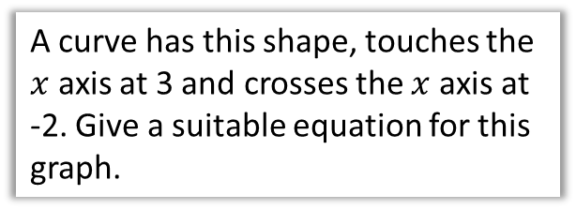

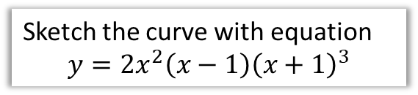

Test Your Understanding
3
A curve has this shape, touches the $x$ axis at 3 and crosses the $x$ axis at -2. Give a suitable equation for this graph.
1
Sketch the curve with equation
$$y=x{\left(x−3\right)}^{2}$$
?
$$y$$
?
$$y={\left(x−3\right)}^{2}\left(x+2\right)$$
N
Sketch the curve with equation
$$y=2x^{2}\left(x−1\right){\left(x+1\right)}^{3}$$
3
$$x$$
?
Point of inflection
Touches
$x$-axis
Crosses
$x$-axis
2
Sketch the curve with equation
$$y=−{\left(x+2\right)}^{3}$$
$$y$$
?
-2
$$x$$
-8

Slide 10
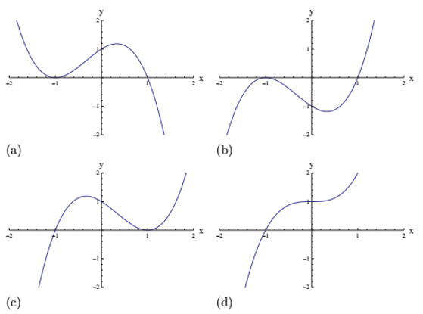
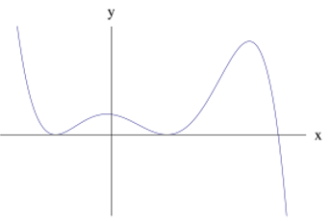
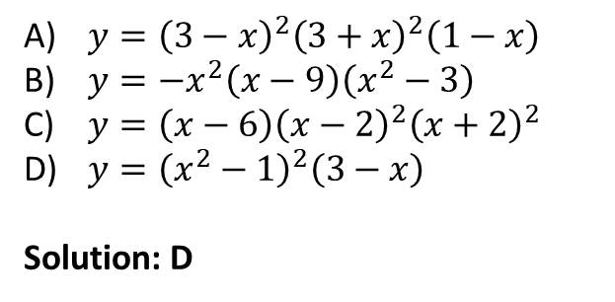
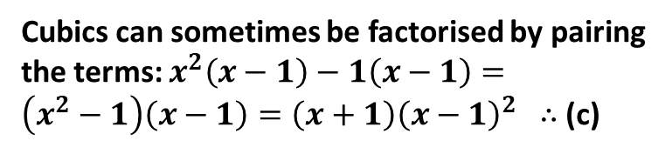
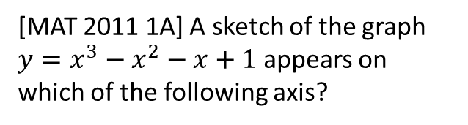
Exercise 4.1
Pearson Pure Mathematics Year 1/AS
Page 26
Extension
2
[MAT 2011 1A] A sketch of the graph $y=x^{3}−x^{2}−x+1$ appears on which of the following axis?
1
[MAT 2012 1E] Which one of the following equations could possibly have the graph given below?
(a)
(b)
$y={\left(3−x\right)}^{2}{\left(3+x\right)}^{2}\left(1−x\right)$
$y=−x^{2}\left(x−9\right)\left(x^{2}−3\right)$
$y=\left(x−6\right){\left(x−2\right)}^{2}{\left(x+2\right)}^{2}$
$y={\left(x^{2}−1\right)}^{2}\left(3−x\right)$
Solution: D
(c)
(d)
?
Cubics can sometimes be factorised by pairing the terms: $x^{2}\left(x−1\right)−1\left(x−1\right)=\left(x^{2}−1\right)\left(x−1\right)=\left(x+1\right){\left(x−1\right)}^{2}$ $∴$ (c)
?

Slide 11
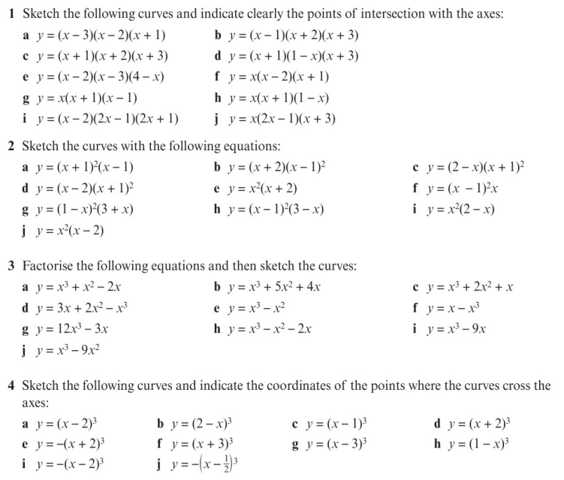
Homework Exercise

Slide 12
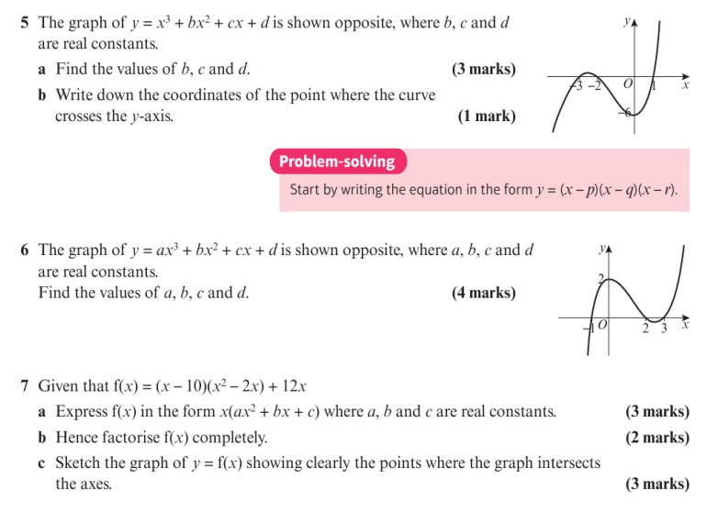
Homework Exercise

Slide 13
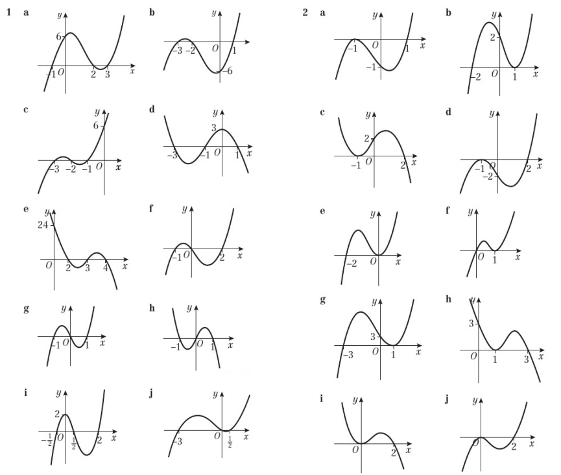
Homework Answers

Slide 14
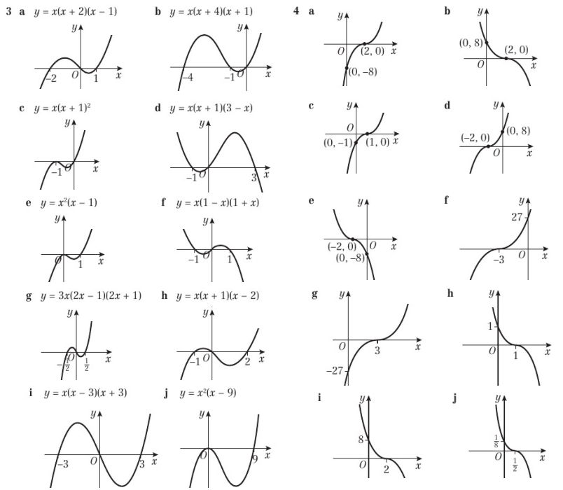
Homework Answers

Slide 15
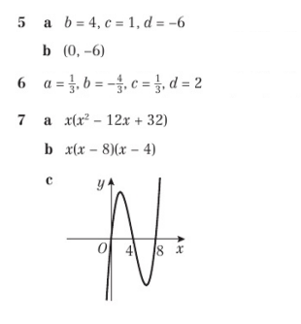
Homework Answers

