Slide 1
Stats Yr2 Chapter 3: Distribution-N The Inverse Normal

Slide 2

Fx-CG50: Inverse Normal Distribution
We now know how to use a calculator to value of the variable to obtain a probability. But we might want to do the reverse: given a probability of being in a region, how do we find the value of the boundary?
$$P\left(X>a\right)=0.4 \\ ∴P\left(X<a\right)=0.6$$
(i.e. if 40% is above $a$, then 60% must be below)
$$a=20.76$$
[Textbook] $X\sim N\left({20,3}^{2}\right)$. Find, correct to two decimal places, the values of $a$ such that:
$P\left(X<a\right)=0.75$
$P\left(X>a\right)=0.4$
$P\left(16<X<a\right)=0.3$
b
?
0.6
$$a$$
20
a
MENU $→$ Statistics
Choose DIST
Choose NORM
Choose ‘InvN’.
Put the area as 0.75 (this is the area up to the $a$ value to determine). Put $μ=20$ and $σ=3$.
You should get 22.0235.
c
?
We need to find the area up to $a$. From the sketch we can therefore see we first find the area up to 16 and add on the 0.3:
$$P\left(X<16\right)=0.09121 \\ ∴P\left(X<a\right)=0.3+0.09121=0.39121$$
$$∴a=19.17$$
0.3
$$16$$
$$a$$
20
The ‘area’ requested by your calculator is the probability up to the value of interest (in this case $a$)
REALLY, DRAW A SKETCH!
0.75
DRAW A SKETCH!
20
$$a$$

Slide 3

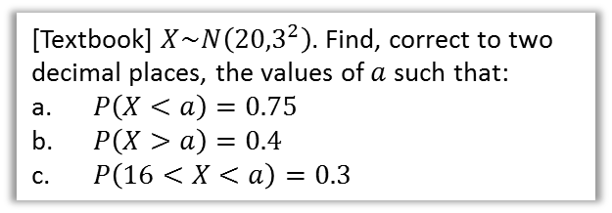

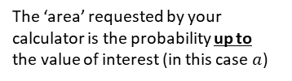


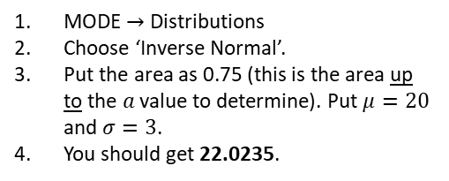

ClassWiz: Inverse Normal Distribution
We now know how to use a calculator to value of the variable to obtain a probability. But we might want to do the reverse: given a probability of being in a region, how do we find the value of the boundary?
$$P\left(X>a\right)=0.4 \\ ∴P\left(X<a\right)=0.6$$
(i.e. if 40% is above $a$, then 60% must be below)
$$a=20.76$$
[Textbook] $X\sim N\left({20,3}^{2}\right)$. Find, correct to two decimal places, the values of $a$ such that:
$P\left(X<a\right)=0.75$
$P\left(X>a\right)=0.4$
$P\left(16<X<a\right)=0.3$
b
?
0.6
$$a$$
20
MODE $→$ Distributions
Choose ‘Inverse Normal’.
Put the area as 0.75 (this is the area up to the $a$ value to determine). Put $μ=20$ and $σ=3$.
You should get 22.0235.
c
?
a
We need to find the area up to $a$. From the sketch we can therefore see we first find the area up to 16 and add on the 0.3:
$$P\left(X<16\right)=0.09121 \\ ∴P\left(X<a\right)=0.3+0.09121=0.39121$$
$$∴a=19.17$$
0.3
$$16$$
$$a$$
20
The ‘area’ requested by your calculator is the probability up to the value of interest (in this case $a$)
REALLY, DRAW A SKETCH!
0.75
20
$$a$$
DRAW A SKETCH!

Slide 4






Further Example
If the IQ of a population is distributed using $X\sim N\left({100,15}^{2}\right)$.
Determine the IQ corresponding to the top 30% of the population.
Determine the interquartile range of IQs.
a
?
b
?
$$P\left(X<Q_{1}\right)=0.25 \\ ∴Q_{1}=89.88$$
$$P\left(X<Q_{3}\right)=0.75 \\ ∴Q_{3}=110.12$$
$$IQR=110.12−89.88=20.24$$
0.70
0.50
0.25
100
$$a$$
$$Q_{1}$$
100
$$Q_{3}$$
$$P\left(X>k\right)=0.3 \\ ∴P\left(X<k\right)=0.7 \\ k=107.87 (2dp)$$
In general the quartiles of a normal distribution are approximately $μ±\frac{2}{3}σ$

Slide 5




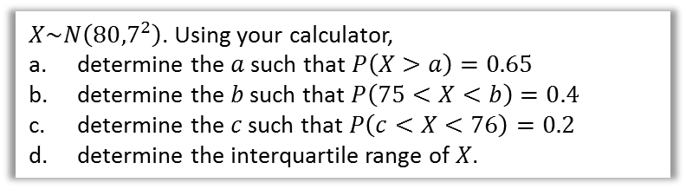


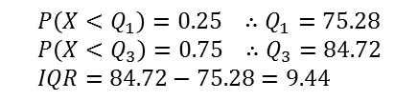


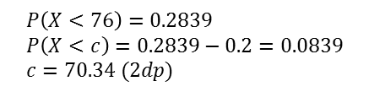
Test Your Understanding
$X\sim N\left({80,7}^{2}\right)$. Using your calculator,
determine the $a$ such that $P\left(X>a\right)=0.65$
determine the $b$ such that $P\left(75<X<b\right)=0.4$
determine the $c$ such that $P\left(c<X<76\right)=0.2$
determine the interquartile range of $X$.
a
?
c
?
$$P\left(X>a\right)=0.65 \\ ∴P\left(X<a\right)=0.35 \\ a=77.303 (3dp)$$
0.2839
$$P\left(X<76\right)=0.2839 \\ P\left(X<c\right)=0.2839−0.2=0.0839 \\ c=70.34 (2dp)$$
0.75
0.2
$$76$$
80
80
$$a$$
$$c$$
b
?
d
?
$$P\left(X<75\right)=0.2375 \\ ∴P\left(X<b\right)=0.2375+0.4=0.6375$$
$$b=82.463$$
$$P\left(X<Q_{1}\right)=0.25 ∴Q_{1}=75.28 \\ P\left(X<Q_{3}\right)=0.75 ∴Q_{3}=84.72 \\ IQR=84.72−75.28=9.44$$
0.4
0.50
0.2375
0.25
$$75$$
80
$$b$$
$$Q_{1}$$
80
$$Q_{3}$$

Slide 6
Exercise 3.3
Pearson Stats/Mechanics Year 2
Pages 24-25

Slide 7
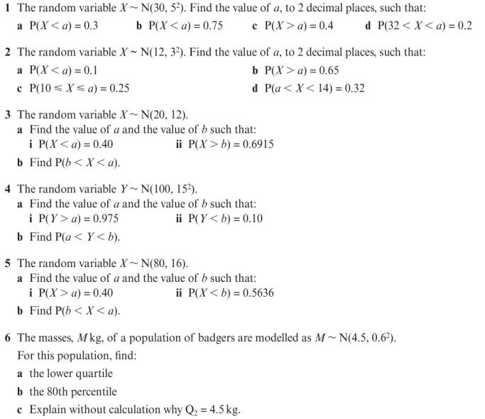
Homework Exercise

Slide 8
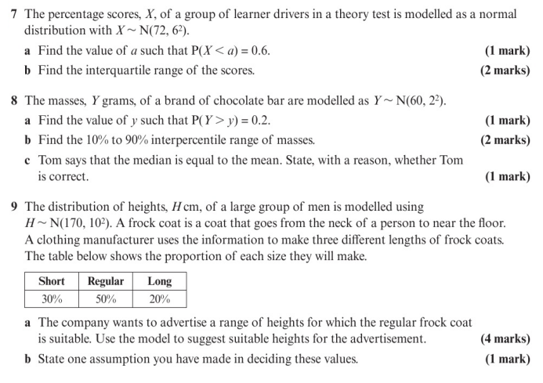
Homework Exercise

Slide 9
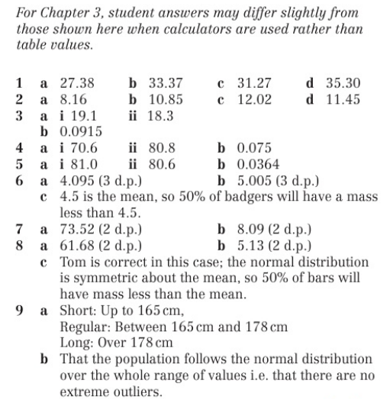
Homework Answers

