Slide 1
M2 Chapter 4: Moments Centre of Mass

Slide 2
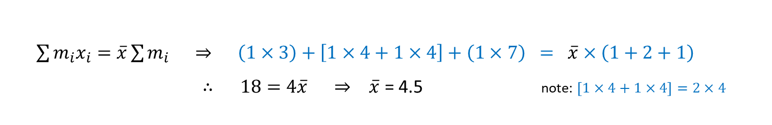
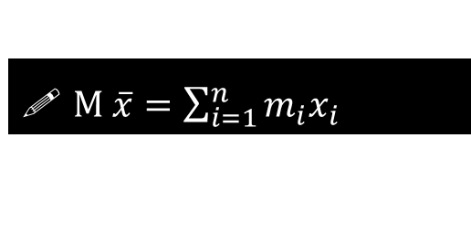
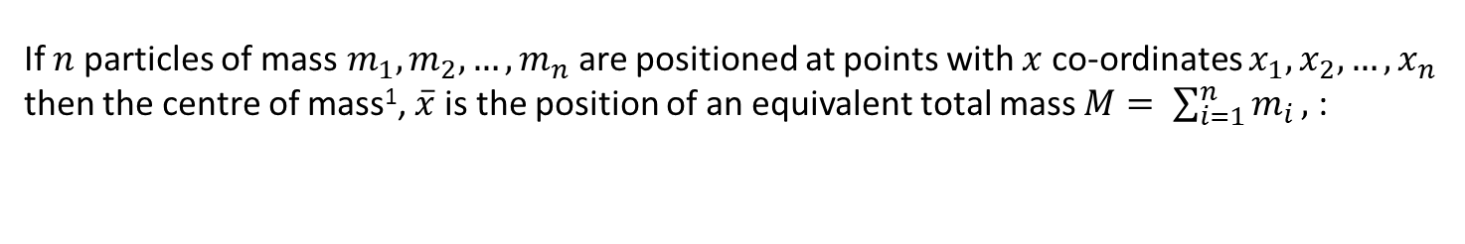


Centre of Mass of a set of particles on a straight line
If $n$ particles of mass$m_{1},m_{2}, …, m_{n}$are positioned at points with $x$ co-ordinates $x_{1}, x_{2},…,x_{n}$ then the centre of mass¹, $\overline{x}$ is the position of an equivalent total mass $M= \sum_{i=1}^{n}{m_{i}},$ :
$M \overline{x}=\sum_{i=1}^{n}{m_{i}x_{i}}$
In other words, it is the total mass times the average position of each unit of mass.
[example] A system of 3 particles with masses 1kg, 2kg and 1kg are placed along the $x$-axis at the points 3, 4 and 7 respectively. Find the $x$coordinate of the centre of mass.
?
1kg
2kg
1kg
$x=$0
$$\overline{x}$$
$x$=10
$\sum{m_{i}x_{i}}=\overline{x}\sum{m_{i } ⇒ }$ $\left(1×3\right)+\left[1×4+1×4\right]+\left(1×7\right) = \overline{x}×\left(1+2+1\right)$
$∴ 18=4\overline{x} ⇒ \overline{x}$ = 4.5 note: $\left[1×4+1×4\right]=2×4$

Slide 3
An example
[textbook] A system of 3 particles with masses 2kg, 5kg and 3kg are placed along the $x$-axis at the points (3,0), (4,0) and (6,0) respectively. Find the centre of mass of the system.
2kg
5kg
3kg
0
10
$$\sum{m_{i}x_{i}}=\overline{x}\sum{m_{i}}$$
$$2×3+5×4+3×6=\overline{x}×\left(2+5+3\right)$$
$$\overline{x}=\frac{44}{10}=4.4$$
$⇒$ centre of mass is $(4.4, 0)$
?

Slide 4



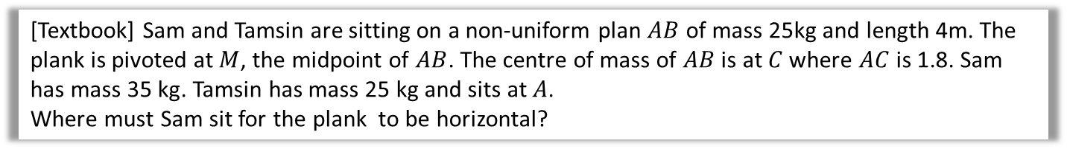








Centres of Mass
We have assumed that the rod is uniform, that is, its mass is equally distributed across the rod, such that the centre of mass is the centre.
But this may not be the case, and for non-uniform rods we may wish to find where the centre of mass lies, or we will be told where it lies.
[Textbook] Sam and Tamsin are sitting on a non-uniform plan $AB$ of mass 25kg and length 4m. The plank is pivoted at $M$, the midpoint of $AB$. The centre of mass of $AB$ is at $C$ where $AC$ is 1.8. Sam has mass 35 kg. Tamsin has mass 25 kg and sits at $A$.
Where must Sam sit for the plank to be horizontal?
? Diagram
? Working
Tamsin
$$R$$
Sam
Moments about $M$:
$$\left(25g×2\right)+\left(25g×0.2\right)=35g\left(x−2\right) \\ … \\ x=3.57$$
i.e. Sam should sit 3.57m from end $A$.
$$A$$
$$B$$
$1$m
$0.2$m
$2$m
$1.8$m
$$25g$$
$$25g$$
$x$m

Slide 5
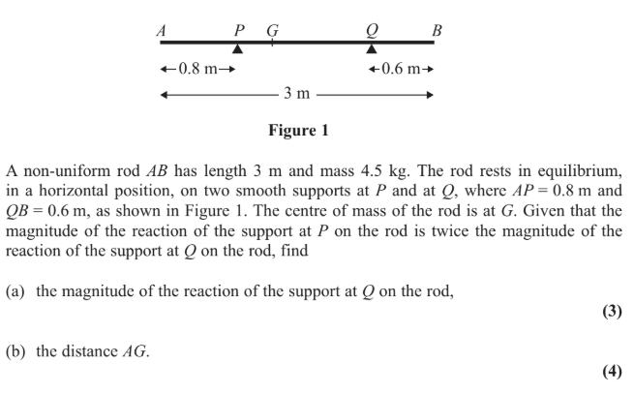
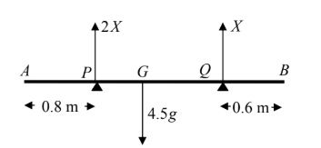
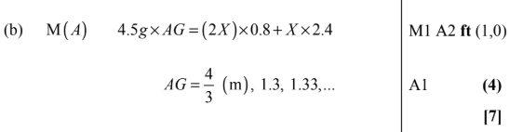

Test Your Understanding
Edexcel M1(Old) May 2012 Q2
? Diagram
?
?

Slide 6
Exercise 4.4
Pearson Stats/Mechanics Year 2
Page 38-39

Slide 7
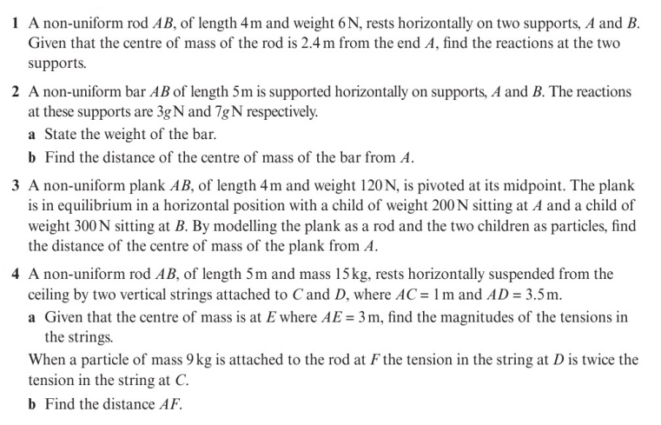
Homework Exercise

Slide 8
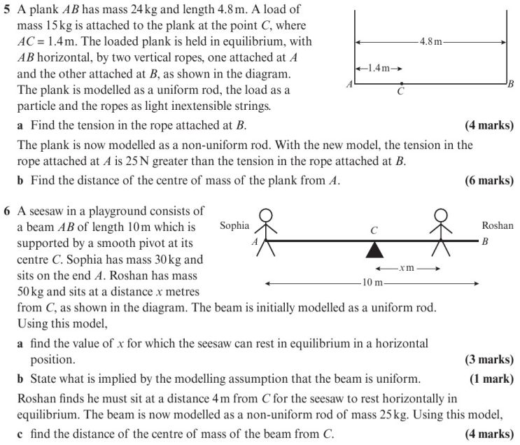
Homework Exercise

Slide 9
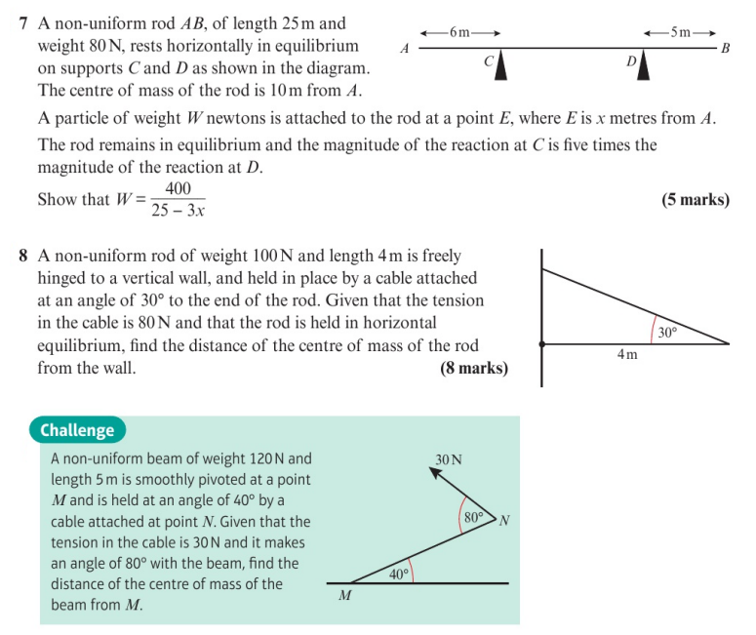
Homework Exercise

Slide 10
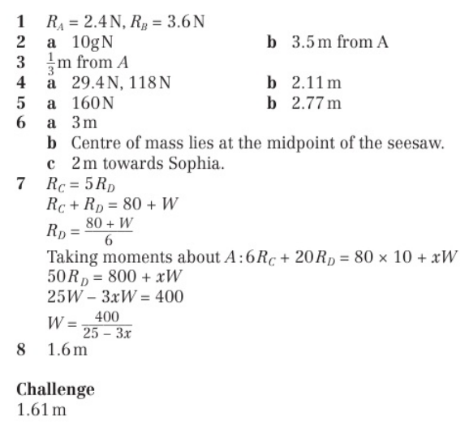
Homework Answers

