Slide 1
S1 Chapter 3: Data Representations Histograms

Slide 2
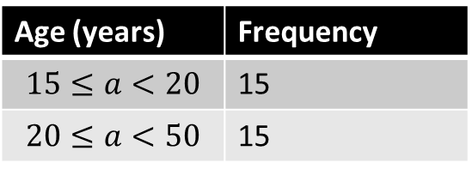
Histograms
Pablo is hosting a party. He counts how many people are between 15 and 20, and 20 and 50.
Age (years) | Frequency
$$15≤a<20$$ | 15
$$20≤a<50$$ | 15
Why is below graph somewhat unhelpful.
How could we fix it?
Click to Start Animation
15
The 15 people in the second group are more spread out in age, but this graph seems to suggest that people’s ages are spread out uniformly between 15 and 50.
Frequency
10 20 30 40 50
Age

Slide 3
Let’s presume that within each age group, the ages are evenly spread.
Then there would 3 people of each age in the 15-20 group, and 0.5 people of each age in the 20-50 group.
Age (years) | Frequency
15 ≤ a < 20 | 15
20 ≤ a < 50 | 15
?
?
Click to Start Animation
3
2
1
The resulting diagram is known as a histogram; it allows us to display the ‘concentration’ (i.e. density) of people per unit value.
The ‘frequency per age’ is known as the ‘frequency density’. In general, given the frequency and class width, we can calculate it using:
Frequency Density
Estimated Frequency
Frequency
Class Width
Frequency Density =
?
10 20 30 40 50
Age

Slide 4
Bar Charts vs Histograms
Histograms
For continuous data.
Data divided into (potentially uneven) intervals.
[GCSE definition] Frequency given by area of bars.*
No gaps between bars.
Bar Charts
For discrete data.
Frequency given by height of bars.
?
?
?
?
Use this as a reason whenever you’re asked to justify use of a histogram.
Frequency
Frequency Density
6 7 8 9
1.0m 1.2m 1.4m 1.6m 1.8m
Shoe Size
Height
* Not necessarily true. We’ll correct this in a sec.

Slide 5
Bar Charts vs Histograms
Q1
Still using the incorrect GCSE formula:
Weight (w kg) | Frequency | Frequency Density
0 < w ≤ 10 | 40 | 4
10 < w ≤ 15 | 6 | 1.2
15 < w ≤ 35 | 52 | 2.6
35 < w ≤ 45 | 10 | 1
?
?
Freq
?
?
F.D.
Width
Q2
Frequency = 40
5
4
3
2
1
?
Frequency = 15
?
Frequency = 25
?
Frequency Density
Frequency = 30
?
10 20 30 40 50
Height (m)

Slide 6
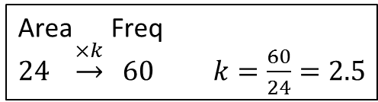
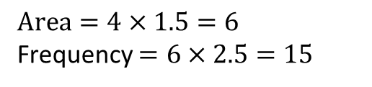
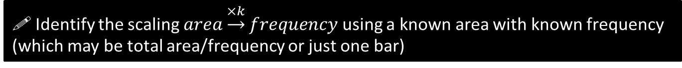
SKILL #1 :: Area = frequency?
Unlike at GCSE, the area of a bar is not necessarily equal to the frequency; there are just proportional.
! Identify the scaling $area\underset{→}{×k}frequency$ using a known area with known frequency (which may be total area/frequency or just one bar)
There were 60 runners in a 100m race. The following histogram represents their times. Determine the number of runners with times above 14s.
5
4
3
2
1
0
Total frequency is known; therefore find total area and hence the ‘scaling’.
?
Total area = 15 + 9 = 24
Area Freq
$24 \underset{→}{×k} 60$ $k=\frac{60}{24}=2.5$
Frequency Density
Then use this scaling along with the desired area.
?
$$Area=4×1.5=6$$
Frequency $=6×2.5=15$
9
12
18
Time (s)

Slide 7

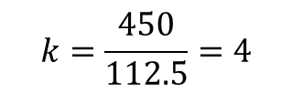



Test Your Understanding
(on your printed sheet)
Edexcel S1 May 2012 Q5
A policeman records the speed of the traffic on a busy road with a 30 mph speed limit. He records the speeds of a sample of 450 cars. The histogram in Figure 2 represents the results.
(a) Calculate the number of cars that were exceeding the speed limit by at least 5 mph in the sample. (4 marks)
Tip: We can make the frequency density scale what we like.
M1 A1: Determine what one small square or one large square is worth.
7
6
5
4
3
2
1
(i.e. work out $area→freq$ scaling)
$$k=\frac{450}{112.5}=4$$
?
Area Freq
$$112.5 \underset{→}{×k} 450$$
M1 A1: Use this to find number of cars travelling >35mph.
?
Area Freq
$$22.5 \underset{→}{×4} 90$$
Write: $22.5×4=90$

Slide 8
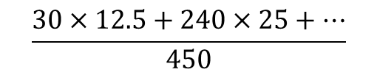

Test Your Understanding
(on your printed sheet)
(b) Estimate the value of the mean speed of the cars in the sample. (3 marks)
M1 M1: Use histogram to construct sum of speeds.
?
$$\frac{30×12.5+240×25+…}{450}$$
A1 Correct value
?
$$=28.8$$
Tip: Whenever you are asked to calculate mean, median or quartiles from a histogram, form a grouped frequency table. Use your scaling factor to work out the frequency of each bar.

Slide 9
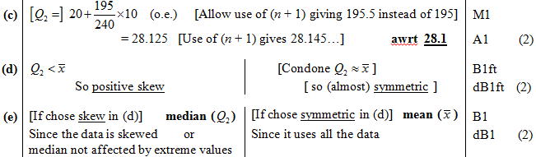
Test Your Understanding
(on your printed sheet)
(c) Estimate, to 1 decimal place, the value of the median speed of the cars in the sample.(2)
(d) Comment on the shape of the distribution. Give a reason for your answer. (2)
(e) State, with a reason, whether the estimate of the mean or the median is a better representation of the average speed of the traffic on the road. (2)
(crossed out questions would not appear in new syllabus)
?
?
?

Slide 10
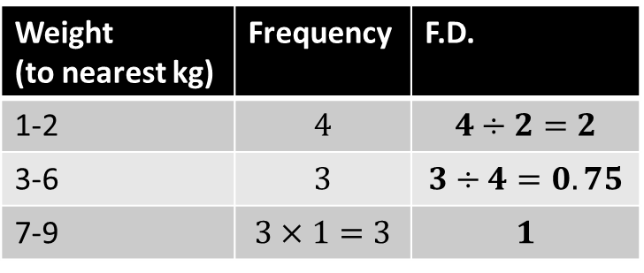
SKILL #2 :: Gaps!
Weight (to nearest kg) | Frequency | F.D.
1-2 | $$4$$ | $$4÷2=2$$
3-6 | $$3$$ | $$3÷4=0.75$$
7-9 | $$3×1=3$$ | $$1$$
Note the gaps affects class width!
Remember the frequency density axis is only correct to scale, so there may be some scaling. However in an exam scaling is unlikely to be required for F.D. if the F.D. scale is already given.
?
?
?
?
For simplicity we can set the scaling between area and frequency to be 1.
2
1
0
Frequency Density
?
1 2 3 4 5 6 7 8 9 10
Time (s)

Slide 11
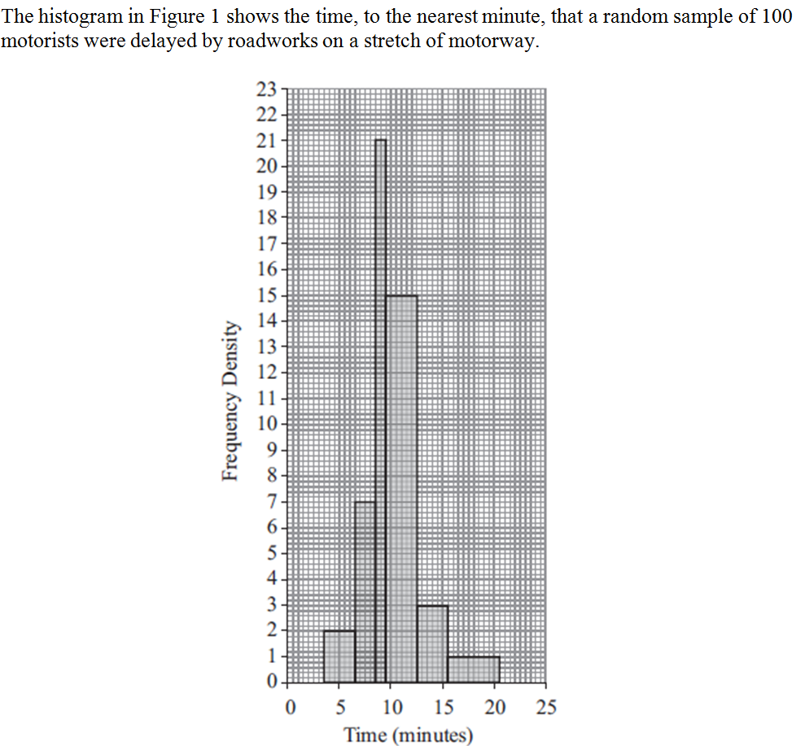
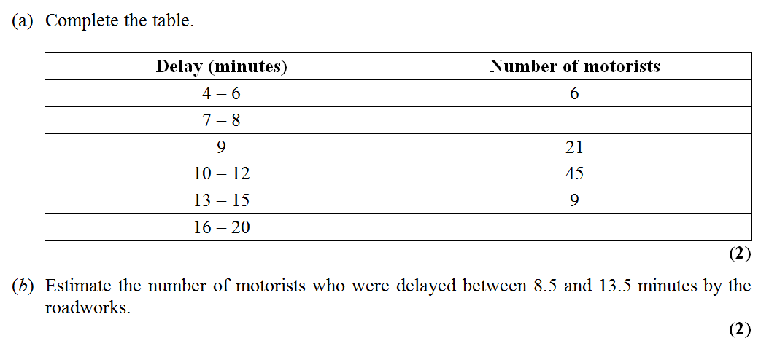
Test Your Understanding
(on your printed sheet)
Jan 2012 Q1
Fro Tip: Be careful that you use the correct class widths!
14
?
5
?
?
21 + 45 + 3 = 69
Notes:
Be sure to ask first what they notice about the ranges in the table (i.e. gaps!)

Slide 12

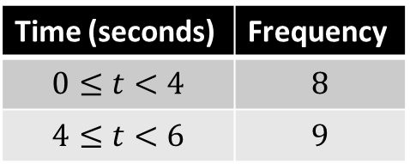
SKILL #3 :: Width and height on diagram
An exam favourite is to ask what width and height we’d draw a bar in a drawn histogram.
Q: The frequency table shows some running times. On a histogram the bar for 0-4 seconds is drawn with width 6cm and height 8cm. Find the width and height of the bar for 4-6 seconds.
Time (seconds) | Frequency
$$0≤t<4$$ | $$8$$
$$4≤t<6$$ | $$9$$
! Tip: Find the scaling for class width to drawn width and frequency density to drawn height.
Strategy ?
Solution ?
For 0-4 bar:
Class width $=4$
Frequency density $=8÷4=2$
$∴$ Scaling for width: 1.5
Scaling for height: 4
4-6 bar: class width 2, frequency density 4.5
$$Width=2×1.5=3cm \\ Height=4.5×4=18cm$$

Slide 13
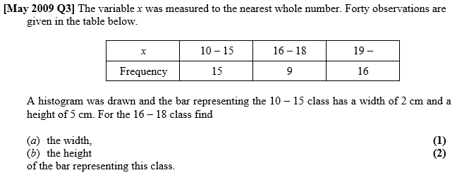
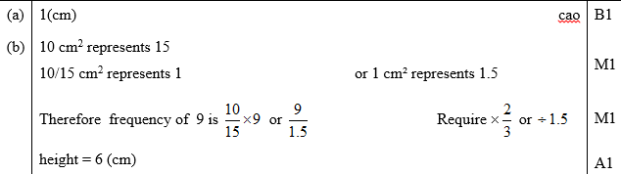
Test Your Understanding
(on your printed sheet)
?
?

Slide 14
SKILL #4 :: Forming a frequency polygon
Recall that a frequency polygon can be drawn by using the midpoint of each interval. This corresponds to the midpoint of the top of each bar in a histogram.
Click to Sketch
Note that the frequency in this interval is 0. That needs to be reflected in the frequency polygon.

Slide 15
Exercise 3.4
Pearson Pure Mathematics Year 1/AS
Pages 20-22

Slide 16
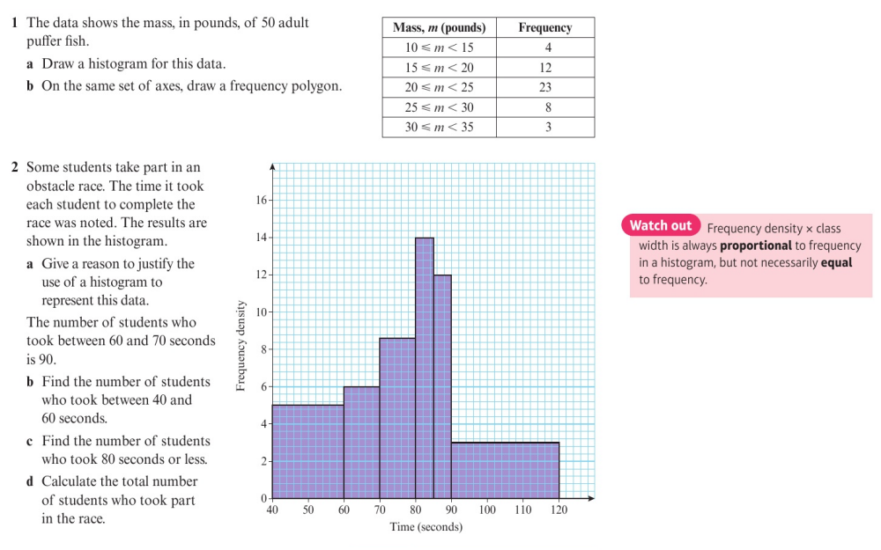
Homework Exercise

Slide 17
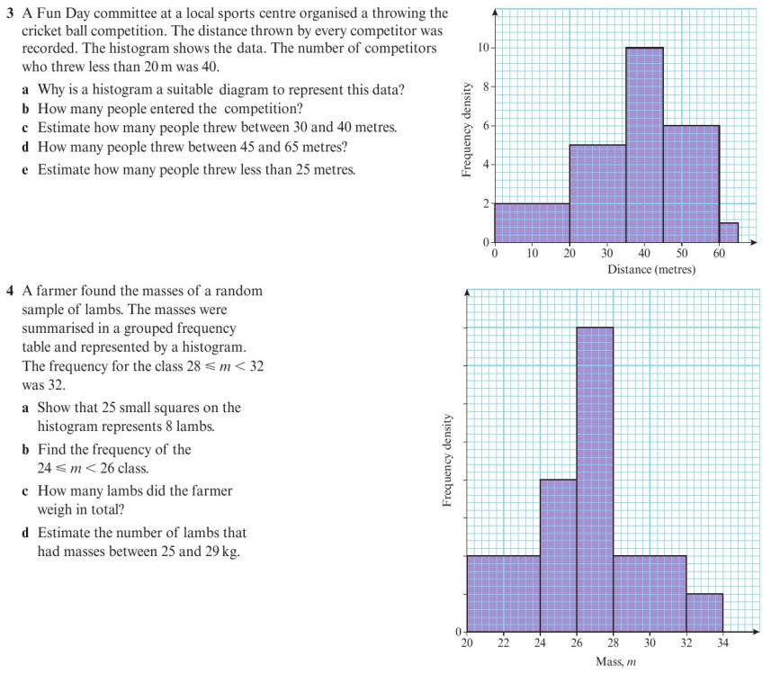
Homework Exercise

Slide 18
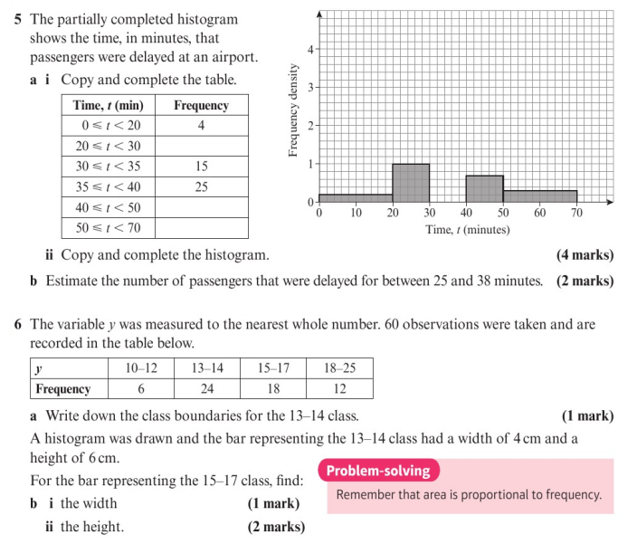
Homework Exercise

Slide 19
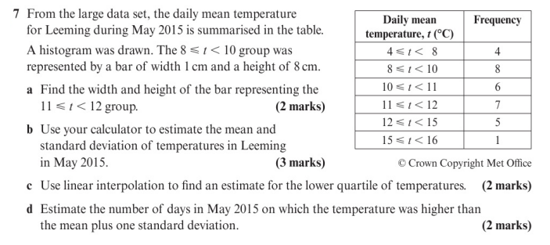
Homework Exercise

Slide 20
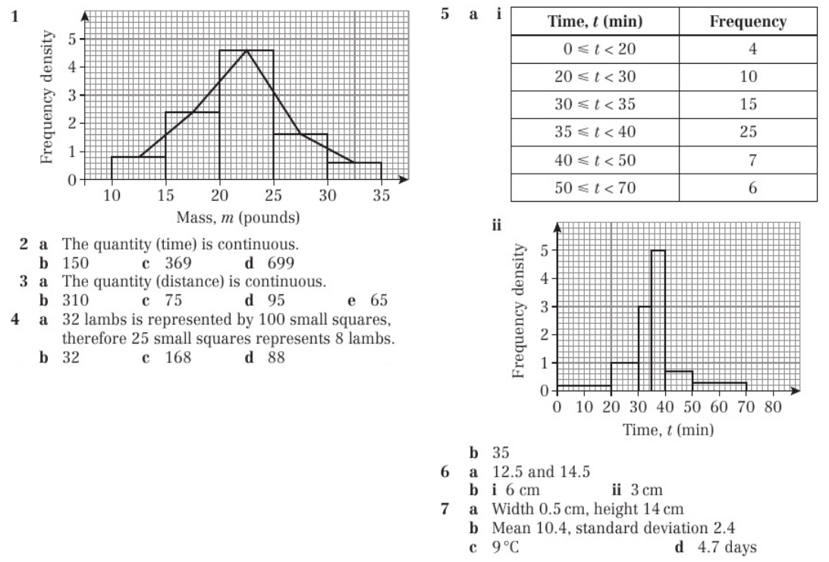
Homework Answers

