Slide 1
P2 Chapter 11: Integration Modelling with Differential Equations

Slide 2
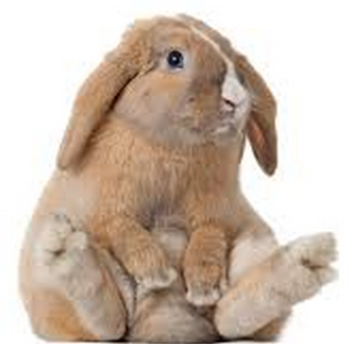
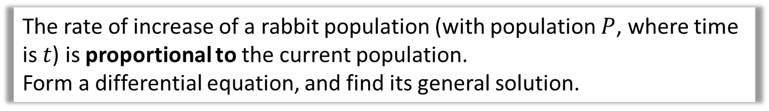

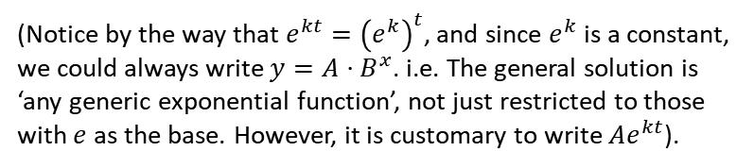

Forming differential equations
Differential equations are useful because regularly in real-life, the rate of change of a variable is based on its current value. For example in Year 1, we saw a property of exponential growth is that the rate of change is proportional to the current value:
Q
The rate of increase of a rabbit population (with population $P$, where time is $t$) is proportional to the current population.
Form a differential equation, and find its general solution.
? Form equation
Recall from GCSE that $k$ is the ‘constant of proportionality’.
$$\frac{dP}{dt}∝P ∴ \frac{dP}{dt}=kP \\ \frac{1}{P}\frac{dP}{dt}=k \\ \int{\frac{1}{P} dP}=\int{k dt} \\ \ln\left|P\right|=kt+C \\ P=e^{kt+C} \\ P=Ae^{kt} (where A=e^{C})$$
? Solve it
(Notice by the way that $e^{kt}={\left(e^{k}\right)}^{t}$, and since $e^{k}$ is a constant, we could always write $y=A⋅B^{x}$. i.e. The general solution is ‘any generic exponential function’, not just restricted to those with $e$ as the base. However, it is customary to write $Ae^{kt}$).

Slide 3



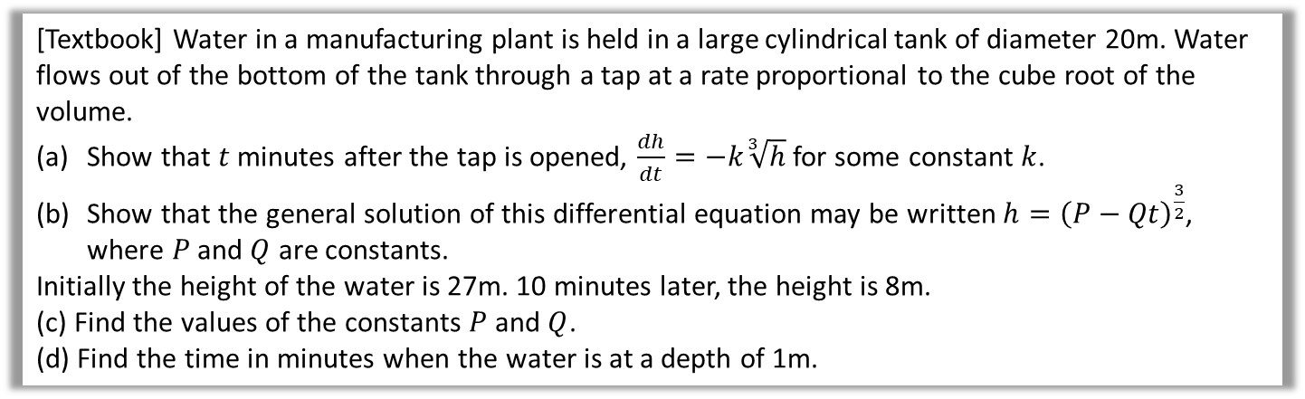
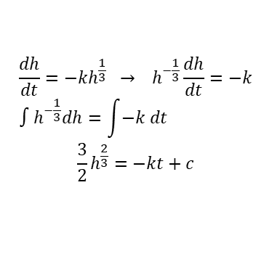


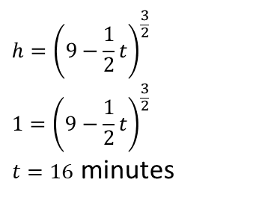
Further Example
[Textbook] Water in a manufacturing plant is held in a large cylindrical tank of diameter 20m. Water flows out of the bottom of the tank through a tap at a rate proportional to the cube root of the volume.
Show that $t$ minutes after the tap is opened, $\frac{dh}{dt}=−k\sqrt[3]{h}$ for some constant $k$.
Show that the general solution of this differential equation may be written $h={\left(P−Qt\right)}^{\frac{3}{2}}$, where $P$ and $Q$ are constants.
Initially the height of the water is 27m. 10 minutes later, the height is 8m.
(c) Find the values of the constants $P$ and $Q$.
(d) Find the time in minutes when the water is at a depth of 1m.
(a) is a ‘connected rate of change’ question in the style we saw in Chapter 9. Model the fact we have a cylinder.
$$h$$
?
a
$$V=πr^{2}h=100πh \\ \frac{dV}{dh}=100π \\ \frac{dV}{dt}=−c\sqrt[3]{V} \\ =−c\sqrt[3]{100πh} \\ \frac{dh}{dt}=\frac{dh}{dV}×\frac{dV}{dt}=\frac{1}{100π}×\left(−c\sqrt[3]{100πh}\right)$$ $∴\frac{dh}{dt}=−k\sqrt[3]{h}$ where $k=\frac{c\sqrt[3]{100π}}{100π}$
$$t=0, h=27 \\ 27=P^{\frac{3}{2}} ⇒ P=9 \\ t=10, h=8 \\ 8={\left(9−10Q\right)}^{\frac{3}{2}} \\ 4=9−10Q \\ Q=\frac{1}{2}$$
c
?
$$20m$$
If water is flowing out, the rate of change is negative.
Use chain rule.
d
?
$$h={\left(9−\frac{1}{2}t\right)}^{\frac{3}{2}} \\ 1={\left(9−\frac{1}{2}t\right)}^{\frac{3}{2}}$$ $t=16$ minutes
$$\frac{dh}{dt}=−kh^{\frac{1}{3}} → h^{−\frac{1}{3}}\frac{dh}{dt}=−k \\ ∫h^{−\frac{1}{3}}dh=\int{−k dt}$$
$$\frac{3}{2}h^{\frac{2}{3}}=−kt+c$$
$$h^{\frac{2}{3}}=−\frac{2}{3}kt+\frac{2}{3}c \\ h={\left(−\frac{2}{3}kt+\frac{2}{3}c\right)}^{\frac{3}{2}} \\ h={\left(P−Qt\right)}^{\frac{3}{2}}$$
b
?

Slide 4
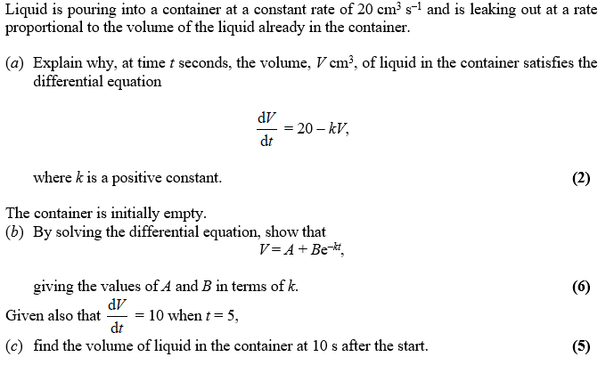
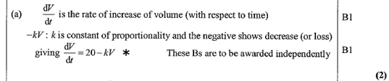
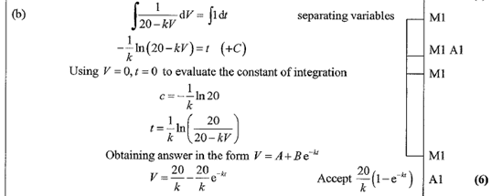
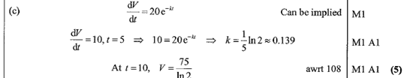
Test Your Understanding
Edexcel C4 June 2005 Q8
?
Teachers/Students: I recommend also looking at Edexcel Jan 2008 Q8 which has a part (a) similar to the previous example.
?
?

Slide 5
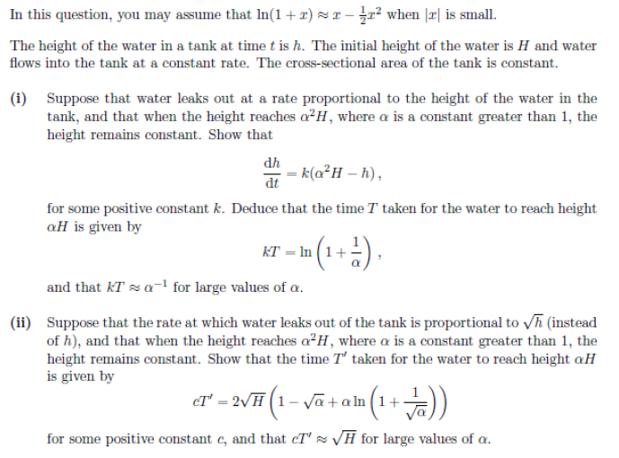
Exercise 11.11
Pearson Pure Year 2
Pages 99-100
Extension:
[STEP 2011 Q7]

Slide 6
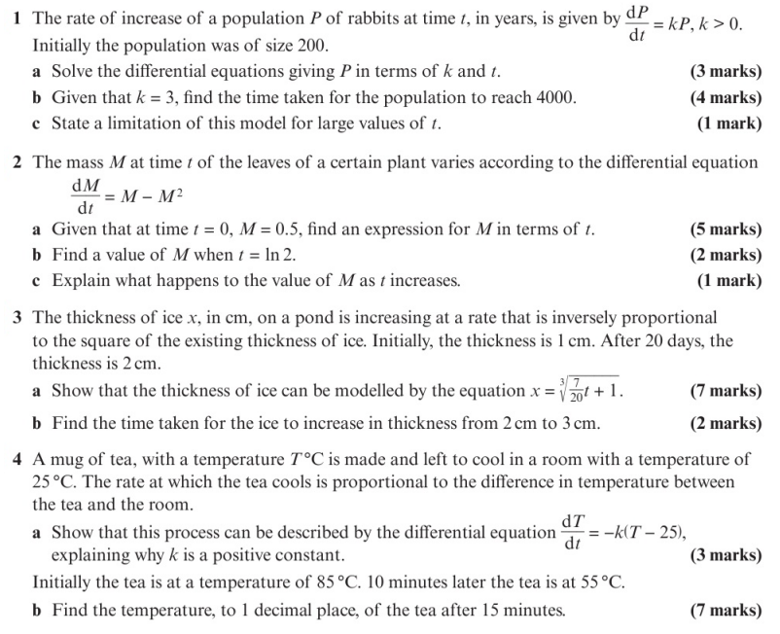
Homework Exercise

Slide 7
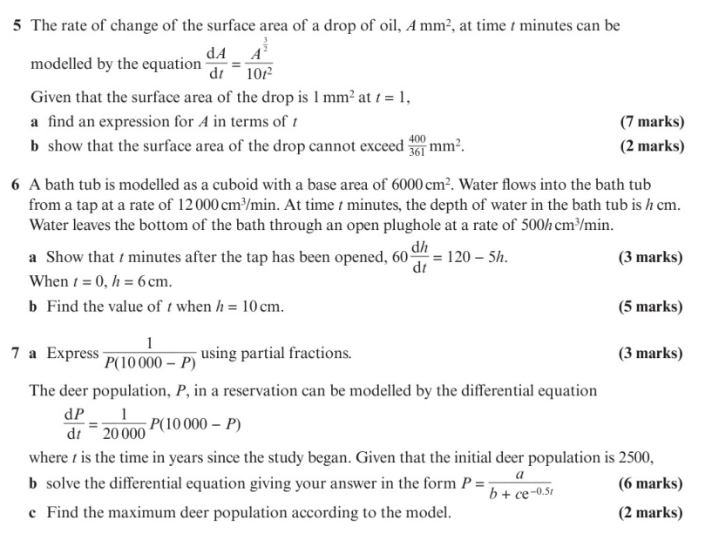
Homework Exercise

Slide 8
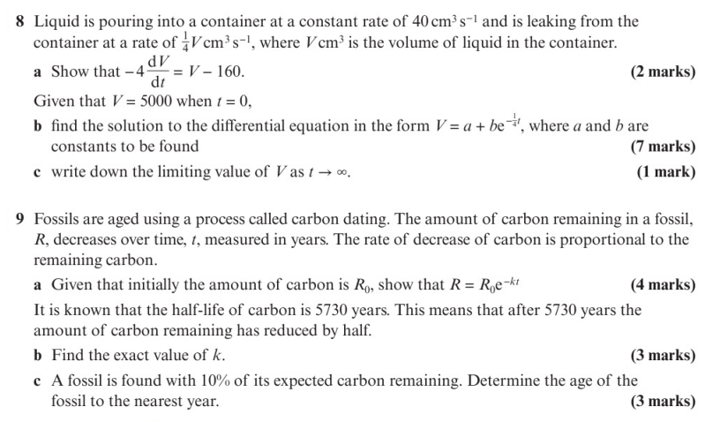
Homework Exercise

Slide 9
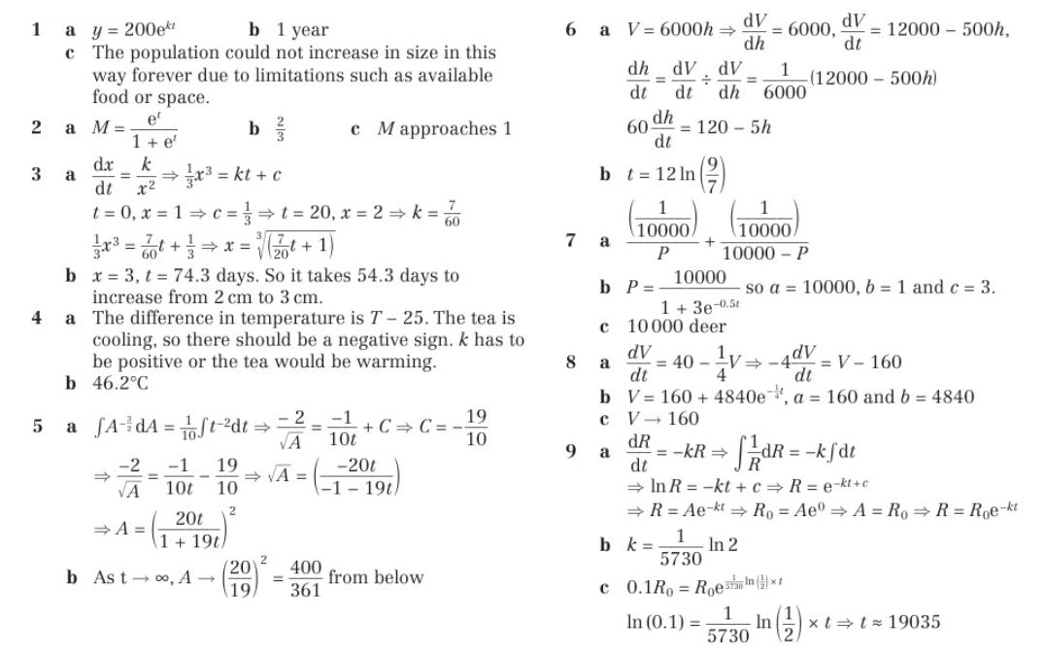
Homework Answers

