Slide 1
P2 Chapter 6: CoAngle Trigonometry
Co-angle Graphs

Slide 2




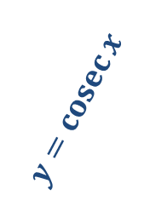



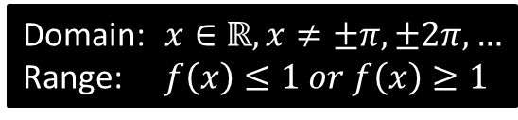

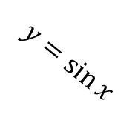


Sketches
To draw a graph of $y=cosec x$, start with a graph of $y=\sin{x}$, then consider what happens when we reciprocate each $y$ value.
It touches here because the reciprocal of 1 is 1.
$$y$$
$$y=\operatorname{cosec}{x}$$
$cosec$ isn’t defined for multiples of $π$ because we can’t divide by 0. We get an asymptote.
Click to sketch $y=cosec x$
$$1$$
$$y=\sin{x}$$
$$x$$
$$\frac{1}{2}π$$
$$π$$
$$\frac{3}{2}π$$
$$2π$$
$$−1$$
Domain: $x∈ℝ, x≠±π,±2π,…$
Range: $f\left(x\right)≤1 or f\left(x\right)≥1$
?
?
Reciprocating preserves sign. When we divide by a small positive number, we get a very large positive number.

Slide 3
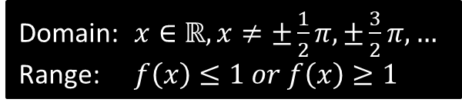
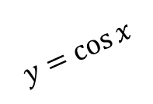
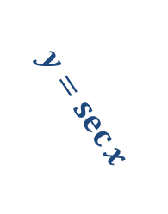

Sketches
$$y$$
$$y=\sec{x}$$
Click to sketch $y=sec x$
$$1$$
$$y=\cos{x}$$
$$x$$
$$\frac{1}{2}π$$
$$π$$
$$\frac{3}{2}π$$
$$2π$$
$$−1$$
Domain: $x∈ℝ, x≠±\frac{1}{2}π,±\frac{3}{2}π,…$
Range: $f\left(x\right)≤1 or f\left(x\right)≥1$
?
?

Slide 4
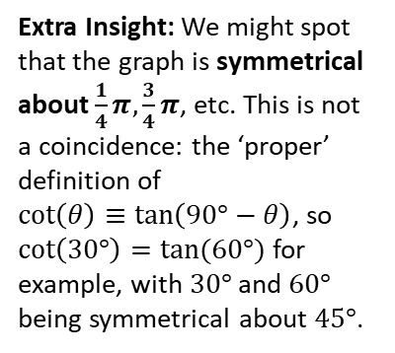

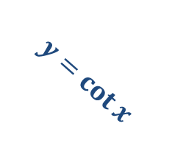
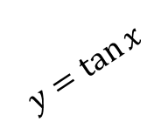
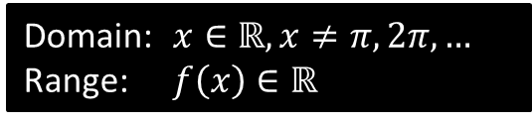
Sketches
Click to sketch $y=cot x$
$$y$$
?
Domain: $x∈ℝ, x≠π,2π,…$
Range: $f\left(x\right)∈ℝ$
?
$$y=\tan{x}$$
$$y=\cot{x}$$
$$x$$
$$\frac{1}{2}π$$
$$π$$
$$\frac{3}{2}π$$
$$2π$$
Extra Insight: We might spot that the graph is symmetrical about $\frac{1}{4}π,\frac{3}{4}π$, etc. This is not a coincidence: the ‘proper’ definition of
$\cot\left(θ\right)≡\tan\left(90°−θ\right)$, so $\cot\left(30°\right)=tan⁡(60°)$ for example, with $30°$ and $60°$ being symmetrical about $45°$.

Slide 5




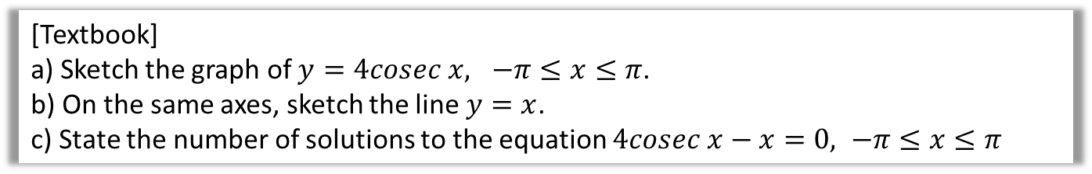





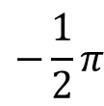
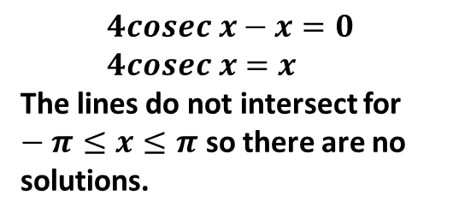
Example
[Textbook]
a) Sketch the graph of $y=4cosec x, −π≤x≤π$.
b) On the same axes, sketch the line $y=x$.
c) State the number of solutions to the equation $4cosec x−x=0, −π≤x≤π$
?
$$y$$
$$y=\operatorname{cosec}{x}$$
$$y=x$$
$$4$$
$$x$$
$$−π$$
$$−\frac{1}{2}π$$
$$\frac{1}{2}π$$
$$π$$
$$4cosec x−x=0 \\ 4cosec x=x$$
The lines do not intersect for $−π≤x≤π$ so there are no solutions.
$$−4$$

Slide 6






















Test Your Understanding
Sketch $y=−1+\sec{2x}$ in the interval $0≤x<360°$.
?
$$y$$
$$y$$
$$y=\sec{x}$$
$$y=\sec{2x}$$
$$1$$
$$1$$
$$x$$
$$x$$
$$90°$$
$$180°$$
$$270°$$
$$360°$$
$$90°$$
$$180°$$
$$270°$$
$$360°$$
$$−1$$
$$−1$$
$$y$$
$$y=−1+\sec{2x}$$
$$x$$
Draw the transformations stage by stage, unless you feel comfortable doing multiple transformations at once.
$$90°$$
$$180°$$
$$270°$$
$$360°$$
$$−2$$

Slide 7
Exercise 6.2
Pearson Pure Mathematics Year 2/AS
Page 43

Slide 8
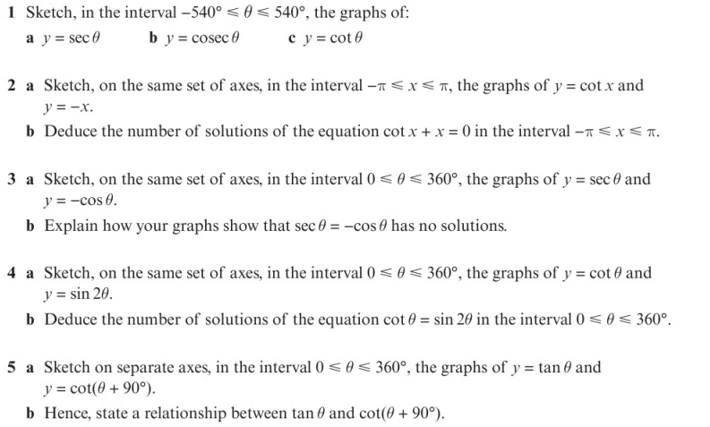
Homework Exercise

Slide 9
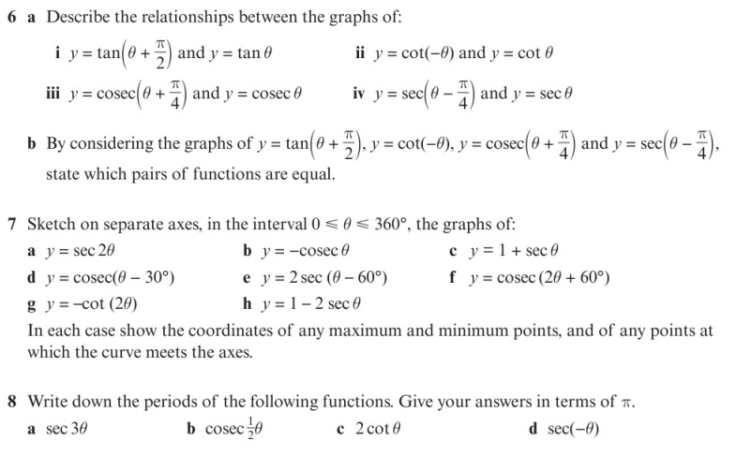
Homework Exercise

Slide 10
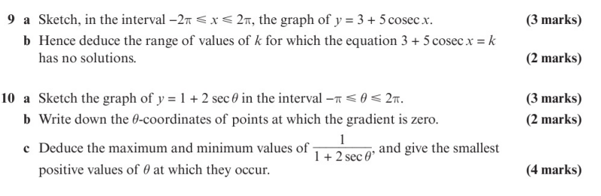
Homework Exercise

Slide 11
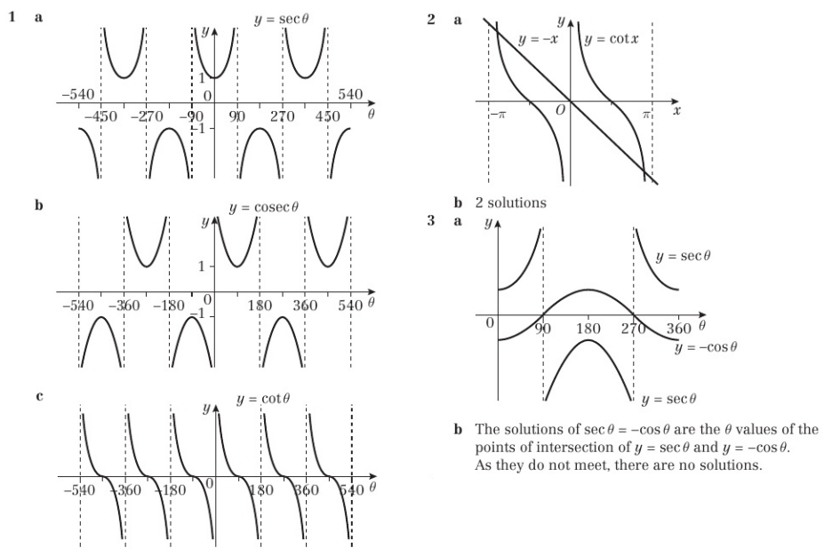
Homework Answers

Slide 12
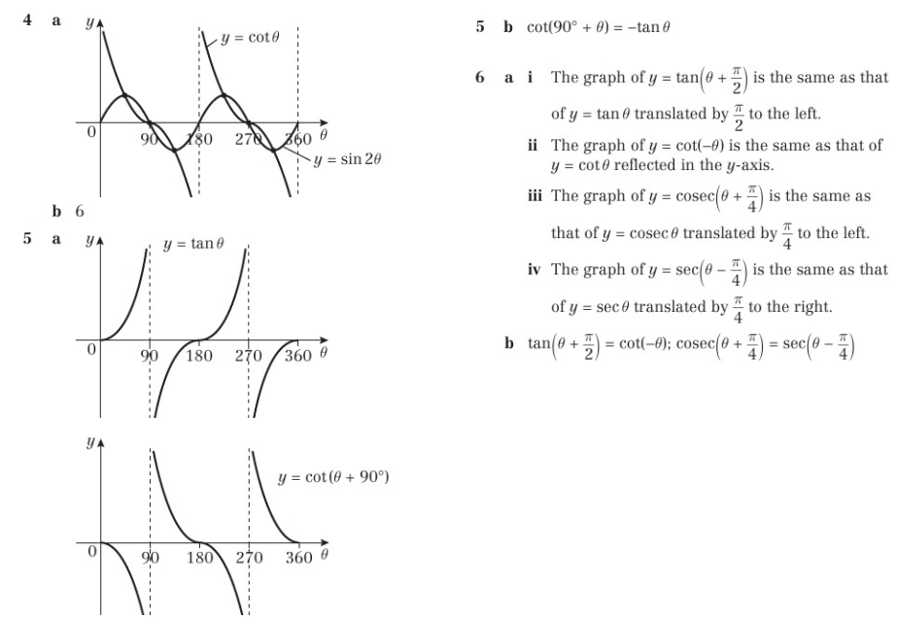
Homework Answers

Slide 13
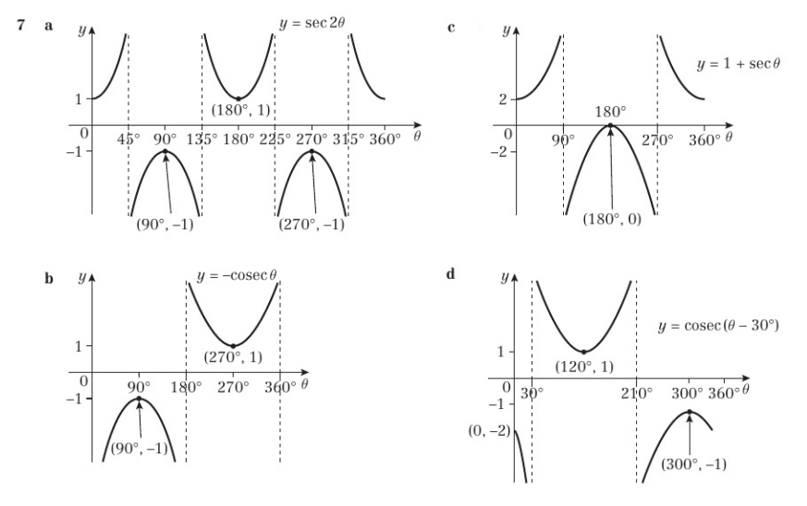
Homework Answers

Slide 14
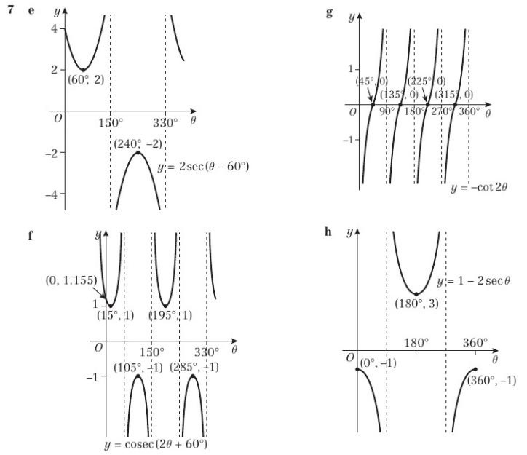
Homework Answers

Slide 15
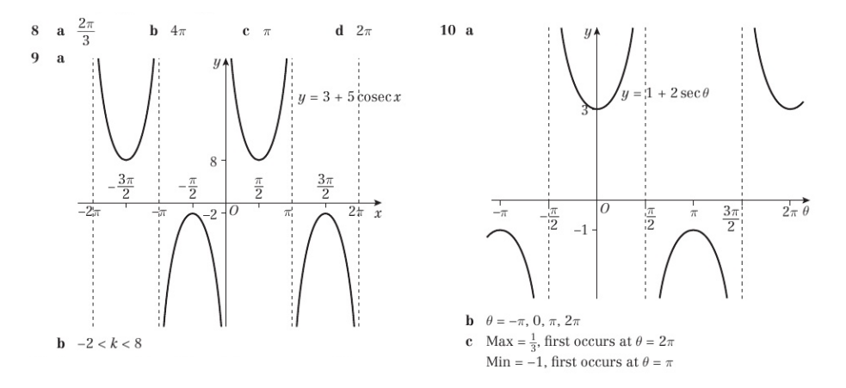
Homework Answers

