Slide 1
M2 Chapter 4: Moments Turning Forces

Slide 2

Motivating problem
This… is a door.
Why do you think the handle is put on the other side of the door from the hinge?
Increasing the distance of the force applied from the point of rotation increases the ‘turning effect’ of the force.
If I double the distance of my finger from the hinge, what happens to the force required to keep the door open?
As the distance doubles, the force required halves (we’ll see why).
?
?

Slide 3




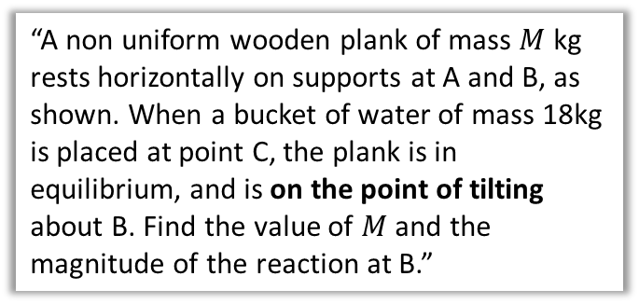




Rigid Bodies and Overview
$$R$$
$$T$$
We previously dealt with particles, where each object was modelled just as a single point, and considered forces acting on each point separately.
Body rotating about pivot.
$$mg$$
$$mg$$
In this chapter we consider rigid bodies (in this case rods), which takes into account the size of the object.
This means we can consider other properties, e.g. rotation of the body.
1:: Moments in equilibrium
Clockwise moment = Anticlockwise moment
2:: Centre of Mass
3:: On the point of Tilting
For a ‘non-uniform’ rod we can’t model its weight as acting at the centre.
“A non uniform wooden plank of mass $M$ kg rests horizontally on supports at A and B, as shown. When a bucket of water of mass 18kg is placed at point C, the plank is in equilibrium, and is on the point of tilting about B. Find the value of $M$ and the magnitude of the reaction at B.”
$$R_{1}$$
$$R_{2}$$
$x$?
$$mg$$

Slide 4



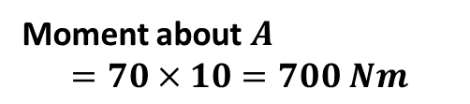
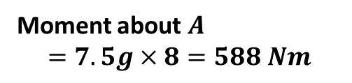
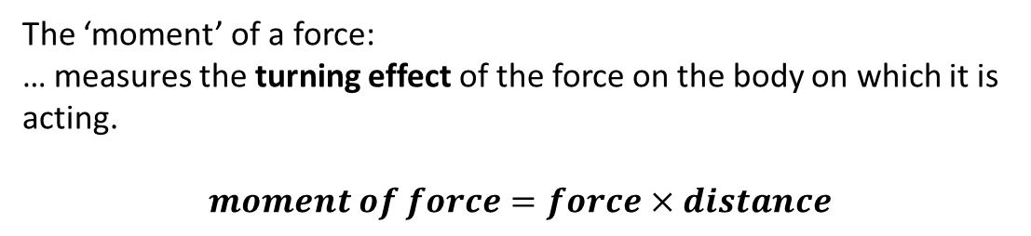

Moments
!
The ‘moment’ of a force:
… measures the turning effect of the force on the body on which it is acting.
$$moment of force=force×distance$$
?
about a point
perpendicular distance
Notice that the measured distance is perpendicular to the force being considered.
Big Kat has a mass of 7.5kg.
10m
8m
$$A$$
?
70 N
$$7.5g$$
Moment about $A$
$$=70×10=700 Nm$$
Moment about $A$
$$=7.5g×8=588 Nm$$
?
?
The anticlockwise moment is greater, so the seesaw will tilt in an anticlockwise direction.

Slide 5


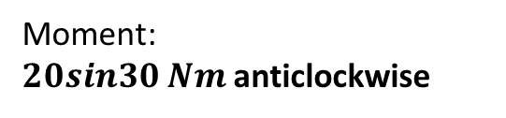



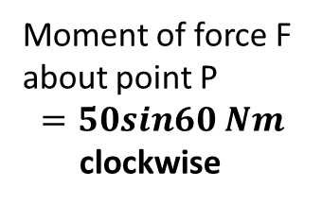

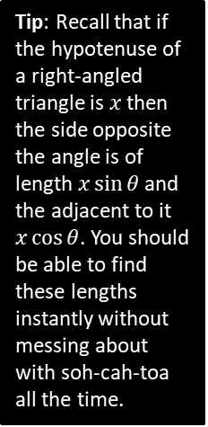






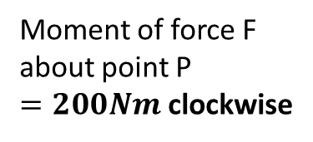

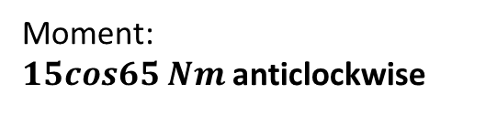






Quickfire Examples
1
$$F=20N$$
2
3
$$10N$$
$$F=20N$$
$$10m$$
$$5m$$
$$60°$$
We see what force is acting perpendicularly.
$$P$$
$$P$$
$$5sin60$$
$$P$$
Moment of force F about point P
$$=50sin60 Nm$$
clockwise
Tip: Recall that if the hypotenuse of a right-angled triangle is $x$ then the side opposite the angle is of length $x\sin{θ}$ and the adjacent to it $x\cos{θ}$. You should be able to find these lengths instantly without messing about with soh-cah-toa all the time.
Moment of force F about point P
$=200Nm$ clockwise
Moment of force F about point P
$$=0Nm$$
There is no ‘turning’ effect.
?
?
?
4
5
$$10N$$
$$5N$$
$$30°$$
$$2m$$
$$3m$$
$$65°$$
$$P$$
$$P$$
Moment:
$20sin30 Nm$anticlockwise
Moment:
$15cos65 Nm$anticlockwise
?
?

Slide 6



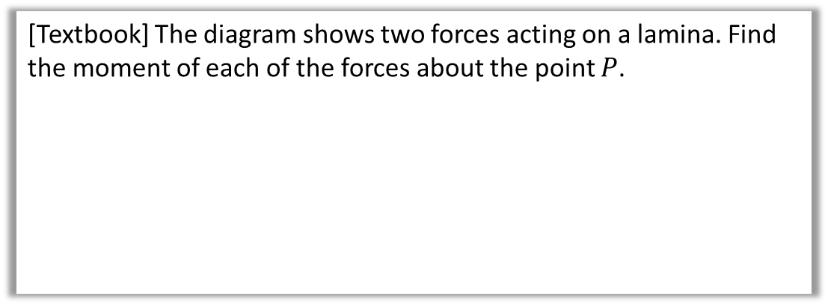



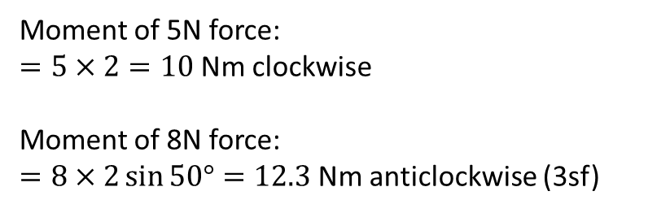
Test Your Understanding
[Textbook] The diagram shows two forces acting on a lamina. Find the moment of each of the forces about the point $P$.
$$5N$$
$2$m
$$P$$
$$8N$$
$2$m
$$50°$$
Terminology: A lamina is a flat 2D object whose thickness can be ignored.
Moment of 5N force:
$=5×2=10$Nm clockwise
Moment of 8N force:
$=8×2\sin{50°}=12.3$Nm anticlockwise (3sf)
?
?

Slide 7
Exercise 4.1
Pearson Stats/Mechanics Year 2
Page 33-34

Slide 8
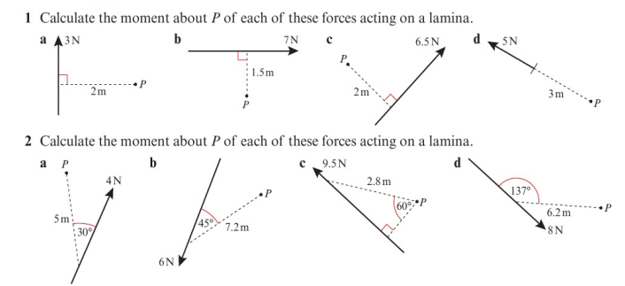
Homework Exercise

Slide 9
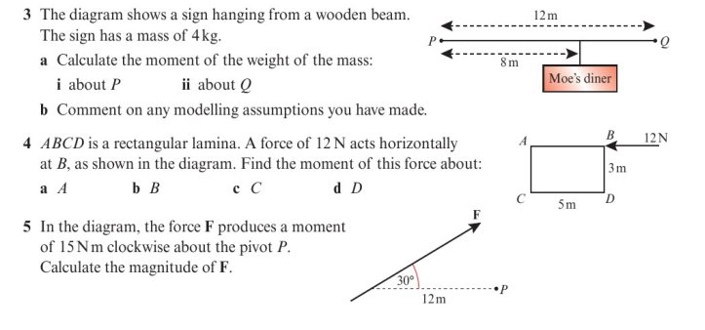
Homework Exercise

Slide 10
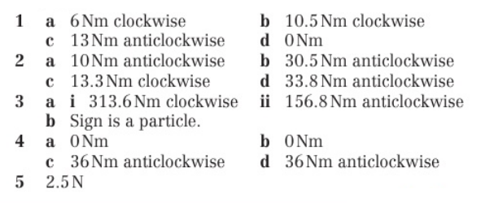
Homework Answers

