Slide 1
Stats1 Chapter 7: Hypothesis Testing Critical Values

Slide 2

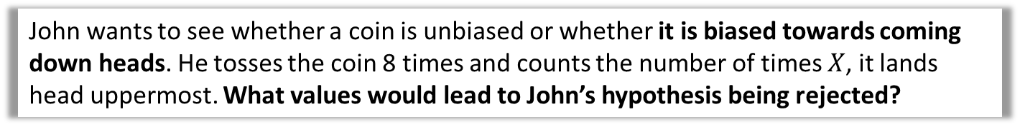
Critical Regions and Values
John wants to see whether a coin is unbiased or whether it is biased towards coming down heads. He tosses the coin 8 times and counts the number of times $X$, it lands head uppermost. What values would lead to John’s hypothesis being rejected?
As before, we’re interested how likely a given outcome is likely to happen ‘just by chance’ under the null hypothesis (i.e. when the coin is not biased).
However, there are values which collectively form a range of ‘extreme values’ where it would be unlikely that the coin would be unbiased. Their combined probability is limited by the level of significance set (e.g. 5%)
The probability of getting exactly 5 heads is only 22%, which is more likely to not happen than to happen. If we saw this number of heads, why would it not be sensible to think the coin is biased?
The probability is only low because there’s lots of possible outcomes. But 5 heads forms part of a range of possible number of heads that collectively would be consistent with a coin not biased towards heads.
?
Prob under $H_{0}$
0 1 2 3 4 5 6 7 8
Num heads

Slide 3

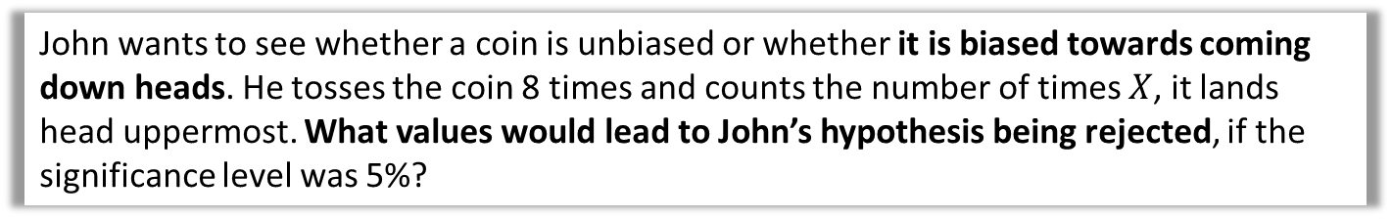
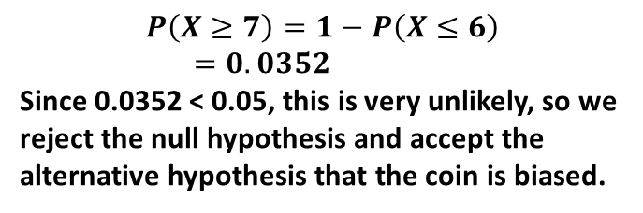
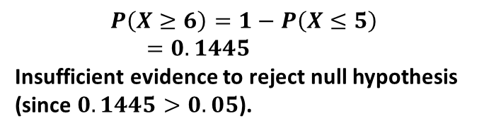
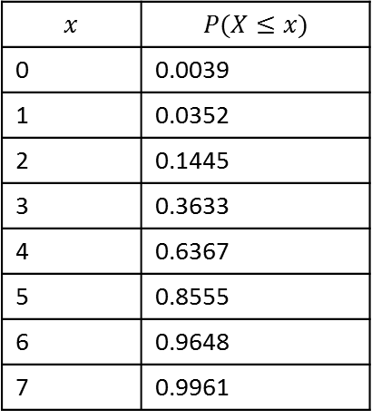
Critical Regions and Values
John wants to see whether a coin is unbiased or whether it is biased towards coming down heads. He tosses the coin 8 times and counts the number of times $X$, it lands head uppermost. What values would lead to John’s hypothesis being rejected, if the significance level was 5%?
What’s the probability that we would see 6 heads, or an even more extreme value? Is this sufficiently unlikely to support John’s claim that the coin is biased?
C.D.F. Binomial table:
$$p=0.5, n=8$$
$$x$$ | $$P(X≤x)$$
0 | 0.0039
1 | 0.0352
2 | 0.1445
3 | 0.3633
4 | 0.6367
5 | 0.8555
6 | 0.9648
7 | 0.9961
$$P\left(X≥6\right)=1−P\left(X≤5\right) \\ =0.1445$$
Insufficient evidence to reject null hypothesis (since $0.1445>0.05$).
?
What’s the probability that we would see 7 heads, or an even more extreme value?
?
$$P\left(X≥7\right)=1−P\left(X≤6\right) \\ =0.0352$$
Since 0.0352 < 0.05, this is very unlikely, so we reject the null hypothesis and accept the alternative hypothesis that the coin is biased.

Slide 4
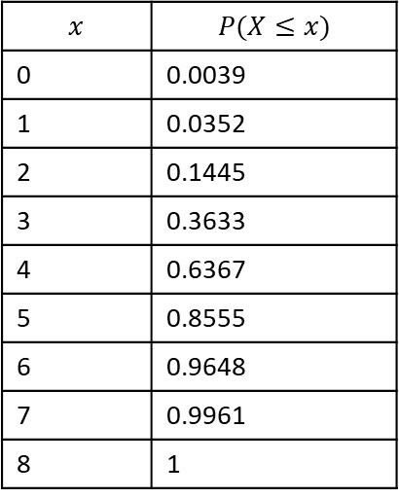
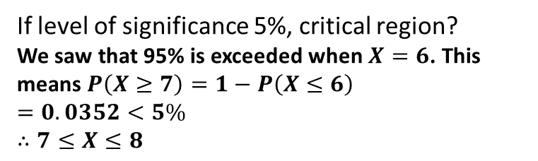

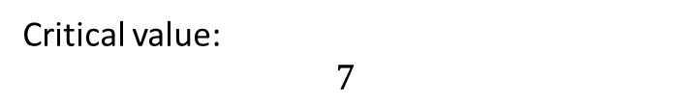
Critical Regions and Values
John wants to see whether a coin is unbiased or whether it is biased towards coming down heads. He tosses the coin 8 times and counts the number of times $X$, it lands head uppermost. What values would lead to John’s hypothesis being rejected, if the significance level was 5%?
! The critical region is the range of values of the test statistic that would lead to you rejecting $H_{0}$
C.D.F. Binomial table:
$$p=0.5, n=8$$
?
$$x$$ | $$P(X≤x)$$
0 | 0.0039
1 | 0.0352
2 | 0.1445
3 | 0.3633
4 | 0.6367
5 | 0.8555
6 | 0.9648
7 | 0.9961
8 | 1
If level of significance 5%, critical region?
We saw that 95% is exceeded when $X=6$. This means $P\left(X≥7\right)=1−P\left(X≤6\right)$ $=0.0352<5\%$
$$∴7≤X≤8$$
Fro Tip: Use the first value AFTER the one in the table that exceeds 95%.
! The value(s) on the boundary of the critical region are called critical value(s).
Critical value:
$$7$$
?

Slide 5

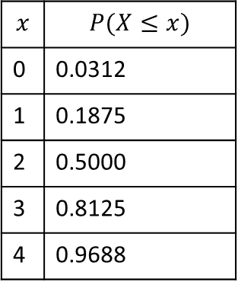

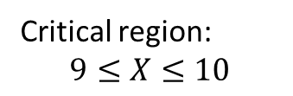

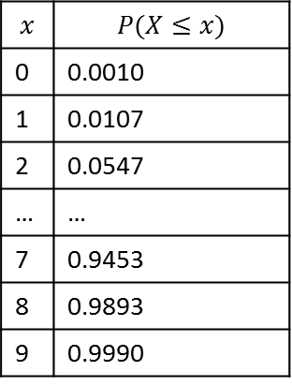
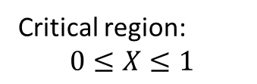
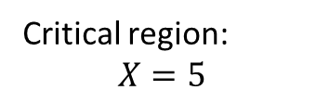
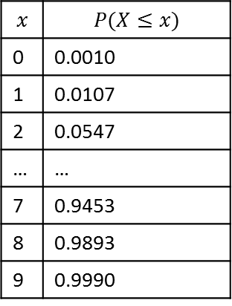
Quickfire Critical Regions
Determine the critical region when we throw a coin where we’re trying to establish if there’s the specified bias, given the specified number of throws, when the level of significance is 5%.
Coin thrown 5 times. Trying to establish if biased towards heads.
Coin thrown 10 times. Trying to establish if biased towards heads.
Coin thrown 10 times. Trying to establish if biased towards tails.
Fro Reminder: At the positive tail, use the value AFTER the first that exceeds 95% (100 - 5).
$$p=0.5, n=5$$
$$p=0.5, n=10$$
$$p=0.5, n=10$$
$$x$$ | $$P(X≤x)$$
0 | 0.0312
1 | 0.1875
2 | 0.5000
3 | 0.8125
4 | 0.9688
$$x$$ | $$P(X≤x)$$
0 | 0.0010
1 | 0.0107
2 | 0.0547
… | …
7 | 0.9453
8 | 0.9893
9 | 0.9990
$$x$$ | $$P(X≤x)$$
0 | 0.0010
1 | 0.0107
2 | 0.0547
… | …
7 | 0.9453
8 | 0.9893
9 | 0.9990
At the negative tail, we just use the first value that goes under the significance level.
Critical region:
$$X=5$$
Critical region:
$$9≤X≤10$$
Critical region:
$$0≤X≤1$$
?
?
?

Slide 6

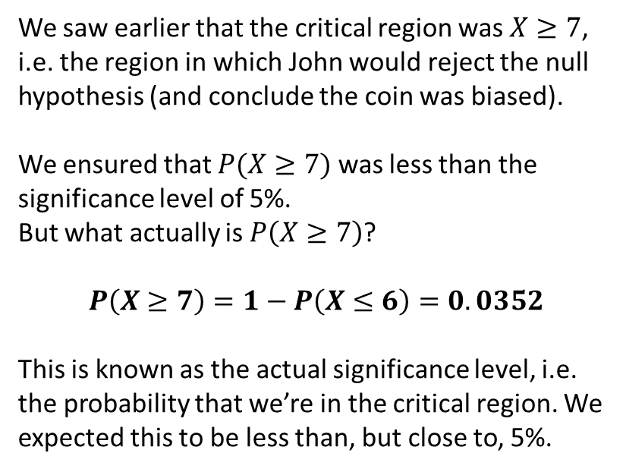
Actual Significance Level
John wants to see whether a coin is unbiased or whether it is biased towards coming down heads. He tosses the coin 8 times and counts the number of times $X$, it lands head uppermost. What values would lead to John’s hypothesis being rejected, if the significance level was 5%?
We saw earlier that the critical region was $X≥7$, i.e. the region in which John would reject the null hypothesis (and conclude the coin was biased).
We ensured that $P(X≥7)$ was less than the significance level of 5%.
But what actually is $P\left(X≥7\right)$?
$$P\left(X≥7\right)=1−P\left(X≤6\right)=0.0352$$
This is known as the actual significance level, i.e. the probability that we’re in the critical region. We expected this to be less than, but close to, 5%.
C.D.F. Binomial table:
$$p=0.5, n=8$$
$$x$$ | $$P(X≤x)$$
0 | 0.0039
1 | 0.0352
2 | 0.1445
3 | 0.3633
4 | 0.6367
5 | 0.8555
6 | 0.9648
7 | 0.9961
8 | 1
?
! The actual significance level is the actual probability of being in the critical region.

Slide 7



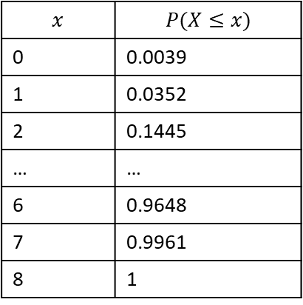
Two-tailed test
Critical region
Acceptance region
Critical region
Suppose I threw a coin 8 times and was now interested in how may heads would suggest it was a biased coin (i.e. either way!). How do we work out the critical values now, with 5% significance?
We split the 5% so there’s 2.5% at either tail, then proceed as normal:
Prob under $H_{0}$
?
0 1 2 3 4 5 6 7 8
Num heads
C.D.F. Binomial table:
$$p=0.5, n=8$$
Critical region at positive tail:
Look at closest value above 0.975 (then go one above):
$$X=8$$
Critical region at negative tail:
Look at closest value below 0.025.
$$X=0$$
?
$$x$$ | $$P(X≤x)$$
0 | 0.0039
1 | 0.0352
2 | 0.1445
… | …
6 | 0.9648
7 | 0.9961
8 | 1
?

Slide 8
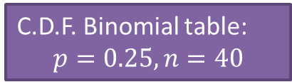

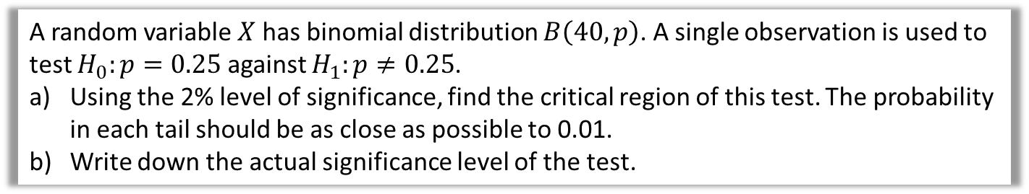
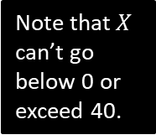

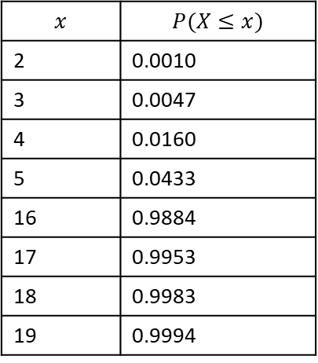
Test Your Understanding
A random variable $X$ has binomial distribution $B\left(40,p\right)$. A single observation is used to test $H_{0}:p=0.25$ against $H_{1}:p≠0.25$.
Using the 2% level of significance, find the critical region of this test. The probability in each tail should be as close as possible to 0.01.
Write down the actual significance level of the test.
The $≠$ indicates bias either way, i.e. two-tailed.
This means you find the closest to 0.01 (even if slightly above) rather than the closest under 0.01
a
?
To ensure all method marks always show the probability of being in the critical region (even if you don’t subsequently need the value!)
(Half of 0.02 is 0.01)
$$P\left(X≤3\right)=0.0047$$
$$0≤X≤3$$
$$P\left(X≥17\right)=1−P\left(X≤16\right)=0.0116$$
$$17≤X≤40$$
Critical region is $0≤X≤3$ or $17≤X≤40$
$$0.0047+0.0116=0.0163=1.63\%$$
C.D.F. Binomial table:
$$p=0.25, n=40$$
$$x$$ | $$P(X≤x)$$
2 | 0.0010
3 | 0.0047
4 | 0.0160
5 | 0.0433
16 | 0.9884
17 | 0.9953
18 | 0.9983
19 | 0.9994
Note that $X$ can’t go below 0 or exceed 40.
b
?
Warning: Textbook has several typos in this example.

Slide 9
Exercise 7.2
Pearson Applied Year 1/AS
Pages 46-47

Slide 10
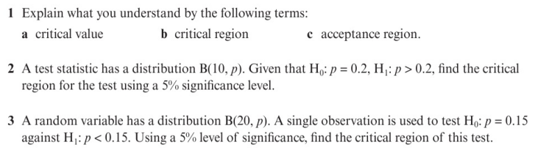
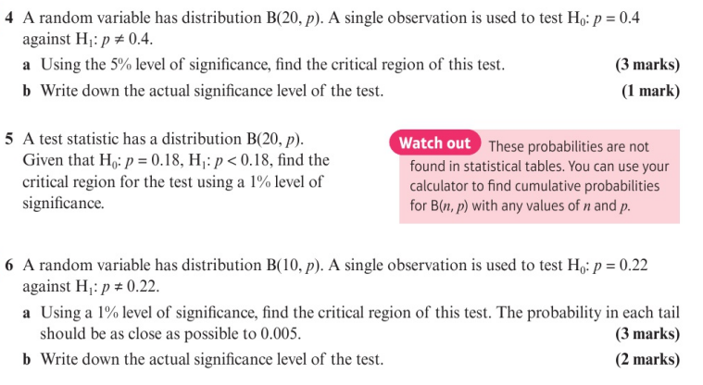
Homework Exercise

Slide 11
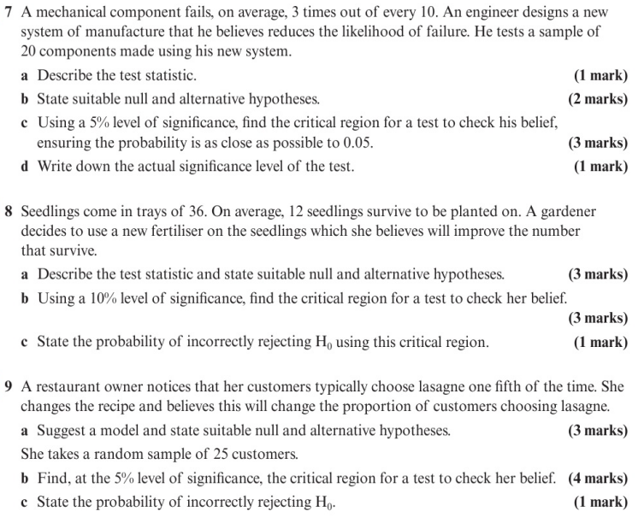
Homework Exercise

Slide 12
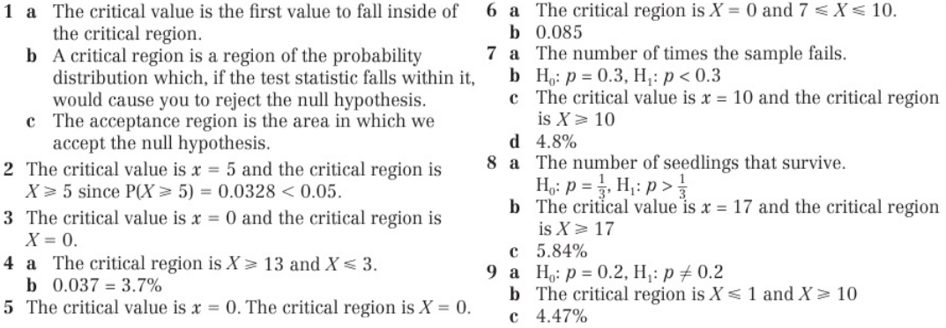
Homework Answers

