Slide 1
M2 Chapter 7: Application of Forces Further Connected Particles

Slide 2





















Connected particles involving friction
We have already encountered problems involving connected particles in Mechanics Year 1. We just now throw friction into the mix.
[Textbook] Two particles $P$ and $Q$ of masses 5kg and 10kg respectively are connected by a light inextensible string. The string passes over a small smooth pulley which is fixed at the top of a rough inclined plane. $P$ rests on the inclined plane and $Q$ hangs on the edge of the plane with the string vertical and taut. The plane is inclined to the horizontal at an angle $α$ where $\tan{α}=0.75$, as shown in the diagram. The coefficient of friction between $P$ and the plane is 0.2. The system is released from rest.
Find the acceleration of the system.
Find the tension in the string.
$$P$$
5kg
$$Q$$
10kg
$$α$$
$$\sin{α}=\frac{3}{5}, \cos{α}=\frac{4}{5}$$
For $P$:
$$R\left(↖\right): N=5g\cos{α} \\ N=5g×\frac{4}{5}=4g \\ R\left(↗\right):T−5g\sin{α}−0.2N=5a \\ T−3.8g=5a (1)$$
At $Q$: $R\left(↓\right)$: $10g−T=10a (2)$
Adding $(1)$ and $(2)$: $6.2g=15a → a=\frac{31g}{75}=4.1 ms^{−2}$
Rearranging $(1)$:
$$T=5a+3.8g=57 N (2sf)$$
a
?
? Diagram
5
$$a$$
$$5$$
3
$$3$$
$$N$$
$$a$$
$$α$$
$$T$$
4
$$P$$
5kg
$$T$$
$$4$$
$$0.2R$$
$$mg\cos{α}$$
10kg
$$Q$$
$$mg\sin{α}$$
$$mg$$
$$α$$
$$α$$
$$10g$$
b
?

Slide 3




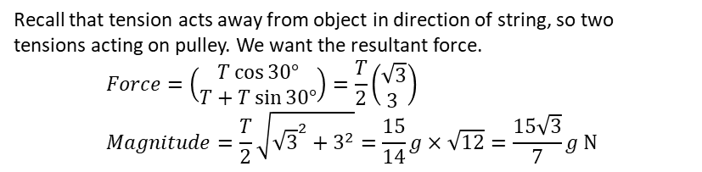



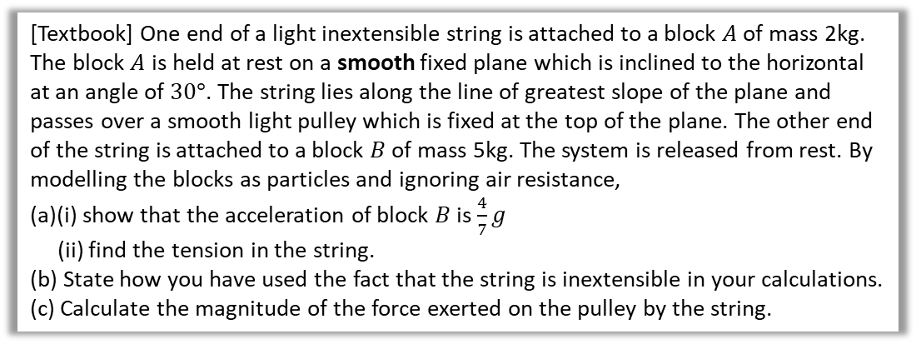









Further Example
[Textbook] One end of a light inextensible string is attached to a block $A$ of mass 2kg. The block $A$ is held at rest on a smooth fixed plane which is inclined to the horizontal at an angle of $30°$. The string lies along the line of greatest slope of the plane and passes over a smooth light pulley which is fixed at the top of the plane. The other end of the string is attached to a block $B$ of mass 5kg. The system is released from rest. By modelling the blocks as particles and ignoring air resistance,
(a)(i) show that the acceleration of block $B$ is $\frac{4}{7}g$
(ii) find the tension in the string.
(b) State how you have used the fact that the string is inextensible in your calculations.
(c) Calculate the magnitude of the force exerted on the pulley by the string.
$$A$$
2kg
$$B$$
5kg
$$30°$$
$$a$$
For $A$: $R\left(↗\right): T−2g\sin{30°}=2a$ $$T=2a+g (1)$$
For $B$: $R\left(↓\right)$: $5g−T=5a (2)$
Adding $(1)$ and $(2)$: $5g=7a+g → a=\frac{4}{7}g$
$$T=2a+g=\frac{8}{7}g+g=\frac{15}{7}g$$
String is inextensible so acceleration at $A$ and $B$ the same.
? Diagram
a
?
$$N$$
$$T$$
$$a$$
$$A$$
2kg
$$T$$
$$mg\sin{30}$$
5kg
$$B$$
$$mg$$
$$α$$
$$30$$
$$5g$$
b
?
c
Recall that tension acts away from object in direction of string, so two tensions acting on pulley. We want the resultant force.
$$Force=\left(\begin{matrix}T\cos{30°} \\ T+T\sin{30°}\end{matrix}\right)=\frac{T}{2}\left(\begin{matrix}\sqrt{3} \\ 3 \end{matrix}\right) \\ Magnitude=\frac{T}{2}\sqrt{{\sqrt{3}}^{2}+3^{2}}=\frac{15}{14}g×\sqrt{12}=\frac{15\sqrt{3}}{7}g N$$
?
$$30°$$
We can consider left and down directions the positive ones to avoid negatives. $T$ is constant so can factor out.
$$T$$
$$T$$

Slide 4
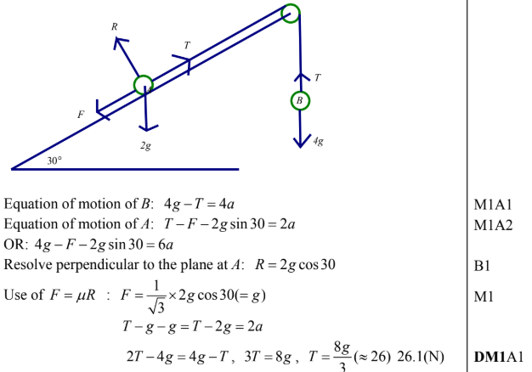
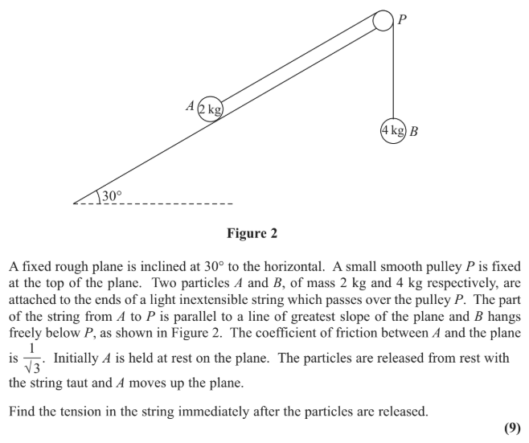
Test Your Understanding
?
Edexcel M1(Old) May 2013(R) Q3

Slide 5
Exercise 7.6
Pearson Stats/Mechanics Year 2
Pages 63-65

Slide 6
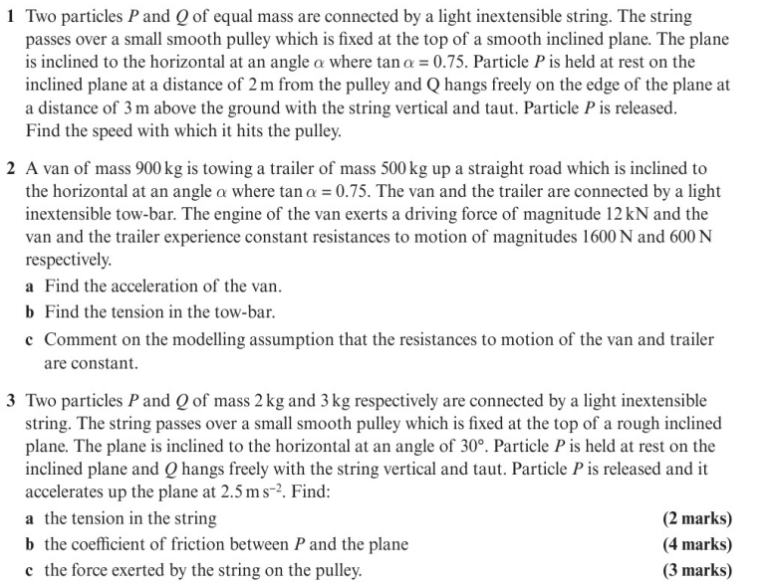
Homework Exercise

Slide 7
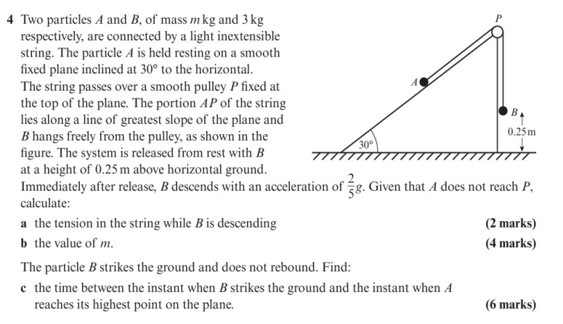
Homework Exercise

Slide 8
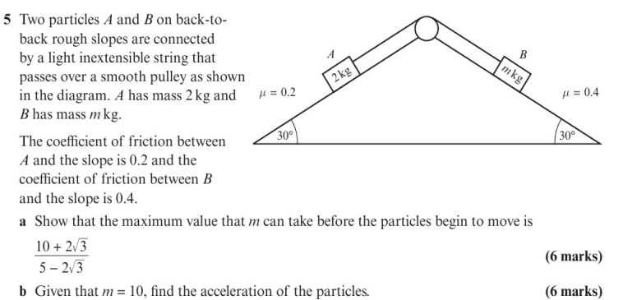
Homework Exercise

Slide 9
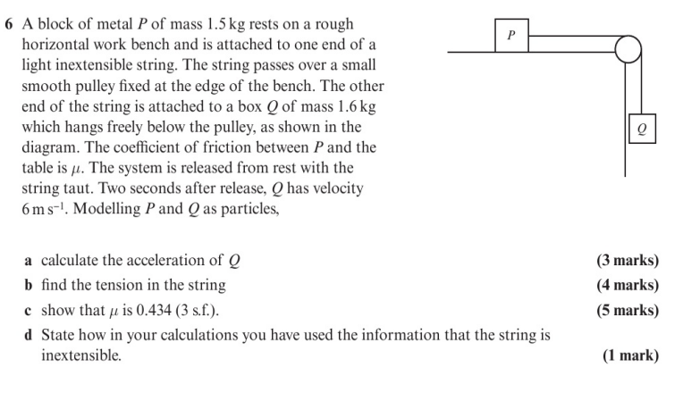
Homework Exercise

Slide 10
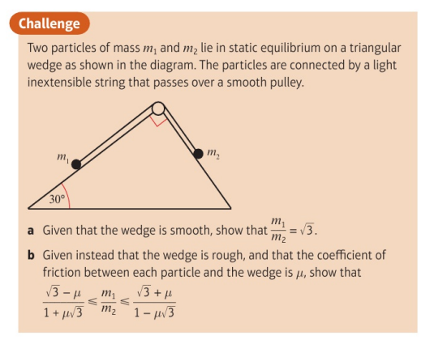
Homework Exercise

Slide 11
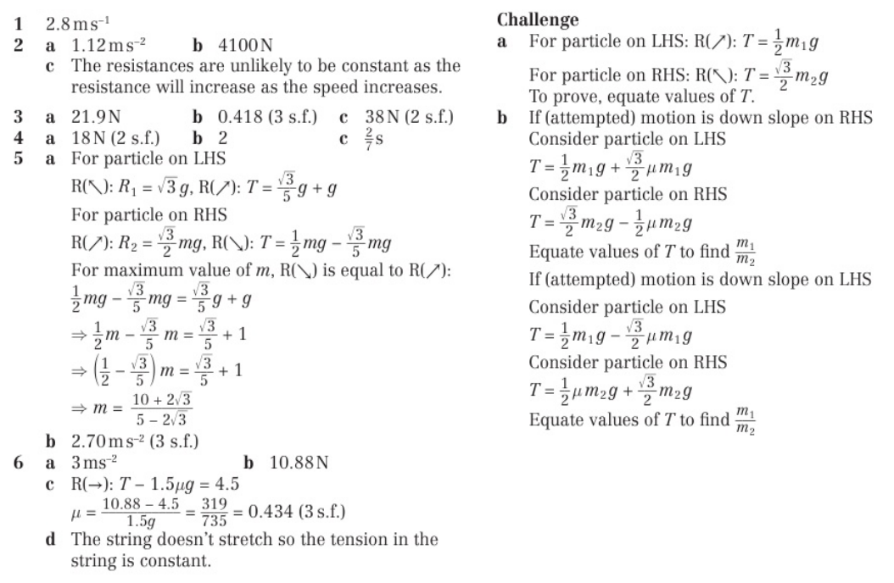
Homework Answers

