Slide 1
Stats1 Chapter 2: Measures of Data Central Tendency

Slide 2
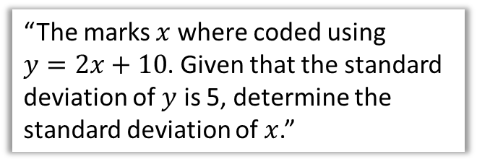
This Chapter Overview
This is identical to the equivalent chapter in the old S1 module. Some content will be familiar from GCSE (mean of grouped/ungrouped data), but many concepts new (e.g. standard deviation) along with possibly unfamiliar notation.
1:: Mean, Median, Mode
2:: Quartiles, Percentiles, Deciles
“Calculate the mean of this grouped frequency table.”
“Use linear interpolation to estimate the interquartile range.”
4:: Coding
3:: Variance & Standard Deviation
“The marks $x$ where coded using $y=2x+10$. Given that the standard deviation of $y$ is 5, determine the standard deviation of $x$.”
“Calculate the standard deviation of the maths marks.”

Slide 3
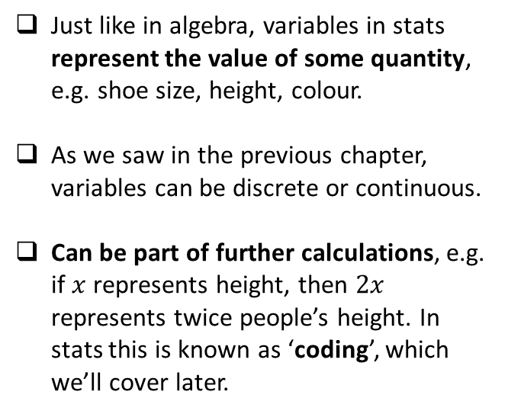
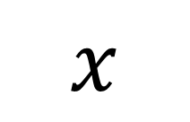
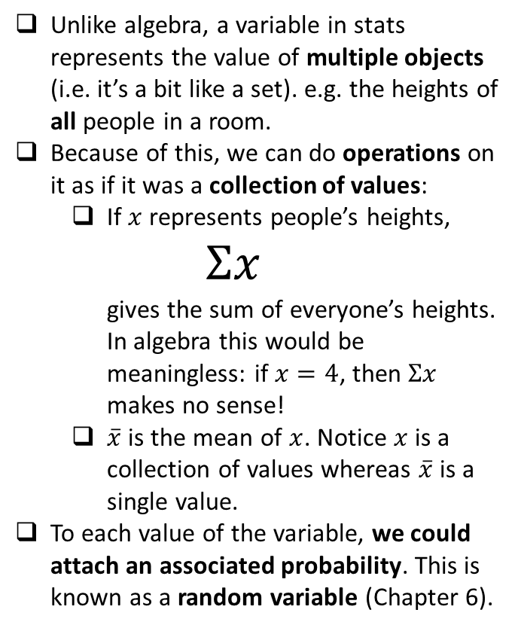
Variables in algebra vs stats
$$x$$
Similarities
Differences
Just like in algebra, variables in stats represent the value of some quantity, e.g. shoe size, height, colour.
As we saw in the previous chapter, variables can be discrete or continuous.
Can be part of further calculations, e.g. if $x$ represents height, then $2x$ represents twice people’s height. In stats this is known as ‘coding’, which we’ll cover later.
Unlike algebra, a variable in stats represents the value of multiple objects (i.e. it’s a bit like a set). e.g. the heights of all people in a room.
Because of this, we can do operations on it as if it was a collection of values:
If $x$ represents people’s heights, $Σx$ gives the sum of everyone’s heights. In algebra this would be meaningless: if $x=4$, then $Σx$ makes no sense!
$\overline{x}$ is the mean of $x$. Notice $x$ is a collection of values whereas $\overline{x}$ is a single value.
To each value of the variable, we could attach an associated probability. This is known as a random variable (Chapter 6).

Slide 4
Measures of …
Measures of Location
Measures of Spread
Range
Standard Deviation
Measures of Central Tendency
Maximum
Median
Minimum
Mode
Quartiles
Interquartile Range
Mean
Percentiles
Variance
Deciles
Measures of location are single values which describe a position in a data set.
Of these, measures of central tendency are to do with the centre of the data, i.e. a notion of ‘average’.
Measures of spread are to do with how data is spread out.

Slide 5
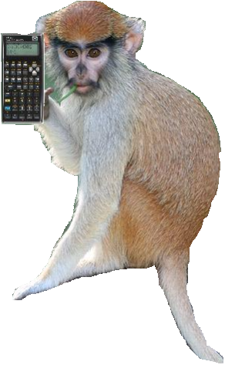
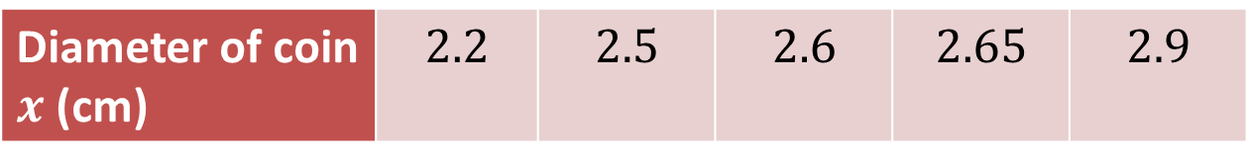

Mean of ungrouped data
Diameter of coin $x$ (cm) | $$2.2$$ | $$2.5$$ | $$2.6$$ | $$2.65$$ | $$2.9$$
You all know how to find the mean of a list of values. But lets consider the notation, and see how theoretically we could calculate each of the individual components on a calculator.
$$\overline{x}=\frac{Σx}{n}$$
?
?
The ‘overbar’ in stats specifically means ‘the sample mean of’, but don’t worry about the ‘sample’ bit for now.
“Use of Technology” Monkey says:
Time to whip out yer Casios…

Slide 6







Inputting Data
Diameter of coin $x$ (cm) | $$2.2$$ | $$2.5$$ | $$2.6$$ | $$2.65$$ | $$2.9$$
Use the MENU button to access STATS mode.
On older black/silver Casios:
Select 1-VAR meaning “1 variable”.
Enter each value above, pressing = after each entry.
Press AC to start a statistical calculation.
Use SHIFT $→$ 1 to access statistical symbols, e.g. $\overline{x}$, to insert into your calculation. Press = to evaluate when done.
On a Classwiz:
Select 1-Variable.
Enter each value above, pressing = after each entry.
Press AC to start a statistical calculation.
Press the OPTN button. “1-Variable Calc” will calculate all common statistics (including all on the left). Alternatively you can construct a statistical expression yourself – in the OPTN menu press Down. “Variable” for example contains $\overline{x}$. This will insert it into your calculation; press = when done.
?
$$n =5$$
$$Σx /n =2.57$$
?
?
$$3\overline{x}+1 =8.71$$
?
$$Σx =12.85$$
?
$$\overline{x} =2.57$$

Slide 7

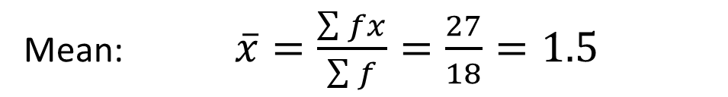
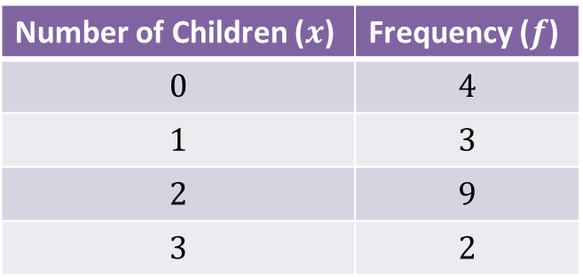
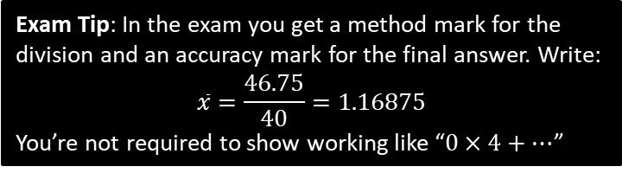
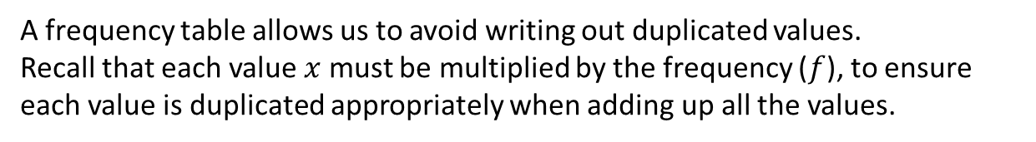
Frequency Tables (ungrouped data)
Number of Children ($x$) | Frequency ($f$)
$$0$$ | $$4$$
$$1$$ | $$3$$
$$2$$ | $$9$$
$$3$$ | $$2$$
A frequency table allows us to avoid writing out duplicated values.
Recall that each value $x$ must be multiplied by the frequency ($f$), to ensure each value is duplicated appropriately when adding up all the values.
Mean: $\overline{x}=\frac{\sum{fx}}{\sum{f}}=\frac{27}{18}=1.5$
?
?
?
Exam Tip: In the exam you get a method mark for the division and an accuracy mark for the final answer. Write:
$$\overline{x}=\frac{46.75}{40}=1.16875$$
You’re not required to show working like “$0×4+…$”

Slide 8
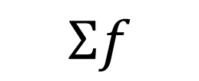
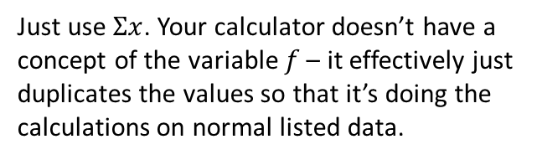
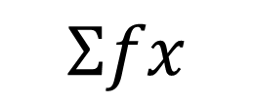
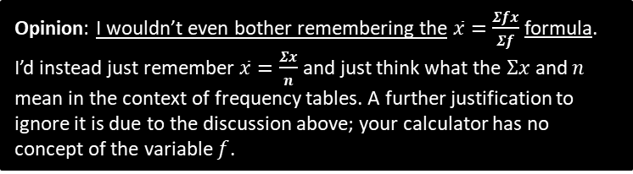
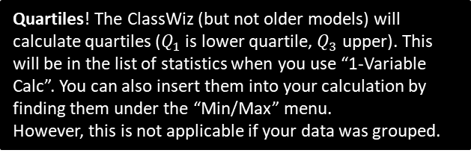
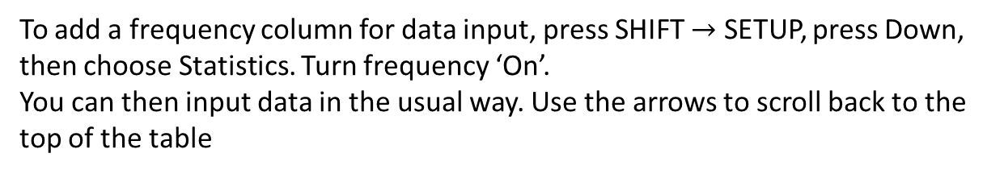

Doing it in STATS mode
Number of Children ($x$) | Frequency ($f$)
$$0$$ | $$4$$
$$1$$ | $$3$$
$$2$$ | $$9$$
$$3$$ | $$2$$
To add a frequency column for data input, press SHIFT $→$ SETUP, press Down, then choose Statistics. Turn frequency ‘On’.
You can then input data in the usual way. Use the arrows to scroll back to the top of the table
?
Just use $Σx$. Your calculator doesn’t have a concept of the variable $f$ – it effectively just duplicates the values so that it’s doing the calculations on normal listed data.
$$Σfx$$
How on the calculator would we get…
$$Σf$$
?
This is $n$. (Since $n=Σf$)
Opinion: I wouldn’t even bother remembering the $\overline{x}=\frac{Σfx}{Σf}$ formula. I’d instead just remember $\overline{x}=\frac{Σx}{n}$ and just think what the $Σx$ and $n$ mean in the context of frequency tables. A further justification to ignore it is due to the discussion above; your calculator has no concept of the variable $f$.
Quartiles! The ClassWiz (but not older models) will calculate quartiles ($Q_{1}$ is lower quartile, $Q_{3}$ upper). This will be in the list of statistics when you use “1-Variable Calc”. You can also insert them into your calculation by finding them under the “Min/Max” menu.
However, this is not applicable if your data was grouped.

Slide 9
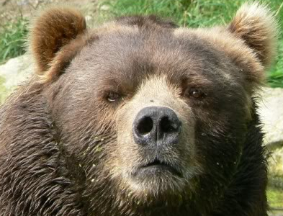
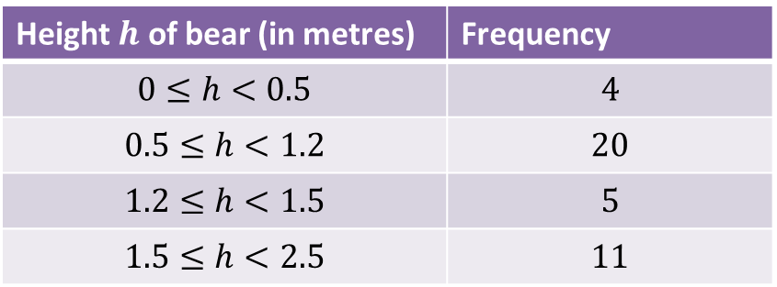

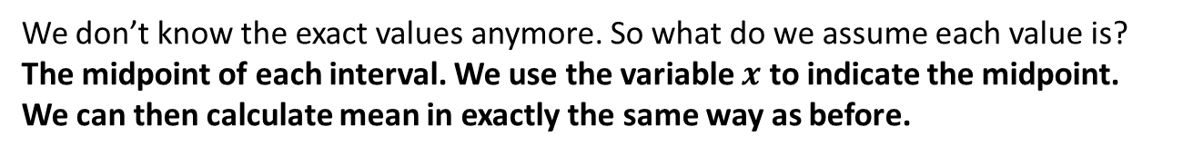
Grouped Data
Height $h$ of bear (in metres) | Frequency
$$0≤h<0.5$$ | $$4$$
$$0.5≤h<1.2$$ | $$20$$
$$1.2≤h<1.5$$ | $$5$$
$$1.5≤h<2.5$$ | $$11$$
We don’t know the exact values anymore. So what do we assume each value is?
The midpoint of each interval. We use the variable $x$ to indicate the midpoint.
We can then calculate mean in exactly the same way as before.
?
Estimate of Mean: $\overline{x}=\frac{\sum{fx}}{\sum{f}}=\frac{46.75}{40}=1.17m$
?
?
?
?
Why is our mean just an estimate?
Because we don’t know the exact heights within each group. Grouping data loses information.
Warning: ClassWizs will calculate the lower and upper quartiles ($Q_{1}, Q_{3}$) along with the median. However, this is not applicable to grouped data: When you input your midpoints in the data input, your calculator doesn’t know these are midpoints – it just assumes for example that the first 4 bears did have a height of 0.25m. We need to take into account the class widths to estimate the median and quartiles (which we’ll see later), and your calculator cannot do this.

Slide 10
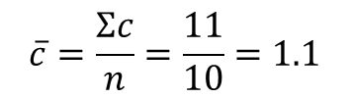

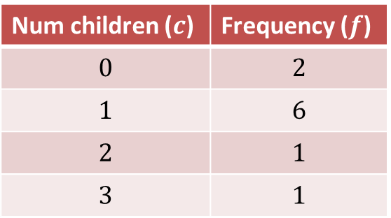
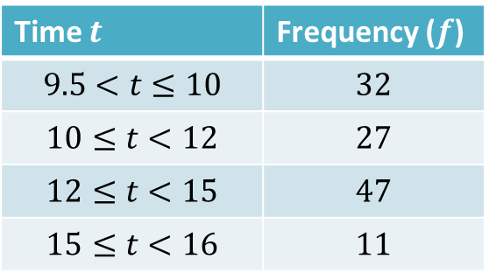
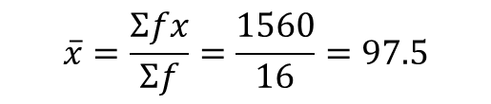
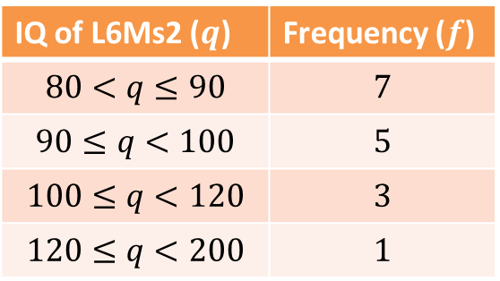
Mini-Exercise
Use your calculator’s STATS mode to determine the mean (or estimate of the mean).
Ensure that you show the division in your working.
1
Num children ($c$) | Frequency ($f$)
$$0$$ | $$2$$
$$1$$ | $$6$$
$$2$$ | $$1$$
$$3$$ | $$1$$
2
IQ of L6Ms2 ($q$) | Frequency ($f$)
$$80<q≤90$$ | $$7$$
$$90≤q<100$$ | $$5$$
$$100≤q<120$$ | $$3$$
$$120≤q<200$$ | $$1$$
?
?
$$\overline{c}=\frac{Σc}{n}=\frac{11}{10}=1.1$$
$$\overline{x}=\frac{Σfx}{Σf}=\frac{1560}{16}=97.5$$
Time $t$ | Frequency ($f$)
$$9.5<t≤10$$ | $$32$$
$$10≤t<12$$ | $$27$$
$$12≤t<15$$ | $$47$$
$$15≤t<16$$ | $$11$$
3
?
$\overline{x}=\frac{Σfx}{Σf}=\frac{1414}{117}=12.1$ to 3sf.

Slide 11
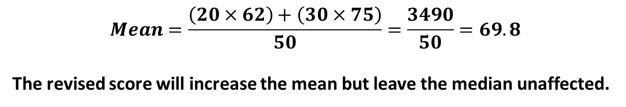
GCSE RECAP :: Combined Mean
This subtopic doesn’t appear in your textbook but has cropped up in exams.
The mean maths score of 20 pupils in class A is 62.
The mean maths score of 30 pupils in class B is 75.
What is the overall mean of all the pupils’ marks.
The teacher realises they mismarked one student’s paper; he should have received 100 instead of 95. Explain the effect on the mean and median.
?
$$Mean=\frac{\left(20×62\right)+\left(30×75\right)}{50}=\frac{3490}{50}=69.8$$
The revised score will increase the mean but leave the median unaffected.
Test Your Understanding
Archie the Archer competes in a competition with 50 rounds. He scored an average of 35 points in the first 10 rounds and an average of 25 in the remaining rounds. What was his average score per round?
$$Mean=\frac{\left(35×10\right)+\left(25×40\right)}{50}=27$$
?

Slide 12
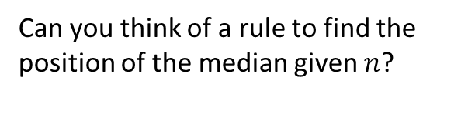

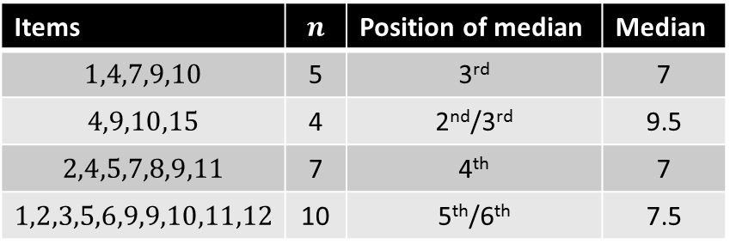
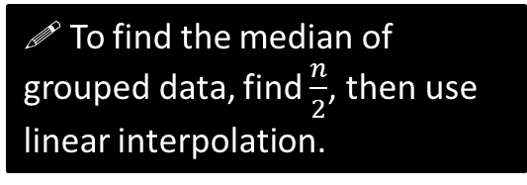
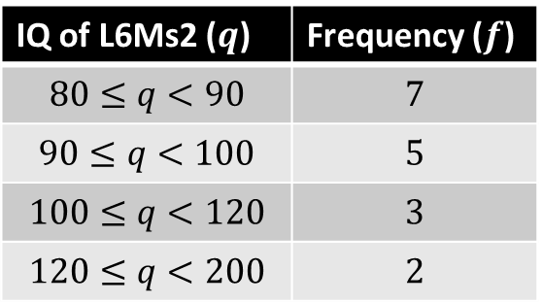
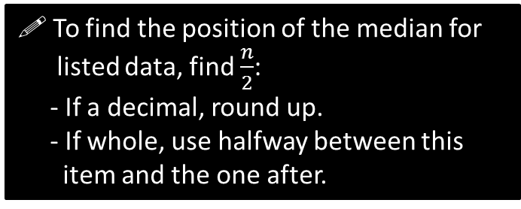
Median – which item?
You need to be able to find the median of both listed data and of grouped data.
Listed data
Grouped data
Items | $$n$$ | Position of median | Median
$$1,4,7,9,10$$ | 5 | 3rd | 7
$$4,9,10,15$$ | 4 | 2nd/3rd | 9.5
$$2,4,5,7,8,9,11$$ | 7 | 4th | 7
$$1,2,3,5,6,9,9,10,11,12$$ | 10 | 5th/6th | 7.5
IQ of L6Ms2 ($q$) | Frequency ($f$)
$$80≤q<90$$ | $$7$$
$$90≤q<100$$ | $$5$$
$$100≤q<120$$ | $$3$$
$$120≤q<200$$ | $$2$$
?
?
?
?
?
?
?
?
Can you think of a rule to find the position of the median given $n$?
Position to use for median:
8.5
?
! To find the position of the median for listed data, find $\frac{n}{2}$:
- If a decimal, round up.
- If whole, use halfway between this item and the one after.
?
! To find the median of grouped data, find $\frac{n}{2}$, then use linear interpolation.
DO NOT round $\frac{n}{2}$ or adjust it in any way. This is just like at GCSE where, if you had a cumulative frequency graph with 60 items, you’d look across the 30th. We’ll cover linear interpolation in a sec…

Slide 13
Exercises 2.1
Pearson Statistics & Mechanics Year 1/AS
Pages 8-9

Slide 14
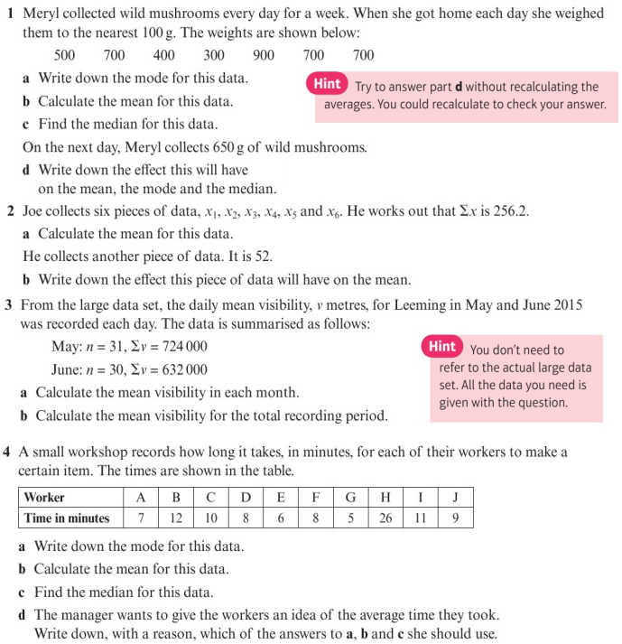
Homework Exercise

Slide 15
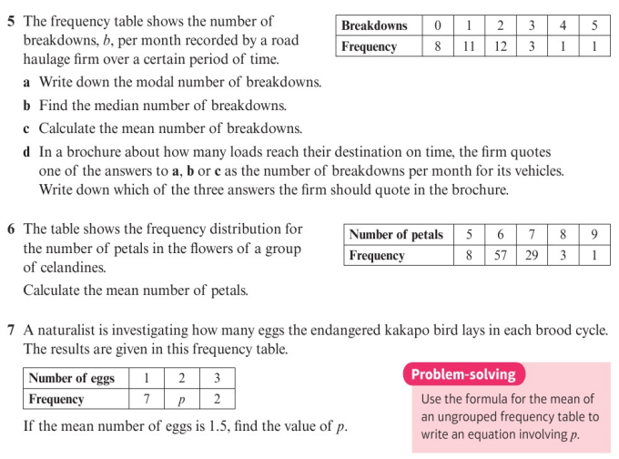
Homework Exercise

Slide 16
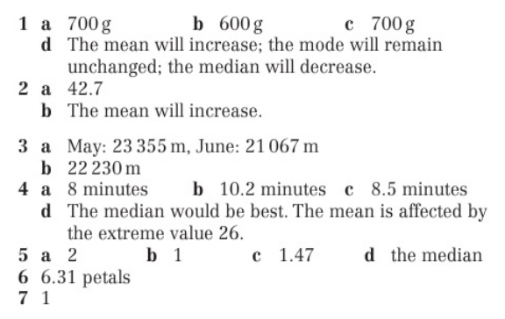
Homework Answers

