Slide 1
P2 Chapter 3: Sequences and Series
Geometric Sequences

Slide 2





Recap of Arithmetic vs Geometric Sequences
common difference $d$
?
+3
+3
+3
This is a:
2, 5, 8, 11, 14, …
?
Arithmetic Sequence
common ratio $r$
?
$$×2$$
$$×2$$
$$×2$$
3, 6, 12, 24, 48, …
?
Geometric Sequence
! A geometric sequence is one in which there is a common ratio between terms.

Slide 3















Quickfire Common Ratio
Identify the common ratio $r$:
$$r=2$$
1
$$1, 2, 4, 8, 16, 32, …$$
?
$$27, 18, 12, 8, …$$
$$r=2/3$$
2
?
$$10, 5, 2.5, 1.25, …$$
$$r=1/2$$
3
?
An alternating sequence is one which oscillates between positive and negative.
$$5, −5, 5, −5, 5, −5, …$$
$$r=−1$$
4
?
$$x, −2x^{2}, 4x^{3}$$
$$r=−2x$$
5
?
?
6
$$1, p, p^{2}, p^{3}, …$$
$$r=p$$
$$r=−0.25$$
7
$$4, −1, 0.25, −0.0625, …$$
?

Slide 4





$n$^{th} term
Arithmetic Sequence
Geometric Sequence
?
?
$$u_{n}=a+\left(n−1\right)d$$
$$u_{n}=ar^{n−1}$$
Determine the 10th and $n$^{th} terms of the following:
$$a=3, r=2 \\ u_{10}=3×2^{9}=1536 \\ u_{n}=3\left(2^{n−1}\right)$$
?
3, 6, 12, 24, …
$$a=40, r=−\frac{1}{2} \\ u_{10}=40×{\left(−\frac{1}{2}\right)}^{9}=−\frac{5}{64} \\ u_{n}={\left(−1\right)}^{n−1}×\frac{5}{2^{n−4}}$$
40, -20, 10, -5, …
?
Fro Tip: As before, write out $a=$ and $r=$ first before substituting.

Slide 5
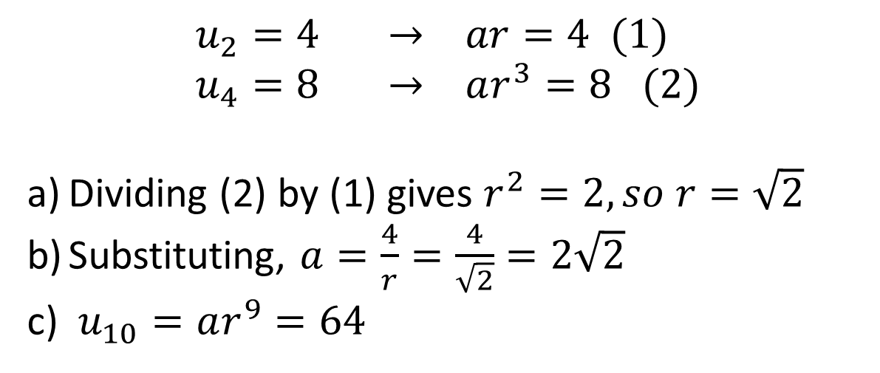
Further Example
[Textbook] The second term of a geometric sequence is 4 and the 4th term is 8. The common ratio is positive. Find the exact values of:
The common ratio.
The first term.
The 10th term.
?
$$u_{2}=4 → ar=4 (1) \\ u_{4}=8 → ar^{3}=8 (2)$$
Dividing (2) by (1) gives $r^{2}=2, so r=\sqrt{2}$
Substituting, $a=\frac{4}{r}=\frac{4}{\sqrt{2}}=2\sqrt{2}$
$u_{10}=ar^{9}=64$
Fro Tip: Explicitly writing $u_{2}=4$ first helps you avoid confusing the $n$^{th} term with the ‘sum of the first $n$ terms’ (the latter of which we’ll get onto).

Slide 6

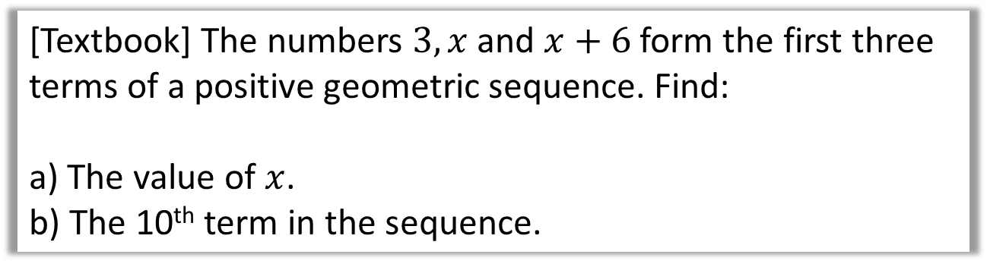

Further Example
[Textbook] The numbers $3, x$ and $x+6$ form the first three terms of a positive geometric sequence. Find:
a) The value of $x$.
b) The 10th term in the sequence.
Hint: You’re told it’s a geometric sequence, which means the ratio between successive terms must be the same. Consequently $\frac{u_{2}}{u_{1}}=\frac{u_{3}}{u_{2}}$
?
$$\frac{x}{3}=\frac{x+6}{x} → x^{2}=3x+18 \\ x^{2}−3x−18=0 \\ \left(x+3\right)\left(−6\right)=0$$
$$x=6 or −3$$
But there are no negative terms so $x=6$
$$r=\frac{x}{3}=\frac{6}{3}=2 a=3 n=10$$
$$u_{10}=3×2^{9}=1536$$
Exam Note: This kind of question has appeared in the exam multiple times.

Slide 7
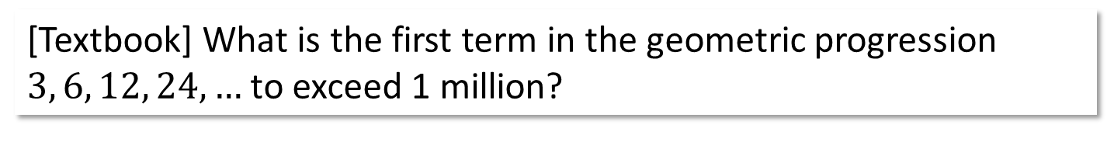

$n$^{th} term with inequalities
[Textbook] What is the first term in the geometric progression $3, 6, 12, 24, …$ to exceed 1 million?
$$u_{n}>1000000 a=3, r=2 \\ ∴ 3×2^{n−1}>1000000 \\ 2^{n−1}>\frac{1000000}{3} \\ \log{2^{n−1}>\log{\frac{1000000}{3}}} \\ n−1>\frac{\log\left(\frac{1000000}{3}\right)}{log2} \\ n−1>18.35 \\ n>19.35 \\ n=20$$
?

Slide 8
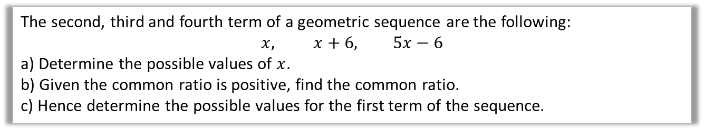



Test Your Understanding
All the terms in a geometric sequence are positive.
The third term of the sequence is 20 and the fifth term 80. What is the 20th term?
?
$$u_{3}=20 → ar^{2}=20 \\ u_{5}=80 → ar^{4}=80$$
Dividing: $r^{2}=4, ∴r=2$
$$a=\frac{20}{r^{2}}=\frac{20}{4}=5$$
$$u^{20}=5×2^{19}=2621440$$
The second, third and fourth term of a geometric sequence are the following:
$$x, x+6, 5x−6$$
a) Determine the possible values of $x$.
b) Given the common ratio is positive, find the common ratio.
c) Hence determine the possible values for the first term of the sequence.
?
$$\frac{x+6}{x}=\frac{5x−6}{x+6}$$
$${\left(x+6\right)}^{2}=x\left(5x−6\right) \\ x^{2}+12x+36=5x^{2}−6x \\ 4x^{2}−18x−36=0 \\ 2x^{2}−9x−18=0 \\ \left(2x+3\right)\left(x−6\right)$$
$$x=−\frac{3}{2} or x=6$$
$$r=\frac{x+6}{x}=\frac{6+6}{6}=2$$
$$u_{2}=x=6 \\ ar=6 \\ a=\frac{6}{2}=3$$

Slide 9
Exercise 3.3
Pearson Pure Mathematics Year 2/AS
Page 20

Slide 10
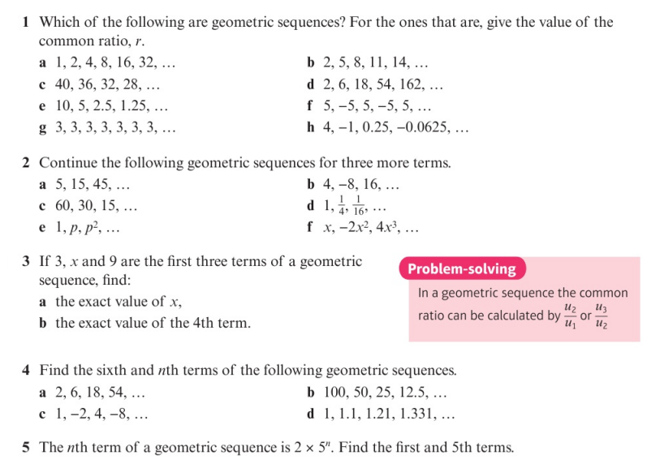
Homework Exercise

Slide 11
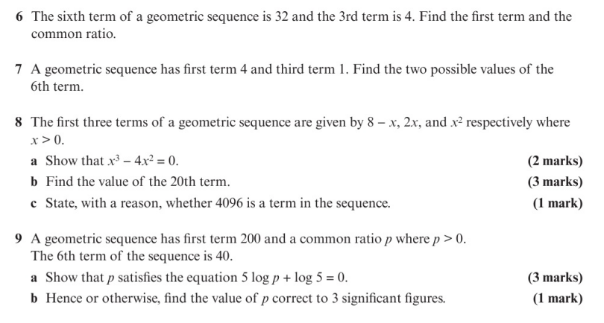
Homework Exercise

Slide 12
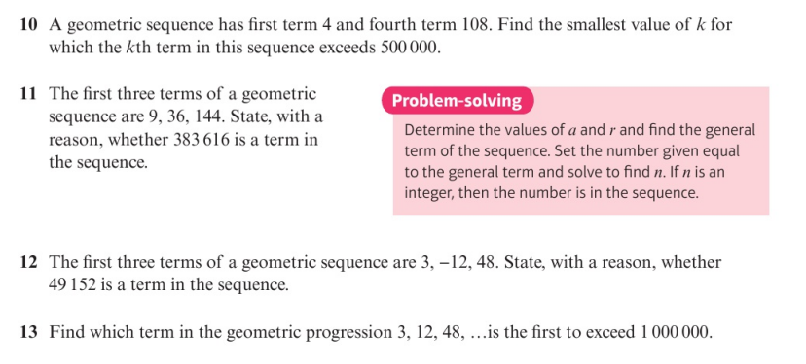
Homework Exercise

Slide 13
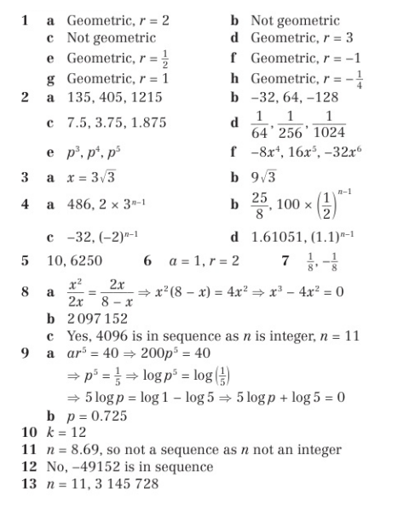
Homework Answers

