Slide 1
P2 Chapter 5: Radians
Chapter Practice

Slide 2
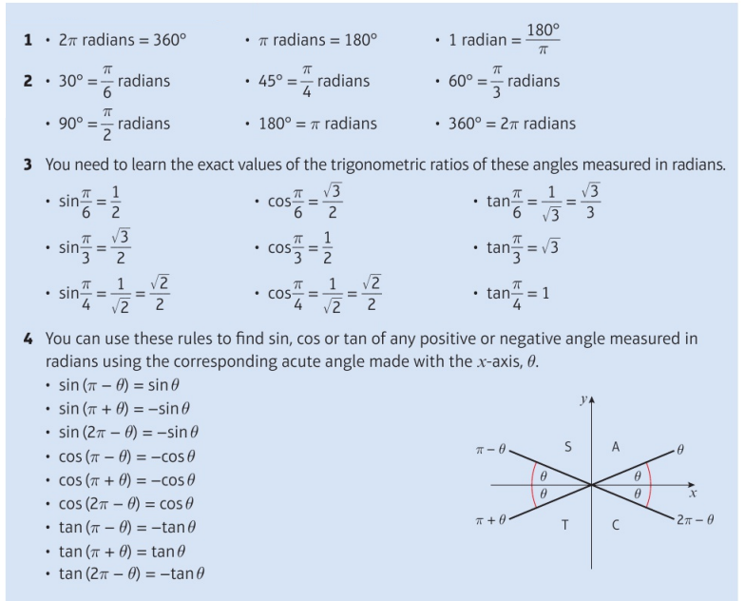
Key Points

Slide 3
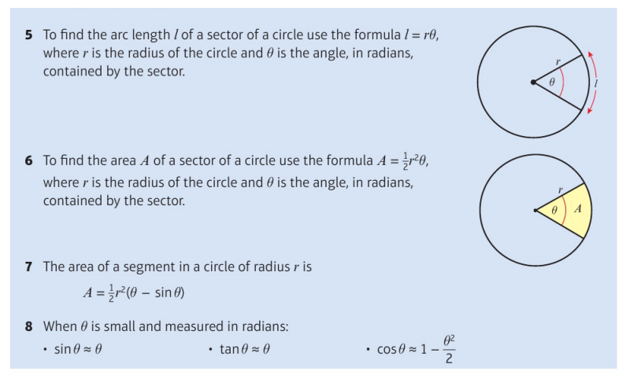
Key Points

Slide 4
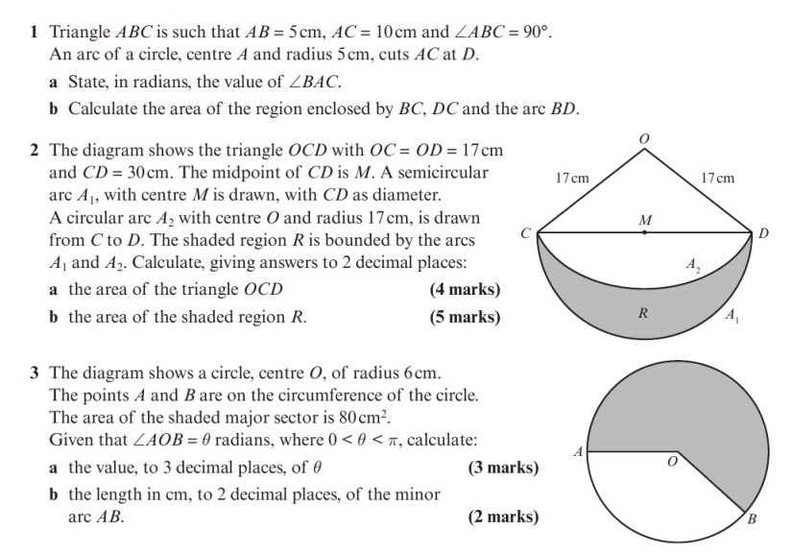
Chapter Exercises

Slide 5
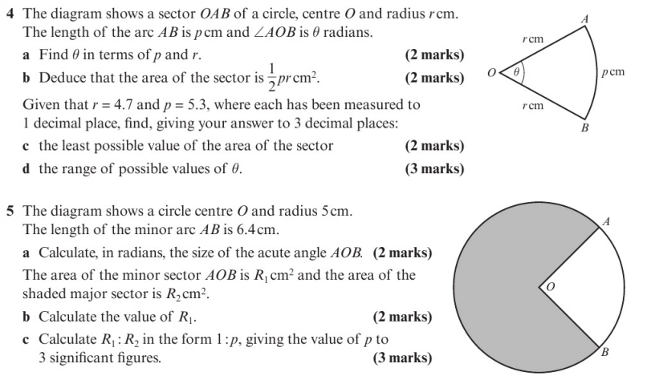
Chapter Exercises

Slide 6
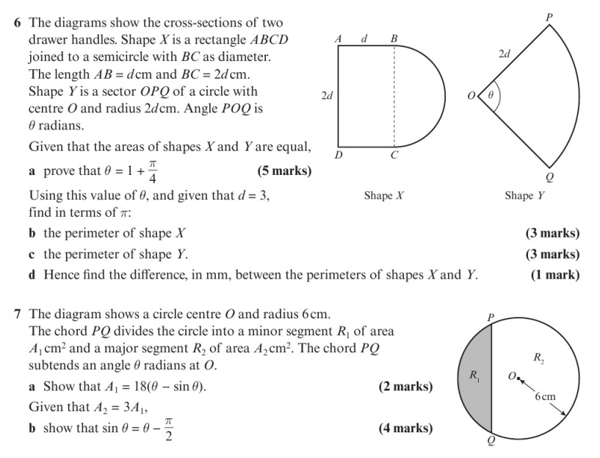
Chapter Exercises

Slide 7
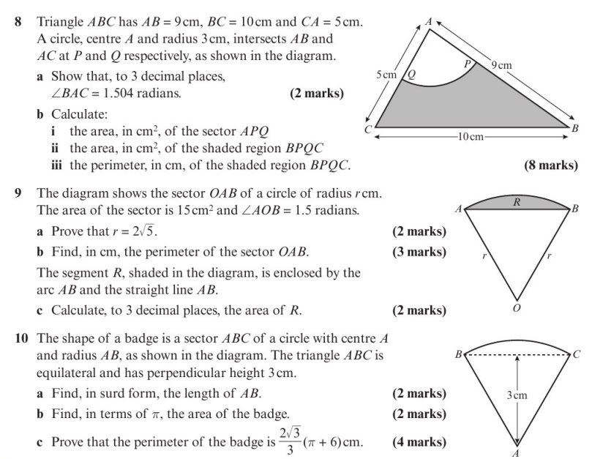
Chapter Exercises

Slide 8
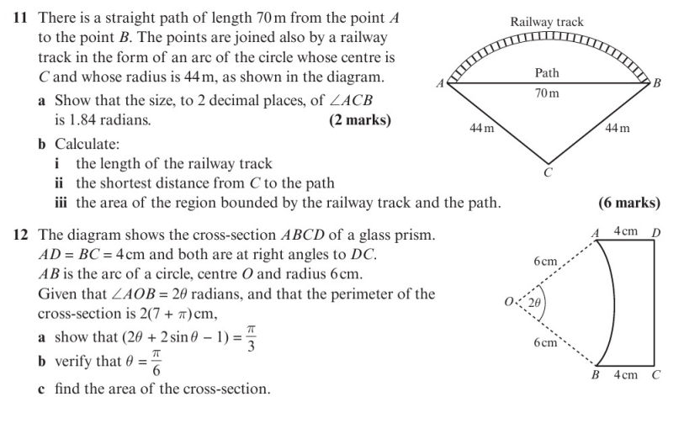
Chapter Exercises

Slide 9
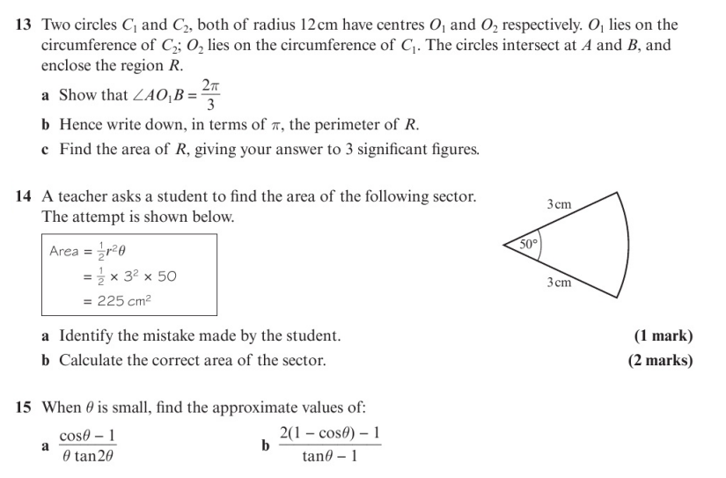
Chapter Exercises

Slide 10
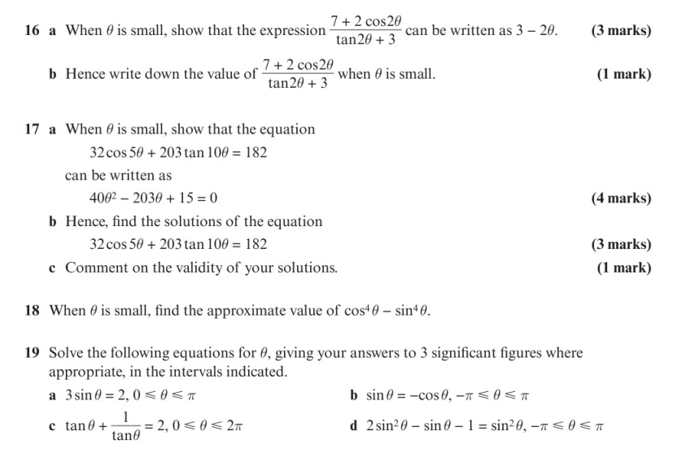
Chapter Exercises

Slide 11
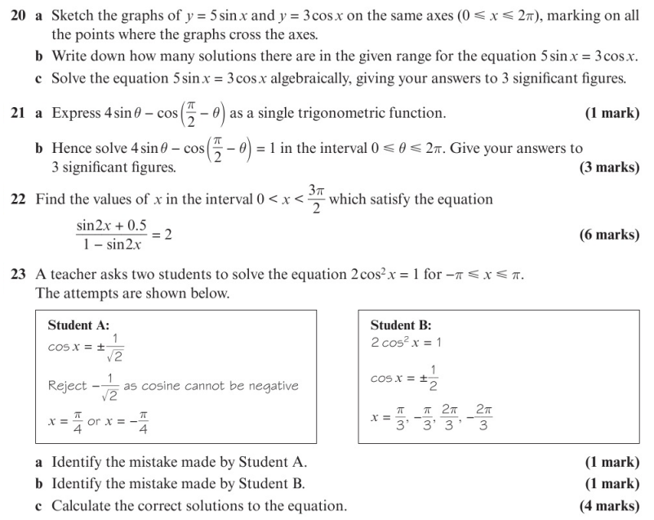
Chapter Exercises

Slide 12
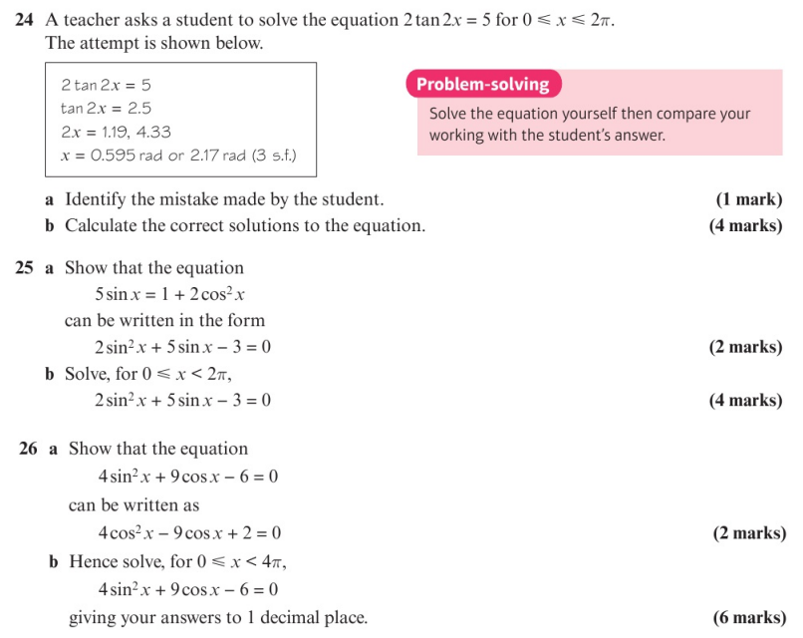
Chapter Exercises

Slide 13
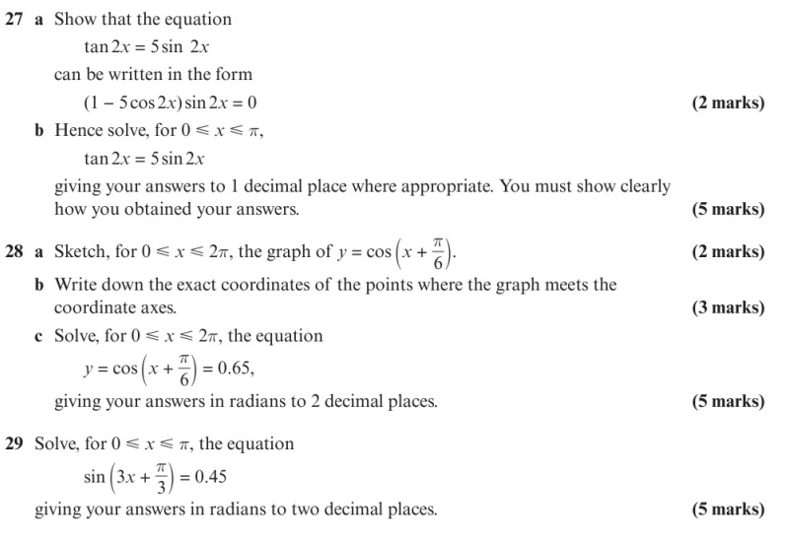
Chapter Exercises

Slide 14
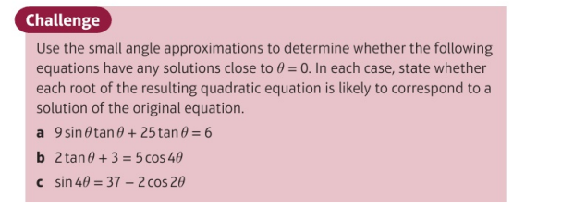
Chapter Exercises

Slide 15
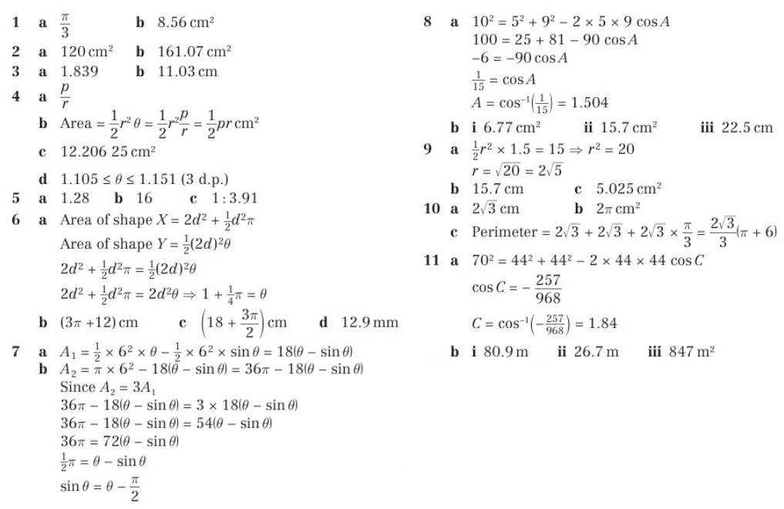
Chapter Answers

Slide 16
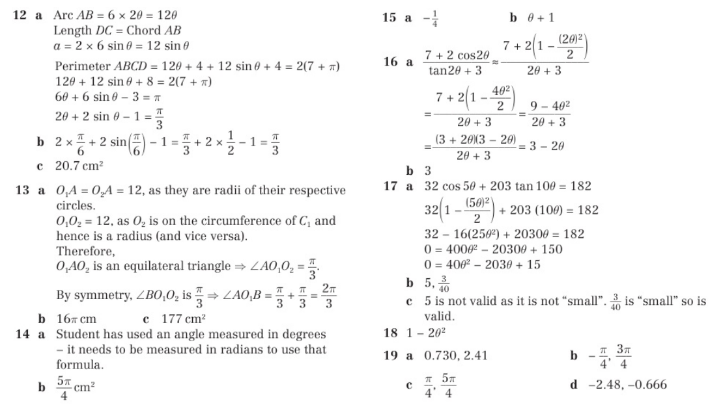
Chapter Answers

Slide 17
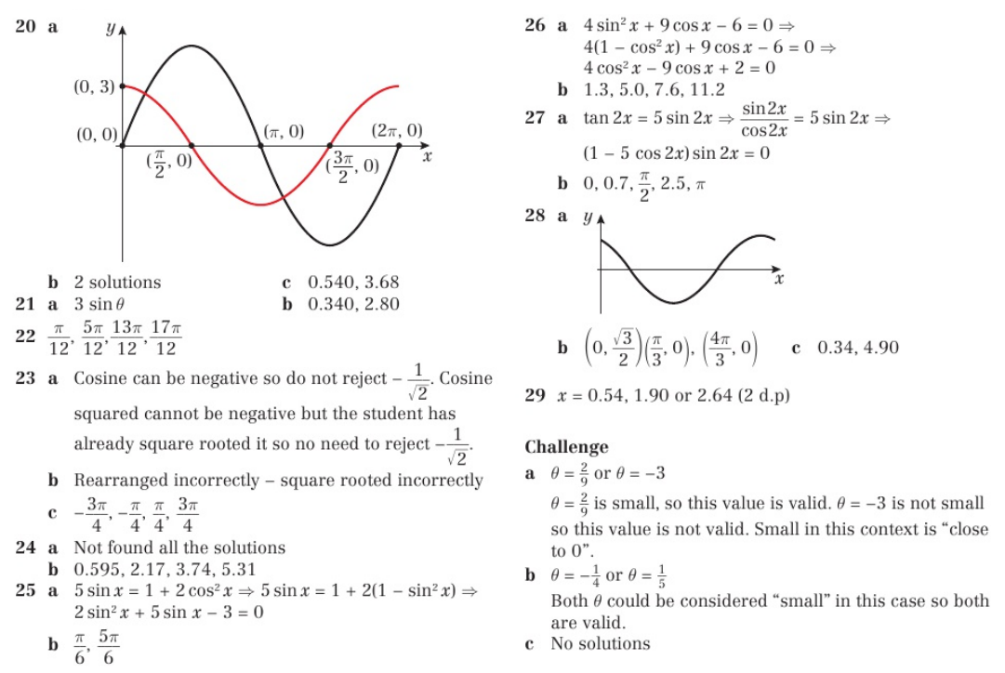
Chapter Answers

