Slide 1
P1 Chapter 12: Differentiation
Quadratic Gradient Function

Slide 2
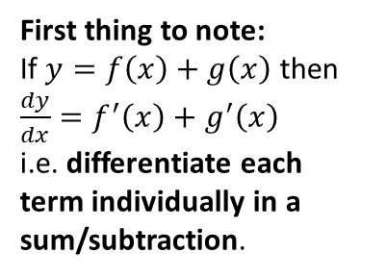

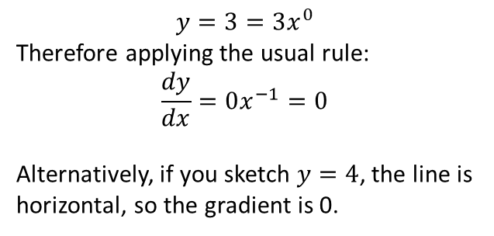
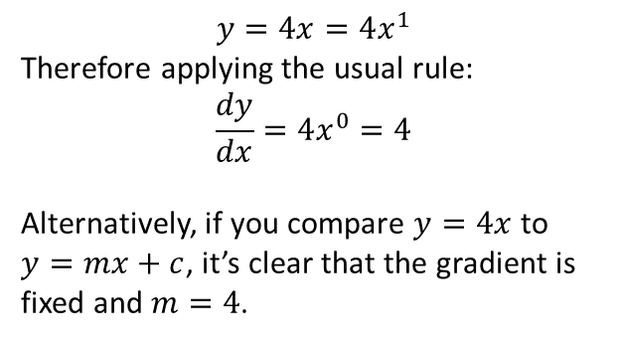
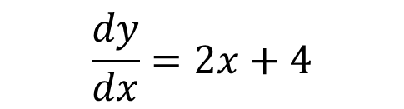
Differentiating Multiple Terms
Differentiate $y=x^{2}+4x+3$
First thing to note:
If $y=f\left(x\right)+g\left(x\right)$ then $\frac{dy}{dx}=f^{′}\left(x\right)+g^{′}\left(x\right)$
i.e. differentiate each term individually in a sum/subtraction.
$$\frac{dy}{dx}=2x+4$$
?
?
?
$$y=4x=4x^{1}$$
Therefore applying the usual rule:
$$\frac{dy}{dx}=4x^{0}=4$$
Alternatively, if you compare $y=4x$ to $y=mx+c$, it’s clear that the gradient is fixed and $m=4$.
$$y=3=3x^{0}$$
Therefore applying the usual rule:
$$\frac{dy}{dx}=0x^{−1}=0$$
Alternatively, if you sketch $y=4$, the line is horizontal, so the gradient is 0.

Slide 3

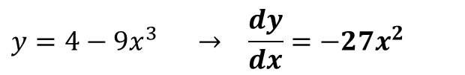

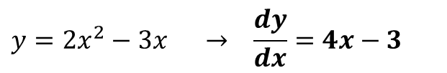
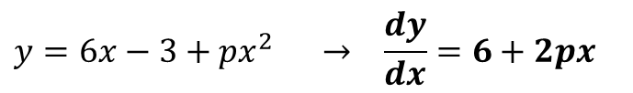
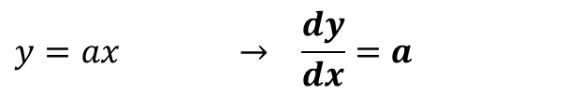
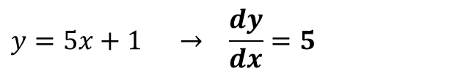
Quickfire Questions
?
$$y=2x^{2}−3x → \frac{dy}{dx}=4x−3$$
1
?
2
$$y=4−9x^{3} → \frac{dy}{dx}=−27x^{2}$$
?
$$y=5x+1 → \frac{dy}{dx}=5$$
3
?
$$y=ax → \frac{dy}{dx}=a$$
4
(where $a$ is a constant)
?
$$y=6x−3+px^{2} → \frac{dy}{dx}=6+2px$$
5
(where $p$ is a constant)

Slide 4

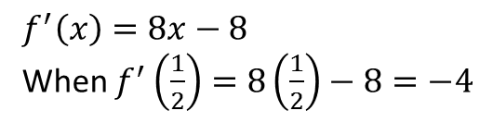
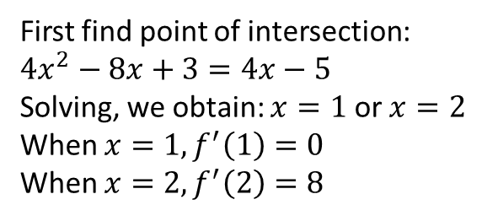
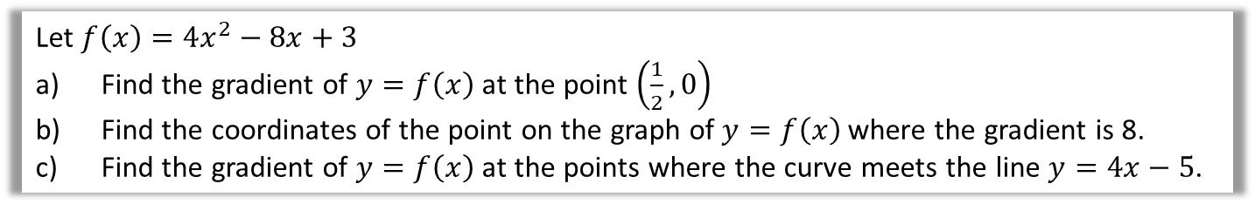
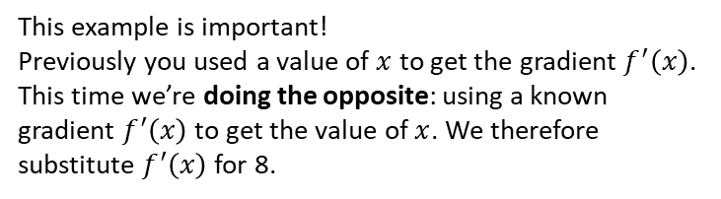
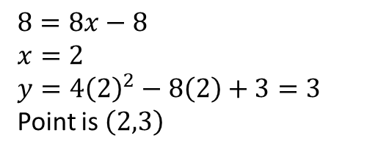

Harder Example
Let $f\left(x\right)=4x^{2}−8x+3$
Find the gradient of $y=f\left(x\right)$ at the point $\left(\frac{1}{2},0\right)$
Find the coordinates of the point on the graph of $y=f\left(x\right)$ where the gradient is 8.
Find the gradient of $y=f\left(x\right)$ at the points where the curve meets the line $y=4x−5$.
a
$$f^{′}\left(x\right)=8x−8$$
When $f^{′}\left(\frac{1}{2}\right)=8\left(\frac{1}{2}\right)−8=−4$
?
Remember that the ‘gradient function’ allows you to find the gradient for a particular value of $x$.
b
$$8=8x−8 \\ x=2 \\ y=4{\left(2\right)}^{2}−8\left(2\right)+3=3$$
Point is $\left(2,3\right)$
This example is important!
Previously you used a value of $x$ to get the gradient $f^{′}\left(x\right)$. This time we’re doing the opposite: using a known gradient $f^{′}\left(x\right)$ to get the value of $x$. We therefore substitute $f^{′}\left(x\right)$ for 8.
?
Once you have your $x$, you need to work out $y$.
Ensure you use the correct equation!
c
First find point of intersection:
$$4x^{2}−8x+3=4x−5$$
Solving, we obtain: $x=1$ or $x=2$
When $x=1, f^{′}\left(1\right)=0$
When $x=2, f^{′}\left(2\right)=8$
?

Slide 5
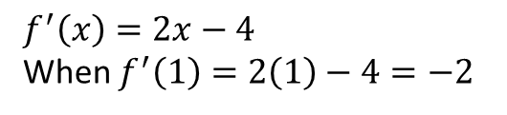
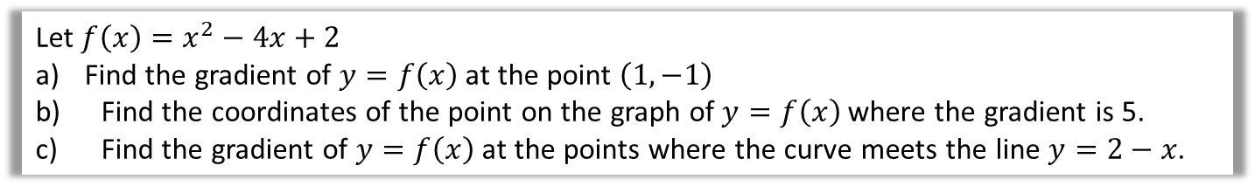
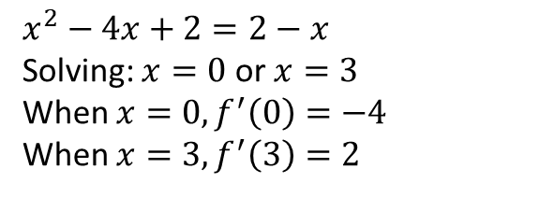

Test Your Understanding
Let $f\left(x\right)=x^{2}−4x+2$
Find the gradient of $y=f\left(x\right)$ at the point $\left(1,−1\right)$
Find the coordinates of the point on the graph of $y=f\left(x\right)$ where the gradient is 5.
Find the gradient of $y=f\left(x\right)$ at the points where the curve meets the line $y=2−x$.
a
$$f^{′}\left(x\right)=2x−4$$
When $f^{′}\left(1\right)=2\left(1\right)−4=−2$
?
$$5=2x−4 \\ x=\frac{9}{2} \\ y={\left(\frac{9}{2}\right)}^{2}−4\left(\frac{9}{2}\right)+2=\frac{17}{4}$$
Point is $\left(\frac{9}{2},\frac{17}{4}\right)$
b
?
$$x^{2}−4x+2=2−x$$
Solving: $x=0$ or $x=3$
When $x=0, f^{′}\left(0\right)=−4$
When $x=3, f^{′}\left(3\right)=2$
c
?

Slide 6
Exercise 12.4
Pearson Pure Mathematics Year 1/AS
Page 94

Slide 7
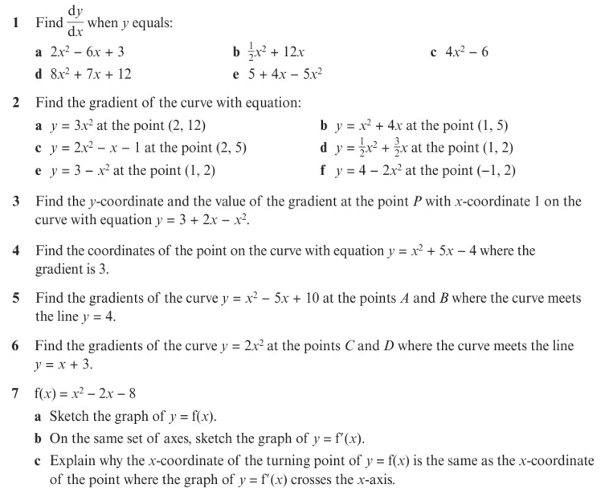
Homework Exercise

Slide 8
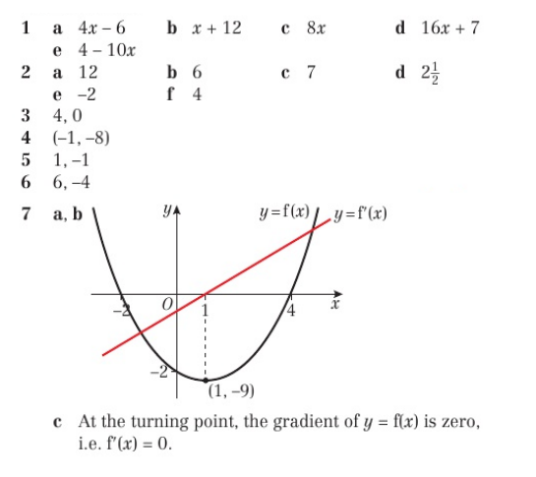
Homework Answers

