Slide 1
P1 Chapter 9: Trigonometric Ratios Areas of Any Triangle

Slide 2

Area of Non Right-Angled Triangles
3cm
Area = 0.5 x 3 x 7 x sin(59)
= 9.00cm²
?
59°
7cm
!
Area = $\frac{1}{2}a b\sin\left(C\right)$
where $C$ is the angle between two sides $a$ and $b$.
Fro Tip: You shouldn’t have to label sides/angles before using the formula. Just remember that the angle is between the two sides.

Slide 3


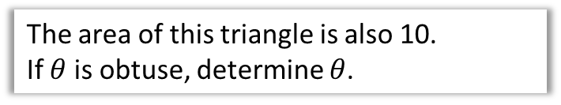



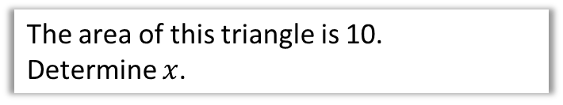



Test Your Understanding
The area of this triangle is 10.
Determine $x$.
$$x$$
?
$$\frac{1}{2}x\left(x+3\right)\sin\left(30°\right)=10 \\ \frac{1}{4}x\left(x+3\right)=10 \\ x\left(x+3\right)=40 \\ x^{2}+3x−40=0 \\ \left(x+8\right)\left(x−5\right)=0$$ As $x>0, x=5$
$$30°$$
$$x+3$$
$$5$$
The area of this triangle is also 10.
If $θ$ is obtuse, determine $θ$.
$$6$$
$$θ$$
?
$$\frac{1}{2}×5×6×\sin\left(θ\right)=10 \\ \sin\left(θ\right)=\frac{10}{15} \\ θ=180°−41.8°=138.2°$$

Slide 4
Exercise 9.3
Pearson Pure Mathematics Year 1/AS
Page 71

Slide 5
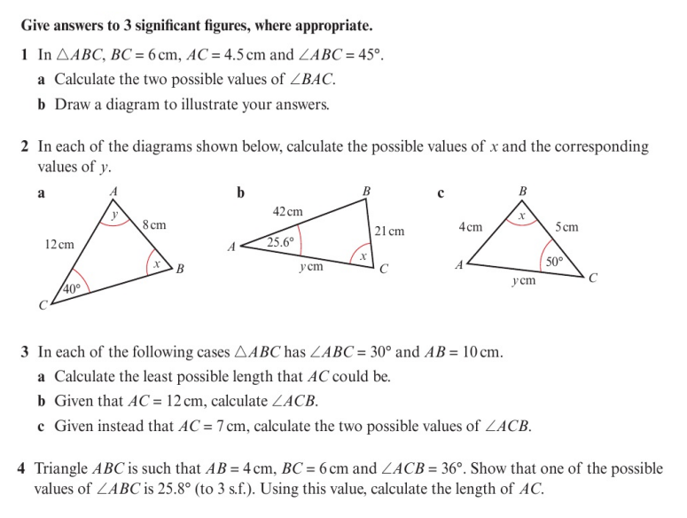
Homework Exercise

Slide 6
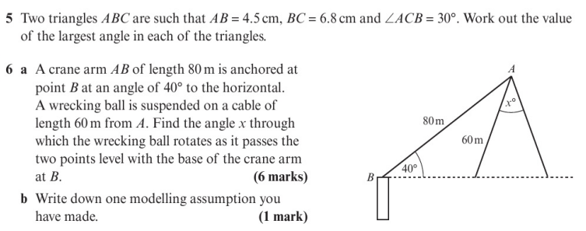
Homework Exercise

Slide 7
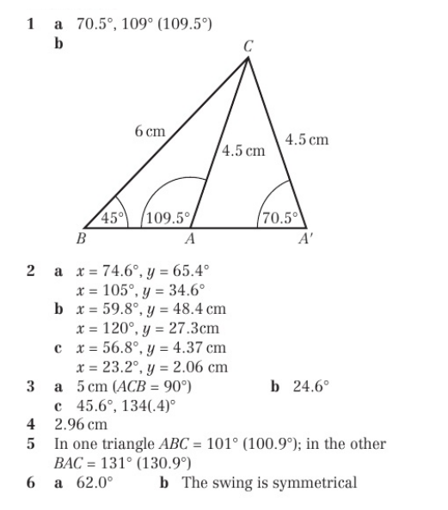
Homework Answers

Slide 8
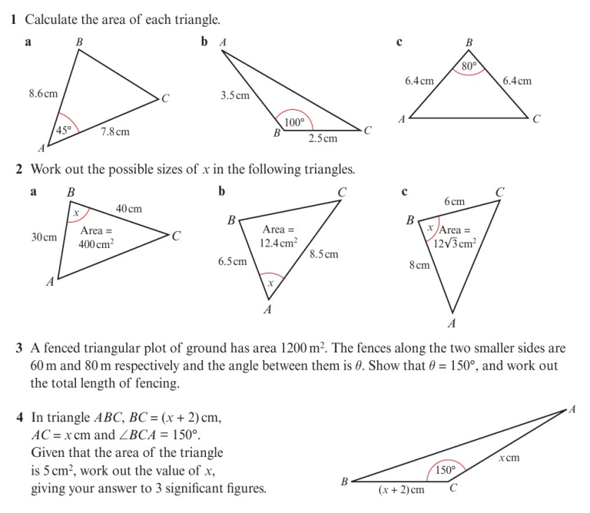
Homework Exercise

Slide 9
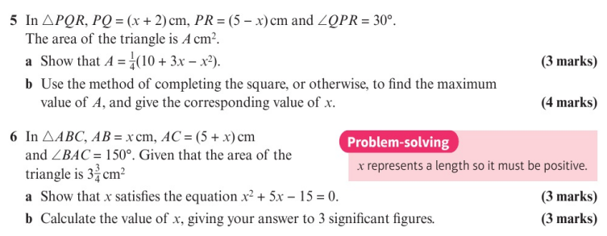
Homework Exercise

Slide 10
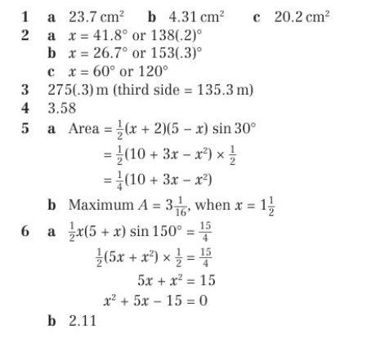
Homework Answers

