Slide 1
P1 Chapter 12: Differentiation
Polynomial Gradients

Slide 2

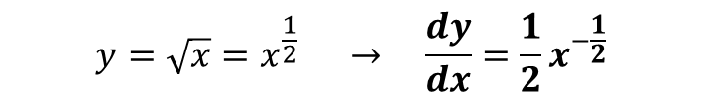
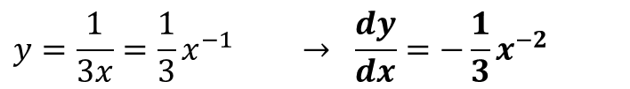
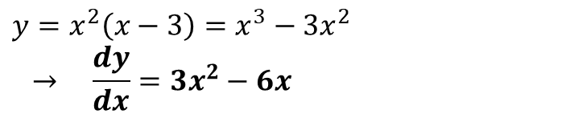
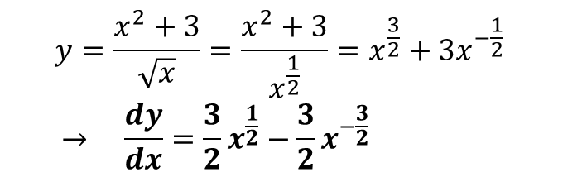
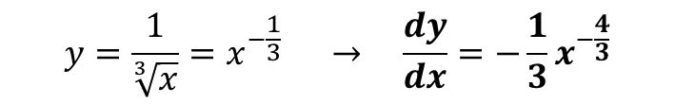
Differentiating Harder Expressions
If your expression isn’t a sum of $x^{n}$ terms, simply manipulate it until it is!
$$y=\sqrt{x}=x^{\frac{1}{2}} → \frac{dy}{dx}=\frac{1}{2}x^{−\frac{1}{2}}$$
1. Turn roots into powers:
?
?
?
?
$$y=\frac{1}{\sqrt[3]{x}}=x^{−\frac{1}{3}} → \frac{dy}{dx}=−\frac{1}{3}x^{−\frac{4}{3}}$$
2. Split up fractions.
?
$$y=\frac{x^{2}+3}{\sqrt{x}}=\frac{x^{2}+3}{x^{\frac{1}{2}}}=x^{\frac{3}{2}}+3x^{−\frac{1}{2}} \\ → \frac{dy}{dx}=\frac{3}{2}x^{\frac{1}{2}}−\frac{3}{2}x^{−\frac{3}{2}}$$
?
?
3. Expand out brackets.
$$y=x^{2}\left(x−3\right)=x^{3}−3x^{2} \\ → \frac{dy}{dx}=3x^{2}−6x$$
?
NOT $3x^{−1}$!!!
4. Beware of numbers in denominators!
?
?
$$y=\frac{1}{3x}=\frac{1}{3}x^{−1} → \frac{dy}{dx}=−\frac{1}{3}x^{−2}$$

Slide 3
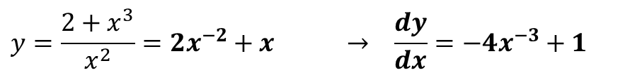
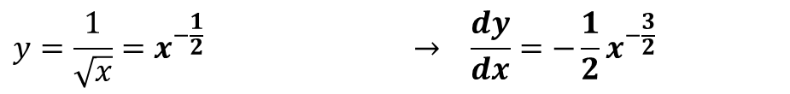
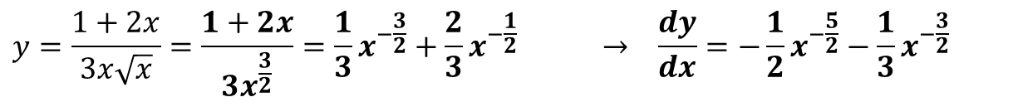
Test Your Understanding
Differentiate the following.
?
$$y=\frac{1}{\sqrt{x}}=x^{−\frac{1}{2}} → \frac{dy}{dx}=−\frac{1}{2}x^{−\frac{3}{2}}$$
?
$$y=\frac{2+x^{3}}{x^{2}}=2x^{−2}+x → \frac{dy}{dx}=−4x^{−3}+1$$
?
$$y=\frac{1+2x}{3x\sqrt{x}}=\frac{1+2x}{3x^{\frac{3}{2}}}=\frac{1}{3}x^{−\frac{3}{2}}+\frac{2}{3}x^{−\frac{1}{2}} → \frac{dy}{dx}=−\frac{1}{2}x^{−\frac{5}{2}}−\frac{1}{3}x^{−\frac{3}{2}}$$

Slide 4

Exercise 12.5
Pearson Pure Mathematics Year 1/AS
Page 95
Extension
[MAT 2013 1E]
The expression $\frac{d^{2}}{dx^{2}}\left[{\left(2x−1\right)}^{4}{\left(1−x\right)}^{5}\right]+\frac{d}{dx}\left[{\left(2x+1\right)}^{4}{\left(3x^{2}−2\right)}^{2}\right]$
is a polynomial of degree:
9
8
7
less than 7
Full expansion is not needed. The highest power term in the first polynomial is $16x^{4}×{\left(−x\right)}^{5}=−16x^{9}$, differentiating twice to give ${\left(−16×9×8\right)}^{9}x^{7}$.
The highest power term in the second polynomial is $16x^{4}×9x^{2}=\left(16×9\right)x^{8}$, differentiating once to give $\left(16×9×8\right)x^{7}$. These terms cancel leaving a polynomial of order (at most) 6. The answer is (D).
This just means “differentiate twice”. We’ll be looking at the ‘second derivative’ later in this chapter.
?

Slide 5
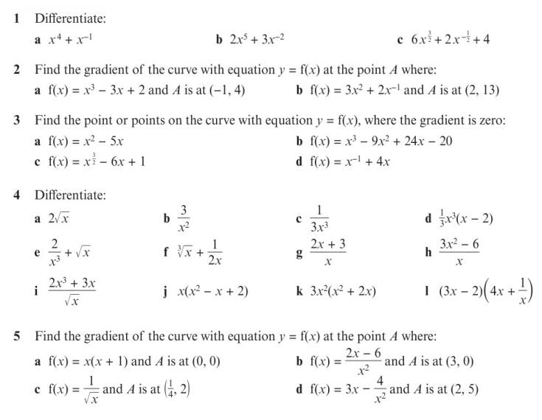
Homework Exercise

Slide 6
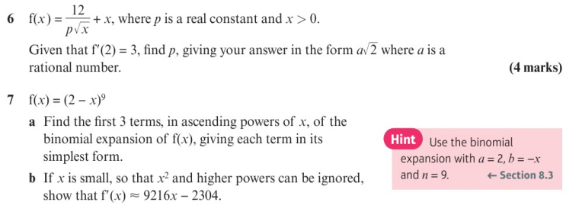
Homework Exercise

Slide 7
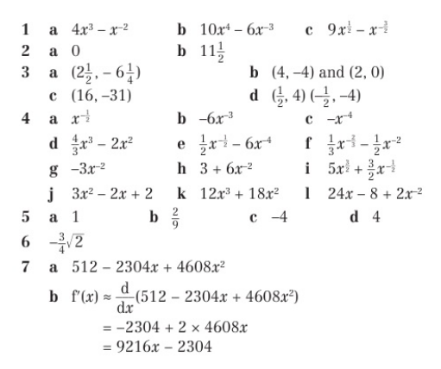
Homework Answers

