Slide 1
P1 Chapter 3: Inequalities Inequality Regions

Slide 2
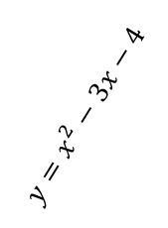




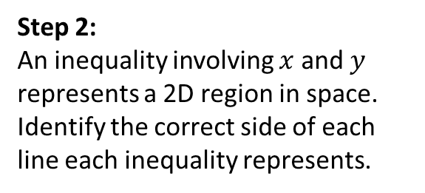

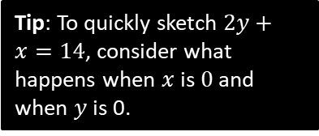


Inequality Regions
On graph paper, shade the region that satisfies the inequalities:
$$2y+x<14 \\ y≥x^{2}−3x−4$$
You did this at GCSE, the only difference here being that the graphs involved might not be straight lines.
?
Step 1: Imagine inequalities as equations and sketch.
Step 2:
An inequality involving $x$ and $y$ represents a 2D region in space.
Identify the correct side of each line each inequality represents.
$$y$$
$$y=x^{2}−3x−4$$
$$2y+x=14$$
Click to Frosketch >
$$x$$
$$−1$$
$$4$$
Tip: To quickly sketch $2y+x=14$, consider what happens when $x$ is $0$ and when $y$ is 0.
Tip: Make sure $y$ is on the side where it is positive.
If $y$ is on the smaller side, you’re below the line.
If $y$ is on the greater side, you’re above the line.

Slide 3
Exercise 3.7
Pearson Pure Mathematics Year 1/AS
Page 22

Slide 4
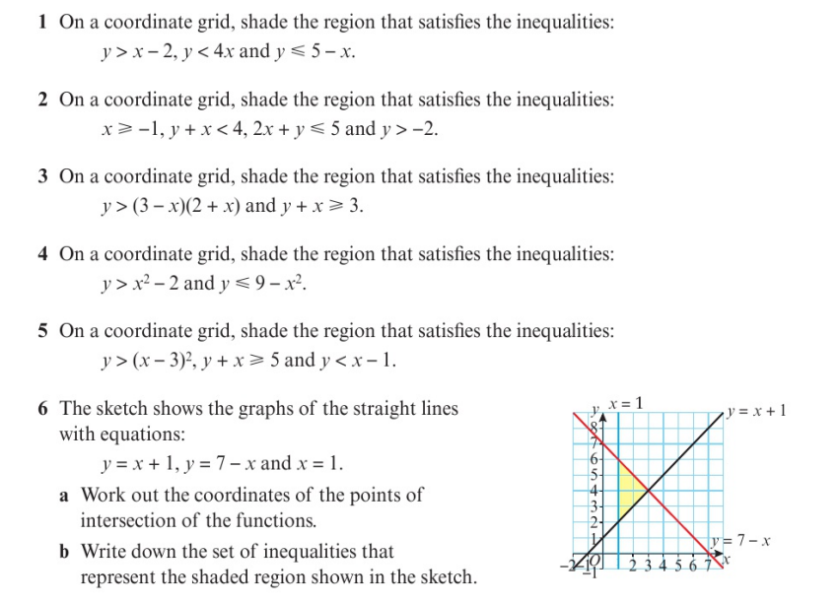
Homework Exercise

Slide 5
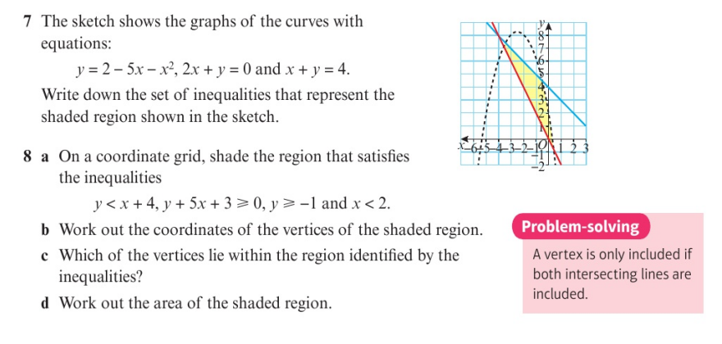
Homework Exercise

Slide 6
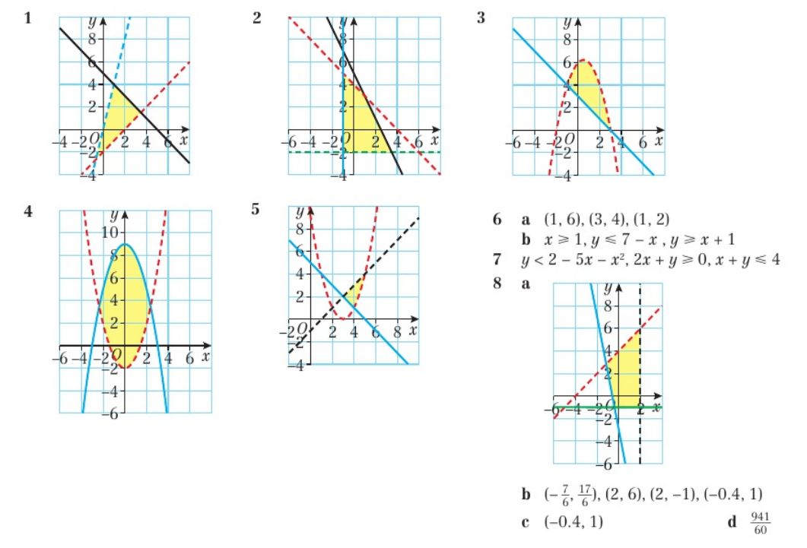
Homework Answers

