Slide 1
P2 Chapter 4: Binomial Terms
Expanding Partial Fractions

Slide 2

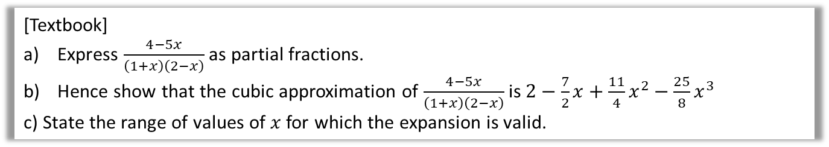


Using Partial Fractions
Partial fractions allows us to split up a fraction into ones we can then find the binomial expansion of.
[Textbook]
Express $\frac{4−5x}{\left(1+x\right)\left(2−x\right)}$ as partial fractions.
Hence show that the cubic approximation of $\frac{4−5x}{\left(1+x\right)\left(2−x\right)}$ is $2−\frac{7}{2}x+\frac{11}{4}x^{2}−\frac{25}{8}x^{3}$
c) State the range of values of $x$ for which the expansion is valid.
First find the valid range for each of the expansions:
$$\left|x\right|<1 \\ \left|\frac{x}{2}\right|<1 → \left|x\right|<2$$
$$∴\left|x\right|<1$$
a
?
?
$$\frac{4−5x}{\left(1+x\right)\left(2−x\right)}=\frac{A}{1+x}+\frac{B}{2−x}$$
$$4−5x=A\left(2−x\right)+B\left(1+x\right)$$
Let $x=2$: $−6=3B → B=−2$
Let $x=−1$: $9=3A → A=3$
Therefore $\frac{4−5x}{\left(1+x\right)\left(2−x\right)}=\frac{3}{1+x}−\frac{2}{2−x}$
$$=3{\left(1+x\right)}^{−1}−2{\left(2−x\right)}^{−1}$$
Expansion of $3{\left(1+x\right)}^{−1}$:
$$3\left[1+\left(−1\right)x+\frac{\left(−1\right)\left(−2\right)}{2!}x^{2}+\frac{\left(−1\right)\left(−2\right)\left(−3\right)}{3!}x^{3}+…\right]=3−3x+3x^{2}−3x^{3}+…$$
Similarly $2{\left(2−x\right)}^{−1}=2×2^{−1}{\left(1−\frac{1}{2}x\right)}^{−1}=…=1+\frac{1}{2}x+\frac{1}{4}x^{2}+\frac{1}{8}x^{3}$
Hence $\frac{4−5x}{\left(1+x\right)\left(2−x\right)}≈3−3x+3x^{2}−3x^{3}−\left(1+\frac{1}{2}x+\frac{1}{4}x^{2}+\frac{1}{8}x^{3}\right)$
$$=2−\frac{7}{2}x+\frac{11}{4}x^{2}−\frac{25}{8}x^{3}$$
c
b
?
$−1<x<1$ is more restrictive than $−2<x<2$. If both have to be true, the more restrictive one applies (this can be seen by drawing the inequalities a number line).

Slide 3
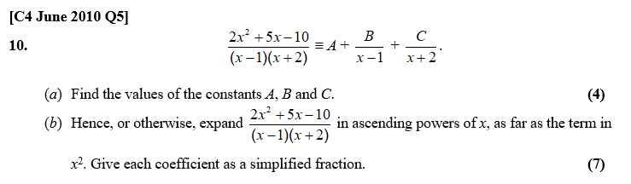
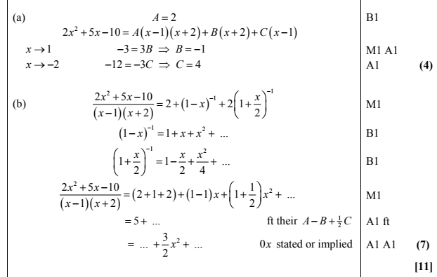
Test Your Understanding
? a
? b

Slide 4
Exercise 4.3
Pearson Pure Mathematics Year 2/AS
Page 31

Slide 5
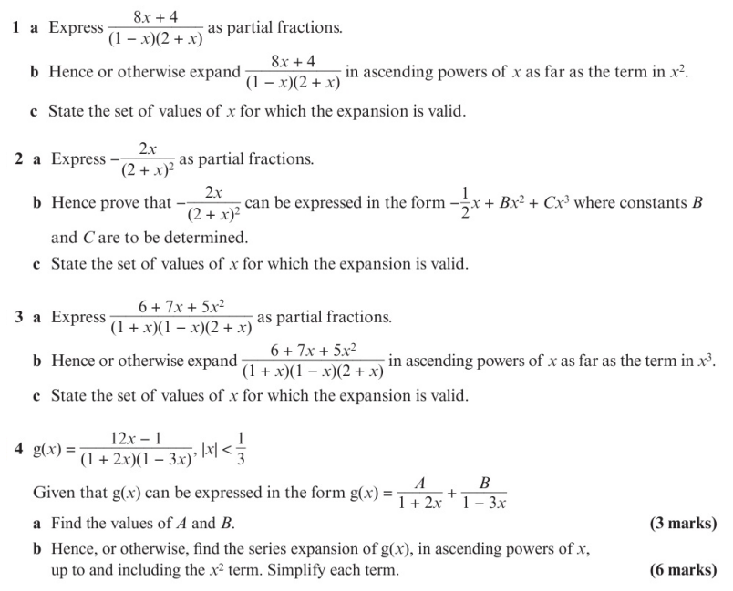
Homework Exercise

Slide 6
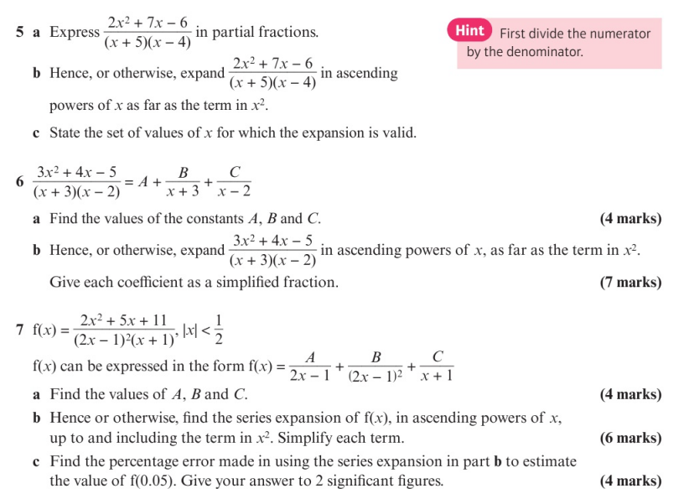
Homework Exercise

Slide 7
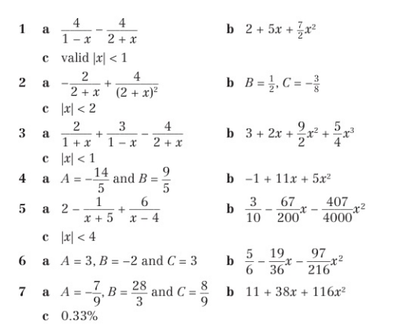
Homework Answers

