Slide 1
P2 Chapter 11: Integration Using Linear Substitutions

Slide 2



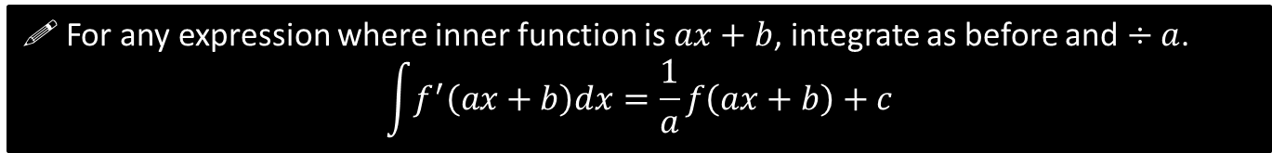
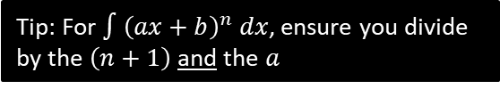
SKILL #2: Integrating $f\left(ax+b\right)$
?
$$\frac{d}{dx}\left(\sin\left(3x+1\right)\right)=3\cos\left(3x+1\right)$$
Therefore:
$$\int{\cos\left(3x+1\right) dx}=\frac{1}{3}\sin\left(3x+1\right)+C$$
?
! For any expression where inner function is $ax+b$, integrate as before and $÷a$. $$\int{f^{′}\left(ax+b\right)dx}=\frac{1}{a}f\left(ax+b\right)+c$$
Quickfire:
$$\int{e^{3x} dx}=\frac{1}{3}e^{3x}+C$$
$$\int{\frac{1}{5x+2}dx}=\frac{1}{5}\ln\left|5x+2\right|+C$$
$$\int{{2sec}^{2}\left(3x−2\right) dx=\frac{2}{3}\tan\left(3x−2\right)}+C$$
?
?
$$\int{{\left(3x+4\right)}^{3} dx}=\frac{1}{12}{\left(3x+4\right)}^{4}+C$$
$$\int{\sin\left(1−5x\right)dx}=\frac{1}{5}\cos\left(1−5x\right)+C$$
$$\int{\frac{1}{3{\left(4x−2\right)}^{2}}dx=−\frac{1}{12}{\left(4x−2\right)}^{−1}}+C$$
$$\int{{\left(10x+11\right)}^{12}=\frac{1}{130}{\left(10x+11\right)}^{13}+C}$$
?
?
?
?
Tip: For $∫{\left(ax+b\right)}^{n} dx$, ensure you divide by the $\left(n+1\right)$ and the $a$
?

Slide 3

Check Your Understanding
$$\int{e^{3x+1}dx}=\frac{1}{3}e^{3x+1}+C$$
$$\int{\frac{1}{1−2x}dx}=−\frac{1}{2}\ln\left|1−2x\right|+C$$
$$\int{{\left(4−3x\right)}^{5}dx}=−\frac{1}{18}{\left(4−3x\right)}^{6}+C$$
$$\int{\sec\left(3x\right)tan⁡(3x) dx}=\frac{1}{3}\sec\left(3x\right)+C$$
?
?
?
?

Slide 4

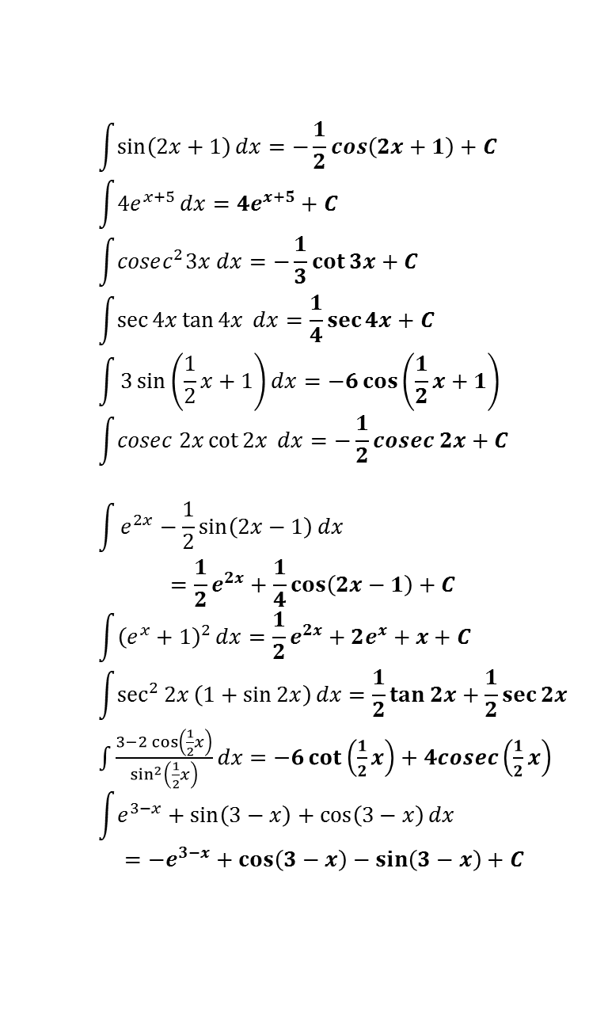
Exercise 11B
?
$$\int{\frac{1}{2x+1}}dx=\frac{1}{2}\ln\left|2x+1\right|+C \\ \int{\frac{1}{{\left(2x+1\right)}^{2}}}dx=−\frac{1}{2\left(2x+1\right)}+C \\ \int{{\left(2x+1\right)}^{2}}dx=\frac{1}{6}{\left(2x+1\right)}^{3}+C \\ \int{\frac{3}{4x−1}dx}=\frac{3}{4}\ln\left|4x−1\right|+C$$
$$\int{\frac{3}{{\left(1−4x\right)}^{2}}}dx=\frac{3}{4\left(1−4x\right)}+C \\ \int{\frac{3}{{\left(1−2x\right)}^{3}}dx}=\frac{3}{4{\left(1−2x\right)}^{2}}+C \\ \int{\frac{5}{3−2x}dx}=−\frac{5}{2}\ln\left|3−2x\right|+C$$
$$\int{3\sin\left(2x+1\right)+\frac{4}{2x+1} dx} \\ =−\frac{3}{2}\cos\left(2x+1\right)+2\ln\left|2x+1\right|+C$$
$$\int{\frac{1}{\sin^{2}{2x}}+\frac{1}{1+2x}+\frac{1}{{\left(1+2x\right)}^{2}}dx} \\ =−\frac{1}{2}\cot{2x}+\frac{1}{2}\ln\left|1+2x\right|−\frac{1}{2\left(1+2x\right)}$$
1
a
$$\int{\sin\left(2x+1\right)}dx=−\frac{1}{2}\cos\left(2x+1\right)+C \\ \int{4e^{x+5}}dx=4e^{x+5}+C \\ \int{cosec^{2}3x dx}=−\frac{1}{3}\cot{3x}+C \\ \int{\sec{4x}\tan{4x} dx}=\frac{1}{4}\sec{4x}+C \\ \int{3\sin\left(\frac{1}{2}x+1\right)dx}=−6\cos\left(\frac{1}{2}x+1\right) \\ \int{cosec 2x\cot{2x}} dx=−\frac{1}{2}cosec 2x+C$$
$$\int{e^{2x}−\frac{1}{2}\sin\left(2x−1\right)}dx \\ =\frac{1}{2}e^{2x}+\frac{1}{4}\cos\left(2x−1\right)+C \\ \int{{\left(e^{x}+1\right)}^{2}}dx=\frac{1}{2}e^{2x}+2e^{x}+x+C$$
$$\int{\sec^{2}{2x}\left(1+\sin{2x}\right)}dx=\frac{1}{2}\tan{2x}+\frac{1}{2}\sec{2x}$$ $\int{\frac{3−2\cos\left(\frac{1}{2}x\right)}{\sin^{2}\left(\frac{1}{2}x\right)}}dx=−6\cot\left(\frac{1}{2}x\right)+4cosec\left(\frac{1}{2}x\right)$
$$\int{e^{3−x}+\sin\left(3−x\right)+\cos\left(3−x\right)dx} \\ =−e^{3−x}+\cos\left(3−x\right)−\sin\left(3−x\right)+C$$
3
a
?
c
?
?
b
e
?
c
?
f
?
?
d
?
g
h
?
?
f
h
?
2
a
?
?
j
b
?
c
?
4
a
?
d
?
c
e
?
?

Slide 5
Exercise 11.2
Pearson Pure Year 2
Page 91

Slide 6
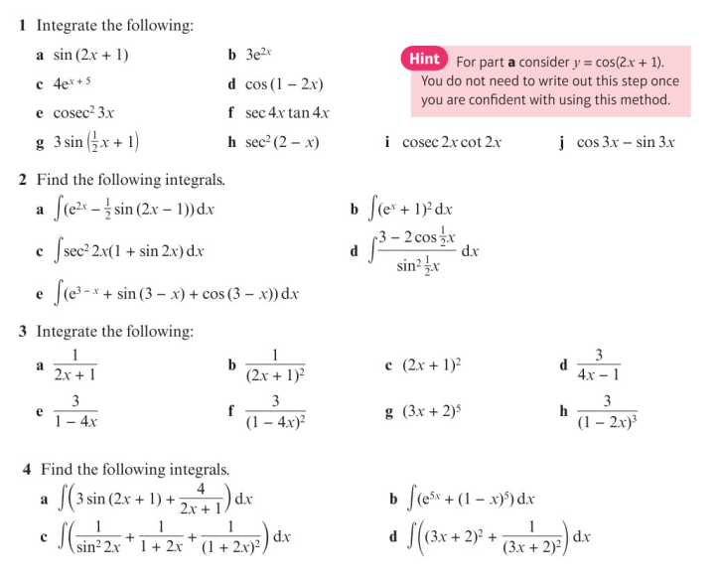
Homework Exercise

Slide 7
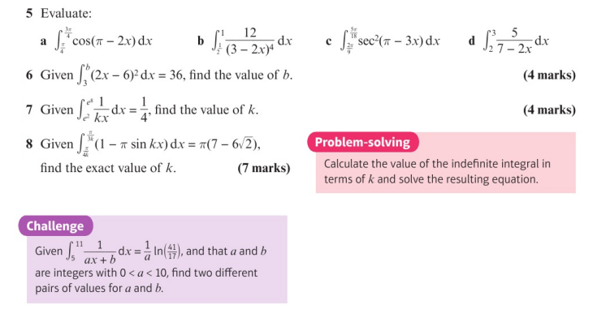
Homework Exercise

Slide 8
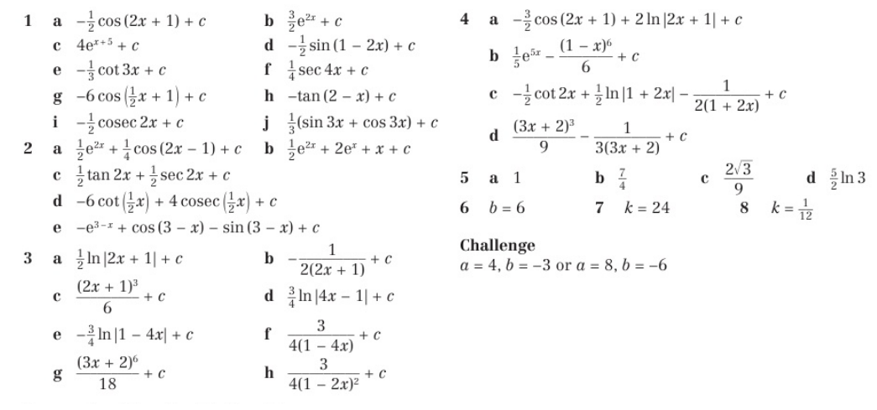
Homework Answers

