Slide 1
P2 Chapter 11: Integration Finding Areas

Slide 2

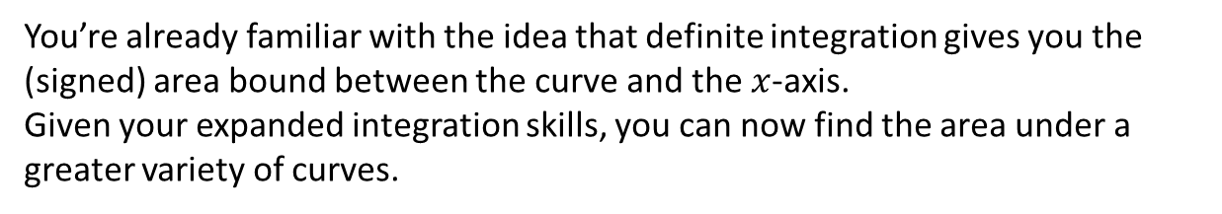




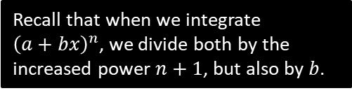
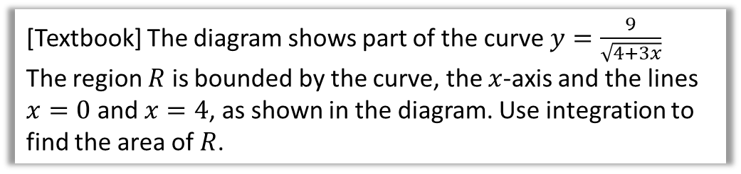

Finding Areas
You’re already familiar with the idea that definite integration gives you the (signed) area bound between the curve and the $x$-axis.
Given your expanded integration skills, you can now find the area under a greater variety of curves.
$$y$$
[Textbook] The diagram shows part of the curve $y=\frac{9}{\sqrt{4+3x}}$
The region $R$ is bounded by the curve, the $x$-axis and the lines $x=0$ and $x=4$, as shown in the diagram. Use integration to find the area of $R$.
$$\frac{9}{2}$$
$$R$$
$$4$$
$$x$$
?
$$Area=\int_{0}^{4}{\frac{9}{\sqrt{4+3x}}dx} \\ =9\int_{0}^{4}{{\left(4+3x\right)}^{−\frac{1}{2}} dx} \\ =6{\left[{\left(4+3x\right)}^{\frac{1}{2}}\right]}_{0}^{4} \\ =…=12$$
Recall that when we integrate ${\left(a+bx\right)}^{n}$, we divide both by the increased power $n+1$, but also by $b$.

Slide 3



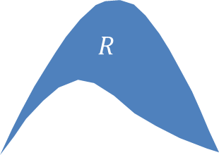
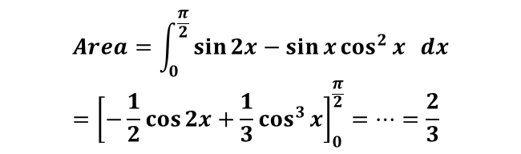

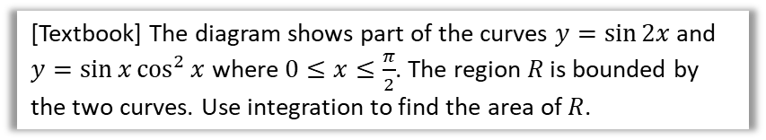






Area between Two Curves
$$y$$
(This was presented in my Year 1 slides as an ‘alternative method’)
The areas under the two curves are $\int_{a}^{b}{f\left(x\right) dx}$ and $\int_{a}^{b}{g\left(x\right) dx}$. It therefore follows the area between them (provided the curves don’t overlap) is:
$$R=\int_{a}^{b}{f\left(x\right) dx}−\int_{a}^{b}{g\left(x\right) dx} \\ =\int_{a}^{b}{\left(f\left(x\right)−g\left(x\right)\right) dx}$$
$$y=f\left(x\right)$$
$$R$$
$$y=g\left(x\right)$$
$$a$$
$$x$$
$$b$$
Tip: Ensure you have top curve minus bottom curve.
[Textbook] The diagram shows part of the curves $y=\sin{2x}$ and $y=\sin{x}\cos^{2}{x}$ where $0≤x≤\frac{π}{2}$. The region $R$ is bounded by the two curves. Use integration to find the area of $R$.
$$y$$
$$y=\sin{2x}$$
$$R$$
?
$$Area=\int_{0}^{\frac{π}{2}}{\sin{2x}−\sin{x}\cos^{2}{x} dx} \\ ={\left[−\frac{1}{2}\cos{2x}+\frac{1}{3}\cos^{3}{x}\right]}_{0}^{\frac{π}{2}}=…=\frac{2}{3}$$
$$y=\sin{x}\cos^{2}{x}$$
$$x$$

Slide 4
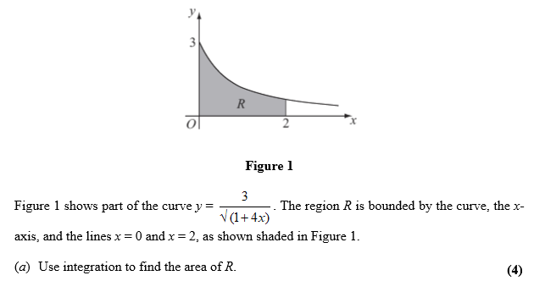
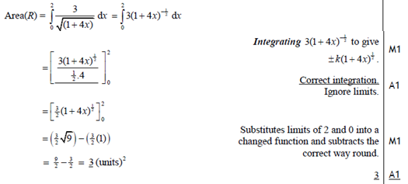
Test Your Understanding
Edexcel C4 Jan 2009 Q2
?

Slide 5
Exercise 11.8
Pearson Pure Mathematics Year 2
Pages 96-98

Slide 6
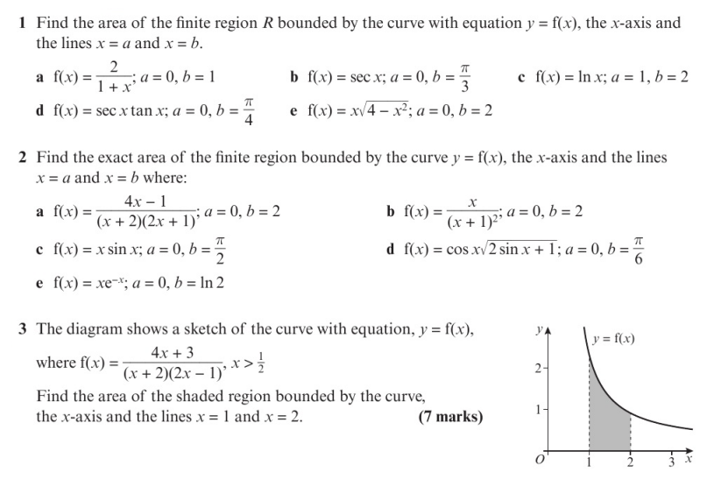
Homework Exercise

Slide 7
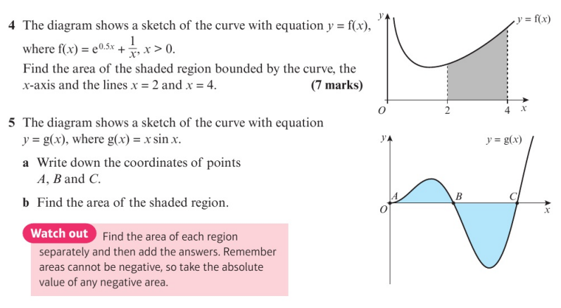
Homework Exercise

Slide 8
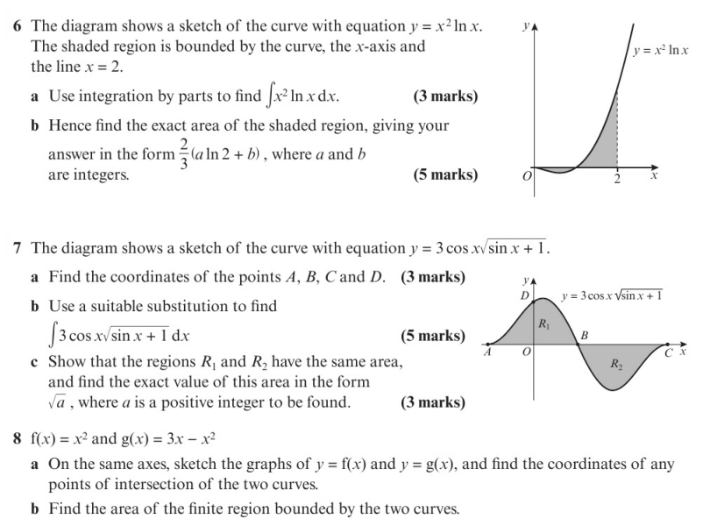
Homework Exercise

Slide 9
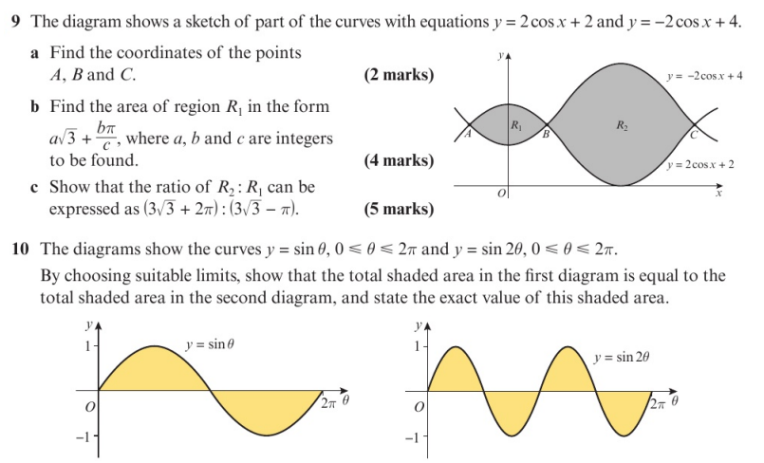
Homework Exercise

Slide 10
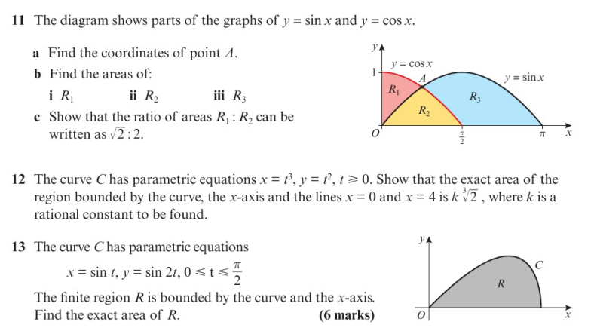
Homework Exercise

Slide 11
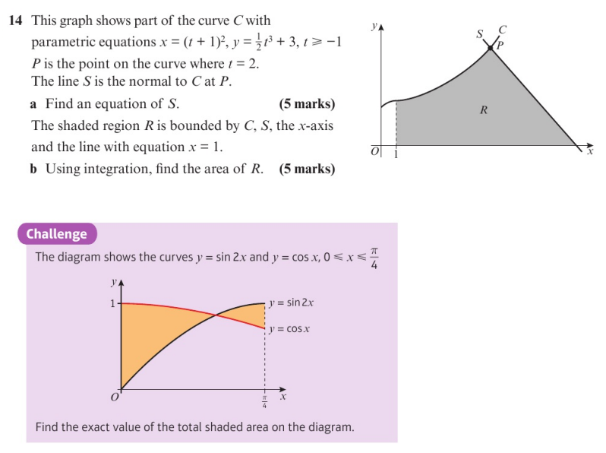
Homework Exercise

Slide 12
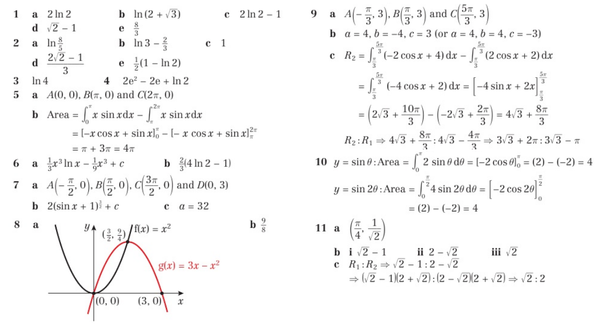
Homework Answers

Slide 13
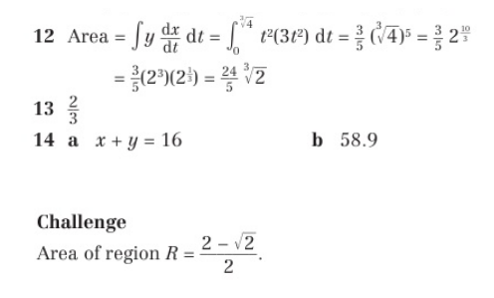
Homework Answers

