Slide 1
M1 Chapter 8: Modelling Modelling in Mechanics

Slide 2



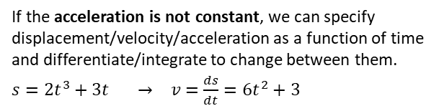




Mechanics, broadly speaking, concerns motion, forces, and how the two interrelate.
This chapter just gives you an overview of what you’ll be covering in Year 1 and how it all links together.
Forces
Motion
At GCSE you may have encountered displacement-time and velocity-time graphs:
You will later encounter force diagrams. This considers the forces acting at a particular point.
Some forces you might consider…
The gradient gives the velocity
The gradient gives the acceleration
Reaction force (that prevents object sinking into the table!)
string
displacement
velocity
Friction (which resists motion)
The bridge!
Area under graph gives distance.
Tension
$$F=ma$$
time
time
object
Newton’s 2nd Law allows us to connect the force world ($F$) with the motion world (acceleration $a$) if the object is moving.
table
Given constant acceleration we have 5 quantities of motion (“$suvat$”):
$s=$ displacement
$u=$ initial velocity
$v=$ final velocity
$a=$ acceleration
$t=$ time
The weight of the object.
which we will see are linked by various equations:
$$s=ut+\frac{1}{2}at^{2} \\ s=\left(\frac{u+v}{2}\right)t \\ v^{2}=u^{2}+2as \\ v=u+at$$
Forces can be considered as vectors.
The magnitude of the force vector gives the ‘size’ of the force.
We often consider forces in a particular direction. e.g. If the object above is stationary, the forces left must equal the force right, and forces up equal forces down (Newton’s 1st Law).
Often we need to consider the forces at multiple different points if objects are connected, e.g. with pulleys:
$$a$$
$$T$$
$$T$$
$$a$$
If the acceleration is not constant, we can specify displacement/velocity/acceleration as a function of time and differentiate/integrate to change between them.
$s=2t^{3}+3t → v=\frac{ds}{dt}=6t^{2}+3$
4kg
3kg
$$4g$$
$$3g$$

Slide 3
Modelling Assumptions
As with many areas of applied maths, we often have to make various modelling assumptions, to make the maths cleaner or to use well-known mathematical approaches.
Here are common modelling assumptions often made in Mechanics: !
Particle
Dimensions of object are negligible
Means: Mass of object concentrated at single point. Rotational forces/air resistance can be ignored.
Smooth/light pulley No friction.
Means: Tension the same in string either side of pulley.
Pulley has no mass.
Fro Tip: Particularly make note of underlined text!
Inextensible string
String does not stretch under load.
Means: Acceleration the same in any connected objects.
Rough/Smooth surface
Means: Objects in contact with surface does/does not experience friction.
Rod
One dimension is negligible, like a pole or beam.
Means: Mass is concentrated along line. Rigid.
Peg/Support
A support from which a body can be suspended or rested.
Means: Dimensionless and fixed. Can be rough or smooth depending on question.

Slide 4
Exercise 8A, 8B
Pearson Stats/Mechanics Year 1
Exercise 8.1 pages 52-53
Exercise 8.2 pages 53-54

Slide 5
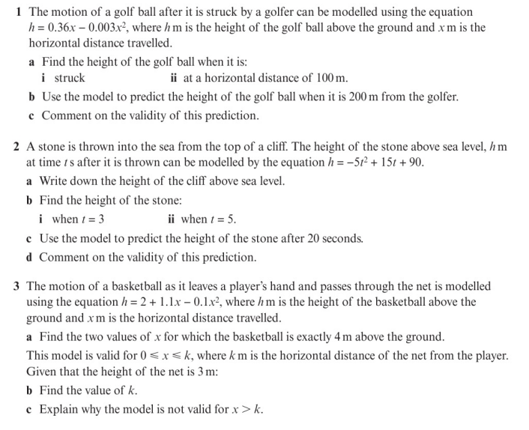
Homework Exercise

Slide 6
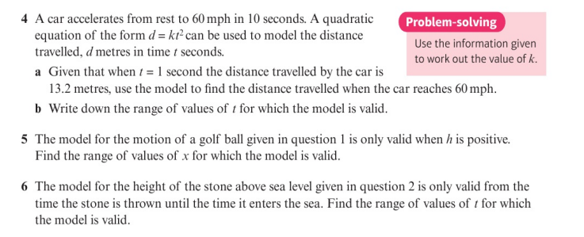
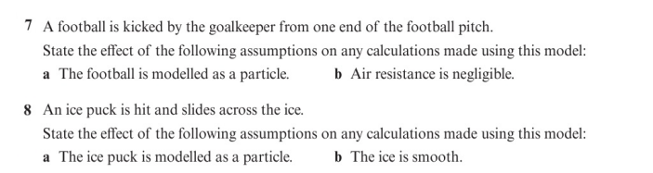
Homework Exercise

Slide 7
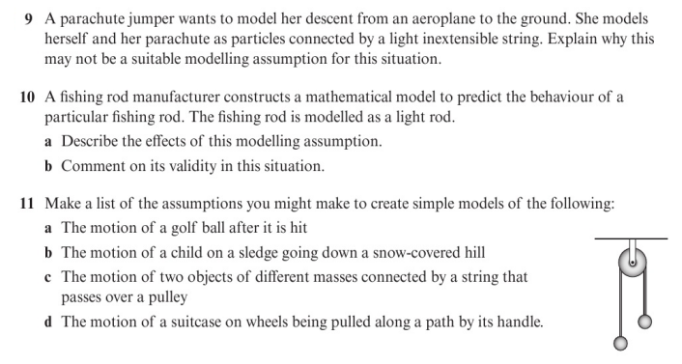
Homework Exercise

Slide 8
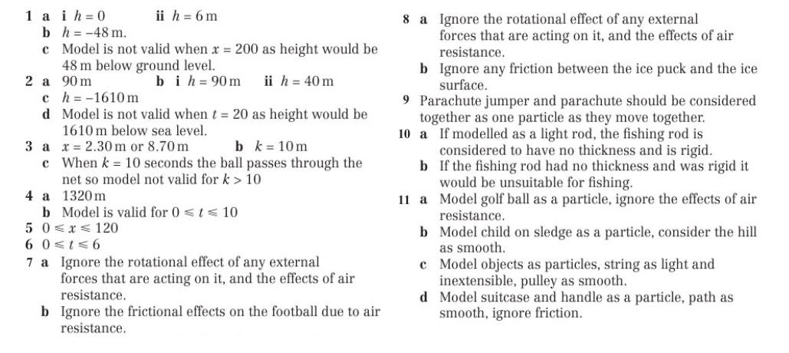
Homework Answers

Slide 9
Homework Answers

