Slide 1
M1 Chapter 11: Variable Acceleration Velocity Turning Points

Slide 2

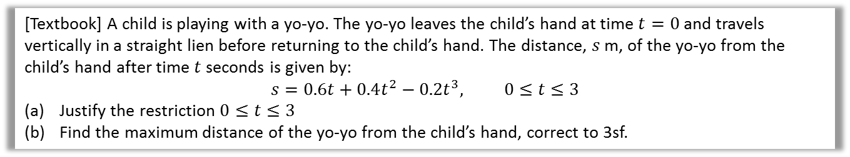

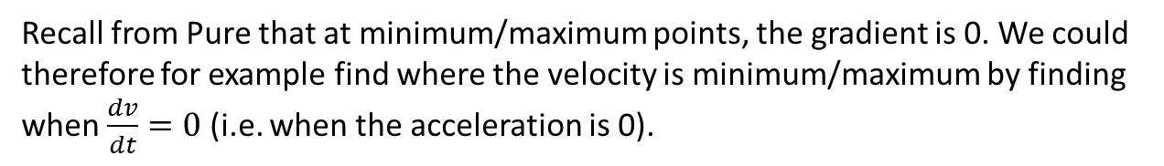




Maxima and Minima Problems
Recall from Pure that at minimum/maximum points, the gradient is 0. We could therefore for example find where the velocity is minimum/maximum by finding when $\frac{dv}{dt}=0$ (i.e. when the acceleration is 0).
[Textbook] A child is playing with a yo-yo. The yo-yo leaves the child’s hand at time $t=0$ and travels vertically in a straight lien before returning to the child’s hand. The distance, $s$ m, of the yo-yo from the child’s hand after time $t$ seconds is given by:
$$s=0.6t+0.4t^{2}−0.2t^{3}, 0≤t≤3$$
Justify the restriction $0≤t≤3$
Find the maximum distance of the yo-yo from the child’s hand, correct to 3sf.
$$s=\frac{1}{5}t\left(3+2t−t^{2}\right)=\frac{1}{5}t\left(3−t\right)\left(1+t\right)$$
$s$ is maximised when $\frac{ds}{dt}=0$.
$$\frac{ds}{dt}=0.6+0.8t−0.6t^{2}=0 \\ 3t^{2}−4t−3=0 \\ t=\frac{4±\sqrt{52}}{6}=1.8685 or −0.5351$$ $s=0.6\left(1.8685\right)+…=1.21$ m (3sf)
a
?
b
?
$$s$$
From the graph, we can see that for non-negative times ($t≥0$), $s$ is only positive for $0≤t≤3$.
$$3$$
$$t$$

Slide 3

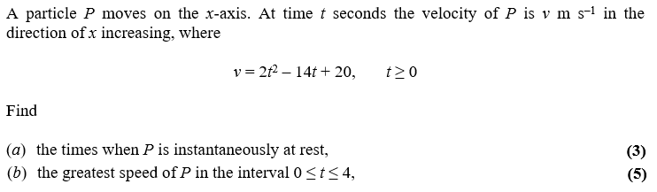
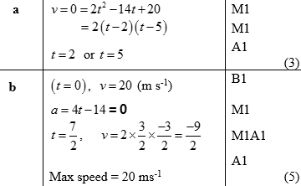
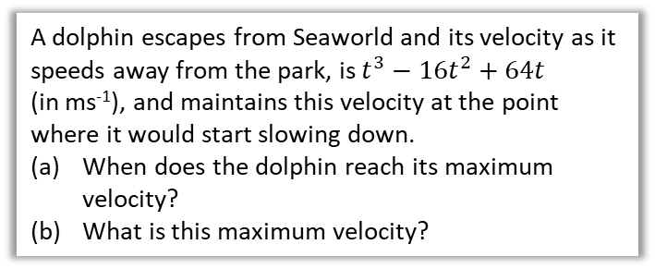

Test Your Understanding
a
?
A dolphin escapes from Seaworld and its velocity as it speeds away from the park, is $t^{3}−16t^{2}+64t$ (in ms⁻¹), and maintains this velocity at the point where it would start slowing down.
When does the dolphin reach its maximum velocity?
What is this maximum velocity?
At the maximum velocity, $\frac{dv}{dt}=0$
$$\frac{dv}{dt}=3t^{2}−32t+64=0 \\ \left(3t−8\right)\left(t−8\right)=0 \\ t=\frac{8}{3} or t=8$$
Given the shape of the cubic, $t=\frac{8}{3}$ corresponds to a maximum (and $t=8$ the minimum)
$v={\left(\frac{8}{3}\right)}^{3}−16{\left(\frac{8}{3}\right)}^{2}+64\left(\frac{8}{3}\right)=75.9$ ms⁻¹
b
?
Edexcel M2 June 2013 Q3a,b
a
?
b
?

Slide 4
Exercise 11.3 Maxima and minimum problems
Pearson Stats/Mechanics Year 1
Page 79-80

Slide 5
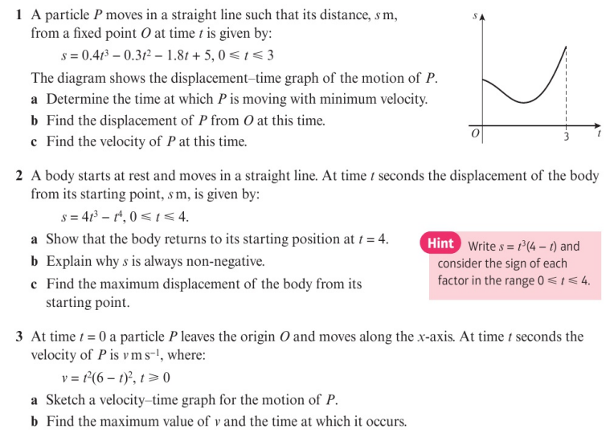
Homework Exercise

Slide 6
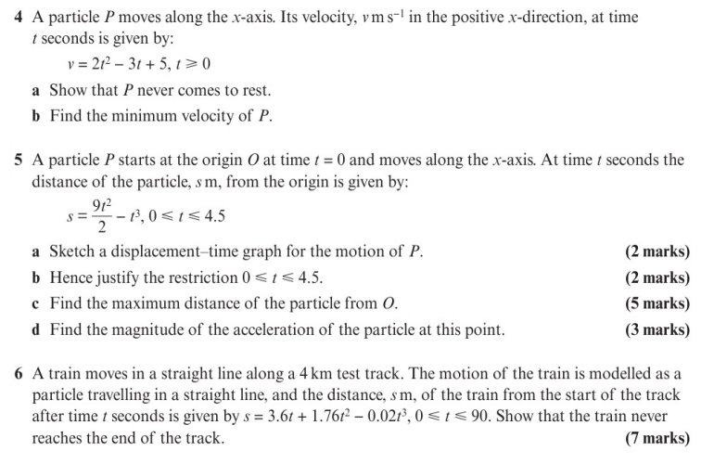
Homework Exercise

Slide 7
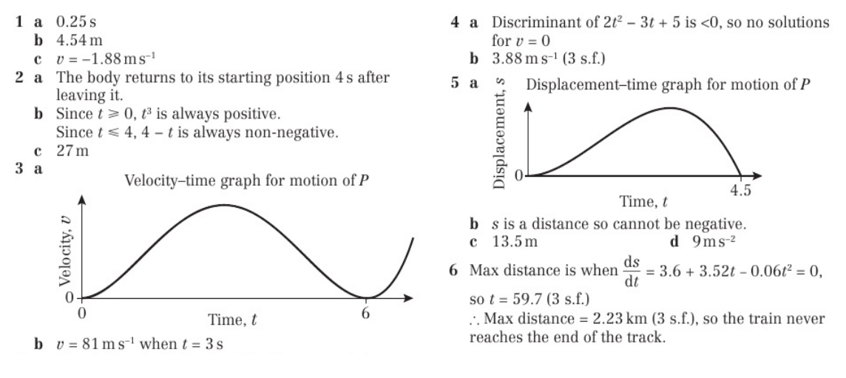
Homework Answers

