Slide 1
P2 Chapter 11: Integration Using Further Substitution

Slide 2


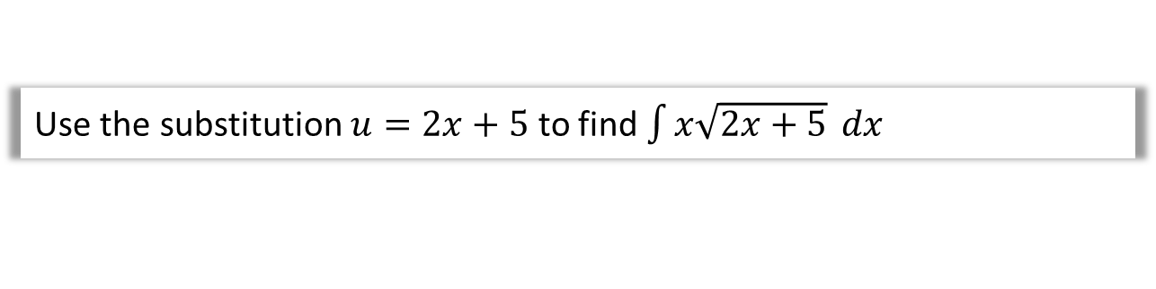
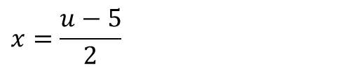
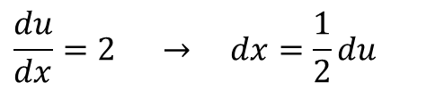
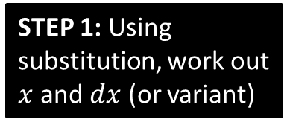
SKILL #5: Integration by Substitution
For some integrations involving a complicated expression, we can make a substitution to turn it into an equivalent integration that is simpler. We wouldn’t be able to use ‘reverse chain rule’ on the following:
Q
Use the substitution $u=2x+5$ to find $\int{x\sqrt{2x+5}} dx$
The aim is to completely remove any reference to $x$, and replace it with $u$. We’ll have to work out $x$ and $dx$ so that we can replace them.
STEP 1: Using substitution, work out $x$ and $dx$ (or variant)
?
$$\frac{du}{dx}=2 → dx=\frac{1}{2}du$$
Fro Tip: Be careful about ensuring you reciprocate when rearranging.
$$x=\frac{u−5}{2}$$
$$\int{x\sqrt{2x+5}} dx=\int{\frac{u−5}{2}\sqrt{u}\frac{1}{2}du}=\frac{1}{4}\int{\sqrt{u}\left(u−5\right) du} \\ =\frac{1}{4}\int{u^{\frac{3}{2}}−5u^{\frac{1}{2}}}$$
$$=\frac{1}{4}\left(\frac{2}{5}u^{\frac{5}{2}}−\frac{10}{3}u^{\frac{3}{2}}\right)+C$$
$$=\frac{{\left(2x+5\right)}^{\frac{5}{2}}}{10}−\frac{5{\left(2x+5\right)}^{\frac{3}{2}}}{6}+C$$
?
STEP 2: Substitute these into expression.
Fro Tip: If you have a constant factor, factor it out of the integral.
STEP 3: Integrate simplified expression.
?
STEP 4: Write answer in terms of $x$.
?

Slide 3
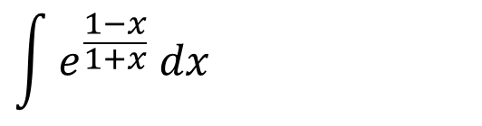


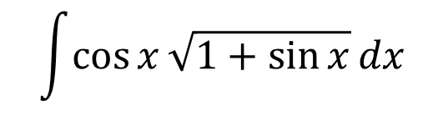
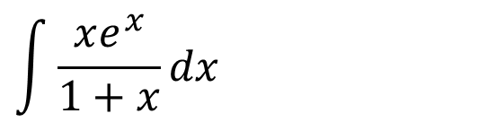

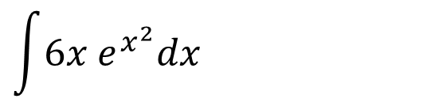

How can we tell what substitution to use?
There’s no hard and fast rule, but it’s often helpful to replace to replace expressions inside roots, powers or the denominator of a fraction.
Good judgement requires the experience of trying!
Sensible substitution:
$$\int{\cos{x}\sqrt{1+\sin{x}}dx}$$
?
$$u=1+\sin{x}$$
$$\int{6x e^{x^{2}}dx}$$
?
$$u=x^{2}$$
But this can be integrated by inspection.
$$\int{\frac{xe^{x}}{1+x}dx}$$
?
$$u=1+x$$
$$\int{e^{\frac{1−x}{1+x}} dx}$$
$$u=\frac{1−x}{1+x}$$
?

Slide 4

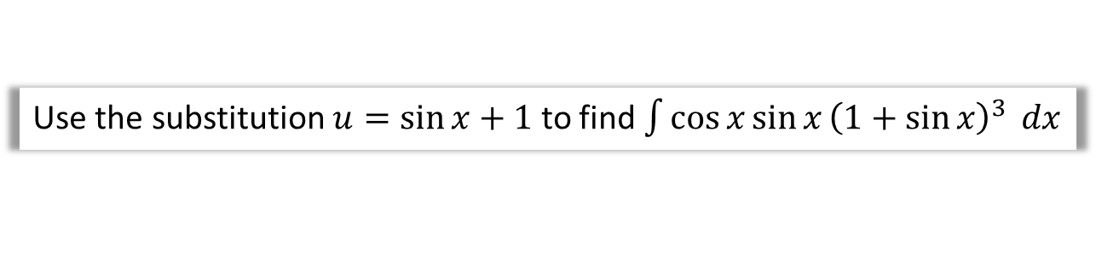



Another Example
Q
Use the substitution $u=\sin{x}+1$ to find $\int{\cos{x}\sin{x}{\left(1+\sin{x}\right)}^{3}} dx$
STEP 1: Using substitution, work out $x$ and $dx$ (or variant)
?
$$u=\sin{x}+1 \\ \frac{du}{dx}=\cos{x} → du=\cos{x} dx \\ \sin{x}=u−1$$
Notice this time we didn’t find $x$ or $dx$. We could, but then $x=\arcsin{(u−1)}$, and it would be slightly awkward simplifying the expression (although is still very much a valid method!)
STEP 2: Substitute these into expression.
?
$$=\int{\left(u−1\right)u^{3} du} \\ =\int{u^{4}−u^{3}} du \\ =\frac{1}{5}u^{5}−\frac{1}{4}u^{4}+C$$
$$=\frac{1}{5}{\left(\sin{x}+1\right)}^{5}−\frac{1}{4}{\left(\sin{x}+1\right)}^{4}+C$$
STEP 3: Integrate simplified expression.
?
STEP 4: Write answer in terms of $x$.
?

Slide 5



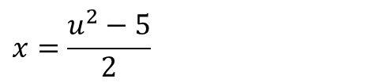
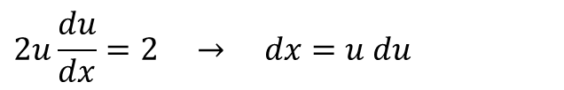


Using substitutions involving implicit differentiation
When a root is involved, it makes thing much tidier if we use $u^{2}=…$
Q
Use the substitution $u^{2}=2x+5$ to find $\int{x\sqrt{2x+5}} dx$
STEP 1: Using substitution, work out $x$ and $dx$ (or variant)
?
$$2u\frac{du}{dx}=2 → dx=u du$$
$$x=\frac{u^{2}−5}{2}$$
$$\int{x\sqrt{2x+5}} dx=\int{\frac{u^{2}−5}{2}u×udu} \\ =\int{\frac{1}{2}u^{4}−\frac{5}{2}u^{2} du} \\ =\frac{1}{10}u^{5}−\frac{5}{6}u^{3}+C$$
$$=\frac{{\left(2x+5\right)}^{\frac{5}{2}}}{10}−\frac{5{\left(2x+5\right)}^{\frac{3}{2}}}{6}+C$$
?
STEP 2: Substitute these into expression.
STEP 3: Integrate simplified expression.
?
STEP 4: Write answer in terms of $x$.
?
This was marginally less tedious than when we used $u=2x+5$, as we didn’t have fractional powers to deal with.

Slide 6
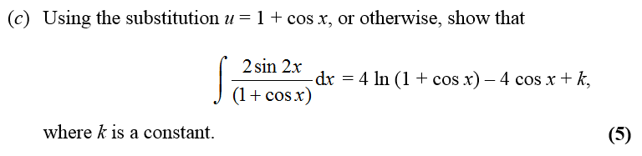

Test Your Understanding
Edexcel C4 Jan 2012 Q6c
Hint: You might want to use your double angle formula first.
$$\frac{du}{dx}=−\sin{x} → dx=−\frac{1}{\sin{x}}du$$
$\cos{x}=u−1$ (As before $x=\arccos\left(u−1\right)$ is going to be messy)
$$\int{\frac{2\sin{2x}}{1+\cos{x}}dx}=\int{\frac{4\sin{x}\cos{x}}{1+\cos{x}}dx}=\int{−\frac{4\sin{x}\left(u−1\right)}{u}}\frac{1}{\sin{x}}du \\ =−4\int{\frac{u−1}{u}du}=−4\int{1−\frac{1}{u}}du \\ =−4\left(u−\ln\left|u\right|\right)+c=−4\left(1+\cos{x}−\ln\left|\cos{x}+1\right|\right)+c=…$$
?

Slide 7
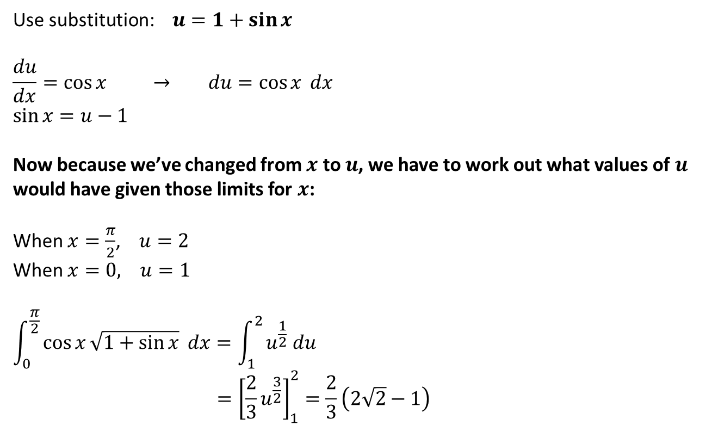
Definite Integration
Now consider:
Q
Calculate $\int_{0}^{\frac{π}{2}}{\cos{x}\sqrt{1+\sin{x}}} dx$
?
Use substitution: $u=1+\sin{x}$
$$\frac{du}{dx}=\cos{x} → du=\cos{x} dx$$
$$\sin{x}=u−1$$
Now because we’ve changed from $x$ to $u$, we have to work out what values of $u$ would have given those limits for $x$:
When $x=\frac{π}{2}$, $u=2$ When $x=0, u=1$
$$\int_{0}^{\frac{π}{2}}{\cos{x}\sqrt{1+\sin{x}}} dx=\int_{1}^{2}{u^{\frac{1}{2}} du} \\ ={\left[\frac{2}{3}u^{\frac{3}{2}}\right]}_{1}^{2}=\frac{2}{3}\left(2\sqrt{2}−1\right)$$
?
?
?

Slide 8
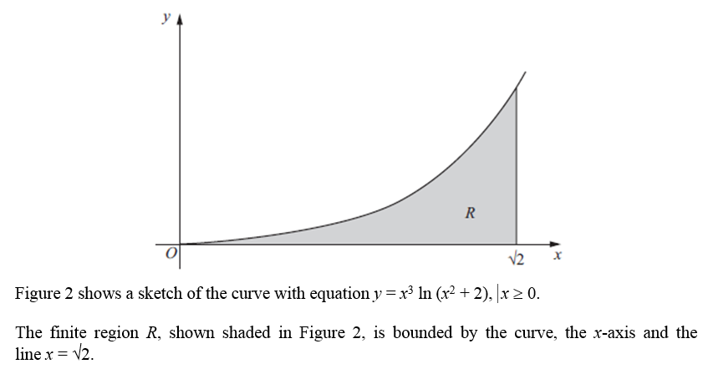
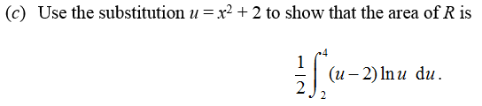

Test Your Understanding
Edexcel C4 June 2011 Q4
?
$$\frac{du}{dx}=2x → du=2x dx \\ x^{2}=u−2$$
When $x=\sqrt{2}$, $u={\left(\sqrt{2}\right)}^{2}+2=4$
When $x=0, u=0^{2}+2=2$
$$\int_{0}^{\sqrt{2}}{x^{2}\ln\left(x^{2}+2\right)x}dx=\int_{2}^{4}{\frac{1}{2}(u−2)\ln\left(u\right) du}$$

Slide 9
Exercise 11.5
Pearson Pure Year 2
Page 93

Slide 10
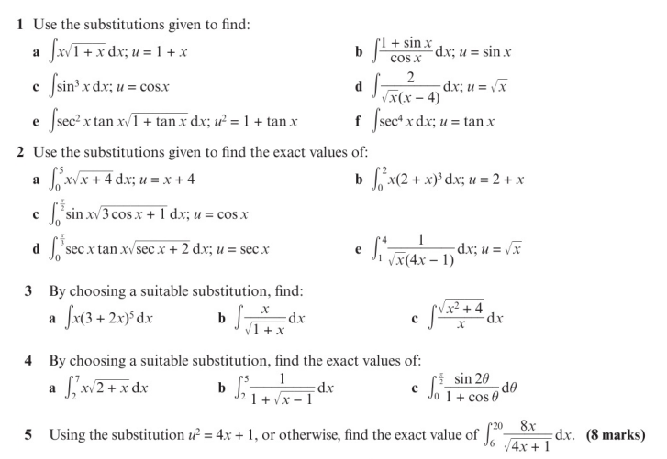
Homework Exercise

Slide 11
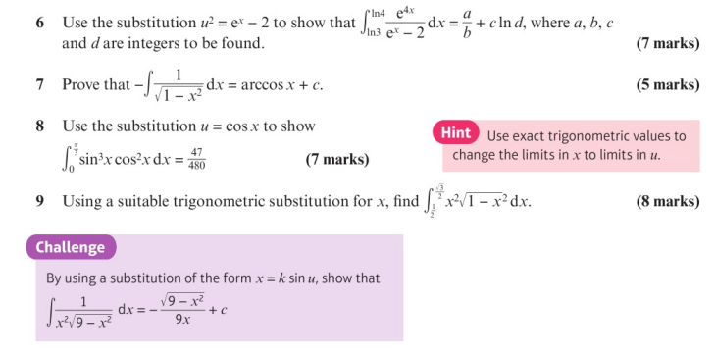
Homework Exercise

Slide 12
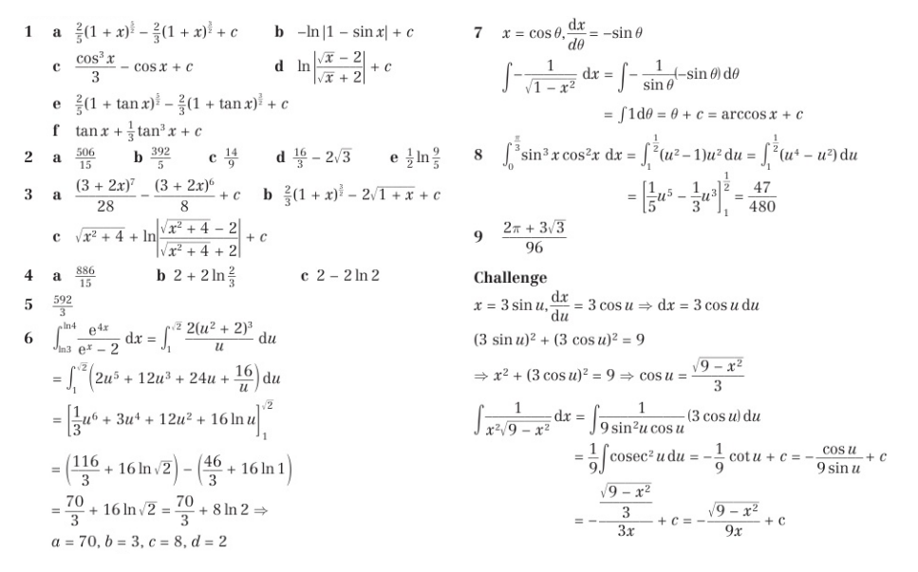
Homework Answers

