Slide 1
P1 Chapter 6: Circles The Circle Equation

Slide 2





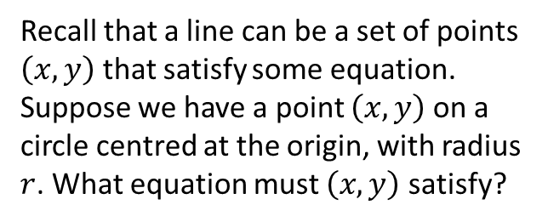




Equation of a circle
$$y$$
Recall that a line can be a set of points $\left(x,y\right)$ that satisfy some equation.
Suppose we have a point $\left(x,y\right)$ on a circle centred at the origin, with radius $r$. What equation must $\left(x,y\right)$ satisfy?
$$r$$
$$(x,y)$$
$$r$$
$$y$$
(Hint: draw a right-angled triangle inside your circle, with one vertex at the origin and another at the circumference)
$$x$$
$$x$$
$$r$$
?
$$x^{2}+y^{2}=r^{2}$$

Slide 3



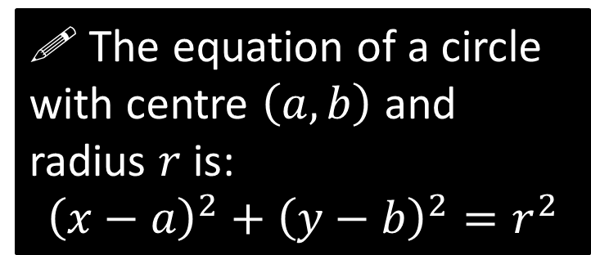
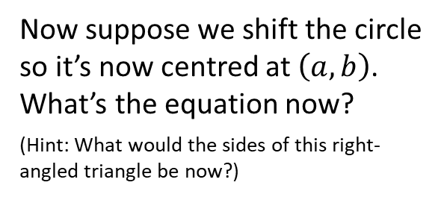
Equation of a circle
$$y$$
$$(x,y)$$
Now suppose we shift the circle so it’s now centred at $\left(a,b\right)$. What’s the equation now?
(Hint: What would the sides of this right-angled triangle be now?)
$$r$$
$$(a,b)$$
$$x$$
?
! The equation of a circle with centre $\left(a,b\right)$ and radius $r$ is:
$${\left(x−a\right)}^{2}+{\left(y−b\right)}^{2}=r^{2}$$

Slide 4





















Quickfire Questions
Centre
Radius
Equation
$$(0,0)$$
$$5$$
?
$$x^{2}+y^{2}=25$$
$$(1,2)$$
$$6$$
?
$${\left(x−1\right)}^{2}+{\left(y−2\right)}^{2}=36$$
?
?
$$(−3,5)$$
$$1$$
$${\left(x+3\right)}^{2}+{\left(y−5\right)}^{2}=1$$
?
?
$$(−5,2)$$
$$7$$
$${\left(x+5\right)}^{2}+{\left(y−2\right)}^{2}=49$$
?
?
$$(−6,0)$$
$$4$$
$${\left(x+6\right)}^{2}+y^{2}=16$$
?
?
$$(1,−1)$$
$$\sqrt{3}$$
$${\left(x−1\right)}^{2}+{\left(y+1\right)}^{2}=3$$
?
?
$$(−2,3)$$
$$2\sqrt{2}$$
$${\left(x+2\right)}^{2}+{\left(y−3\right)}^{2}=8$$

Slide 5



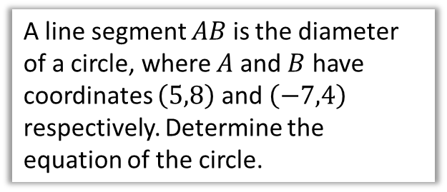
Finding the equation using points
A line segment $AB$ is the diameter of a circle, where $A$ and $B$ have coordinates $\left(5,8\right)$ and $\left(−7,4\right)$ respectively. Determine the equation of the circle.
$$A\left(5,8\right)$$
$$B\left(−7,4\right)$$
Hint: What two things do we need to use the circle formula?
?
Centre: $C\left(−1, 6\right)$
We can use the distance $BC$ or $AC$ as the radius. Using $B\left(−7,4\right)$ and $M\left(−1,6\right)$
$$r=\sqrt{6^{2}+2^{2}}=\sqrt{40}=2\sqrt{10}$$
$$∴ {\left(x+1\right)}^{2}+{\left(y−6\right)}^{2}=40$$

Slide 6
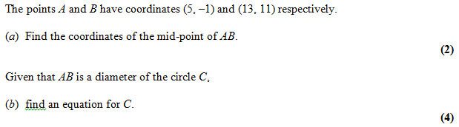
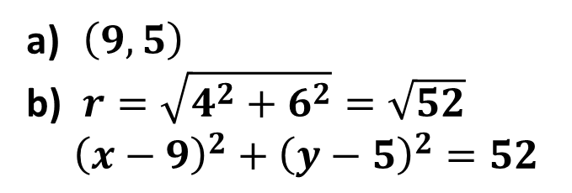
Test Your Understanding
Edexcel C2 Jan 2005 Q2
?
$\left(9, 5\right)$
$r=\sqrt{4^{2}+6^{2}}=\sqrt{52}$ ${\left(x−9\right)}^{2}+{\left(y−5\right)}^{2}=52$
?

Slide 7
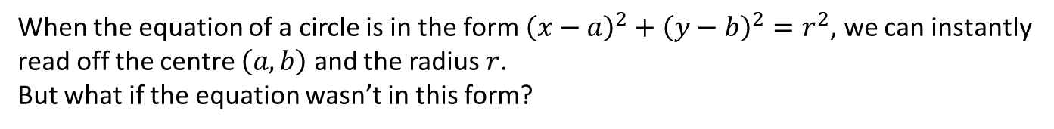
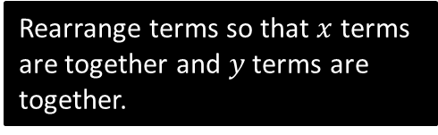
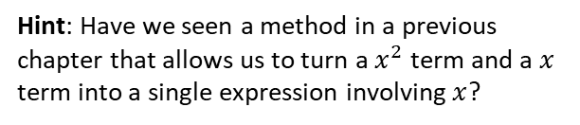
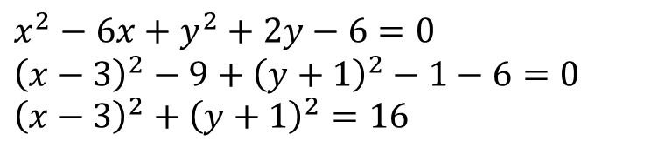
Completing the square
When the equation of a circle is in the form ${\left(x−a\right)}^{2}+{\left(y−b\right)}^{2}=r^{2}$, we can instantly read off the centre $\left(a,b\right)$ and the radius $r$.
But what if the equation wasn’t in this form?
Find the centre and radius of the circle with equation $x^{2}+y^{2}−6x+2y−6=0$
Hint: Have we seen a method in a previous chapter that allows us to turn a $x^{2}$ term and a $x$ term into a single expression involving $x$?
?
$$x^{2}−6x+y^{2}+2y−6=0 \\ {\left(x−3\right)}^{2}−9+{\left(y+1\right)}^{2}−1−6=0 \\ {\left(x−3\right)}^{2}+{\left(y+1\right)}^{2}=16$$
Rearrange terms so that $x$ terms are together and $y$ terms are together.
Complete the square!

Slide 8
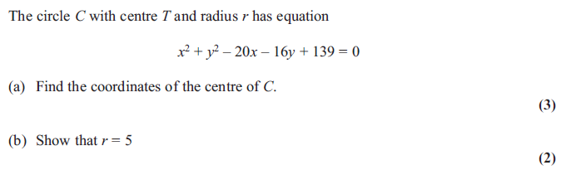
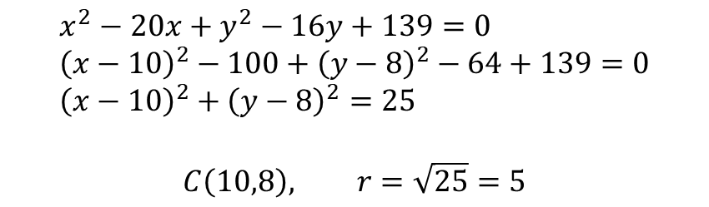
Further Example
Edexcel C2 June 2012 Q3a,b
?
$$x^{2}−20x+y^{2}−16y+139=0 \\ {\left(x−10\right)}^{2}−100+{\left(y−8\right)}^{2}−64+139=0 \\ {\left(x−10\right)}^{2}+{\left(y−8\right)}^{2}=25$$
$$C\left(10,8\right), r=\sqrt{25}=5$$

Slide 9
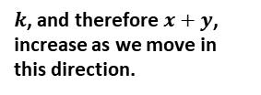




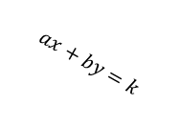



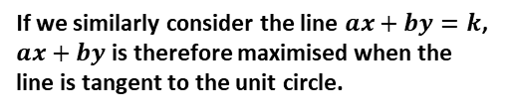





Exercise 6.2
Pearson Pure Mathematics Year 1/AS
Page 47
Extension:
2
[MAT 2007 1D]
The point on the circle
$${\left(x−5\right)}^{2}+{\left(y−4\right)}^{2}=4$$
which is closest to the circle
$${\left(x−1\right)}^{2}+{\left(y−1\right)}^{2}=1$$
has what coordinates?
Drawing the circles on the same axes, and drawing a straight line connecting their centres, the point is where the straight line intersects the first circle.
The circle centres are 5 apart, so we need to go $\frac{2}{5}$ of the way across this line, giving $(3.4, 2.8)$
[MAT 2016 1I] Let $a$ and $b$ be positive real numbers. If $x^{2}+y^{2}≤1$ then the largest that $ax+by$ can equal is what? Give your expression in terms of $a$ and $b$.
Many MAT questions consider maximising an expression in terms of $x$ and $y$. Consider for example the simple case $x+y=k$. As we increase $k$, the line stays in the same direction but ‘sweeps’ across:
3
1
[MAT 2009 1B] The point on the circle $x^{2}+y^{2}+6x+8y=75$ which is closest to the origin, is at what distance from the origin?
$${\left(x+3\right)}^{2}+{\left(y+4\right)}^{2}=100 \\ ∴C\left(−3,−4\right), r=10$$
The closest point $P$ lies on the line between the circle centre and the origin. Since $\left(−3,−4\right)$ is 5 away from the origin, the distance between the origin and $P$ must be $10−5=5$
?
?
?
$$y$$
$$k=3$$
$k$, and therefore $x+y$, increase as we move in this direction.
$$k=2$$
$$k=1$$
$$x$$
If we similarly consider the line $ax+by=k$, $ax+by$ is therefore maximised when the line is tangent to the unit circle.
$$\sqrt{\frac{k^{2}}{a^{2}}+\frac{k^{2}}{b^{2}}}$$
$$\frac{k}{b}$$
$$\frac{k}{b}$$
$$ax+by=k$$
1
$$\left(−3,−4\right)$$
1
$$\frac{k}{a}$$
$$\frac{k}{a}$$
Using similar triangles, we can obtain $k=\sqrt{a^{2}+b^{2}}$

Slide 10
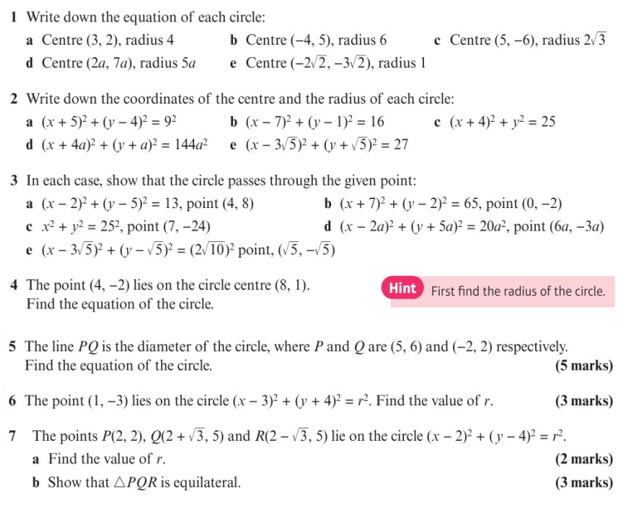
Homework Exercise

Slide 11
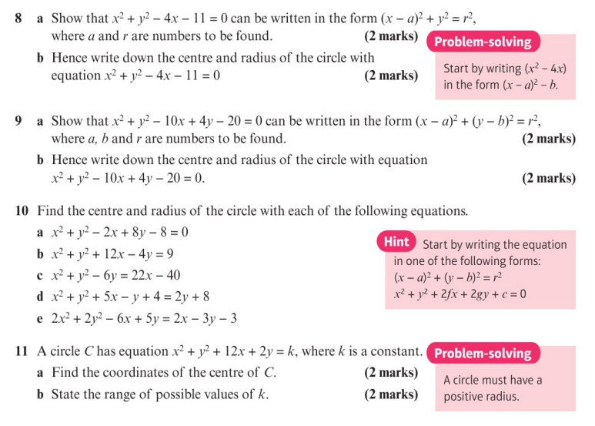
Homework Exercise

Slide 12
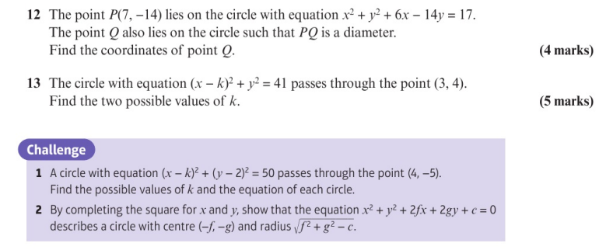
Homework Exercise

Slide 13
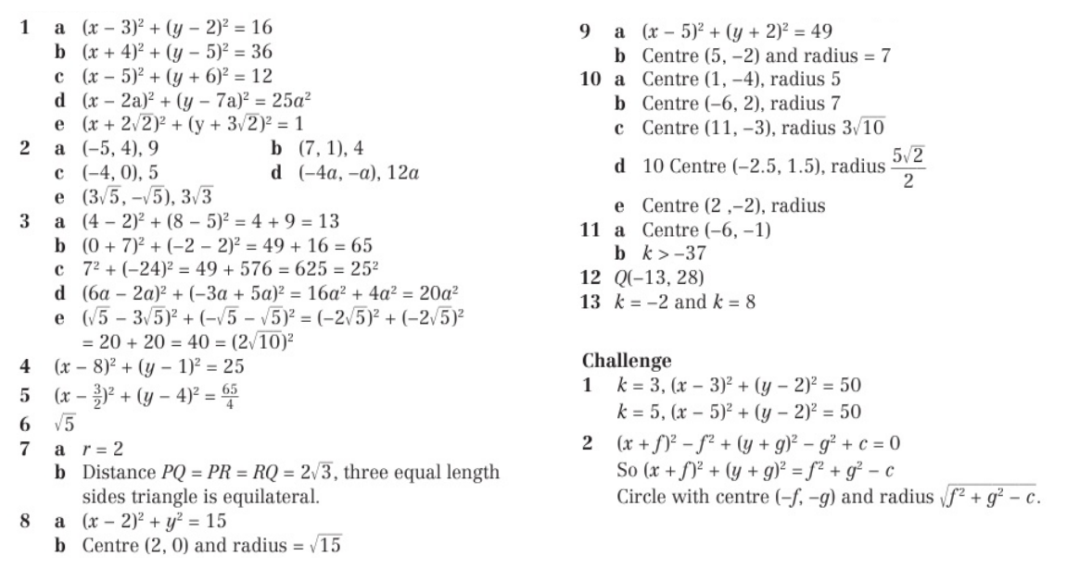
Homework Answers

