Slide 1
P2 Chapter 10: Numerical Methods Iteration

Slide 2
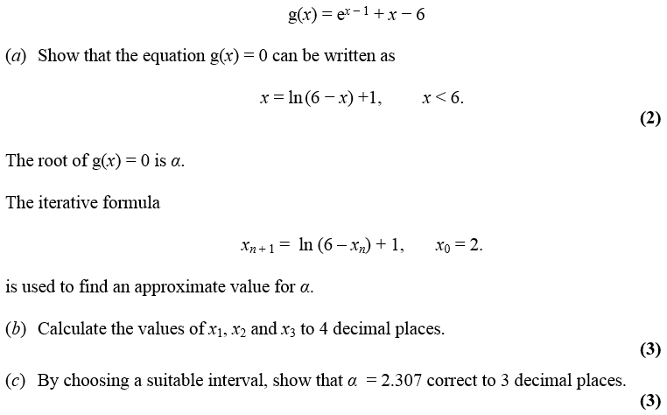

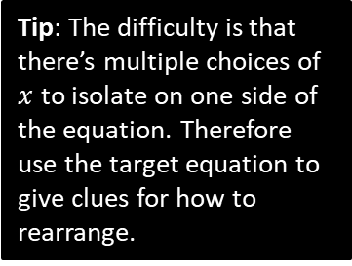
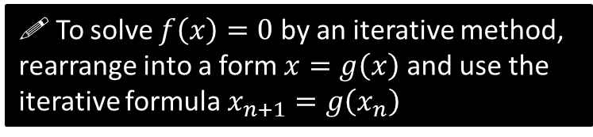
Using iteration to approximate a root
Edexcel C3 Jan 2013
a
?
$$0=e^{x−1}+x−6 \\ 6−x=e^{x−1} \\ \ln\left(6−x\right)=x−1 \\ \ln\left(6−x\right)+1=x$$
Tip: The difficulty is that there’s multiple choices of $x$ to isolate on one side of the equation. Therefore use the target equation to give clues for how to rearrange.
! To solve $f\left(x\right)=0$ by an iterative method, rearrange into a form $x=g\left(x\right)$ and use the iterative formula $x_{n+1}=g\left(x_{n}\right)$
We’ll see why it works later.

Slide 3
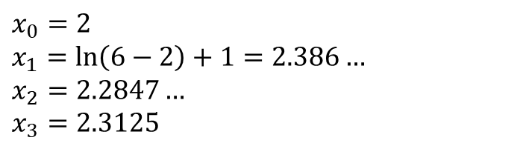
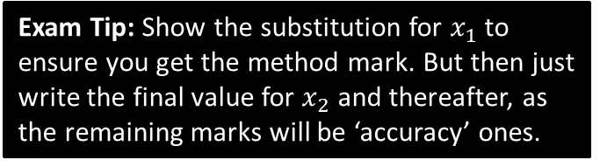
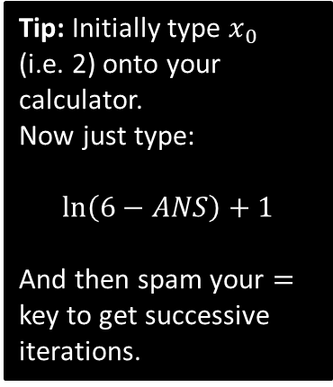
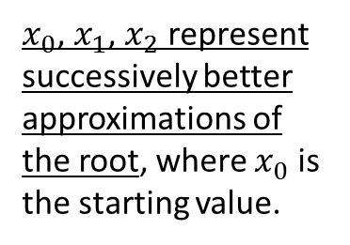
Using iteration to approximate a root
Edexcel C3 Jan 2013
$x_{0}$, $x_{1}$, $x_{2}$ represent successively better approximations of the root, where $x_{0}$ is the starting value.
Tip: Initially type $x_{0}$ (i.e. 2) onto your calculator.
Now just type:
$$\ln\left(6−ANS\right)+1$$
And then spam your $=$ key to get successive iterations.
b
$$x_{0}=2 \\ x_{1}=\ln\left(6−2\right)+1=2.386… \\ x_{2}=2.2847… \\ x_{3}=2.3125$$
?
Exam Tip: Show the substitution for $x_{1}$ to ensure you get the method mark. But then just write the final value for $x_{2}$ and thereafter, as the remaining marks will be ‘accuracy’ ones.

Slide 4
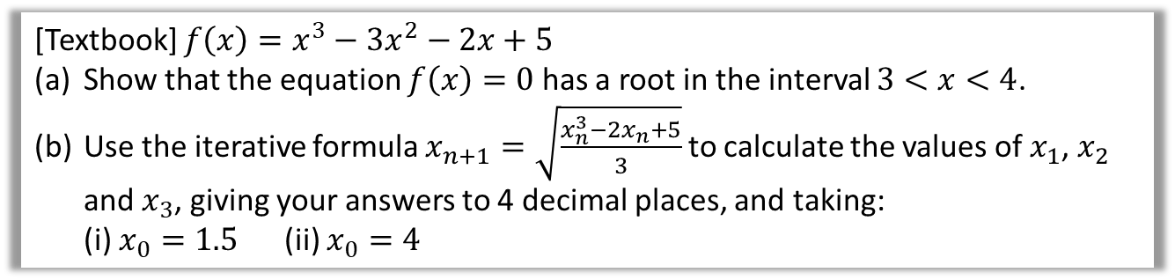
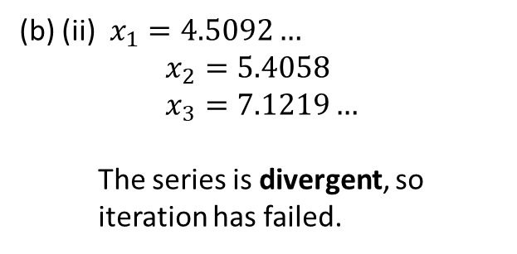

Does the starting value $x_{0}$ matter?
Yes! We’ll see why in a bit when we look at staircase and cobweb diagrams.
If there are a multiple roots, iteration might converge to (i.e. approach) a different root.
Or we may not converge to a root at all, and diverge (i.e. approach infinity).
[Textbook] $f\left(x\right)=x^{3}−3x^{2}−2x+5$
Show that the equation $f\left(x\right)=0$ has a root in the interval $3<x<4$.
Use the iterative formula $x_{n+1}=\sqrt{\frac{x_{n}^{3}−2x_{n}+5}{3}}$ to calculate the values of $x_{1}$, $x_{2}$ and $x_{3}$, giving your answers to 4 decimal places, and taking: (i) $x_{0}=1.5$ (ii) $x_{0}=4$
$f\left(3\right)=−1 f\left(4\right)=13$ There is a change in sign in the interval $3<x<4$ and $f$ is continuous, so there is a root of $f(x)$ in this interval.
i) $x_{1}=\sqrt{\frac{{1.5}^{3}−2\left(1.5\right)+5}{3}}=1.3385…$ $x_{2}=1.2544… , x_{3}=1.2200…$ This appears to be convergent as the change in the root on each iteration is becoming smaller.
(b) (ii) $x_{1}=4.5092…$ $$x_{2}=5.4058 \\ x_{3}=7.1219…$$
The series is divergent, so iteration has failed.
?
?
?

Slide 5
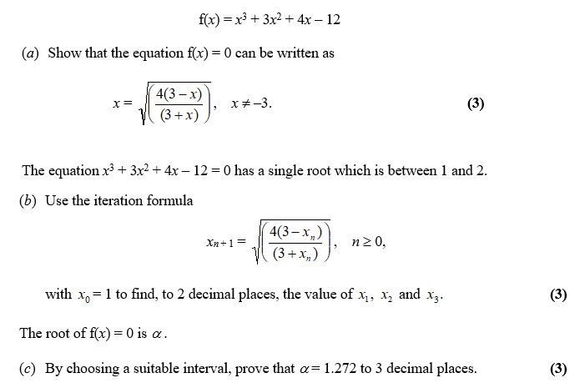
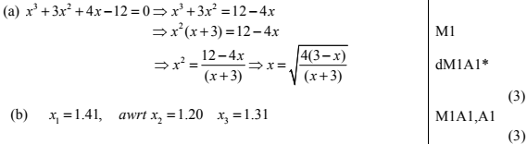
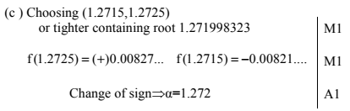
Test Your Understanding
Edexcel C3 June 2012 Q2
Warning: Any particular mark scheme gives what is minimally acceptable. So you should use the full wording earlier to avoid the risk of mark loss.
?
?
?

Slide 6
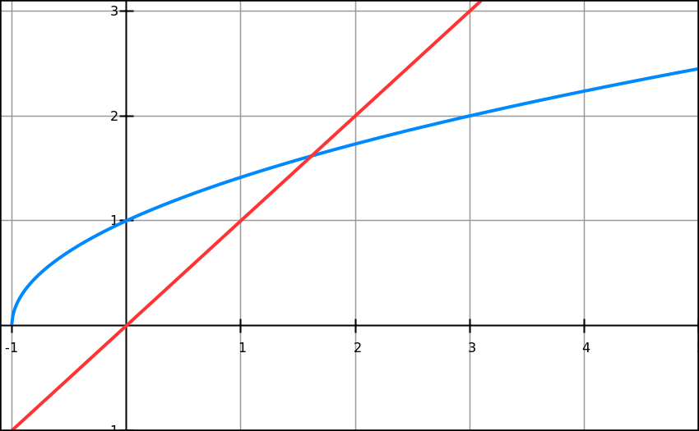
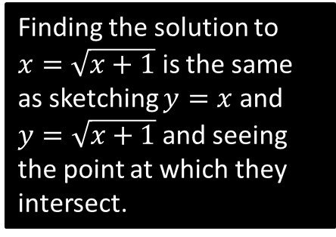
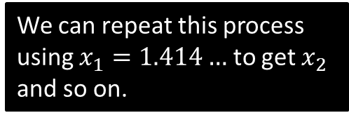





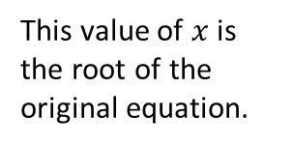

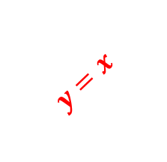
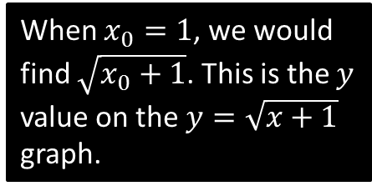

Why does this method work?
Solve $x^{2}−x−1=0$
Recall we put in the form $x=g\left(x\right)$: in this case $x=\sqrt{x+1}$ is one possible rearrangement.
We can then use the recurrence $x_{n+1}=\sqrt{x_{n}+1}$ . Why does this recurrence work?
This is called a staircase diagram due to its shape. We can see that we’re converging towards the root $α$.
$$y=x$$
$$y=\sqrt{x+1}$$
Finding the solution to $x=\sqrt{x+1}$ is the same as sketching $y=x$ and $y=\sqrt{x+1}$ and seeing the point at which they intersect.
This value of $x$ is the root of the original equation.
This gives $x_{1}=1.414…$ This is then fed back into $\sqrt{x_{n}+1}$ for the next iteration, i.e. the $y$ value becomes the new $x$ value! This is equivalent to moving to the line $y=x$.
$$x_{1}$$
$$α$$
$$x_{0}$$
When $x_{0}=1$, we would find $\sqrt{x_{0}+1}$. This is the $y$ value on the $y=\sqrt{x+1}$ graph.
We can repeat this process using $x_{1}=1.414…$ to get $x_{2}$ and so on.

Slide 7
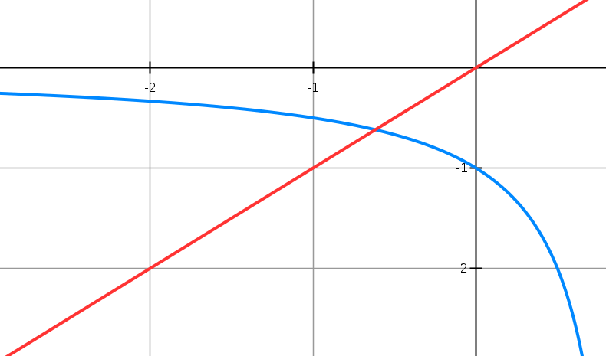





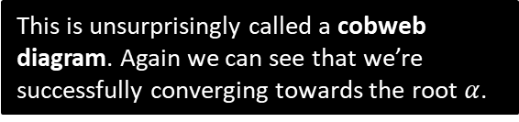
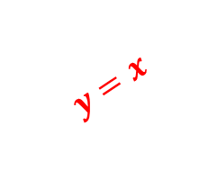

Cobweb Diagrams
Solve $x^{2}−x−1=0$
We could also have rearranged differently to $x=\frac{1}{x−1}$
Therefore we use the recurrence $x_{n+1}=\frac{1}{x_{n}−1}$ . What happens this time?
$$y=x$$
$$x_{2}$$
$$x_{0}$$
$$α$$
$$x_{1}$$
$$x_{3}$$
$$y=\frac{1}{x−1}$$
This is unsurprisingly called a cobweb diagram. Again we can see that we’re successfully converging towards the root $α$.

Slide 8
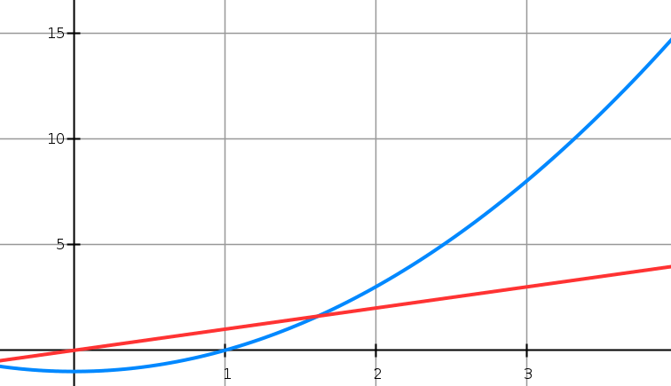

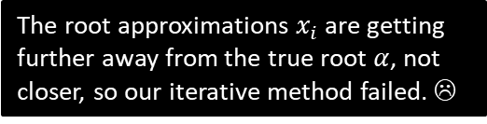



And when iteration fails…
Solve $x^{2}−x−1=0$
But again, we could have rearranged differently! $x=x^{2}−1$
Using the recurrence $x_{n+1}=x_{n}^{2}−1$ : what happens this time?
The root approximations $x_{i}$ are getting further away from the true root $α$, not closer, so our iterative method failed. ☹
$$α$$
$$x_{0}$$
$$x_{1}$$

Slide 9
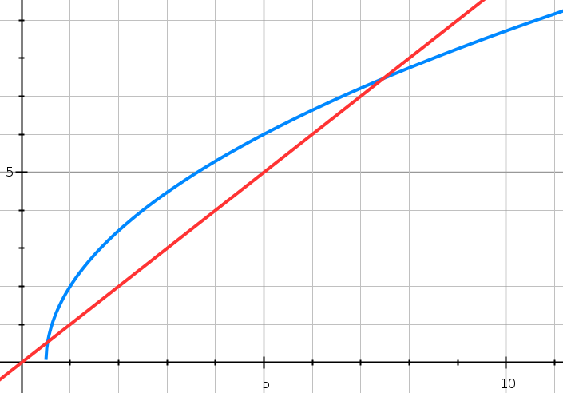


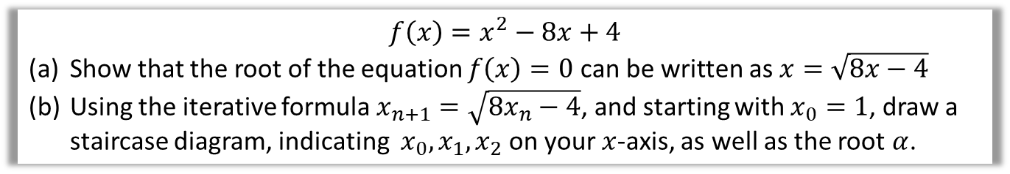


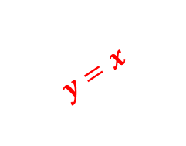

Test Your Understanding
$$f\left(x\right)=x^{2}−8x+4$$
Show that the root of the equation $f\left(x\right)=0$ can be written as $x=\sqrt{8x−4}$
Using the iterative formula $x_{n+1}=\sqrt{8x_{n}−4}$, and starting with $x_{0}=1$, draw a staircase diagram, indicating $x_{0},x_{1}, x_{2}$ on your $x$-axis, as well as the root $α$.
?
$$y=x$$
$$y=\sqrt{8x−4}$$
$$x_{0}$$
$$x_{1}$$
$$x_{2}$$
$$α$$

Slide 10
Exercise 10.2
Pearson Pure Mathematics Year 2/AS
Page 82

Slide 11
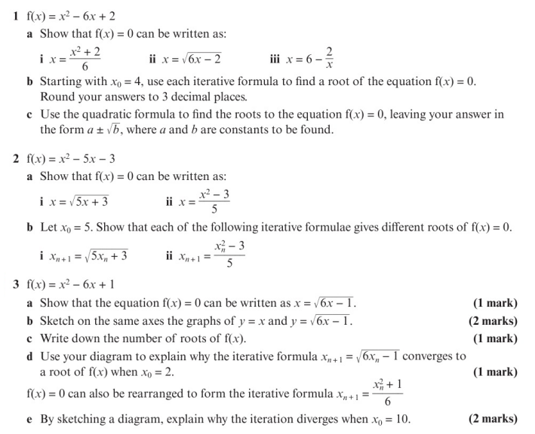
Homework Exercise

Slide 12
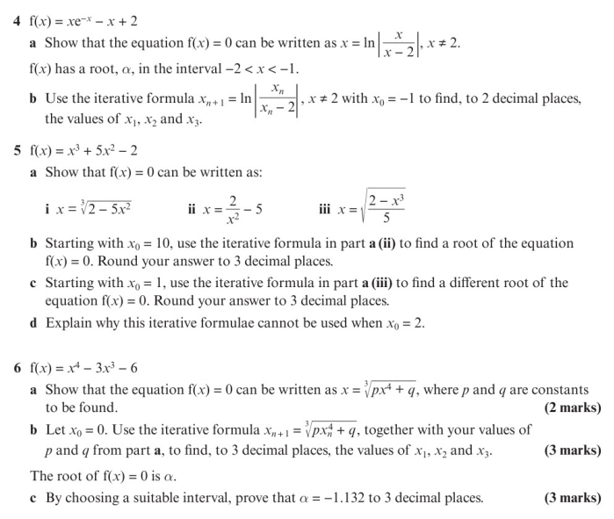
Homework Exercise

Slide 13
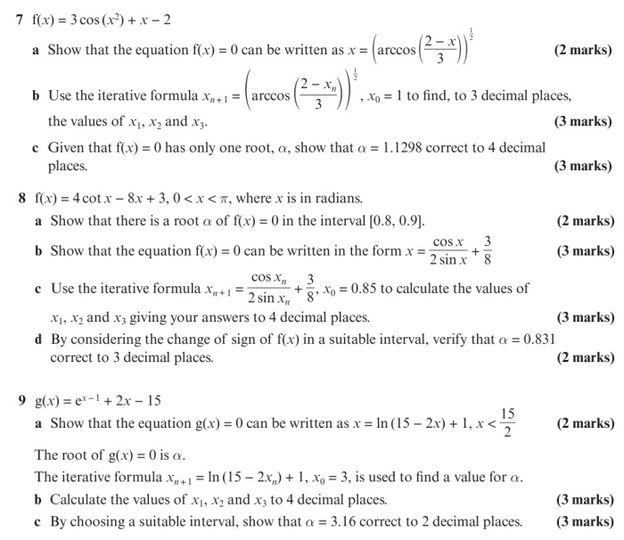
Homework Exercise

Slide 14
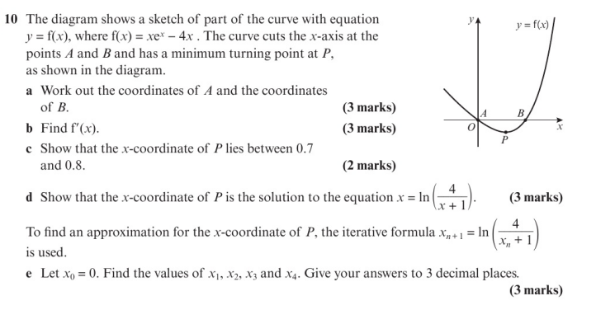
Homework Exercise

Slide 15
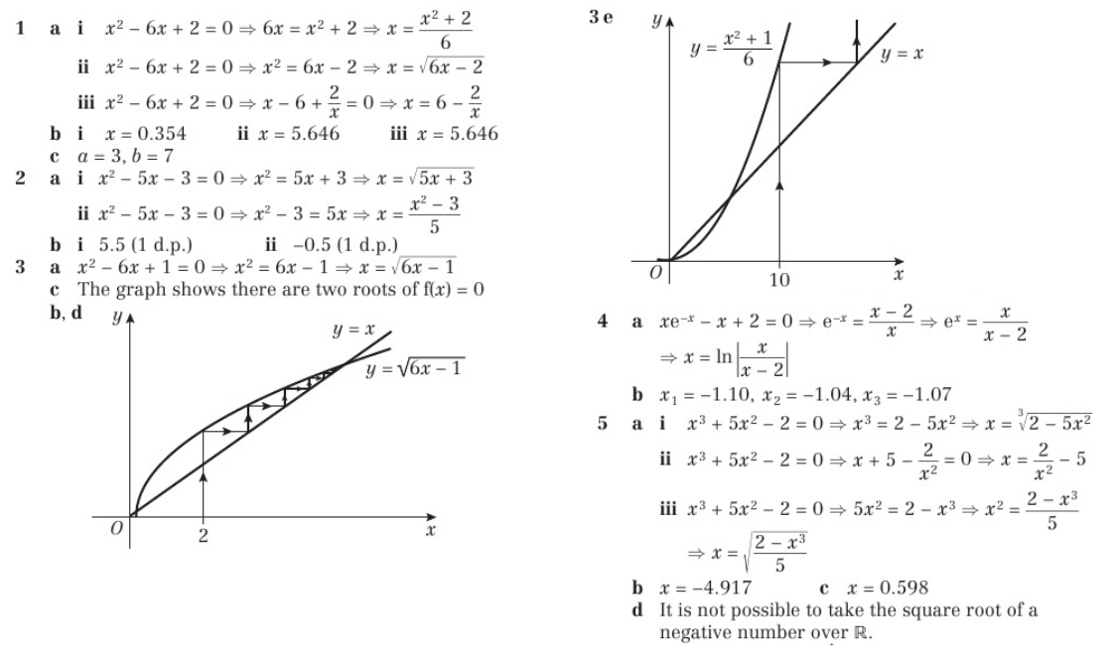
Homework Answers

Slide 16
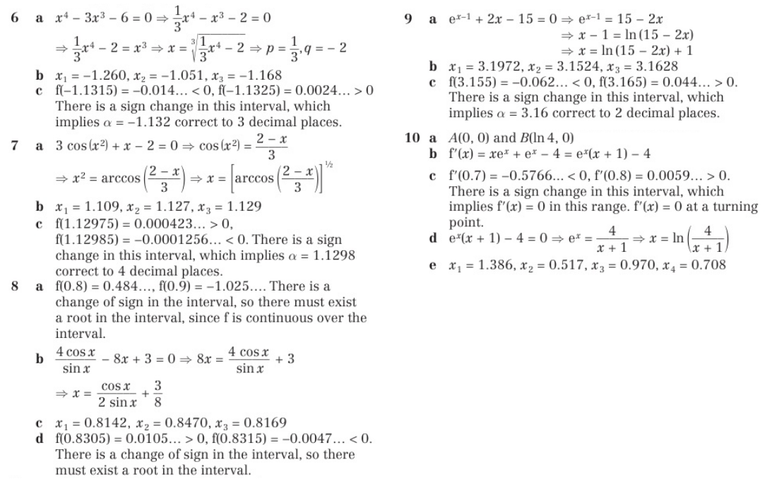
Homework Answers

