Slide 1
P1 Chapter 14: Logarithms Natural Logs

Slide 2


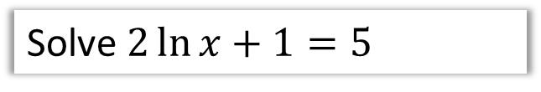
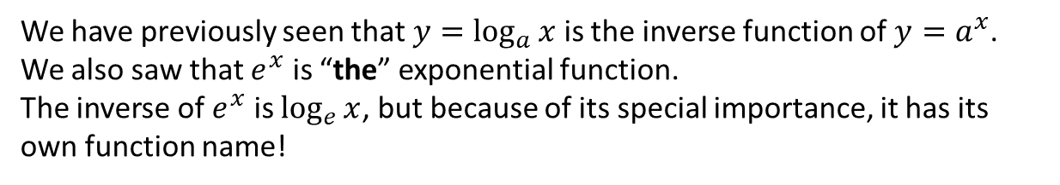
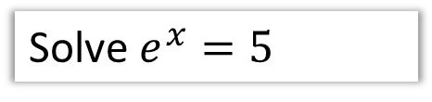
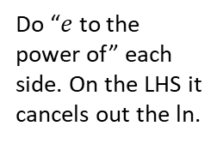
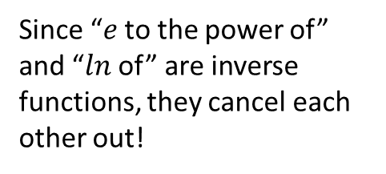


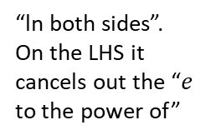
Natural Logarithms
We have previously seen that $y=\log_{a}{x}$ is the inverse function of $y=a^{x}$.
We also saw that $e^{x}$ is “the” exponential function.
The inverse of $e^{x}$ is $\log_{e}{x}$, but because of its special importance, it has its own function name!
! The inverse of $y=e^{x}$ is $y=\ln{x}$
?
Since “$e$ to the power of” and “$ln$ of” are inverse functions, they cancel each other out!
$$\ln{e^{x}}=x \\ e^{\ln{x}}=x$$
?
Solve $e^{x}=5$
Solve $2\ln{x}+1=5$
?
?
“ln both sides”.
On the LHS it cancels out the “$e$ to the power of”
$$\ln{x}=2 \\ x=e^{2}$$
$$x=\ln{5}$$
Do “$e$ to the power of” each side. On the LHS it cancels out the ln.

Slide 3
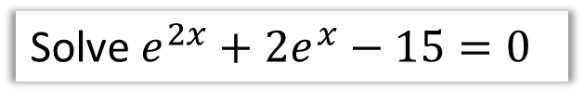


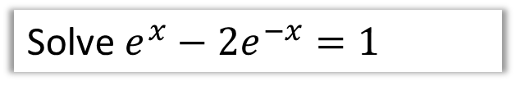
Quadratics in $e^{x}$
In previous chapters we’ve already dealt with quadratics in disguise, e.g. “quadratic in sin”. We therefore just apply our usual approach: either make a suitable substitution so the equation is then quadratic, or (strongly recommended!) go straight for the factorisation.
Solve $e^{2x}+2e^{x}−15=0$
Solve $e^{x}−2e^{−x}=1$
?
?
Note that $e^{2x}={\left(e^{x}\right)}^{2}$ therefore
$$\left(e^{x}+5\right)\left(e^{x}−3\right)=0 \\ e^{x}=−5 or e^{x}=3$$
Exponential functions are always positive therefore:
$$x=\ln{3}$$
First write negative powers as fractions:
$$e^{x}−\frac{2}{e^{x}}=1 \\ {\left(e^{x}\right)}^{2}−2=e^{x} \\ {\left(e^{x}\right)}^{2}−e^{x}−2=0 \\ \left(e^{x}+1\right)\left(e^{x}−2\right)=0 \\ e^{x}=−1 or e^{x}=2 \\ x=\ln{2}$$

Slide 4


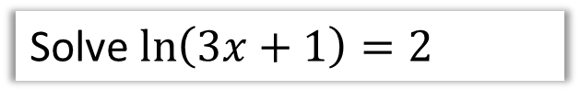

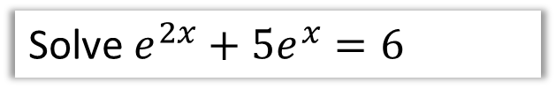
Test Your Understanding
Solve $\ln\left(3x+1\right)=2$
Solve $e^{2x}+5e^{x}=6$
?
?
$$3x+1=e^{2} \\ x=\frac{e^{2}−1}{3}$$
$$e^{2x}+5e^{x}−6=0 \\ \left(e^{x}+6\right)\left(e^{x}−1\right)=0 \\ e^{x}=−6 or e^{x}=1 \\ x=\ln{1}=0$$
Solve $2^{x}e^{x+1}=3$ giving your answer as an exact value.
?
$$\ln{2^{x}e^{x+1}}=\ln{3} \\ \ln{2^{x}}+\ln{e^{x+1}=\ln{3}} \\ x\ln{2}+x+1=\ln{3} \\ x\left(\ln{2}+1\right)=\ln{3}−1 \\ x=\frac{\ln{3}−1}{\ln{2}+1}$$

Slide 5
Exercise 14.7
Pearson Pure Mathematics Year 1/AS
Page 119

Slide 6
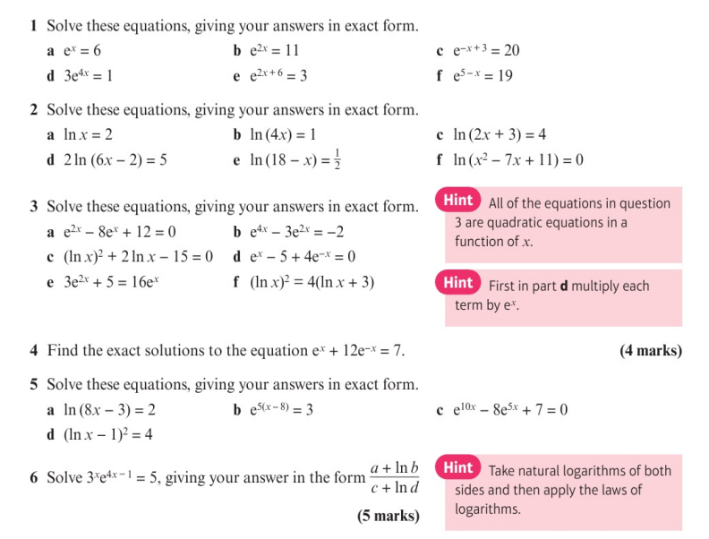
Homework Exercise

Slide 7
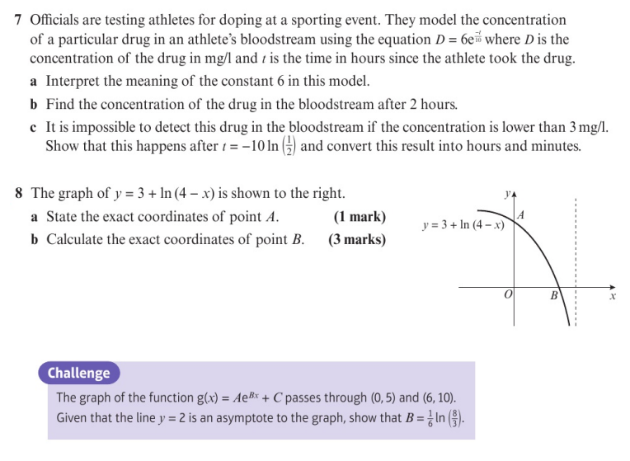
Homework Exercise

Slide 8
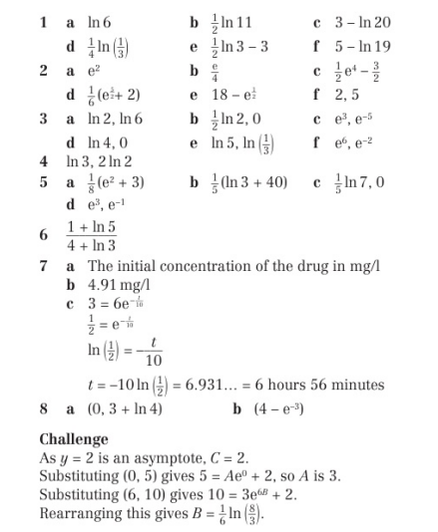
Homework Answers

