Slide 1
P2 Chapter 3: Sequences and Series
Sigma Notation

Slide 2

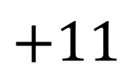
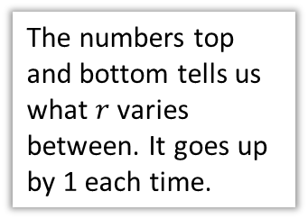
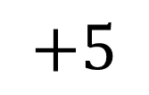


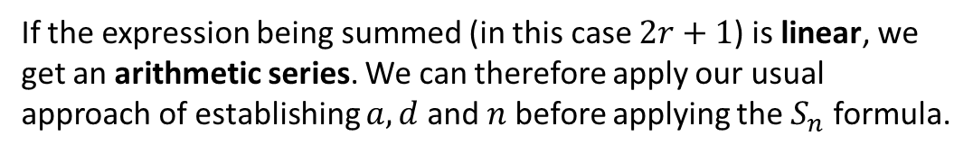

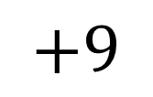
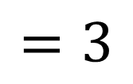
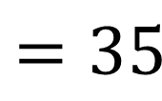

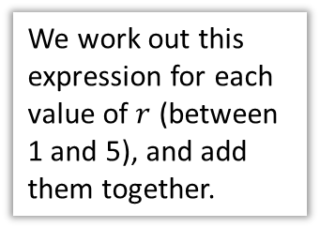
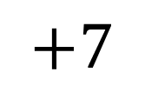

Sigma Notation
What does each bit of this expression mean?
The Greek letter, capital sigma, means ‘sum’.
$$\sum_{r=1}^{5}{(2r+1)}$$
We work out this expression for each value of $r$ (between 1 and 5), and add them together.
The numbers top and bottom tells us what $r$ varies between. It goes up by 1 each time.
$$r=1$$
$$r=2$$
$$r=3$$
$$r=4$$
$$r=5$$
$$=3$$
$$+5$$
$$+7$$
$$+9$$
$$+11$$
$$=35$$
If the expression being summed (in this case $2r+1$) is linear, we get an arithmetic series. We can therefore apply our usual approach of establishing $a, d$ and $n$ before applying the $S_{n}$ formula.

Slide 3


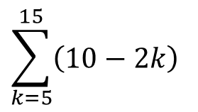


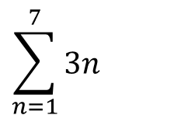
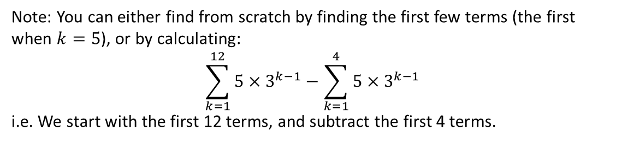

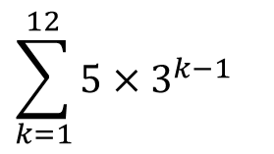

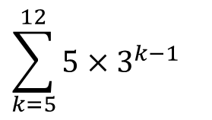




Determining the value
First few terms?
Values of $a, n, d or r$?
Final result?
$$\sum_{n=1}^{7}{3n}$$
?
?
?
$$S_{7}=\frac{7}{2}\left(6+6×3\right) \\ =84$$
$$=3+6+9+…$$
$$a=3, d=3, n=7$$
$$\sum_{k=5}^{15}{\left(10−2k\right)}$$
?
?
?
$$a=0, d=−2, n=11$$
$$S_{11}=\frac{11}{2}\left(0+10×−2\right) \\ =−110$$
$$=0+\left(−2\right)+\left(−4\right)+…$$
Be careful, there are 11 numbers between 5 and 15 inclusive. Subtract and +1.
$$\sum_{k=1}^{12}{5×3^{k−1}}$$
?
?
?
$$=5+15+45+…$$
$$a=5, r=3, n=12$$
$$S_{12}=\frac{5\left(1−3^{12}\right)}{1−3}=1328600$$
$$\sum_{k=5}^{12}{5×3^{k−1}}$$
?
Note: You can either find from scratch by finding the first few terms (the first when $k=5$), or by calculating:
$$\sum_{k=1}^{12}{5×3^{k−1}}−\sum_{k=1}^{4}{5×3^{k−1}}$$
i.e. We start with the first 12 terms, and subtract the first 4 terms.

Slide 4
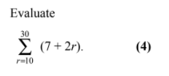


Testing Your Understanding
Solomon Paper A
Method 1: Direct
$$\sum_{r=10}^{30}{\left(7+2r\right)=}27+29+31+…$$
$$a=27, d=2, n=21$$
$$∴S_{21}=\frac{21}{2}\left(54+20×2\right) \\ =987$$
Method 2: Subtraction
$$\sum_{r=10}^{30}{\left(7+2r\right)}=\sum_{r=1}^{30}{\left(7+2r\right)}−\sum_{r=1}^{9}{\left(7+2r\right)}$$
$$\sum_{r=1}^{30}{\left(7+2r\right)}=9+11+13+…$$
$$a=9, d=2, n=30 \\ S_{30}=\frac{30}{2}\left(18+29×2\right)=1140 \\ S_{9}=\frac{9}{2}\left(18+8×2\right)=153 \\ 1140−153=987$$
?
?

Slide 5
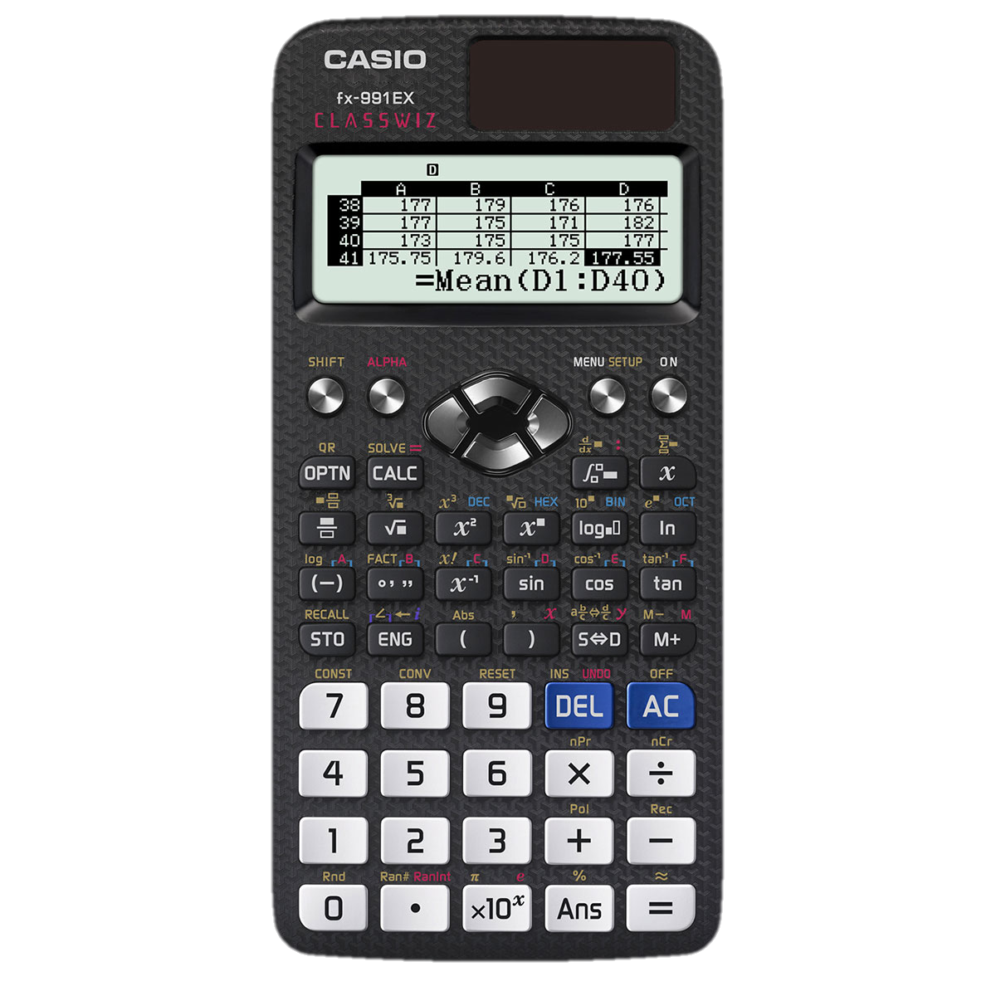
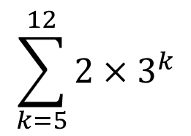
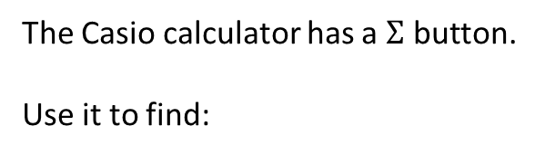
On your calculator
The Casio calculator has a $Σ$ button.
Use it to find:
$$\sum_{k=5}^{12}{2×3^{k}}$$

Slide 6
Exercise 3.6
Pearson Pure Mathematics Year 2/AS
Page 23

Slide 7
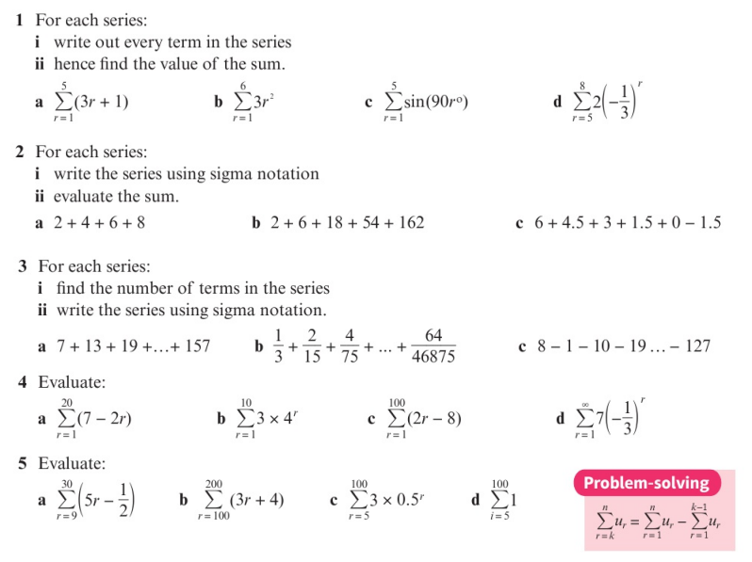
Homework Exercise

Slide 8
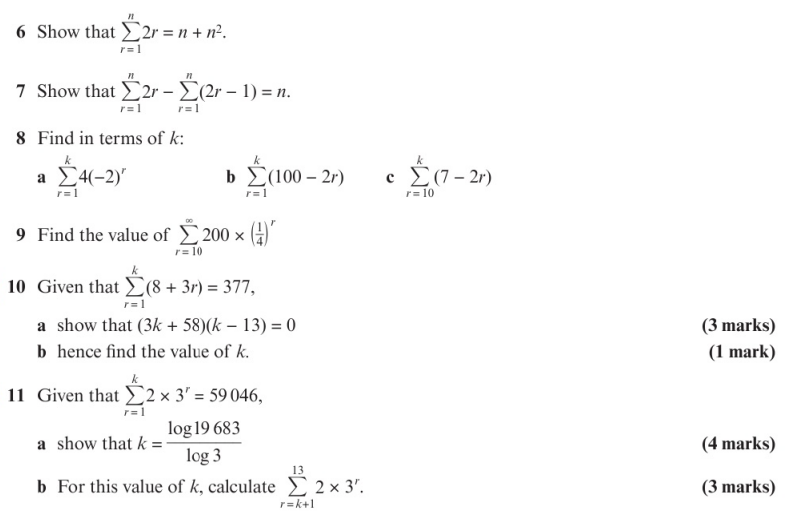
Homework Exercise

Slide 9
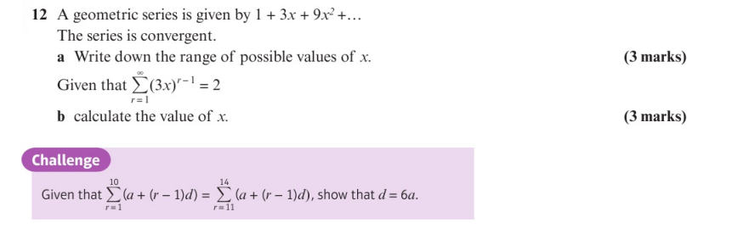
Homework Exercise

Slide 10
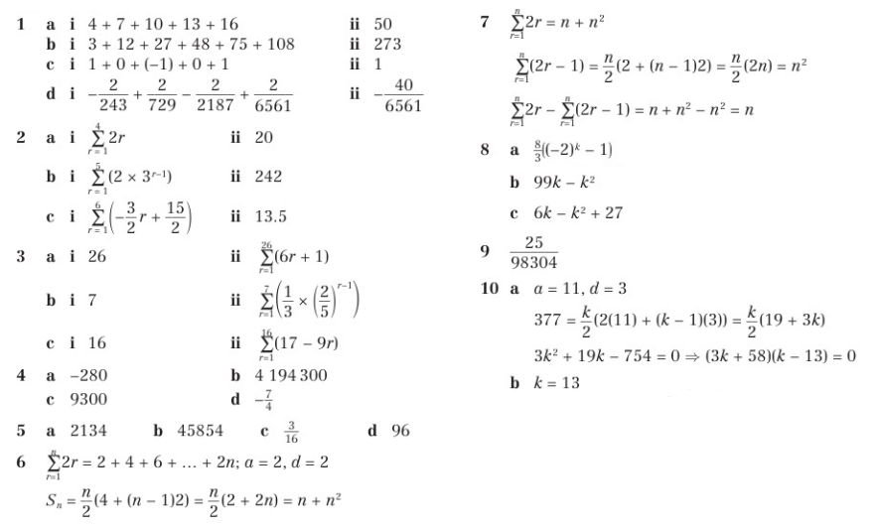
Homework Answers

Slide 11
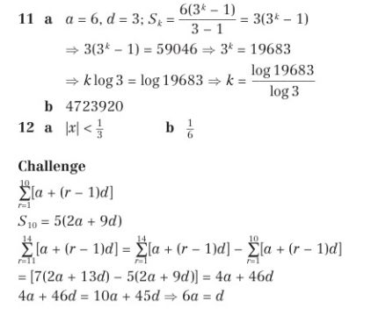
Homework Answers

