Slide 1
P1 Chapter 10: Trigonometry Equations Solving Equations

Slide 2
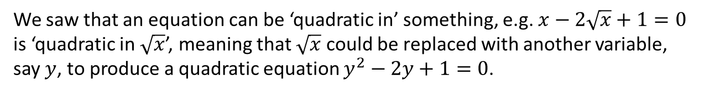


Quadratics in sin/cos/tan
We saw that an equation can be ‘quadratic in’ something, e.g. $x−2\sqrt{x}+1=0$ is ‘quadratic in $\sqrt{x}$’, meaning that $\sqrt{x}$ could be replaced with another variable, say $y$, to produce a quadratic equation $y^{2}−2y+1=0$.
Solve $5\sin^{2}{x}+3\sin{x}−2=0$ in the interval $0≤x≤360°$.
Method 1: Use a substitution.
Let $y=\sin{x}$
Then $5y^{2}+3y−2=0$ $$\left(5y−2\right)\left(y+1\right)=0 \\ y=\frac{2}{5} or y=−1 \\ ∴\sin{x}=\frac{2}{5} or\sin{x}=−1 \\ x=23.6°, 156.4°, \\ or x=270°$$
Method 2: Factorise without substitution.
This is the same, but we ‘imagine’ $\sin{x}$ as a single variable and hence factorise immediately.
$$\left(5\sin{x}−2\right)\left(\sin{x}+1\right)=0 \\ \sin{x}=\frac{2}{5} or\sin{x}=−1 \\ x=23.6°, 156.4°, \\ or x=270°$$
?
?
Note: Method 2 is best provided you feel confident with it. Method 1 is good practice until you build up confidence.

Slide 3
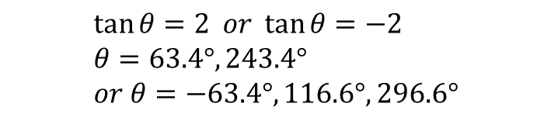

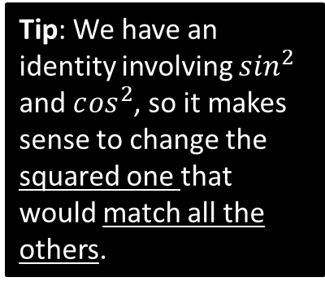

More Examples
Solve $\tan^{2}{θ}=4$ in the interval $0≤x≤360°$.
?
Missing the negative case would result in the loss of multiple marks. Beware!
$$\tan{θ}=2 or \tan{θ}=−2 \\ θ=63.4°, 243.4° \\ or θ=−63.4°, 116.6°,296.6°$$
$−63.4°$ was outside the range so we had to add $180°$ twice.
Solve $2\cos^{2}{x}+9\sin{x}=3\sin^{2}{x}$ in the interval $−180°≤x≤180°$.
?
$$2\left(1−\sin^{2}{x}\right)+\sin{x}=3\sin^{2}{x} \\ 2−2\sin^{2}{x}+\sin{x}=3\sin^{2}{x} \\ 5\sin^{2}{x}−\sin{x}−2=0 \\ \left(5\sin{x}+1\right)\left(\sin{x}−2\right)=0 \\ \sin{x}=−\frac{1}{5} or\sin{x}=2$$
$$x=−168.5°, −11.5°$$
Tip: We have an identity involving $s{in}^{2}$ and $c{os}^{2}$, so it makes sense to change the squared one that would match all the others.

Slide 4
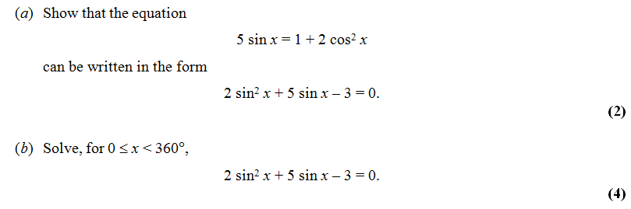
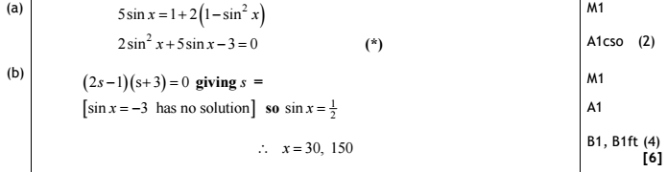
Test Your Understanding
Edexcel C2 Jan 2010 Q2
?

Slide 5


Exercise 10.6
Pearson Pure Mathematics Year 1/AS
Page 83
Extension
1
[MAT 2010 1C] In the range $0≤x<360°$, the equation
$$\sin^{2}{x}+3\sin{x}\cos{x}+2\cos^{2}{x}=0$$
Has how many solutions?
There are multiple ways to do this, including factorising LHS to $(\sin{x}+\cos{x})(\sin{x}+2\cos{x})$, but dividing by $\cos^{2}{x}$ gives:
$$\tan^{2}{x}+3\tan{x}+2=0 \\ \left(\tan{x}+1\right)\left(\tan{x}+2\right)=0 \\ \tan{x}=−1 or\tan{x}=−2$$
tan always gives a pair of solutions per $360°$, so there are 4 solutions.
2
[MAT 2014 1E] As $x$ varies over the real numbers, the largest value taken by the function ${\left(4\sin^{2}{x}+4\cos{x}+1\right)}^{2}$ equals what?
$${\left(4−4\cos^{2}{x}+4\cos{x}+1\right)}^{2} \\ ={\left(−4\cos^{2}{x}+4\cos{x}+5\right)}^{2} \\ ={\left(6−{\left(1−2\cos{x}\right)}^{2}\right)}^{2}$$
We can make $\cos{x}=\frac{1}{2}$, thus giving a maximum value of $6^{2}=36$.
?
?

Slide 6
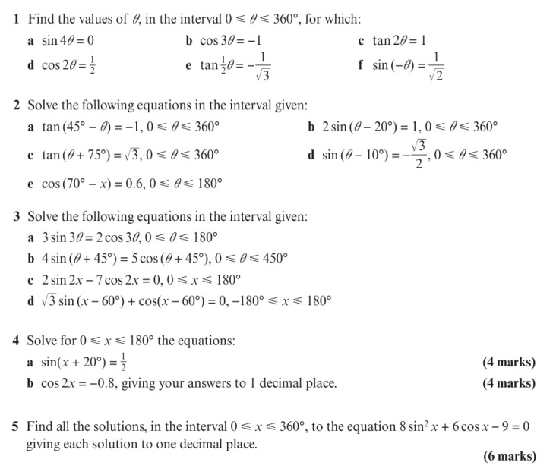
Homework Exercise

Slide 7
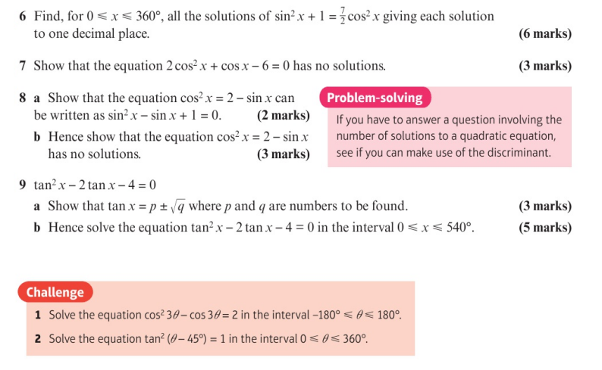
Homework Exercise

Slide 8
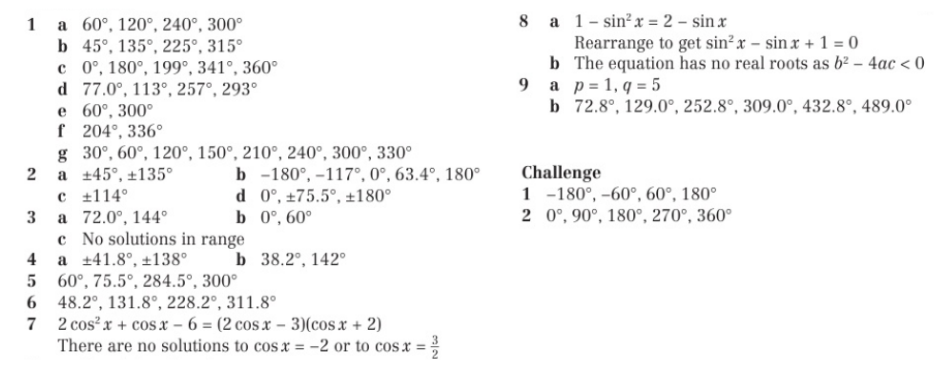
Homework Answers

