Slide 1
P2 Chapter 8: Parametric Equations Parametric Modelling

Slide 2

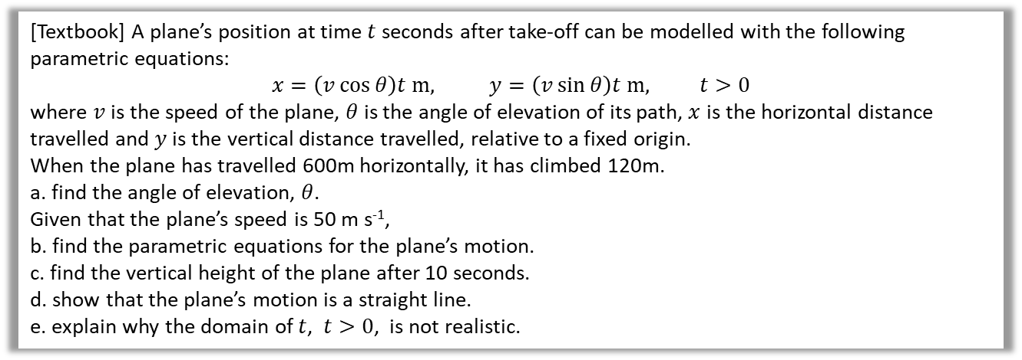
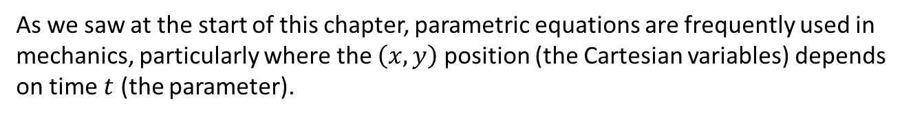


Modelling
As we saw at the start of this chapter, parametric equations are frequently used in mechanics, particularly where the $\left(x,y\right)$ position (the Cartesian variables) depends on time $t$ (the parameter).
[Textbook] A plane’s position at time $t$ seconds after take-off can be modelled with the following parametric equations:
$$x=\left(v\cos{θ}\right)t m, y=\left(v\sin{θ}\right)t m, t>0$$
where $v$ is the speed of the plane, $θ$ is the angle of elevation of its path, $x$ is the horizontal distance travelled and $y$ is the vertical distance travelled, relative to a fixed origin.
When the plane has travelled 600m horizontally, it has climbed 120m.
a. find the angle of elevation, $θ$.
Given that the plane’s speed is 50 m s⁻¹,
b. find the parametric equations for the plane’s motion.
c. find the vertical height of the plane after 10 seconds.
d. show that the plane’s motion is a straight line.
e. explain why the domain of $t$, $t>0$, is not realistic.
$$θ$$
$$θ=\tan^{−1}\left(\frac{120}{600}\right)=11.3° \left(1dp\right)$$
$$x=\left(v\cos{θ}\right)t \\ =(50×\cos{11.3…)t=49.0t m (3sf)} \\ y=\left(v\sin{θ}\right)t=(50×\sin{11.3…)=9.80t m (3sf)}$$
At $t=10$, $y=9.80t=98 m$
$x=49t → t=\frac{x}{49}$ and $y=9.8×\frac{x}{49}=\frac{1}{5}x$
$∴y=\frac{1}{5}x$ which is a linear equation.
a
?
e
Plane would continue to climb forever!
?
b
?
c
?
d
?

Slide 3
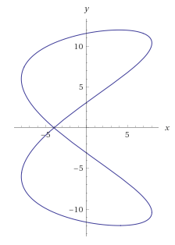
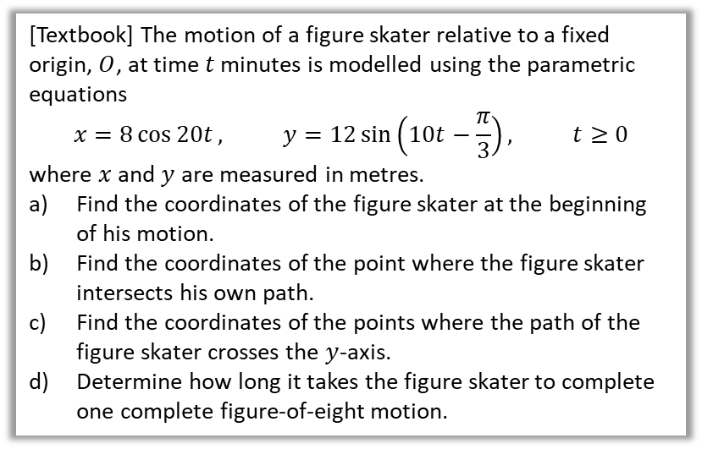

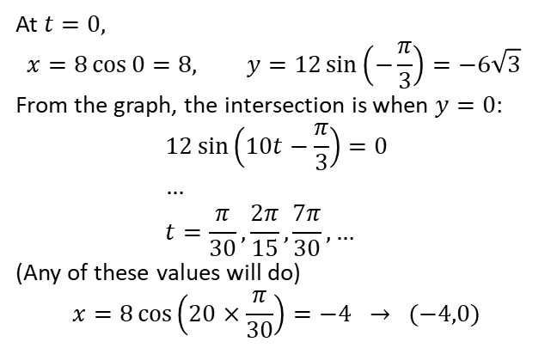
Further Example
[Textbook] The motion of a figure skater relative to a fixed origin, $O$, at time $t$ minutes is modelled using the parametric equations
$$x=8\cos{20t}, y=12\sin\left(10t−\frac{π}{3}\right), t≥0$$
where $x$ and $y$ are measured in metres.
Find the coordinates of the figure skater at the beginning of his motion.
Find the coordinates of the point where the figure skater intersects his own path.
Find the coordinates of the points where the path of the figure skater crosses the $y$-axis.
Determine how long it takes the figure skater to complete one complete figure-of-eight motion.
c
?
At $t=0,$ $$x=8\cos{0}=8, y=12\sin\left(−\frac{π}{3}\right)=−6\sqrt{3}$$
From the graph, the intersection is when $y=0$:
$$12\sin\left(10t−\frac{π}{3}\right)=0 \\ … \\ t=\frac{π}{30},\frac{2π}{15},\frac{7π}{30}, …$$
(Any of these values will do)
$$x=8\cos\left(20×\frac{π}{30}\right)=−4 → (−4,0)$$
When $x=0$:
$$0=8\cos{t} \\ t=\frac{π}{2},\frac{3π}{2},\frac{5π}{2},\frac{7π}{2}, …$$
Substitute these $t$-values into $y$.
$$t=\frac{π}{2} → y=3.11 \left(2dp\right) \\ t=\frac{3π}{2} → y=11.59 … \\ \left(0,−3.11\right), \left(0,11.59\right), \left(0,3.11\right),\left(0,−11.59\right)$$
The period of $\cos{t}$ is $2π$, so the period of $\cos{20t}$ is $\frac{2π}{20}$ (as graph stretched by factor of $\frac{1}{20}$). Similarly period of $y$ is $\frac{2π}{10}$. Both parametric equations must complete full periods (in this case so that skater returns to original $y$ position), so period is $\frac{2π}{10}$ min = 38 seconds.
a
?
b
?
d
?

Slide 4
Exercise 8.5
Pearson Pure Mathematics Year 2/AS
Page 65

Slide 5
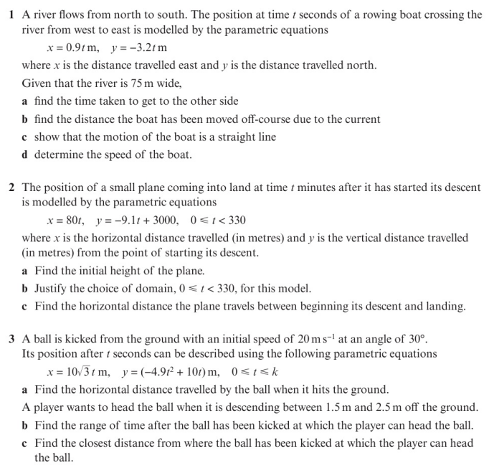
Homework Exercise

Slide 6
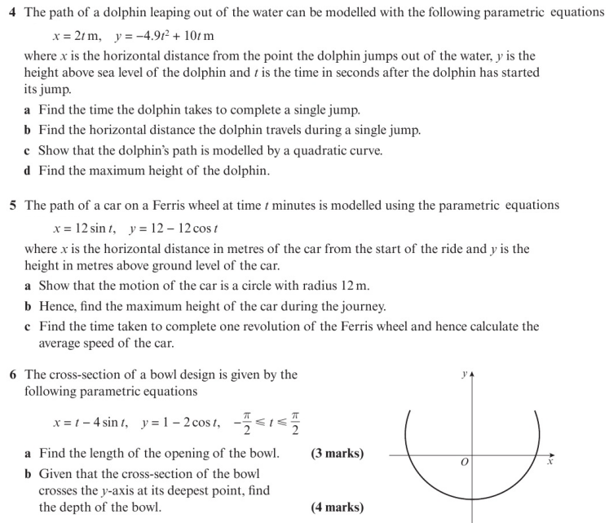
Homework Exercise

Slide 7
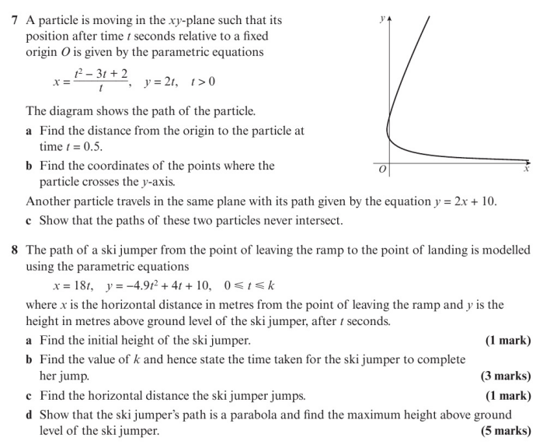
Homework Exercise

Slide 8
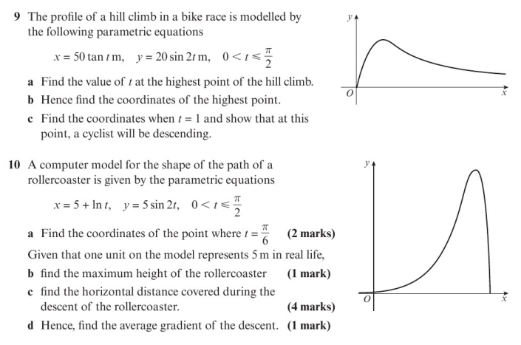
Homework Exercise

Slide 9
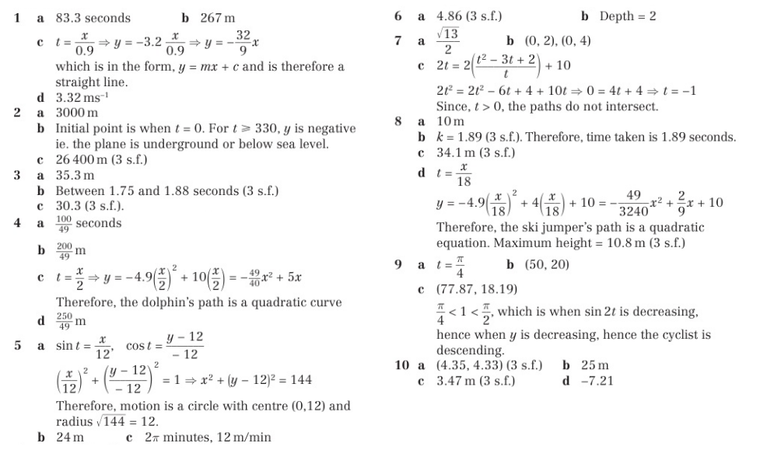
Homework Answers

