Slide 1
P1 Chapter 8: Binomial Expansion Factorial Notation

Slide 2
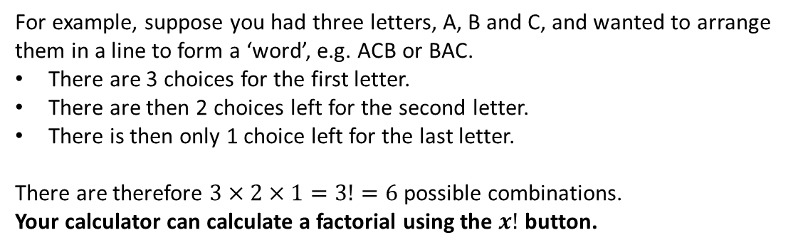

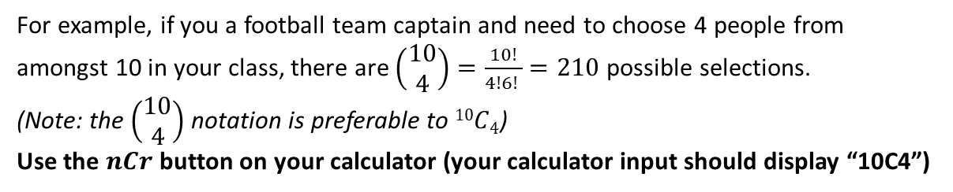
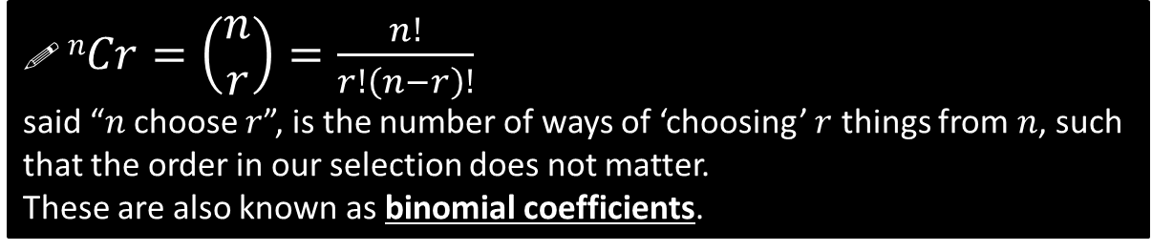
Factorial and Choose Function
! $n!=n×\left(n−1\right)×\left(n−2\right)×…×2×1$ said “$n$ factorial”, is the number of ways of arranging $n$ objects in a line.
For example, suppose you had three letters, A, B and C, and wanted to arrange them in a line to form a ‘word’, e.g. ACB or BAC.
There are 3 choices for the first letter.
There are then 2 choices left for the second letter.
There is then only 1 choice left for the last letter.
There are therefore $3×2×1=3!=6$ possible combinations.
Your calculator can calculate a factorial using the $x!$ button.
! $nCr=\left(\begin{matrix}n \\ r\end{matrix}\right)=\frac{n!}{r!\left(n−r\right)!}$ said “$n$ choose $r$”, is the number of ways of ‘choosing’ $r$ things from $n$, such that the order in our selection does not matter.
These are also known as binomial coefficients.
For example, if you a football team captain and need to choose 4 people from amongst 10 in your class, there are $\left(\begin{matrix}10 \\ 4\end{matrix}\right)=\frac{10!}{4!6! }=210$ possible selections.
(Note: the $\left(\begin{matrix}10 \\ 4\end{matrix}\right)$ notation is preferable to $10C4$)
Use the $nCr$ button on your calculator (your calculator input should display “10C4”)

Slide 3

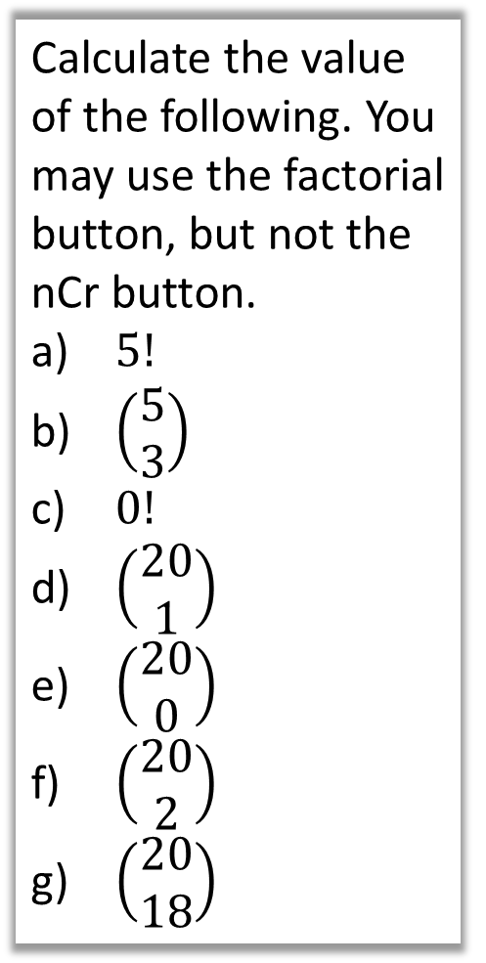
Examples
$$5!=5×4×3×2×1=120$$
$$\left(\begin{matrix}5 \\ 3\end{matrix}\right)=\frac{5!}{3!2!}=\frac{120}{6×2}=10$$
$0!=1$. Accept this for the moment, but all will be explained in part (e).
Conceptually, there is clearly 20 ways to choose 1 thing from 20. But using the formula: $\left(\begin{matrix}20 \\ 1\end{matrix}\right)=\frac{20!}{1!19!}=20$
! $\left(\begin{matrix}n \\ 1\end{matrix}\right)=n$ for all $n$.
We’d expect there to be 1 way to choose no things (since ‘no selection’ is itself a possibility we should count).
Using the formula:$\left(\begin{matrix}20 \\ 0\end{matrix}\right)=\frac{20!}{0!20!}=1$
This provides justification for letting $0!=1$. ! $\left(\begin{matrix}n \\ 0 \end{matrix}\right)=1$
$$\left(\begin{matrix}20 \\ 2\end{matrix}\right)=\frac{20!}{2!18!}=\frac{20×19×18×…×1}{2!×18×17×…×1}=\frac{20×19}{2!}=190$$
$\left(\begin{matrix}n \\ 2\end{matrix}\right)=\frac{n\left(n−1\right)}{2}$ for all $n$.
$\left(\begin{matrix}20 \\ 18\end{matrix}\right)=\frac{20!}{18!2!}$. This is the same as above. In general, where the bottom number is above half of the top, we can subtract it from the top, i.e. $\left(\begin{matrix}20 \\ 18\end{matrix}\right)=\left(\begin{matrix}20 \\ 2\end{matrix}\right)$.
Calculate the value of the following. You may use the factorial button, but not the nCr button.
$5!$
$\left(\begin{matrix}5 \\ 3\end{matrix}\right)$
$0!$
$\left(\begin{matrix}20 \\ 1\end{matrix}\right)$
$\left(\begin{matrix}20 \\ 0\end{matrix}\right)$
$\left(\begin{matrix}20 \\ 2\end{matrix}\right)$
$\left(\begin{matrix}20 \\ 18\end{matrix}\right)$
a
?
b
?
c
?
d
?
e
?
f
?
g
?

Slide 4


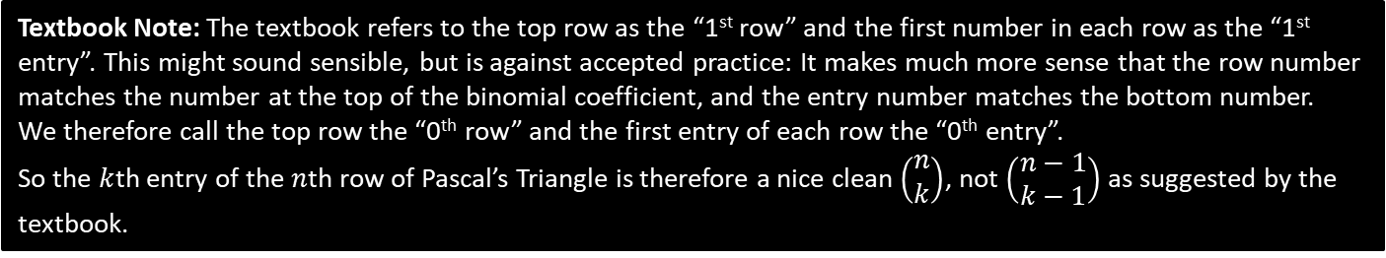



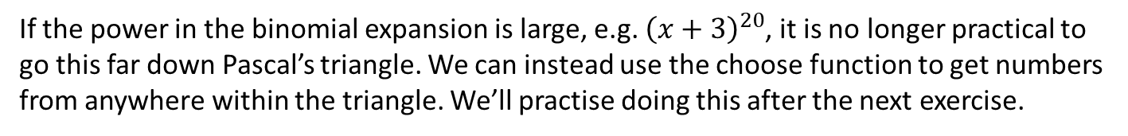







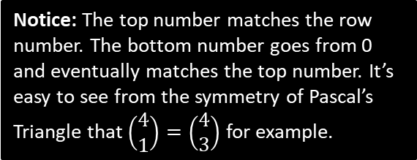



Why do we care?
If the power in the binomial expansion is large, e.g. ${\left(x+3\right)}^{20}$, it is no longer practical to go this far down Pascal’s triangle. We can instead use the choose function to get numbers from anywhere within the triangle. We’ll practise doing this after the next exercise.
1
0th row
$$\left(\begin{matrix}0 \\ 0\end{matrix}\right)$$
Notice: The top number matches the row number. The bottom number goes from 0 and eventually matches the top number. It’s easy to see from the symmetry of Pascal’s Triangle that $\left(\begin{matrix}4 \\ 1\end{matrix}\right)=\left(\begin{matrix}4 \\ 3\end{matrix}\right)$ for example.
1
1
1st row
$$\left(\begin{matrix}1 \\ 0\end{matrix}\right)$$
$$\left(\begin{matrix}1 \\ 1\end{matrix}\right)$$
1
2
1
2nd row
$$\left(\begin{matrix}2 \\ 0\end{matrix}\right)$$
$$\left(\begin{matrix}2 \\ 1\end{matrix}\right)$$
$$\left(\begin{matrix}2 \\ 2\end{matrix}\right)$$
1
3
3
1
3rd row
$$\left(\begin{matrix}3 \\ 0\end{matrix}\right)$$
$$\left(\begin{matrix}3 \\ 1\end{matrix}\right)$$
$$\left(\begin{matrix}3 \\ 2\end{matrix}\right)$$
$$\left(\begin{matrix}3 \\ 3\end{matrix}\right)$$
1
4
6
4
1
$$\left(\begin{matrix}4 \\ 0\end{matrix}\right)$$
$$\left(\begin{matrix}4 \\ 1\end{matrix}\right)$$
$$\left(\begin{matrix}4 \\ 2\end{matrix}\right)$$
$$\left(\begin{matrix}4 \\ 3\end{matrix}\right)$$
$$\left(\begin{matrix}4 \\ 4\end{matrix}\right)$$
Textbook Note: The textbook refers to the top row as the “1st row” and the first number in each row as the “1st entry”. This might sound sensible, but is against accepted practice: It makes much more sense that the row number matches the number at the top of the binomial coefficient, and the entry number matches the bottom number.
We therefore call the top row the “0th row” and the first entry of each row the “0th entry”.
So the $k$th entry of the $n$th row of Pascal’s Triangle is therefore a nice clean $\left(\begin{matrix}n \\ k\end{matrix}\right)$, not $\left(\begin{matrix}n−1 \\ k−1\end{matrix}\right)$ as suggested by the textbook.

Slide 5


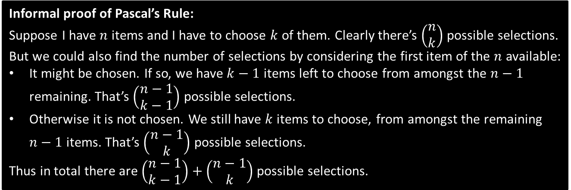



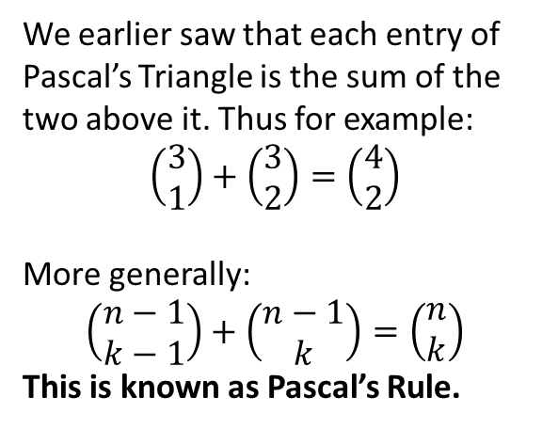










Extra Cool Stuff
$$\left(\begin{matrix}0 \\ 0\end{matrix}\right)$$
(You are not required to know this, but it is helpful for STEP)
$$\left(\begin{matrix}1 \\ 0\end{matrix}\right)$$
$$\left(\begin{matrix}1 \\ 1\end{matrix}\right)$$
We earlier saw that each entry of Pascal’s Triangle is the sum of the two above it. Thus for example:
$$\left(\begin{matrix}3 \\ 1\end{matrix}\right)+\left(\begin{matrix}3 \\ 2\end{matrix}\right)=\left(\begin{matrix}4 \\ 2\end{matrix}\right)$$
More generally:
$$\left(\begin{matrix}n−1 \\ k−1\end{matrix}\right)+\left(\begin{matrix}n−1 \\ k\end{matrix}\right)=\left(\begin{matrix}n \\ k\end{matrix}\right)$$
This is known as Pascal’s Rule.
$$\left(\begin{matrix}2 \\ 0\end{matrix}\right)$$
$$\left(\begin{matrix}2 \\ 1\end{matrix}\right)$$
$$\left(\begin{matrix}2 \\ 2\end{matrix}\right)$$
$$\left(\begin{matrix}3 \\ 0\end{matrix}\right)$$
$$\left(\begin{matrix}3 \\ 1\end{matrix}\right)$$
$$\left(\begin{matrix}3 \\ 2\end{matrix}\right)$$
$$\left(\begin{matrix}3 \\ 3\end{matrix}\right)$$
$$\left(\begin{matrix}4 \\ 0\end{matrix}\right)$$
$$\left(\begin{matrix}4 \\ 1\end{matrix}\right)$$
$$\left(\begin{matrix}4 \\ 2\end{matrix}\right)$$
$$\left(\begin{matrix}4 \\ 3\end{matrix}\right)$$
$$\left(\begin{matrix}4 \\ 4\end{matrix}\right)$$
Informal proof of Pascal’s Rule:
Suppose I have $n$ items and I have to choose $k$ of them. Clearly there’s $\left(\begin{matrix}n \\ k\end{matrix}\right)$ possible selections. But we could also find the number of selections by considering the first item of the $n$ available:
It might be chosen. If so, we have $k−1$ items left to choose from amongst the $n−1$ remaining. That’s $\left(\begin{matrix}n−1 \\ k−1\end{matrix}\right)$ possible selections.
Otherwise it is not chosen. We still have $k$ items to choose, from amongst the remaining $n−1$ items. That’s $\left(\begin{matrix}n−1 \\ k\end{matrix}\right)$ possible selections.
Thus in total there are $\left(\begin{matrix}n−1 \\ k−1\end{matrix}\right)+\left(\begin{matrix}n−1 \\ k\end{matrix}\right)$ possible selections.

Slide 6
Exercise 8.2
Pearson Pure Mathematics Year 1/AS
Page 62

Slide 7
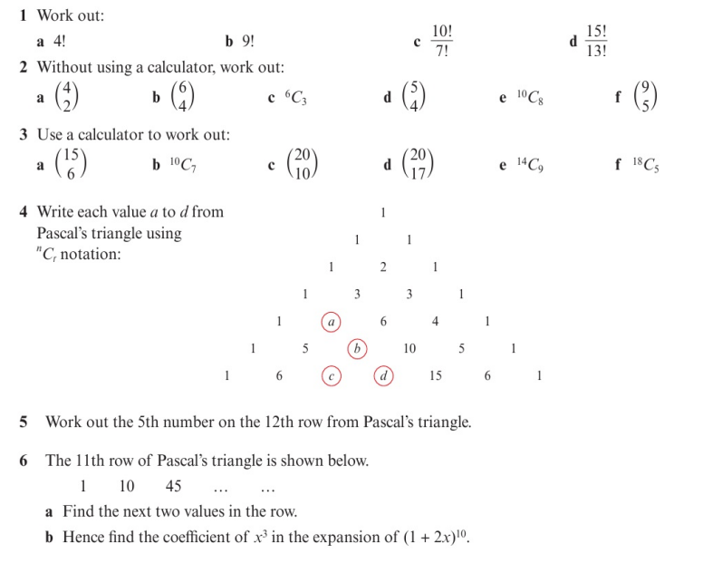
Homework Exercise

Slide 8
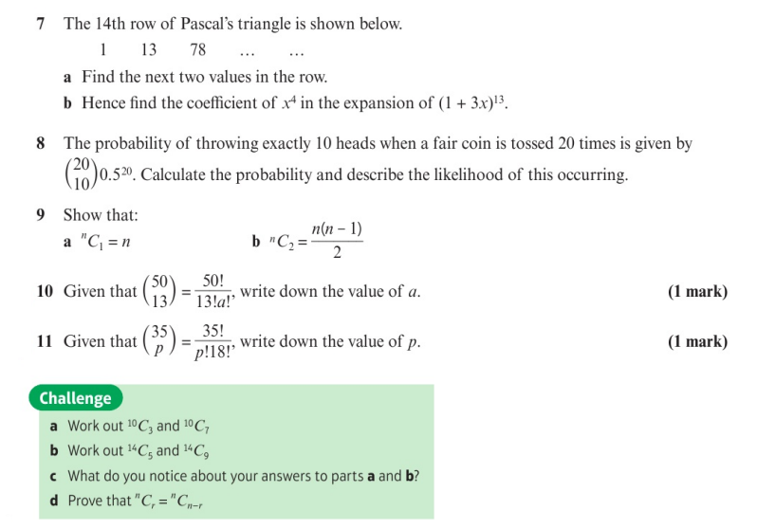
Homework Exercise

Slide 9
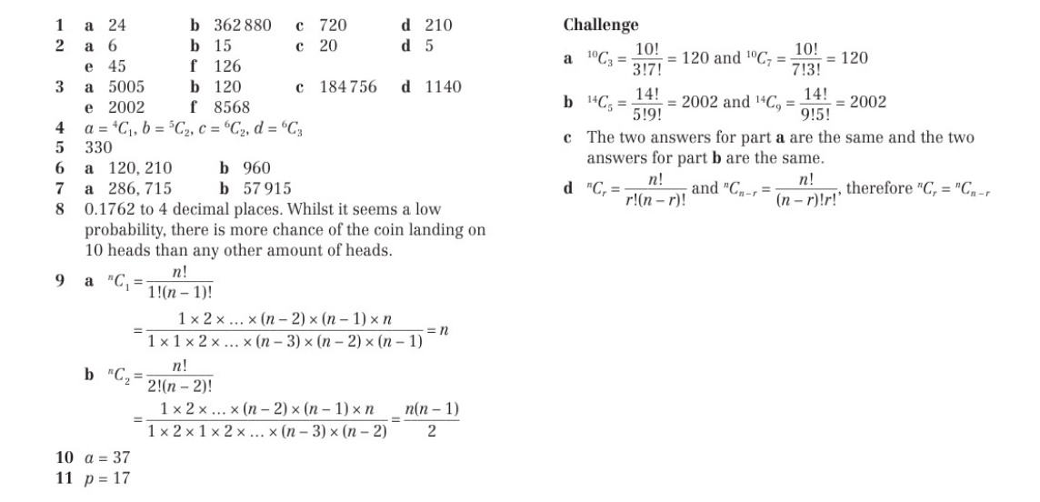
Homework Answers

