Slide 1
P2 Chapter 2: Graphing Functions
Solving Modulus Problems

Slide 2








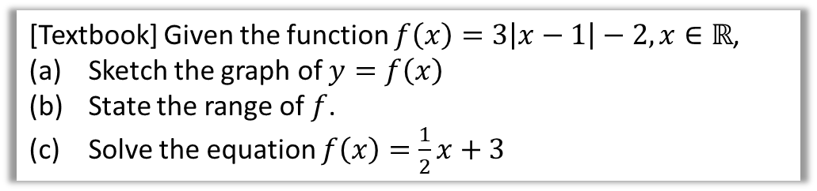


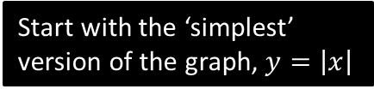









Solving Modulus Problems
[Textbook] Given the function $f\left(x\right)=3\left|x−1\right|−2, x∈ℝ$,
Sketch the graph of $y=f\left(x\right)$
State the range of $f$.
Solve the equation $f\left(x\right)=\frac{1}{2}x+3$
a
It is often helpful to sketch the graph in stages as we apply more transformations:
$$y$$
$$y$$
$$y=\left|x−1\right|$$
$$y$$
$$3$$
$$y=3\left|x−1\right|$$
$$y=\left|x\right|$$
$$1$$
$$x$$
$$1$$
$$x$$
$$1$$
$$x$$
3 is outside modulus function so affects $y$ values.
Start with the ‘simplest’ version of the graph, $y=\left|x\right|$
-1 is ‘inside’ function so translate 1 right.
$$y$$
$$y=3\left|x−1\right|−2$$
$$1$$
-2 is outside modulus function so translate 2 down.
$$x$$
$$\left(1,−2\right)$$

Slide 3
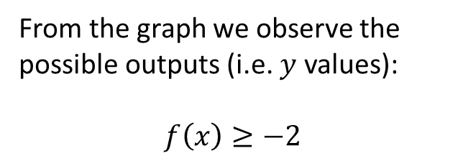





Solving Modulus Problems
[Textbook] Given the function $f\left(x\right)=3\left|x−1\right|−2, x∈ℝ$,
Sketch the graph of $y=f\left(x\right)$
State the range of $f$.
Solve the equation $f\left(x\right)=\frac{1}{2}x+3$
$$y$$
?
b
$$y=3\left|x−1\right|−2$$
From the graph we observe the possible outputs (i.e. $y$ values):
$$f\left(x\right)≥−2$$
$$1$$
$$x$$
$$\left(1,−2\right)$$

Slide 4




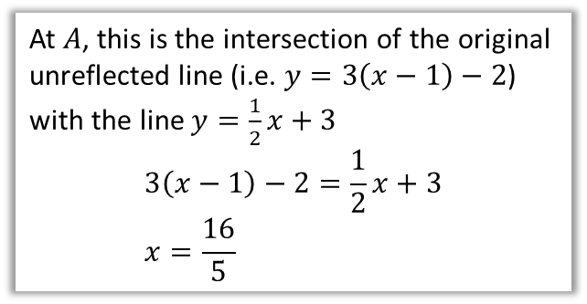






Solving Modulus Problems
[Textbook] Given the function $f\left(x\right)=3\left|x−1\right|−2, x∈ℝ$,
Sketch the graph of $y=f\left(x\right)$
State the range of $f$.
Solve the equation $f\left(x\right)=\frac{1}{2}x+3$
c
?
$$y=3\left|x−1\right|−2$$
In Year 1 we saw how we could sketch the line representing each side of the equation, then find the point of intersection, i.e.
$$y=3\left|x−1\right|−2 \\ y=\frac{1}{2}x+3$$
$$y$$
$$A$$
$$3$$
$$B$$
$$1$$
$$x$$
At $A$, this is the intersection of the original unreflected line (i.e. $y=3\left(x−1\right)−2$) with the line $y=\frac{1}{2}x+3$
$$3\left(x−1\right)−2=\frac{1}{2}x+3 \\ x=\frac{16}{5}$$
At $B$, this is the intersection of the negated reflected line (i.e. $y=3\left(−x+1\right)−2$) with the line $y=\frac{1}{2}x+3$
$$3\left(−x+1\right)−2=\frac{1}{2}x+3 \\ x=−\frac{4}{7}$$
$$\left(1,−2\right)$$
Fro Note: Only the modulus bit is negated, not the whole equation.

Slide 5
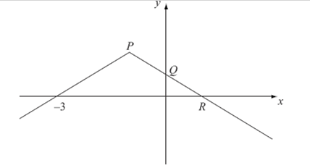
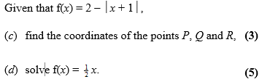



Test Your Understanding
You can sketch this function by starting with $y=|x|$ and gradually transform it as per the previous example.
C4 June 2008 Q3
b
?
$$2−\left|x+1\right|=\frac{1}{2}x$$
When $x+1$ is not reflected:
$$2−x−1=\frac{1}{2}x \\ x=\frac{2}{3}$$
When $x+1$ is reflected:
$$2+x+1=\frac{1}{2}x \\ x=−6$$
Check:
$2−\left|\frac{2}{3}+1\right|=\frac{1}{2}\left(\frac{2}{3}\right)$ works
$2−\left|−6+1\right|=\frac{1}{2}\left(−6\right)$ works
$Q$: When $x=0$, $f\left(x\right)=2−\left|0+1\right|=1$
$$Q\left(0,1\right)$$
$R$: When $y=0$, $2−\left|x+1\right|=0$
$$\left|x+1\right|=2$$
Either $x+1=2 → x=1$
Or $−x−1=2 →x=−3$
$$R\left(1,0\right)$$
$P$: Graph is at its maximum when $\left|x+1\right|=0$
Thus $x=−1$ (alternative by symmetry, -1 is halfway between -3 and 1)
$$P\left(−1,2\right)$$
a
?

Slide 6

Exercise 2.7
Pearson Pure Mathematics Year 2/AS
Page 14
Extension
[MAT 2006 1I]
The equation $\left|x\right|+\left|x−1\right|=0$ has how many solutions?
0 solutions. $|x|$ and $|x−1|$ are each at least 0, and thus must both be 0 to add to 0. But if $\left|x\right|=0$ then $x=0$, but then $\left|x−1\right|=1$.
Alternatively, if we sketch
$y=\left|x\right|+|x−1|$ we can see it never touches the $x$-axis, and therefore has no roots.
?

Slide 7
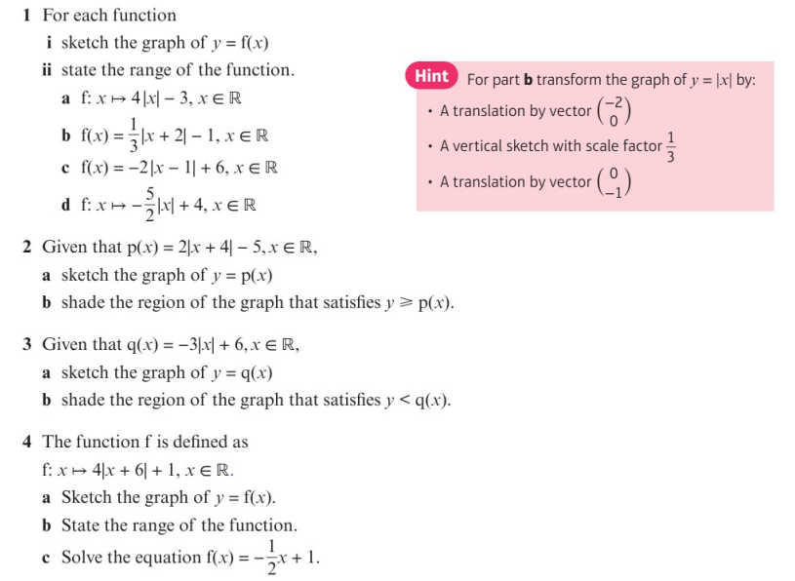
Homework Exercise

Slide 8
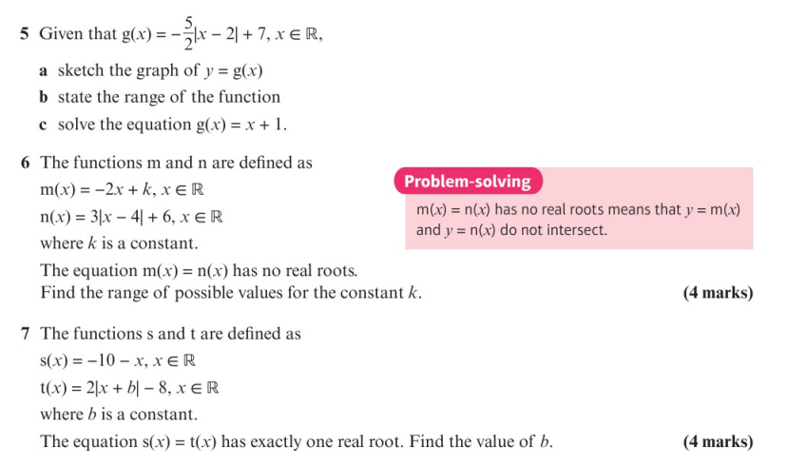
Homework Exercise

Slide 9
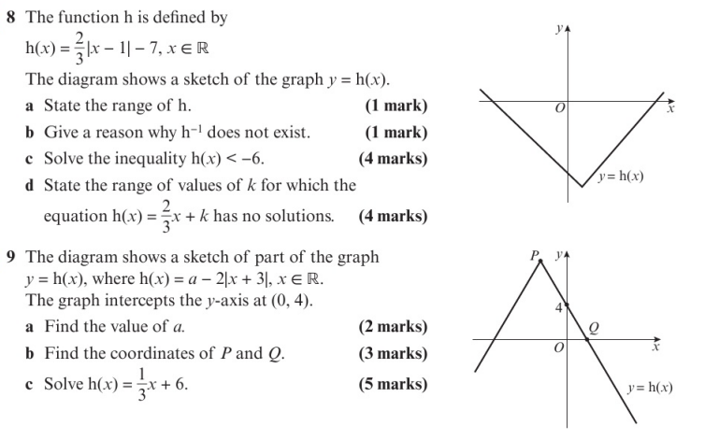
Homework Exercise

Slide 10
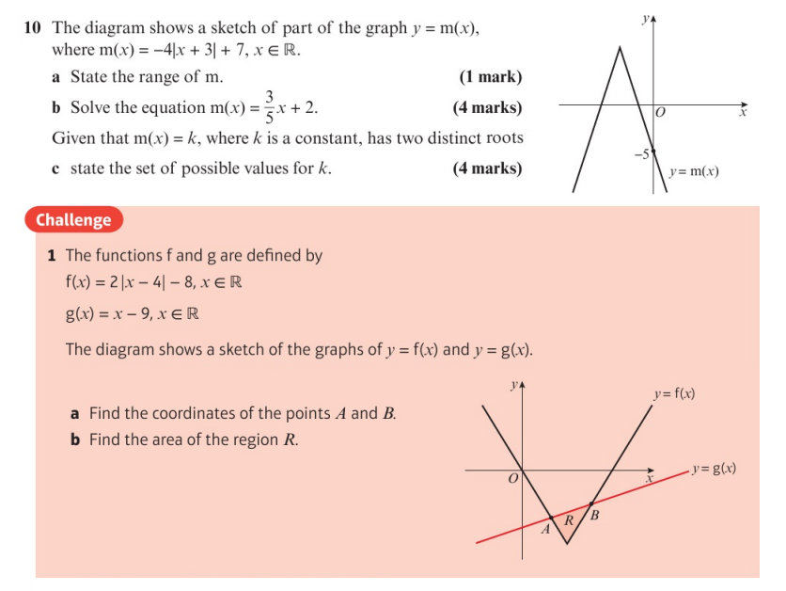
Homework Exercise

Slide 11
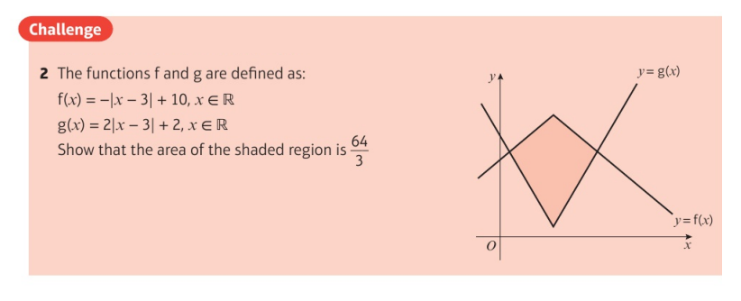
Homework Exercise

Slide 12
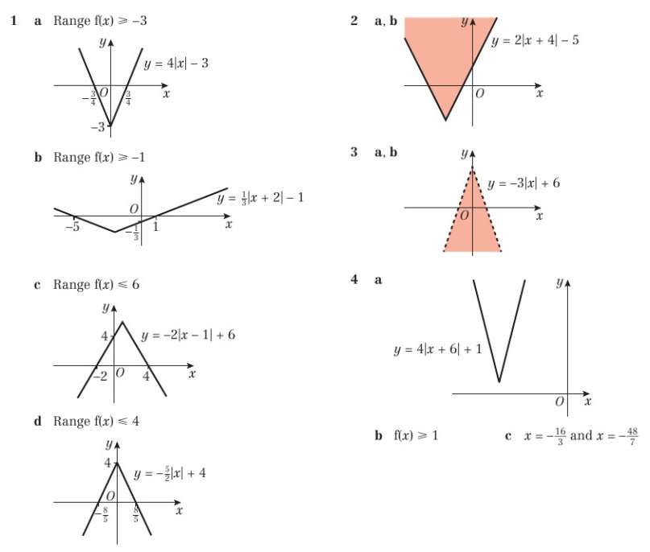
Homework Answers

Slide 13
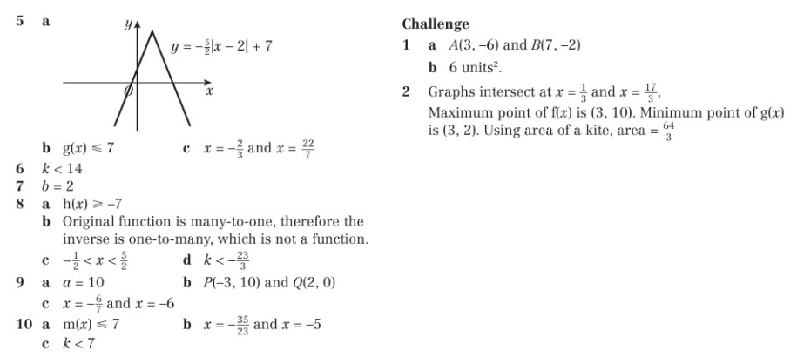
Homework Answers

