Slide 1
Stats1 Chapter 2: Measures of Data Variance and Standard Deviation

Slide 2




What is variance?
Distribution of IQs in L6Ms4
Distribution of IQs in L6Ms5
$$Frequency$$
$$Frequency$$
$$IQ$$
$$IQ$$
$$90 100 110 120 130 140$$
$$90 100 110 120 130 140$$
?
Here are the distribution of IQs in two classes of the same size. What’s the same, and what’s different?
The (estimated) mean IQ is the same for the two classes, as is the (estimated) range, but the overall spread of values is greater for the second class.
The interquartile range would convey this, but do we have a method of measuring spread that takes into account all the values?

Slide 3

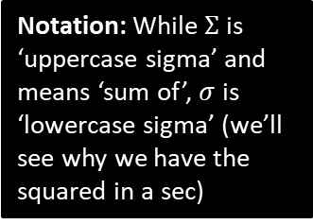




Variance
Variance is a measure of spread that takes all values into account.
Variance, by definition, is the average squared distance from the mean.
Notation: While $Σ$ is ‘uppercase sigma’ and means ‘sum of’, $σ$ is ‘lowercase sigma’ (we’ll see why we have the squared in a sec)
$${\left( \right)}^{2}$$
$$Σ$$
$$x−\overline{x}$$
$$σ^{2}=$$
$$n$$
Distance from mean…
Squared distance from mean…
Average squared distance from mean…

Slide 4



Simpler formula for variance
But in practice you will never use this form, and it’s possible to simplify the formula to the following*:
Variance
“The mean of the squares minus the square of the mean (‘msmsm’)”
?
* Proof: (certainly not in syllabus!) Note that $\overline{x}$ is constant for a fixed variable, and that in general, $Σkf\left(x\right)=kΣf\left(x\right)$ for a constant $k$, i.e. we can factor out constants out of a summation.
$$σ^{2}=\frac{Σ{\left(x−\overline{x}\right)}^{2}}{n}=\frac{Σ\left(x^{2}−2x\overline{x}+{\overline{x}}^{2}\right)}{n} \\ =\frac{Σx^{2}}{n}−\frac{Σ\left(2x\overline{x}\right)}{n}+\frac{Σ{\overline{x}}^{2}}{n} \\ =\frac{Σx^{2}}{n}−2\overline{x}\left(\frac{Σx}{n}\right)+\frac{{\overline{x}}^{2}}{n}Σ1 \\ =\frac{Σx^{2}}{n}−2{\overline{x}}^{2}+\frac{{\overline{x}}^{2}}{n}⋅n \\ =\frac{Σx^{2}}{n}−2{\overline{x}}^{2}+{\overline{x}}^{2} \\ =\frac{Σx^{2}}{n}−{\overline{x}}^{2}$$
?
$$σ^{2}=\frac{Σx^{2}}{n}−{\overline{x}}^{2}$$
?
Standard Deviation
$$σ=\sqrt{Variance}$$
The standard deviation can ‘roughly’ be thought of as the average distance from the mean.

Slide 5
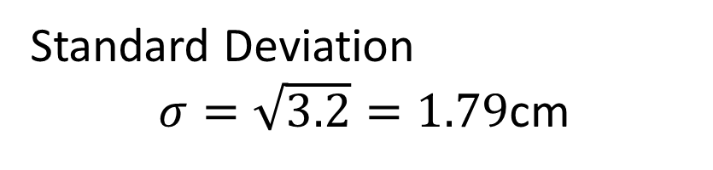
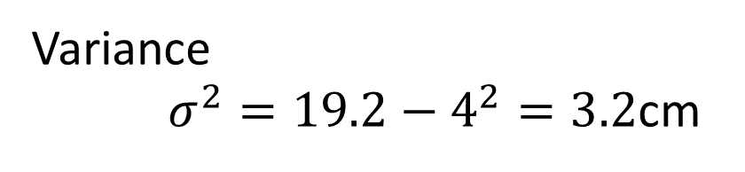
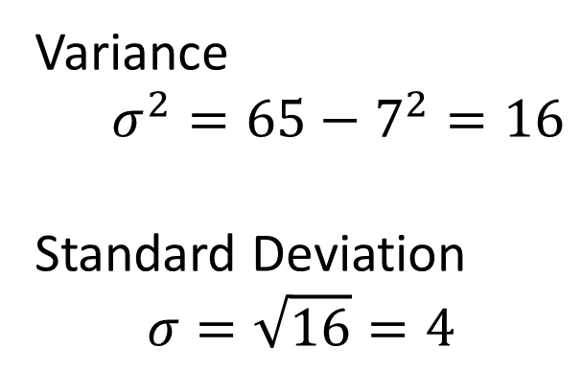
Examples
3, 11
2cm 3cm 3cm 5cm 7cm
Variance
$$σ^{2}=65−7^{2}=16$$
Standard Deviation
$$σ=\sqrt{16}=4$$
Variance
$σ^{2}=19.2−4^{2}=3.2$cm
?
?
Standard Deviation
$σ=\sqrt{3.2}=1.79$cm
?
?
So note that that in the case of two items, the standard deviation is indeed the average distance of the values from the mean.

Slide 6




Practice
Find the variance and standard deviation of the following sets of data.
$$2 4 6$$
?
?
Variance = $2.67$
Standard Deviation = $1.63$
$$1 2 3 4 5$$
?
Variance = $2$
Standard Deviation = $1.41$
?

Slide 7
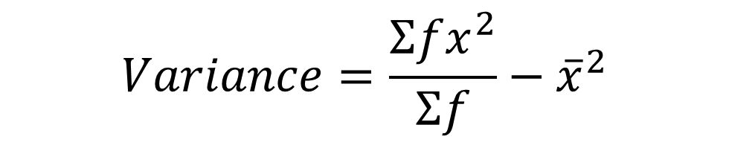
Extending to frequency/grouped frequency tables
We can just mull over our mnemonic again:
Variance: “The mean of the squares minus the square of the mean (‘msmsm’)”
?
?
$$Variance=\frac{Σfx^{2}}{Σf}−{\overline{x}}^{2}$$
Tip: It’s better to try and memorise the mnemonic than the formula itself – you’ll understand what’s going on better.
Exam Note: In an exam, you will pretty much certainly be asked to find the standard deviation for grouped data, and not listed data.

Slide 8
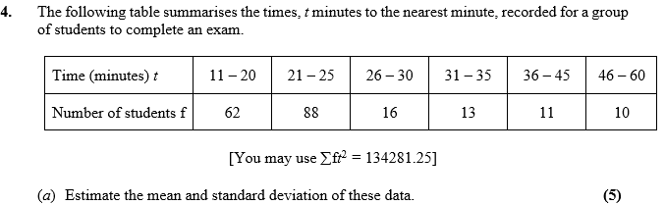
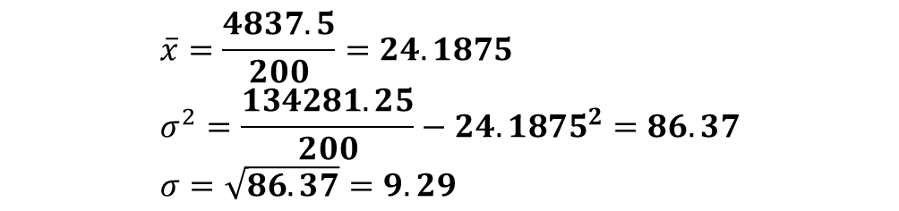
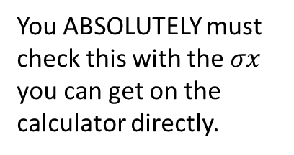
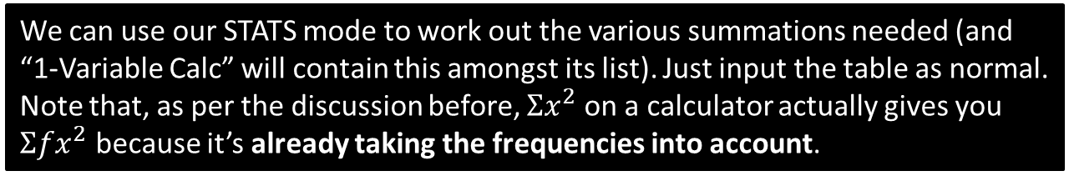
Example
May 2013 Q4
We can use our STATS mode to work out the various summations needed (and “1-Variable Calc” will contain this amongst its list). Just input the table as normal.
Note that, as per the discussion before, $Σx^{2}$ on a calculator actually gives you $Σfx^{2}$ because it’s already taking the frequencies into account.
?
$$\overline{x}=\frac{4837.5}{200}=24.1875 \\ σ^{2}=\frac{134281.25}{200}−{24.1875}^{2}=86.37 \\ σ=\sqrt{86.37}=9.29$$
?
You ABSOLUTELY must check this with the $σx$ you can get on the calculator directly.
?

Slide 9
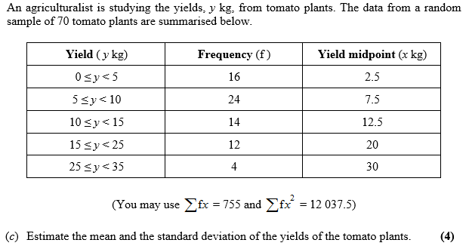
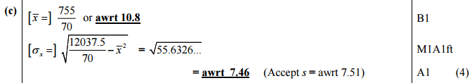
Test Your Understanding
May 2013 (R) Q3
?

Slide 10
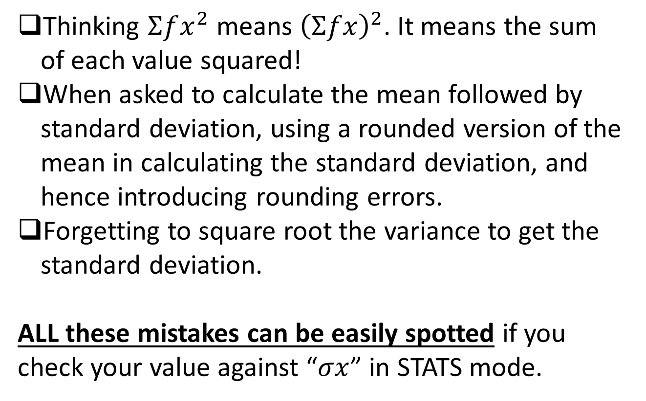
Most common exam errors
Thinking $Σfx^{2}$ means ${\left(Σfx\right)}^{2}$. It means the sum of each value squared!
When asked to calculate the mean followed by standard deviation, using a rounded version of the mean in calculating the standard deviation, and hence introducing rounding errors.
Forgetting to square root the variance to get the standard deviation.
ALL these mistakes can be easily spotted if you check your value against “$σx$” in STATS mode.

Slide 11
Exercise 2.4
Pearson Statistics & Mechanics Year 1/AS
Pages 12-13

Slide 12
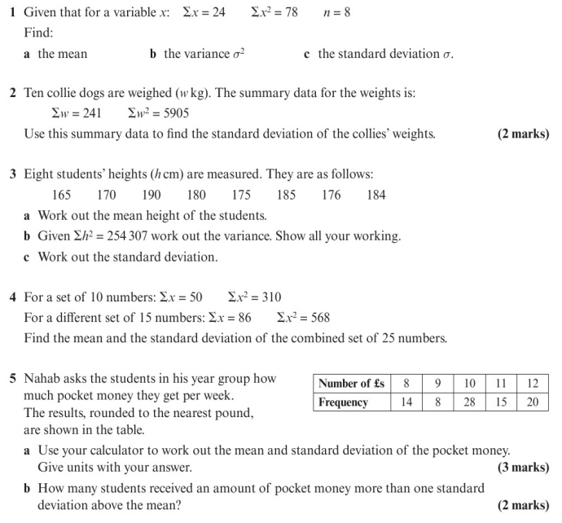
Homework Exercise

Slide 13
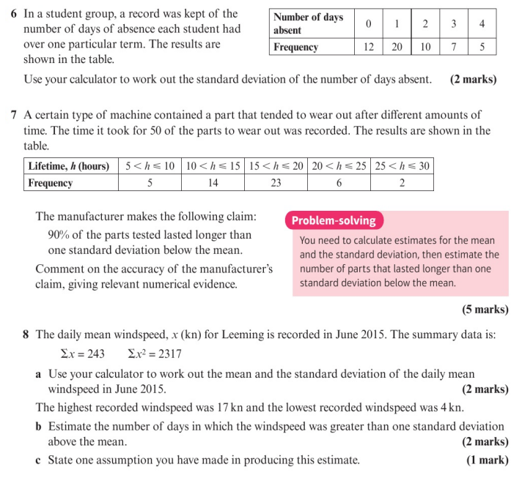
Homework Exercise

Slide 14
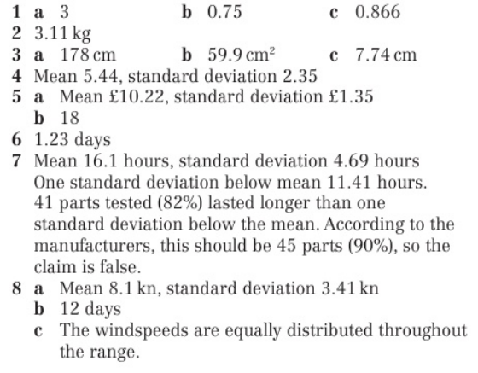
Homework Answers

