Slide 1
P1 Chapter 14: Logarithms Logarithm Equations

Slide 2


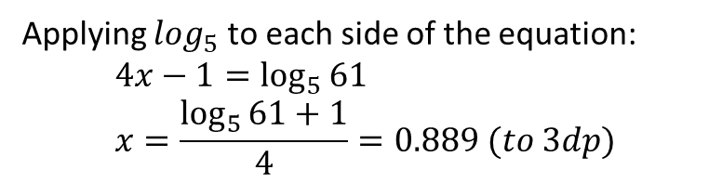

Solving equations with exponential terms
Solve $3^{x}=20$
?
Applying $\log_{3}$ to each side of the equation:
$$x=\log_{3}{20}=2.727 (to 3dp)$$
This is often said “Taking logs of both sides…”
Solve $5^{4x−1}=61$
?
Applying $\log_{5}$ to each side of the equation:
$$4x−1=\log_{5}{61} \\ x=\frac{\log_{5}{61}+1}{4}=0.889 (to 3dp)$$

Slide 3
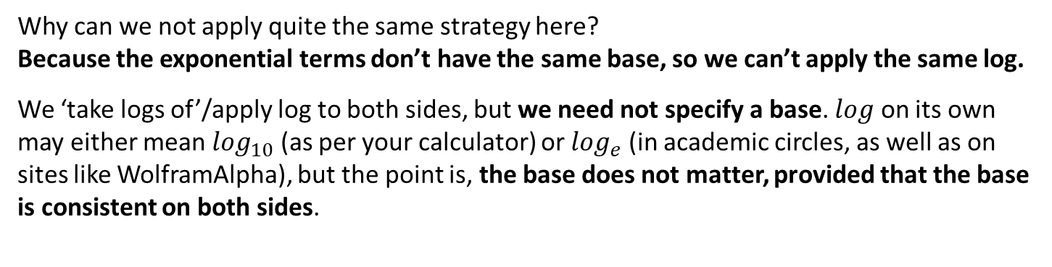

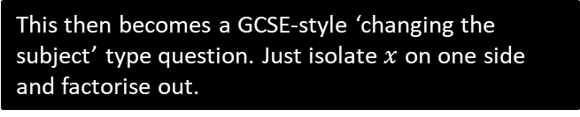

Solving equations with exponential terms
Solve $3^{x}=2^{x+1}$
Why can we not apply quite the same strategy here?
Because the exponential terms don’t have the same base, so we can’t apply the same log.
We ‘take logs of’/apply log to both sides, but we need not specify a base. $log$ on its own may either mean $\log_{10}$ (as per your calculator) or $\log_{e}$ (in academic circles, as well as on sites like WolframAlpha), but the point is, the base does not matter, provided that the base is consistent on both sides.
?
? Solution
$$\log{3^{x}}=\log{2^{x+1}} \\ x\log{3}=\left(x+1\right)\log{2} \\ x\log{3}=x\log{2}+\log{2} \\ x\log{3}−x\log{2}=\log{2} \\ x\left(\log{3}−\log{2}\right)=\log{2} \\ x=\frac{\log{2}}{\log{3}−\log{2}} \\ =1.7095$$
Logs in general are great for solving equations when the variable is in the power, because laws of logs allow us to move the power down.
This then becomes a GCSE-style ‘changing the subject’ type question. Just isolate $x$ on one side and factorise out.
It doesn’t matter what base you use to get the final answer as a decimal, provided that it’s consistent. You may as well use the calculator’s ‘log’ (no base) key.

Slide 4
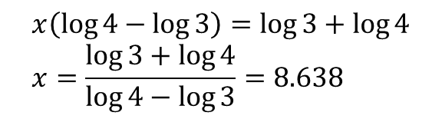
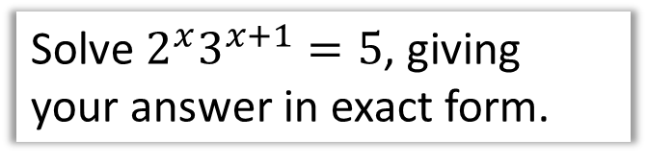
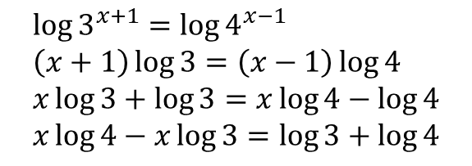
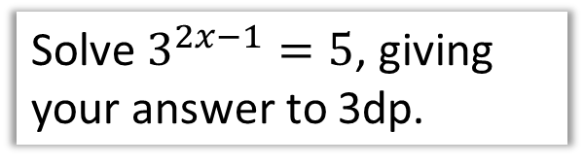

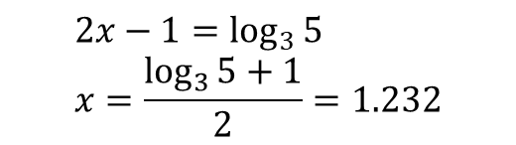
Test Your Understanding
1
Solve $3^{2x−1}=5$, giving your answer to 3dp.
3
Solve $2^{x}3^{x+1}=5$, giving your answer in exact form.
?
?
$$2x−1=\log_{3}{5} \\ x=\frac{\log_{3}{5}+1}{2}=1.232$$
$$\log{2^{x}3^{x+1}}=\log{5} \\ \log{2^{x}}+\log{3^{x+1}}=\log{5} \\ x\log{2}+\left(x+1\right)\log{3}=\log{5} \\ x\log{2}+x\log{3}+\log{3}=\log{5} \\ x \left(\log{2}+\log{3}\right)=\log{5}−\log{3} \\ x=\frac{\log{5}−\log{3}}{\log{2}+\log{3}}$$
which could be simplified to:
$$x=\frac{\log{5}−\log{3}}{\log{6}}$$
2
Solve $3^{x+1}=4^{x−1}$, giving your answer to 3dp.
?
$$\log{3^{x+1}}=\log{4^{x−1}} \\ \left(x+1\right)\log{3}=\left(x−1\right)\log{4} \\ x\log{3}+\log{3}=x\log{4}−\log{4} \\ x\log{4}−x\log{3}=\log{3}+\log{4}$$
$$x\left(\log{4}−\log{3}\right)=\log{3}+\log{4} \\ x=\frac{\log{3}+\log{4}}{\log{4}−\log{3}}=8.638$$

Slide 5

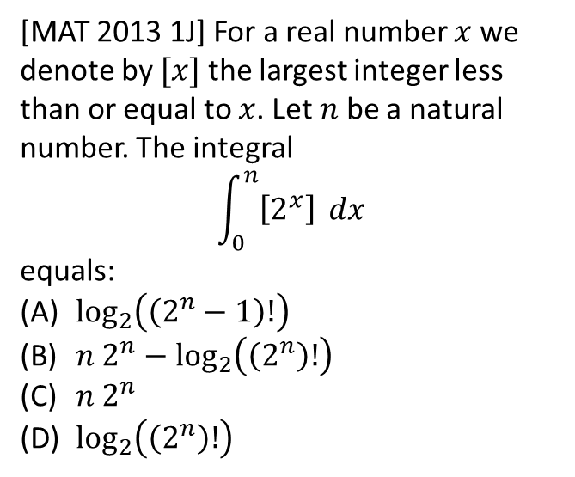

Exercise 14.6
Pearson Pure Mathematics Year 1/AS
Page 118
Extension
2
[MAT 2013 1J] For a real number $x$ we denote by $[x]$ the largest integer less than or equal to $x$. Let $n$ be a natural number. The integral
$$\int_{0}^{n}{\left[2^{x}\right]} dx$$
equals:
$\log_{2}\left(\left(2^{n}−1\right)!\right)$
$n 2^{n}−\log_{2}\left(\left(2^{n}\right)!\right)$
$n 2^{n}$
$\log_{2}\left(\left(2^{n}\right)!\right)$
1
[MAT 2011 1H] How many positive values $x$ which satisfy the equation:
$$x=8^{\log_{2}{x}}−9^{\log_{3}{x}}−4^{\log_{2}{x}}+\log_{0.5}{0.25}$$
$$x={\left(2^{3}\right)}^{\log_{2}{x}}−{\left(3^{2}\right)}^{\log_{3}{x}}−{\left(2^{2}\right)}^{\log_{2}{x}}+2 \\ x=2^{3\log_{2}{x}}−3^{2\log_{3}{x}}−2^{2\log_{2}{x}}+2 \\ x=2^{\log_{2}{x^{3}}}−3^{\log_{3}{x^{2}}}−2^{\log_{2}{x^{2}}}+2 \\ x=x^{3}−x^{2}−x^{2}+2 \\ x^{3}−2x^{2}−x+2=0 \\ x^{2}\left(x−2\right)−1\left(x−2\right)=0 \\ \left(x^{2}−1\right)\left(x−2\right)=0 \\ \left(x+1\right)\left(x−1\right)\left(x−2\right)=0$$
This has 2 positive solutions.
?
(Warning: This one really is very challenging, even for MAT)

Slide 6


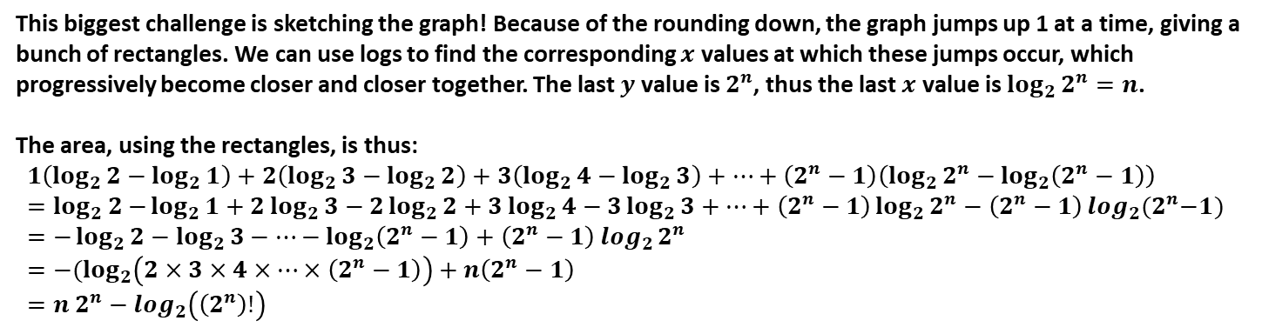




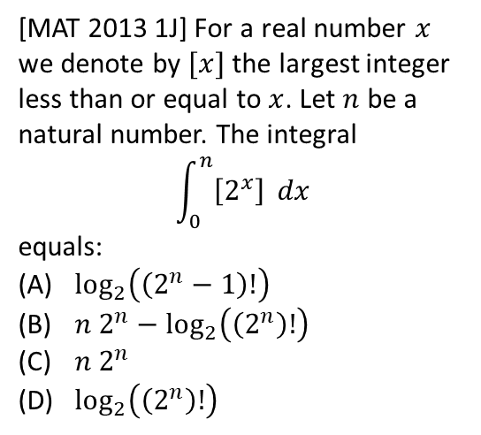









Solution to Extension Question 2
$$y$$
[MAT 2013 1J] For a real number $x$ we denote by $[x]$ the largest integer less than or equal to $x$. Let $n$ be a natural number. The integral
$$\int_{0}^{n}{\left[2^{x}\right]} dx$$
equals:
$\log_{2}\left(\left(2^{n}−1\right)!\right)$
$n 2^{n}−\log_{2}\left(\left(2^{n}\right)!\right)$
$n 2^{n}$
$\log_{2}\left(\left(2^{n}\right)!\right)$
$$y=2^{x}$$
$$2^{n}$$
$$5$$
$$4$$
$$3$$
$$2$$
$$1$$
$$\log_{2}{5}$$
$$x$$
$$\log_{2}{1}$$
$$\log_{2}{2}$$
$$\log_{2}{3}$$
$$\log_{2}{2^{n}}$$
$$\log_{2}{4}$$
This biggest challenge is sketching the graph! Because of the rounding down, the graph jumps up 1 at a time, giving a bunch of rectangles. We can use logs to find the corresponding $x$ values at which these jumps occur, which progressively become closer and closer together. The last $y$ value is $2^{n}$, thus the last $x$ value is $\log_{2}{2^{n}}=n$.
The area, using the rectangles, is thus:
$$1\left(\log_{2}{2}−\log_{2}{1}\right)+2\left(\log_{2}{3}−\log_{2}{2}\right)+3\left(\log_{2}{4}−\log_{2}{3}\right)+…+\left(2^{n}−1\right)\left(\log_{2}{2^{n}}−\log_{2}\left(2^{n}−1\right)\right) \\ =\log_{2} 2{−\log_{2}{1}+2\log_{2}{3}−2\log_{2}{2}+3\log_{2}{4}−3\log_{2}{3}+…+\left(2^{n}−1\right)\log_{2}{2^{n}}−\left(2^{n}−1\right)\log_{2}{{(2}^{n}−1) }} \\ =−\log_{2}{2}−\log_{2}{3}−…−\log_{2}\left(2^{n}−1\right)+\left(2^{n}−1\right)\log_{2}{2^{n}} \\ =−(\log_{2}\left(2×3×4×…×\left(2^{n}−1\right)\right)+n\left(2^{n}−1\right) \\ =n 2^{n}−\log_{2}\left(\left(2^{n}\right)!\right)$$

Slide 7
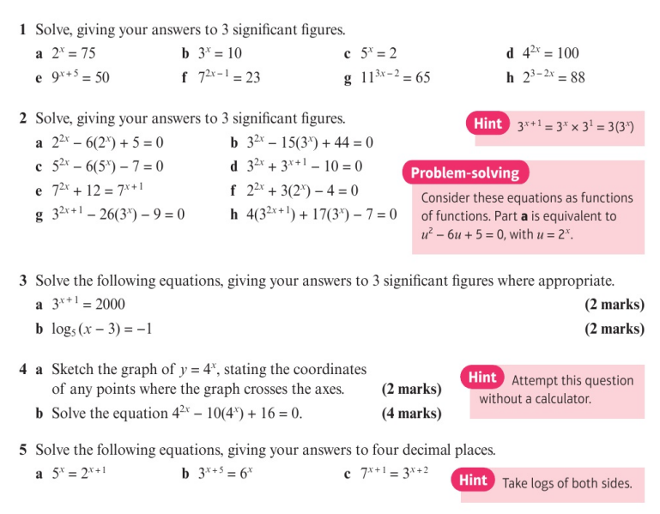
Homework Exercise

Slide 8
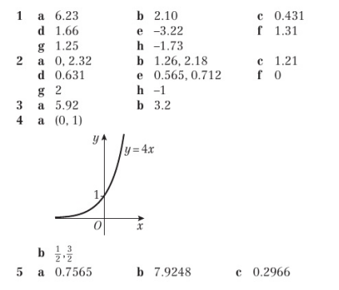
Homework Answers

