Slide 1
P2 Chapter 1: Algebra Techniques
Chapter Practice

Slide 2
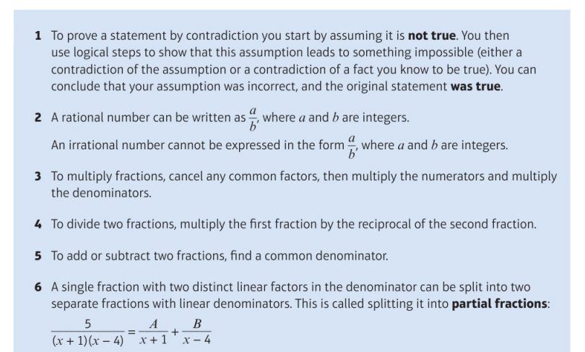
Key Points

Slide 3
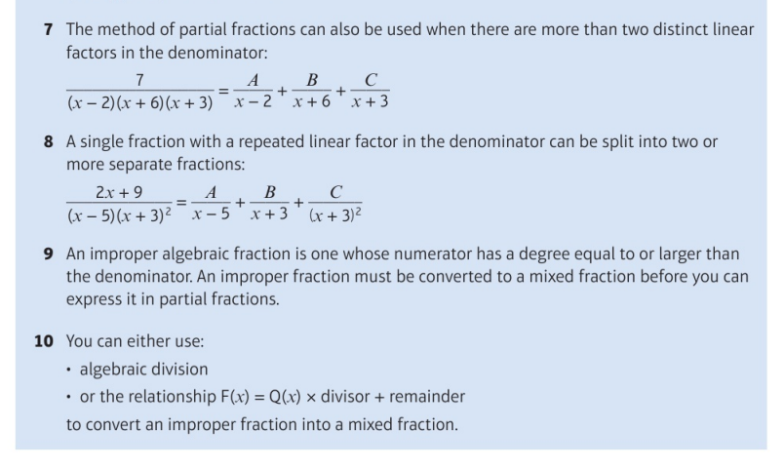
Key Points

Slide 4
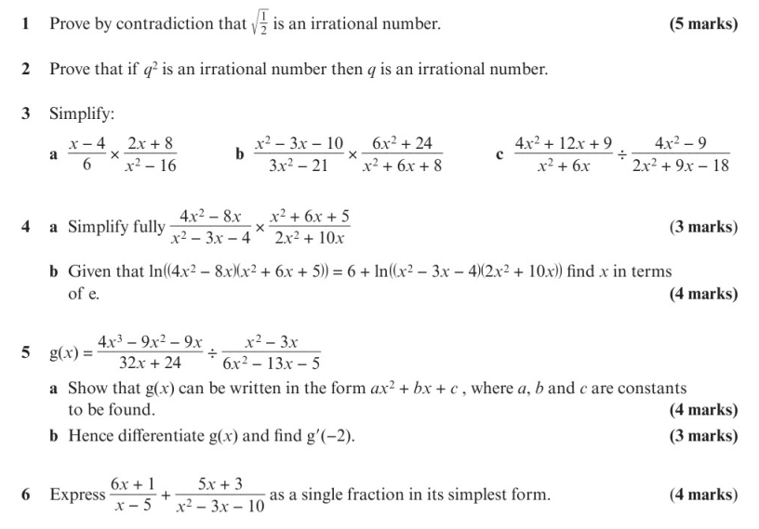
Chapter Exercises

Slide 5
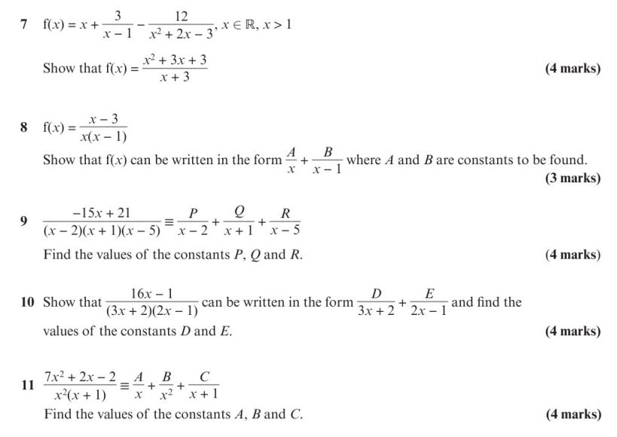
Chapter Exercises

Slide 6
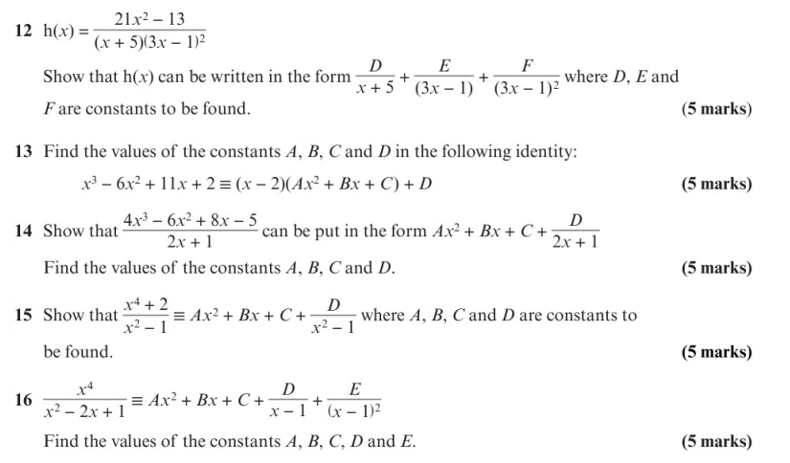
Chapter Exercises

Slide 7
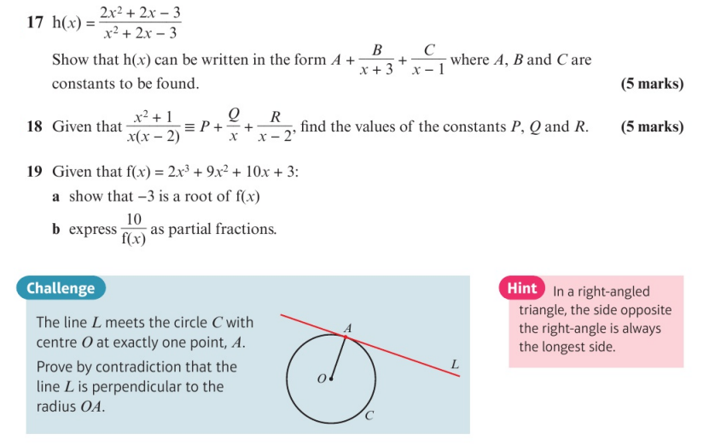
Chapter Exercises

Slide 8
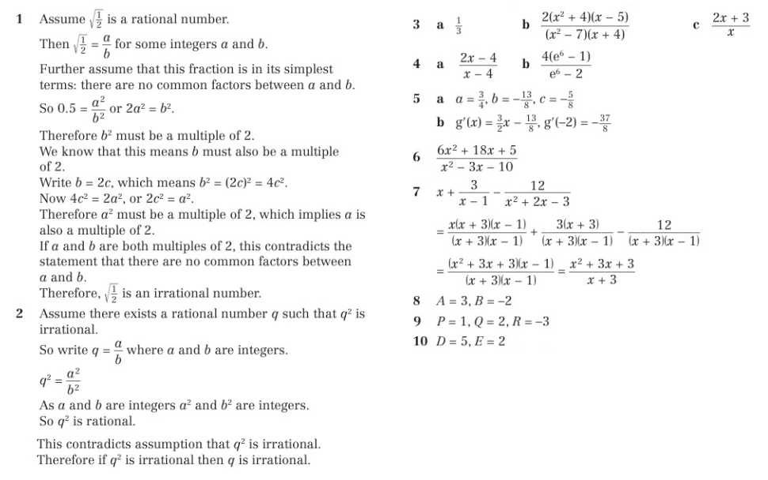
Chapter Answers

Slide 9
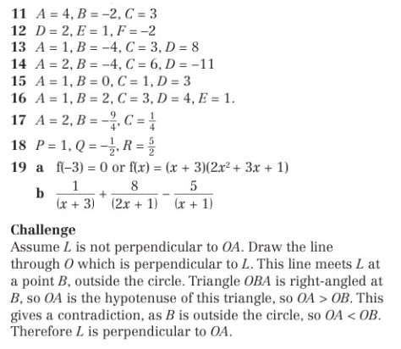
Chapter Answers

