Slide 1
M1 Chapter 9: Constant Acceleration Three Derived Formulae

Slide 2








“suvat” equations (Part 2)
The other “suvat” equations can be derived using $v=u+at$ and $s=\left(\frac{u+v}{2}\right)t$.
Eliminating $t$:
$$t=\frac{v−u}{a} \\ s=\left(\frac{u+v}{2}\right)\left(\frac{v−u}{a}\right) \\ =…$$
Eliminating $v$:
$$s=\left(\frac{u+u+at}{2}\right)t \\ =\left(\frac{2u+at}{2}\right)t$$
?
?
! $v^{2}=u^{2}+2as$
! $s=ut+\frac{1}{2}at^{2}$
Eliminating $u$:
$$u=v−at \\ s=\left(\frac{v−at+v}{2}\right)t \\ =\left(\frac{2v−at}{2}\right)t$$
?
Note: Because this is quadratic in $t$, we typically end up with two different possible times.
Note: Exam questions that use this $suvat$ formula are rare.
! $s=vt−\frac{1}{2}at^{2}$

Slide 3
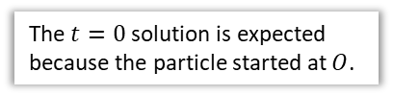
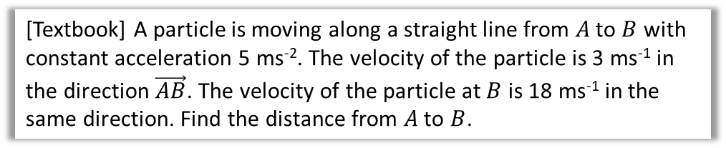

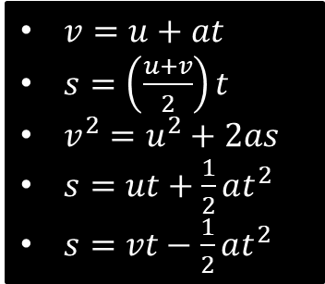

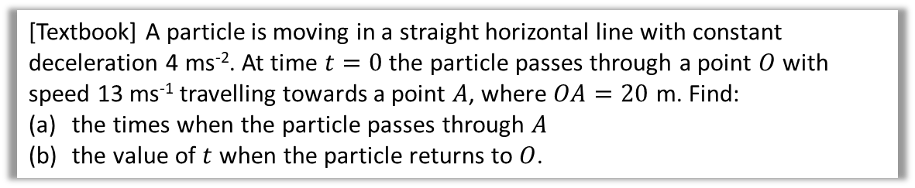
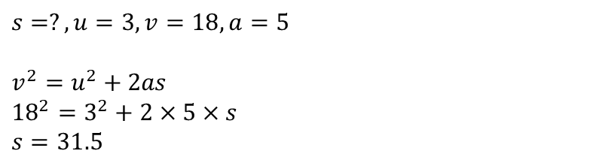
Examples
[Textbook] A particle is moving along a straight line from $A$ to $B$ with constant acceleration 5 ms⁻². The velocity of the particle is 3 ms⁻¹ in the direction $\vec{AB}$. The velocity of the particle at $B$ is 18 ms⁻¹ in the same direction. Find the distance from $A$ to $B$.
$v=u+at$
$s=\left(\frac{u+v}{2}\right)t$
$v^{2}=u^{2}+2as$
$s=ut+\frac{1}{2}at^{2}$
$s=vt−\frac{1}{2}at^{2}$
$$s=?, u=3, v=18,a=5$$
$$v^{2}=u^{2}+2as \\ {18}^{2}=3^{2}+2×5×s \\ s=31.5$$
[Textbook] A particle is moving in a straight horizontal line with constant deceleration 4 ms⁻². At time $t=0$ the particle passes through a point $O$ with speed 13 ms⁻¹ travelling towards a point $A$, where $OA=20$ m. Find:
the times when the particle passes through $A$
the value of $t$ when the particle returns to $O$.
$$s=20, u=13, a=−4,t=?$$
$$s=ut+\frac{1}{2}at^{2} \\ 20=13t−\frac{1}{2}×4t^{2} \\ 2t^{2}−13t+20=0 \\ \left(2t−5\right)\left(t−4\right)=0 \\ t=\frac{5}{2}, t=4$$
b
$$s=0, u=13, a=−4, t=? \\ s=ut+\frac{1}{2}at^{2} \\ 0=13t−2t^{2} \\ =t\left(13−2t\right) \\ t=0, or t=\frac{13}{2}$$
Particle returns after 6.5 s
a
?
?
The $t=0$ solution is expected because the particle started at $O$.

Slide 4
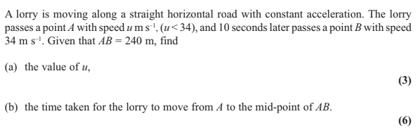
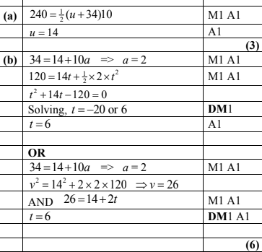
Test Your Understanding
Edexcel M1 May 2013 Q4
?
?

Slide 5
Exercise 9.4 The second two formulae
Pearson Stats/Mechanics Year 1
Pages 62-63

Slide 6
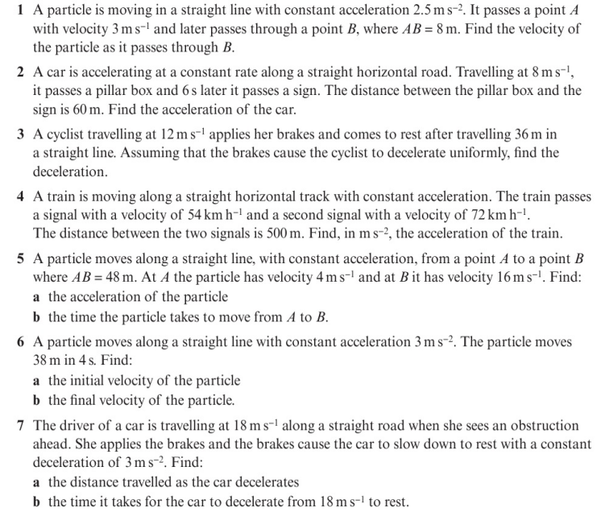
Homework Exercise

Slide 7
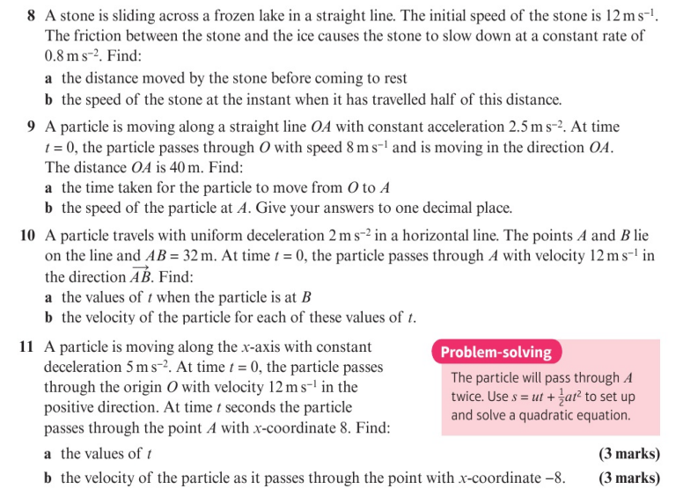
Homework Exercise

Slide 8
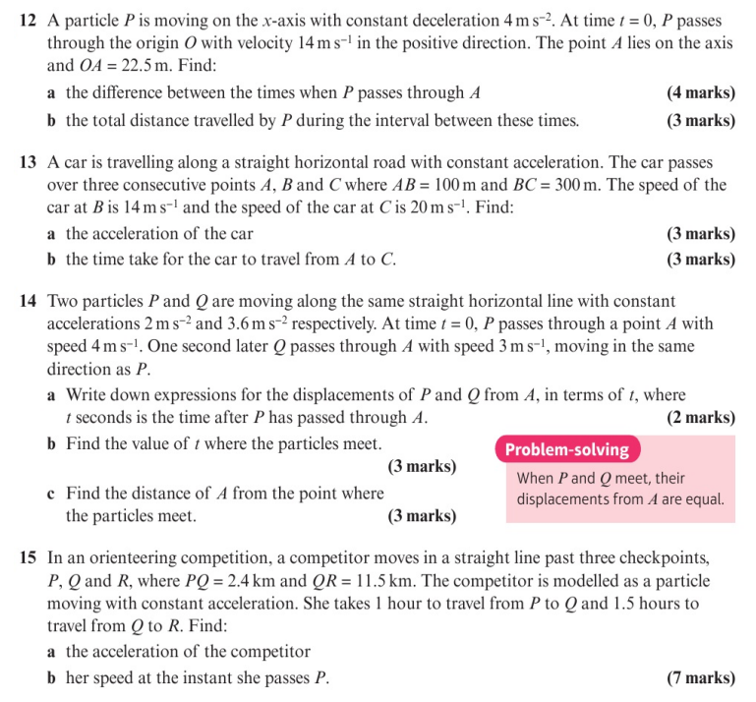
Homework Exercise

Slide 9
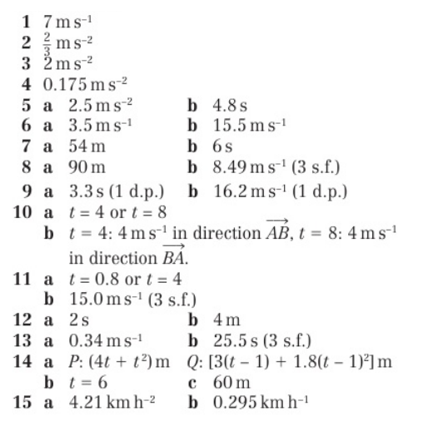
Homework Answers

