Slide 1
P1 Chapter 2: Quadratics Chapter Practice

Slide 2
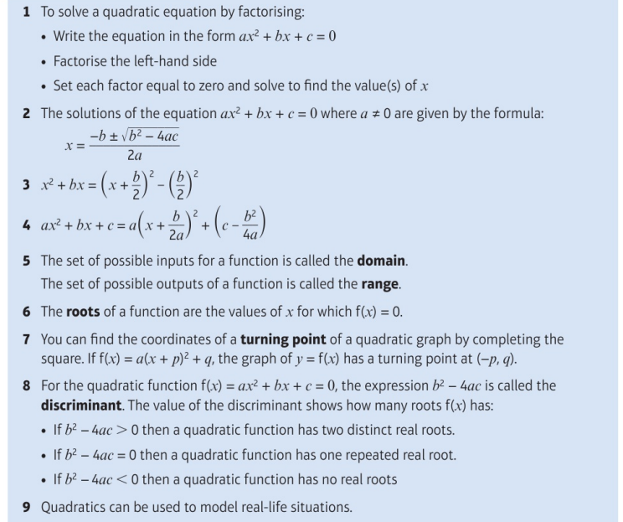
Key Points

Slide 3
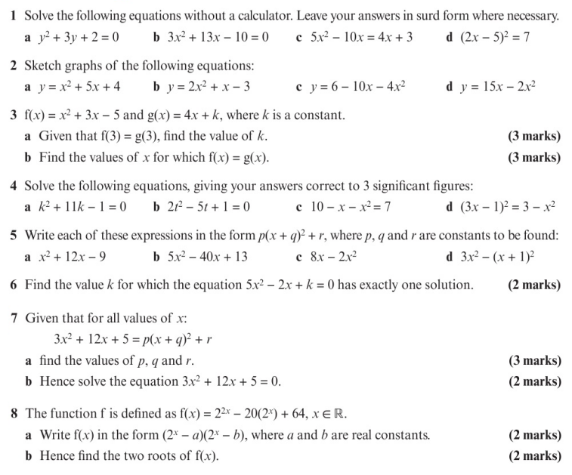
Chapter Exercises

Slide 4
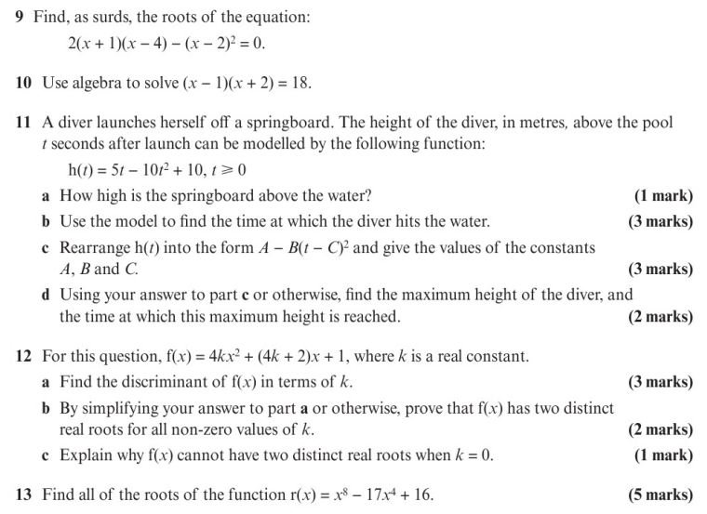
Chapter Exercises

Slide 5
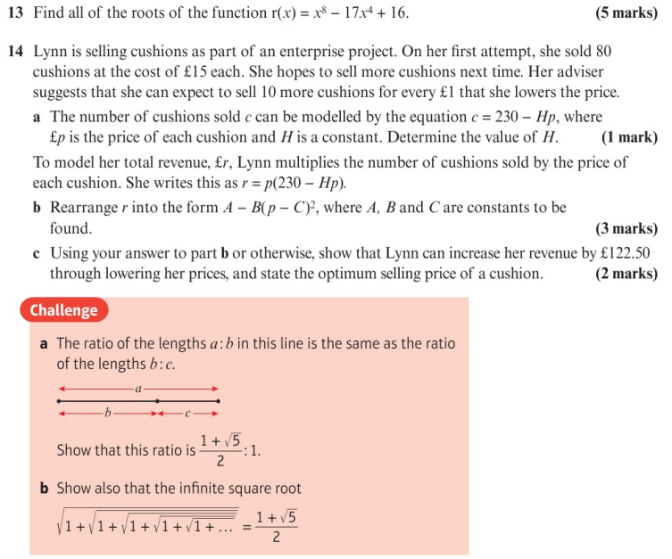
Chapter Exercises

Slide 6
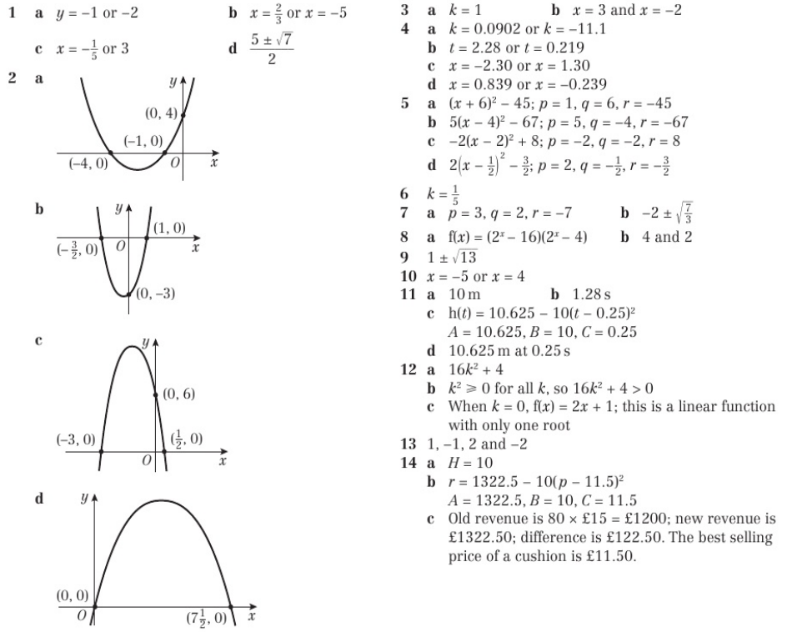
Chapter Answers

Slide 7
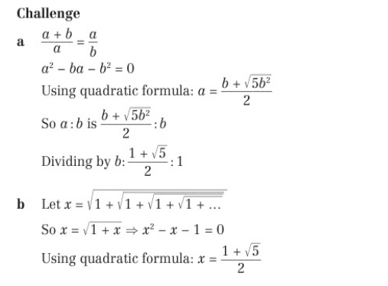
Chapter Answers

