Slide 1
P1 Chapter 14: Logarithms Logarithms

Slide 2










Logarithms
You know the inverse of many mathematical operations; we can undo an addition by 2 for example by subtracting 2. But is there an inverse function for an exponential function?
Function
Inverse
12
4
$$x×3$$
$$x÷3$$
4
?
7
4
$$x+3$$
$$x−3$$
4
?
16
4
$$x^{2}$$
$$\sqrt{x}$$
4
?
1024
4
$$x^{5}$$
$$\sqrt[5]{x}$$
4
?
81
4
$$3^{x}$$
$$\log_{3}{x}$$
4
?
Such functions are known as logarithms, and exist in order to provide an inverse to exponential functions.

Slide 3



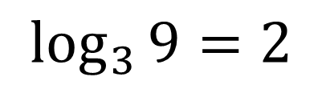

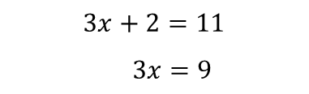


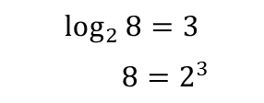


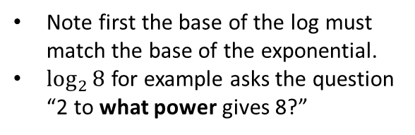


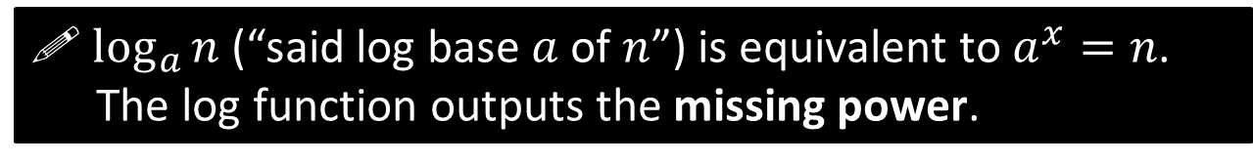


Interchanging between exponential and log form
! $\log_{a}{n}$ (“said log base $a$ of $n$”) is equivalent to $a^{x}=n$. The log function outputs the missing power.
$$3^{2}=9$$
$$\log_{3}{9}=2$$
Here are two methods of interchanging between these forms.
Pick your favourite!
Method 1: ‘Missing Power’
Method 2: Do same operation to each side of equation.
Note first the base of the log must match the base of the exponential.
$\log_{2}{8}$ for example asks the question “2 to what power gives 8?”
Since KS3 you’re used to the idea of doing the same thing to each side of the equation that ‘undoes’ whatever you want to get rid of.
$$3x+2=11$$
$$3x=9$$
We can imagine inserting the output of the log just after the base. Click the button!
$$\left(−2\right)$$
$$\left(−2\right)$$
“log base $a$” undoes “$a$ to the power of” and vice versa, as they are inverse functions.
$$=$$
$$log$$
$$3$$
Click to start Fro-manimation
$$8$$
$$=3$$
$$2$$
$$\log_{2}{8}=3$$
$$8=2^{3}$$
$$\left(2^{□}\right)$$
$$\left(2^{□}\right)$$

Slide 4
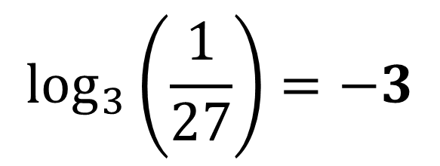
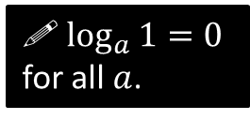
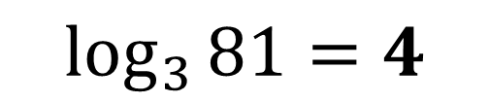
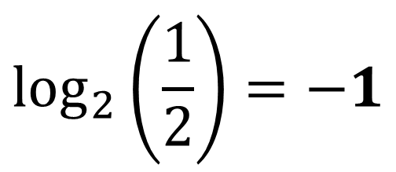

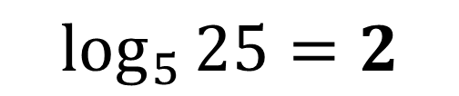

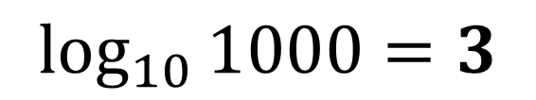
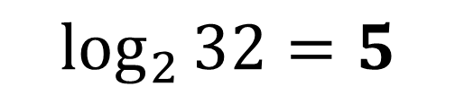
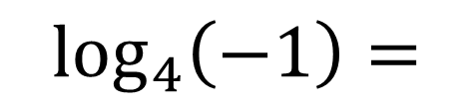

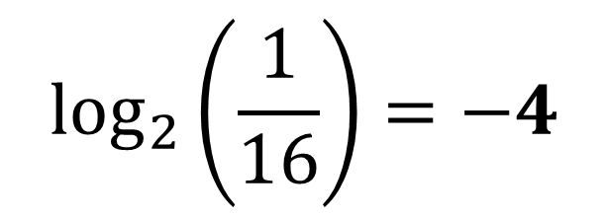
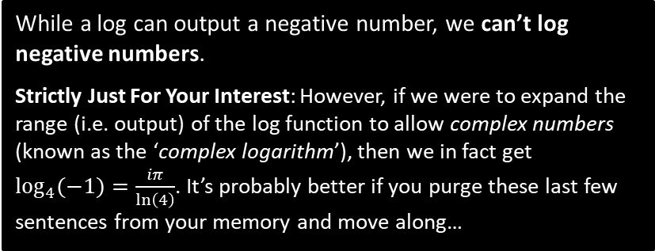
Examples
?
$$\log_{3}\left(\frac{1}{27}\right)=−3$$
$$\log_{5}{25}=2$$
Think: “5 to the power of what gives you 25?”
?
?
$$\log_{3}{81}=4$$
$$\log_{2}\left(\frac{1}{16}\right)=−4$$
?
?
$$\log_{2}{32}=5$$
?
?
$$\log_{10}{1000}=3$$
$$\log_{a}\left(a^{3}\right)=3$$
?
$$\log_{4}{1}=0$$
! $\log_{a}{1}=0$ for all $a$.
?!!??
$$\log_{4}\left(−1\right)=$$
No real answer
$$\log_{4}{4}=1$$
?
While a log can output a negative number, we can’t log negative numbers.
Strictly Just For Your Interest: However, if we were to expand the range (i.e. output) of the log function to allow complex numbers (known as the ‘complex logarithm’), then we in fact get $\log_{4}{(−1)}=\frac{iπ}{\ln\left(4\right)}$. It’s probably better if you purge these last few sentences from your memory and move along…
$$\log_{2}\left(\frac{1}{2}\right)=−1$$
?

Slide 5






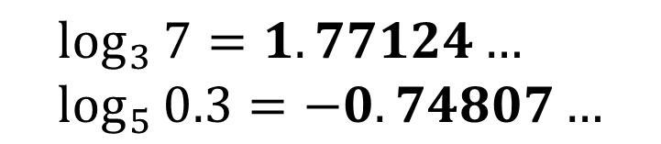
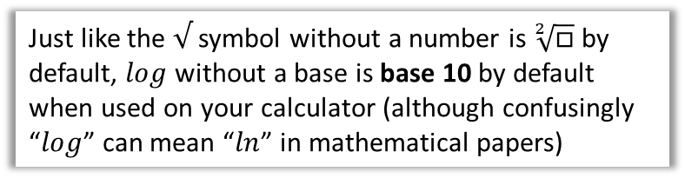

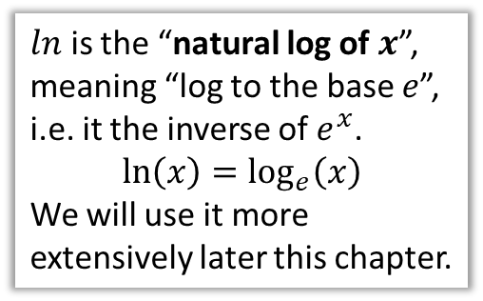
With Your Calculator
There are three buttons on your calculator for computing logs:
I couldn’t think of a word that rhymed with ‘ln’ so I recorded it for you.
?
$$\log_{□}{□}$$
$$\log_{3}{7}=1.77124… \\ \log_{5}{0.3}=−0.74807…$$
?
$ln$ of $x$
$$\ln{10}=2.30258… \\ \ln{e}=1$$
$$ln$$
?
?
$ln$ is the “natural log of $x$”, meaning “log to the base $e$”, i.e. it the inverse of $e^{x}$.
$$\ln\left(x\right)=\log_{e}\left(x\right)$$
We will use it more extensively later this chapter.
$$log$$
$$\log{100}=2$$
?
Just like the $√$ symbol without a number is $\sqrt[2]{□}$ by default, $log$ without a base is base 10 by default when used on your calculator (although confusingly “$log$” can mean “$ln$” in mathematical papers)

Slide 6
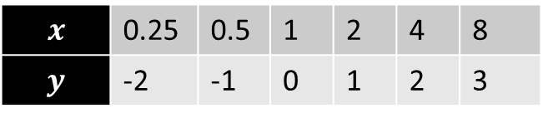


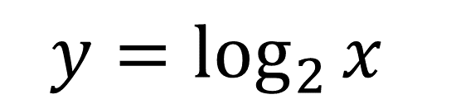
8
4
3
2
1
-1
-2
$$y=\log_{2}{x}$$
$$x$$ | 0.25 | 0.5 | 1 | 2 | 4 | 8
$$y$$ | -2 | -1 | 0 | 1 | 2 | 3
?
?
?
?
?
?
The log graph isn’t defined for $x≤0$
The gradient gradually decreases but remains positive (log is an “increasing function”)
Root is 1.
-2 -1 1 2 3 4 5 6 7
We have a vertical asymptote $x=0$
Notes:
Get students to sketch axes and tables in their books.

Slide 7


Exercise 14.4
Pearson Pure Mathematics Year 1/AS
Page 116
Extension
2
[MAT 2013 1F] Three positive numbers $a,b,c$ satisfy
$$\log_{b}{a}=2 \\ \log_{b}\left(c−3\right)=3 \\ \log_{a}\left(c+5\right)=2$$
This information:
specifies $a$ uniquely;
is satisfied by two values of $a$;
is satisfied by infinitely many values of $a$;
is contradictory
If we take exponents of the three equations:
$$a=b^{2}, c−3=b^{3}, c+5=a^{2}$$
Hence eliminating $a$ and $c$ we get
$$b^{3}+3=b^{4}−5 ⇒ b^{3}\left(b−1\right)=8$$
We are only interested in positive solutions to $b$. Note that $b^{3}\left(b−1\right)$ is negative for $0<b<1$ and then both $b^{3}$ and $b−1$ are positive and increasing for $b>1$. So there is only one positive solution to the equation ($b=2$, so that $a=4, c=11$). Answer is (a).
1
[MAT 2015 1J] Which is the largest of the following numbers?
A) $\frac{\sqrt{7}}{2}$ B) $\frac{5}{4}$ C) $\frac{\sqrt{10!}}{3\left(6!\right)}$
D) $\frac{\log_{2}{30}}{\log_{3}{85}}$ E) $\frac{1+\sqrt{6}}{3}$
(Official solution) Squaring all answers results in (A) $\frac{7}{4}$ which is larger than (B) $\frac{25}{16}$. After squaring (C) it simplifies to $\frac{10×9×8×7}{9×6!}$ which further simplifies to $\frac{7}{9}$ which is smaller than (A).
$\log_{2}{30}≈5$ and $\log_{3}{(85)}≈4$, hence (D) is smaller than (A) after squaring. Comparing (A) with (E) after squaring results in a comparison of $\frac{7}{4}$ and $\frac{7+2\sqrt{6}}{9}$. As $2<\sqrt{6}<3$, (E) squared must be less than $\frac{13}{9}$ and hence less than $\frac{7}{4}$. The answer is (A).
Non-calculator!
?
?

Slide 8
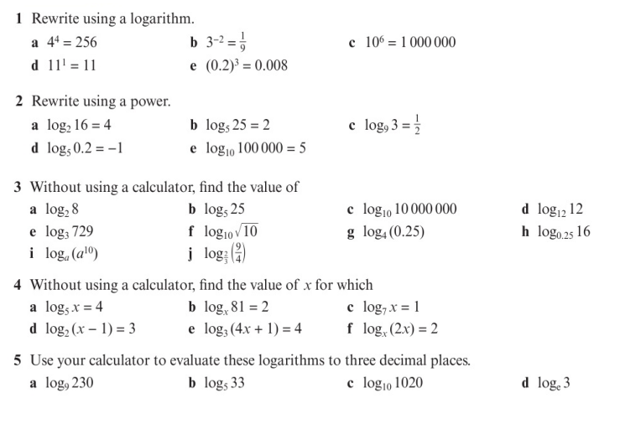
Homework Exercise

Slide 9
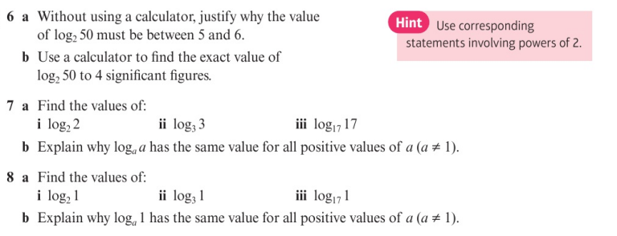
Homework Exercise

Slide 10
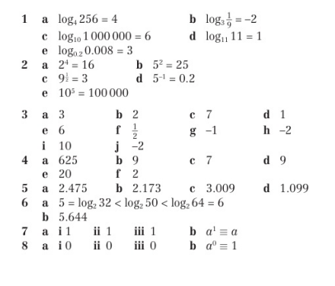
Homework Answers

