Slide 1
S1 Chapter 6: Statistical Distributions Cumulative Probability

Slide 2
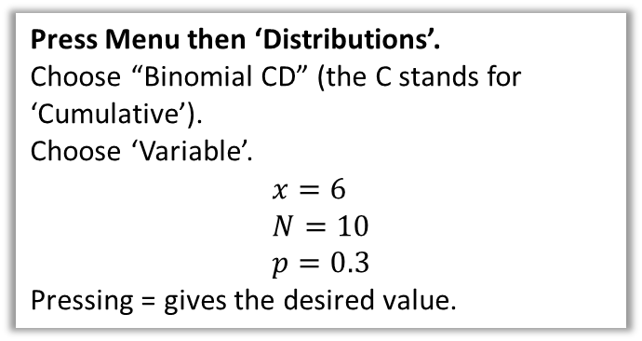
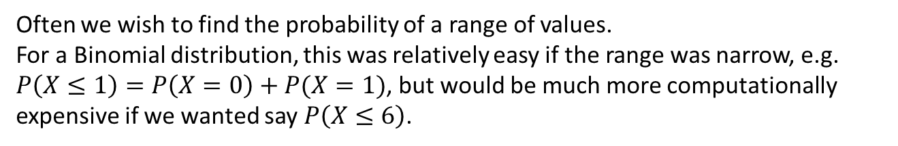
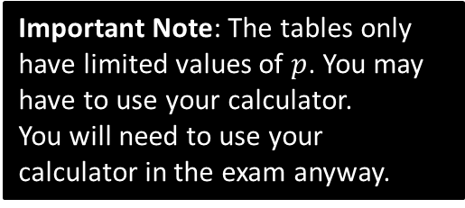
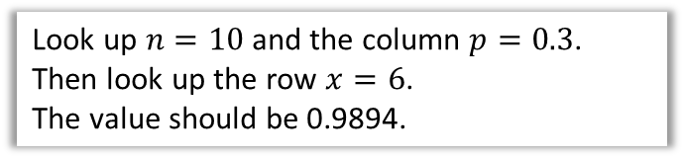
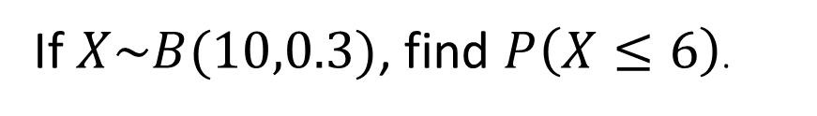
Cumulative Probabilities
Often we wish to find the probability of a range of values.
For a Binomial distribution, this was relatively easy if the range was narrow, e.g. $P\left(X≤1\right)=P\left(X=0\right)+P(X=1)$, but would be much more computationally expensive if we wanted say $P\left(X≤6\right)$.
If $X\sim B(10,0.3)$, find $P\left(X≤6\right)$.
How to calculate on your ClassWiz:
Using tables (e.g. Page 204 of textbook)
Press Menu then ‘Distributions’.
Choose “Binomial CD” (the C stands for ‘Cumulative’).
Choose ‘Variable’.
$$x=6 \\ N=10 \\ p=0.3$$
Pressing = gives the desired value.
Look up $n=10$ and the column $p=0.3$.
Then look up the row $x=6$.
The value should be 0.9894.
Important Note: The tables only have limited values of $p$. You may have to use your calculator.
You will need to use your calculator in the exam anyway.

Slide 3
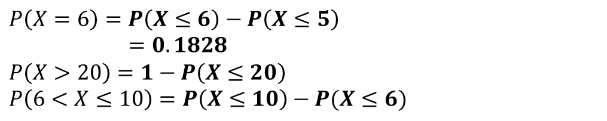

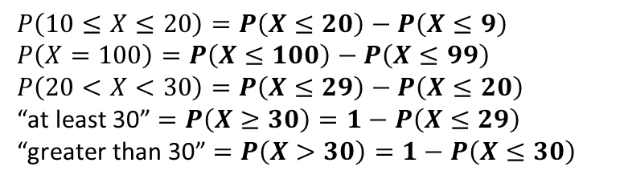
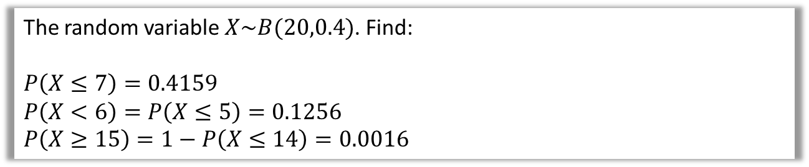
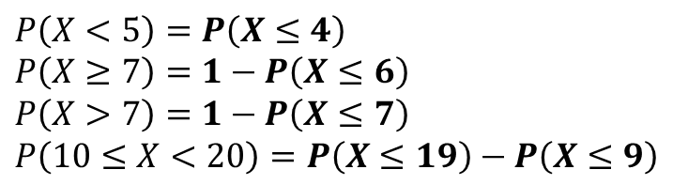



Cumulative Probabilities
The random variable $X\sim B(20,0.4)$. Find:
$$P\left(X≤7\right)=0.4159$$
$$P\left(X<6\right)=P\left(X≤5\right)=0.1256 \\ P\left(X≥15\right)=1−P\left(X≤14\right)=0.0016$$
Look up $n=20, p=0.4, x=7$
?
?
Note that the table requires $≤$
?
To get this right, just say in your head “What’s the opposite of ‘at least 15’?”. Hopefully you can see it’s ‘at most 14’.
Given that $X\sim B\left(25,0.25\right)$
$$P\left(X=6\right)=P\left(X≤6\right)−P\left(X≤5\right) \\ =0.1828$$
$$P\left(X>20\right)=1−P\left(X≤20\right) \\ P\left(6<X≤10\right)=P\left(X≤10\right)−P(X≤6)$$
?
?
$X$ can be 7 to 10. So we want up to 10, with everything up to 6 excluded.
?
Quickfire Questions
Write the following in terms of cumulative probabilities, e.g. $P\left(X<7\right)=P\left(X≤6\right)$
$$P\left(X<5\right)=P\left(X≤4\right) \\ P\left(X≥7\right)=1−P\left(X≤6\right)$$
$$P\left(X>7\right)=1−P\left(X≤7\right)$$
$$P\left(10≤X<20\right)=P\left(X≤19\right)−P\left(X≤9\right)$$
?
?
$$P\left(10≤X≤20\right)=P\left(X≤20\right)−P\left(X≤9\right) \\ P\left(X=100\right)=P\left(X≤100\right)−P\left(X≤99\right)$$
$$P\left(20<X<30\right)=P\left(X≤29\right)−P\left(X≤20\right)$$
“at least 30” $=P\left(X≥30\right)=1−P\left(X≤29\right)$
“greater than 30” $=P\left(X>30\right)=1−P\left(X≤30\right)$
?
?
?
?
?
?
?

Slide 4

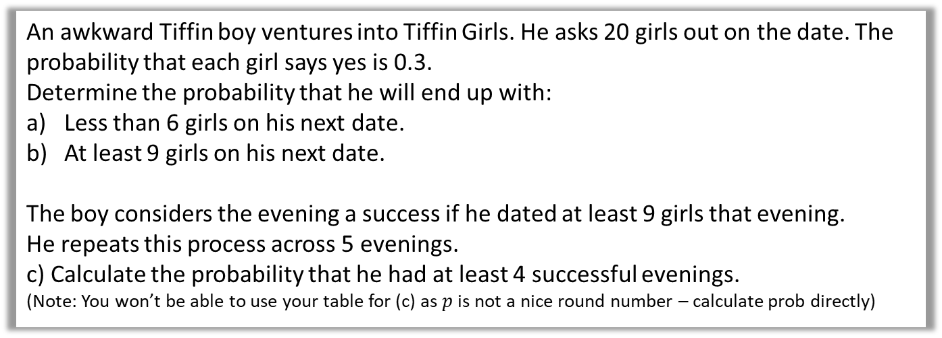
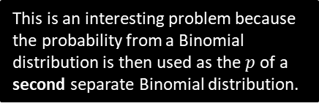

More Challenging Example
Q
An awkward Tiffin boy ventures into Tiffin Girls. He asks 20 girls out on the date. The probability that each girl says yes is 0.3.
Determine the probability that he will end up with:
Less than 6 girls on his next date.
At least 9 girls on his next date.
The boy considers the evening a success if he dated at least 9 girls that evening.
He repeats this process across 5 evenings.
c) Calculate the probability that he had at least 4 successful evenings. (Note: You won’t be able to use your table for (c) as $p$ is not a nice round number – calculate prob directly)
a
$X\sim B\left(20, 0.3\right) X$ is the number of girls dated in an evening. $$P\left(X<6\right)=P\left(X≤5\right)$$ $=0.4164$
$$P\left(X≥9\right)=1−P\left(X≤8\right) \\ =1−0.8867 \\ =0.1133$$
$Y\sim B\left(5, 0.1133\right) Y$ is the number of successful evenings.
$$P\left(X≥4\right)=P\left(X=4\right)+P\left(X=5\right) \\ =\left(\begin{matrix}5 \\ 4\end{matrix}\right){0.1133}^{4}×0.8867 + {0.1133}^{5} \\ =0.000749$$
?
b
?
c
?
This is an interesting problem because the probability from a Binomial distribution is then used as the $p$ of a second separate Binomial distribution.

Slide 5

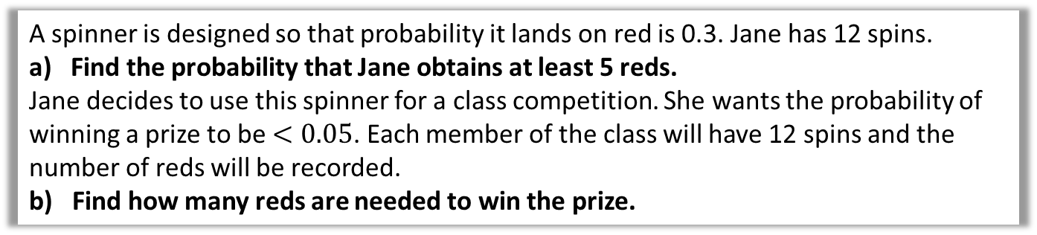

Dealing with Probability Ranges
Q
A spinner is designed so that probability it lands on red is 0.3. Jane has 12 spins.
Find the probability that Jane obtains at least 5 reds.
Jane decides to use this spinner for a class competition. She wants the probability of winning a prize to be $<0.05$. Each member of the class will have 12 spins and the number of reds will be recorded.
b) Find how many reds are needed to win the prize.
?
$$P\left(X≥5\right)=1−P\left(X≤4\right)=0.2763$$
$$P\left(X≥r\right)<0.05 \\ 1−P\left(X≤r−1\right)<0.05 \\ P\left(X≤r−1\right)>0.95$$
$$r−1=6 \\ r=7$$
Note that the textbook does this in a less methodical way: but the method above is what you would find in S2 exam mark schemes, so ignore at your peril.
STEP 1: Represent the sentence using probability.
STEP 2: Ensure LHS involves $≤$ inside probability.
STEP 3: Rearrange.
STEP 4: Use table backwards to find value corresponding to closest probability.

Slide 6


Test Your Understanding
Q
At Camford University, students have 20 exams at the end of the year. All students pass each individual exam with probability 0.45. Students are only allowed to continue into the next year if they pass some minimum of exams out of the 20.
What do the university administrators set this minimum number such that the probability of continuing to next year is at least 90%?
?
$$X\sim B\left(20, 0.45\right) \\ P\left(X≥k\right)≥0.9 \\ 1−P\left(X≤k−1\right)≥0.9 \\ P\left(X≤k−1\right)≤0.1 \\ k−1=5 \\ k=6$$
This is exactly what you should write.

Slide 7
Exercise 6.3
Pearson Applied Year 1/AS
Pages 42-43

Slide 8
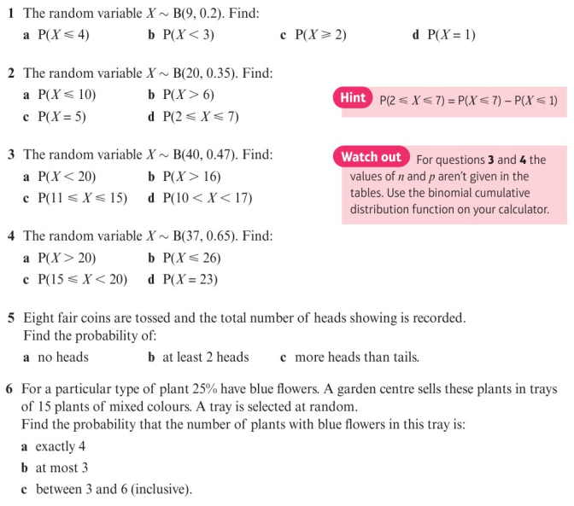
Homework Exercise

Slide 9
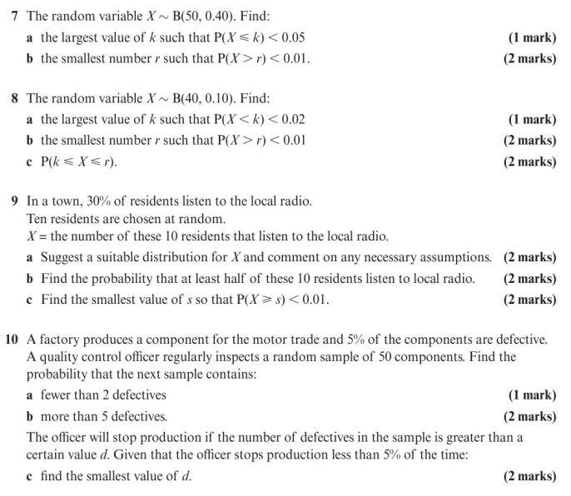
Homework Exercise

Slide 10
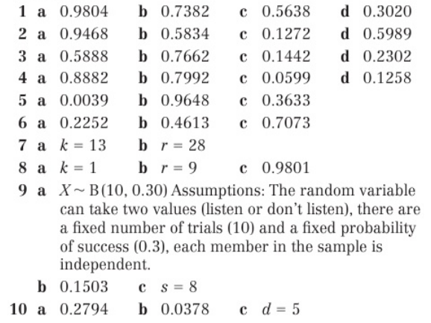
Homework Answers

