Slide 1
S1 Chapter 6: Statistical Distributions Probability Distributions

Slide 2

This Chapter Overview
1 :: General Probability Distributions
“Given that $P\left(X=x\right)=\frac{k}{x}$, find the value of $k$.”
2 :: Binomial Distribution
“I toss an unfair coin, with probability heads of 0.6, 10 times. What’s the probability I see 5 heads?”
3 :: Cumulative Binomial Probabilities
“I toss an unfair coin, with probability heads of 0.6, 10 times. What’s the probability I see at most 3 heads?”

Slide 3
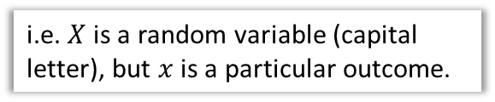
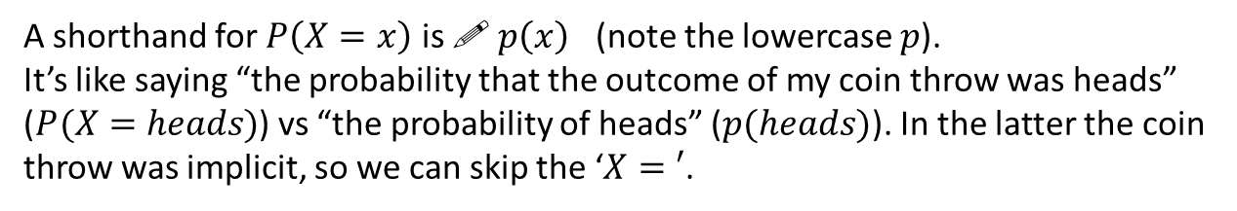

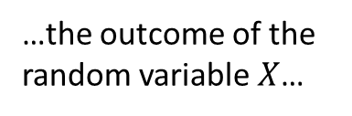


Probability distributions
You are already familiar with the concept of variable in statistics: a collection of values (e.g. favourite colour of students in the room):
$$x$$ | red | green | blue | orange
$$P(X=x)$$ | 0.3 | 0.4 | 0.1 | 0.2
If each is assigned a probability of occurring, it becomes a random variable.
! A random variable $X$ represents a single experiment/trial. It consists of outcomes with a probability for each.
i.e. $X$ is a random variable (capital letter), but $x$ is a particular outcome.
$$P(X=x)$$
“The probability that…
…the outcome of the random variable $X$…
…was the specific outcome $x$”
A shorthand for $P\left(X=x\right)$ is ! $p\left(x\right)$ (note the lowercase $p$).
It’s like saying “the probability that the outcome of my coin throw was heads” ($P(X=heads)$) vs “the probability of heads” ($p(heads)$). In the latter the coin throw was implicit, so we can skip the ‘$X=′$.

Slide 4
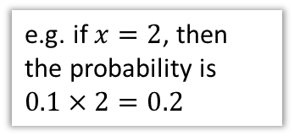

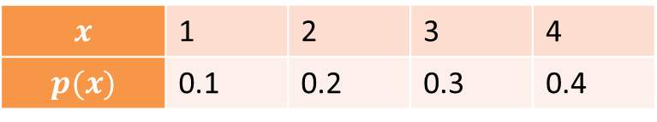
Probability Distributions vs Probability Functions
There are two ways to write the mapping from outcomes to probabilities:
The “{“ means we have a ‘piecewise function’. This just simply means we choose the function from a list depending on the input.
As a function:
e.g. if $x=2$, then the probability is $0.1×2=0.2$
$$p\left(x\right)=\left\{\begin{aligned}0.1x, x=1,2,3,4 \\ &0, otherwise\end{aligned}\right.$$
Advantages of functional form:
Can have a rule/expression based on the outcome. Particularly for continuous random variables (in Yr2), it would be impossible to list the probability for every outcome. More compact.
?
As a table:
$$x$$ | 1 | 2 | 3 | 4
$$p(x)$$ | 0.1 | 0.2 | 0.3 | 0.4
?
The table form that you know and love.
Advantages of table form:
Probability for each outcome more explicit.
?

Slide 5
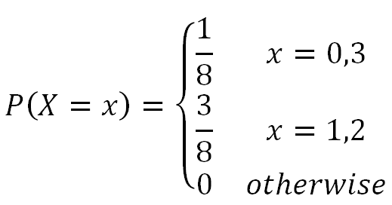
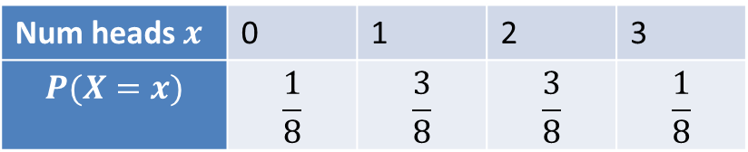

Example
The random variable $X$ represents the number of heads when three coins are tossed.
Underlying Sample Space
Distribution as a Table
?
Num heads $x$ | 0 | 1 | 2 | 3
$$P(X=x)$$ | $$\frac{1}{8}$$ | $$\frac{3}{8}$$ | $$\frac{3}{8}$$ | $$\frac{1}{8}$$
?
{ HHH,
HHT,
HTT,
HTH,
THH,
THT,
TTH,
TTT }
Distribution as a Function
?

Slide 6
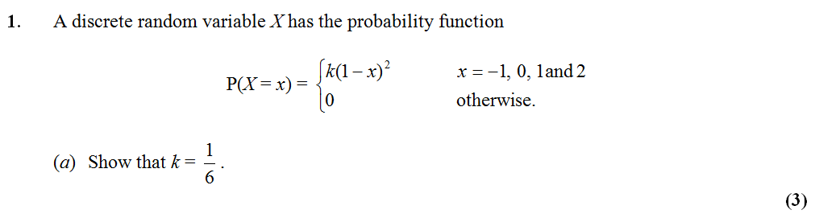
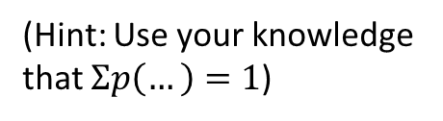
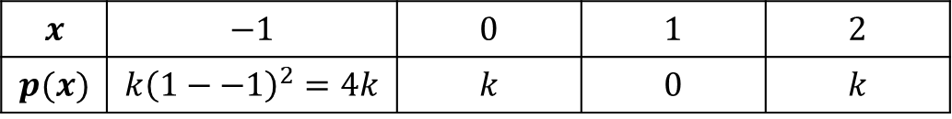
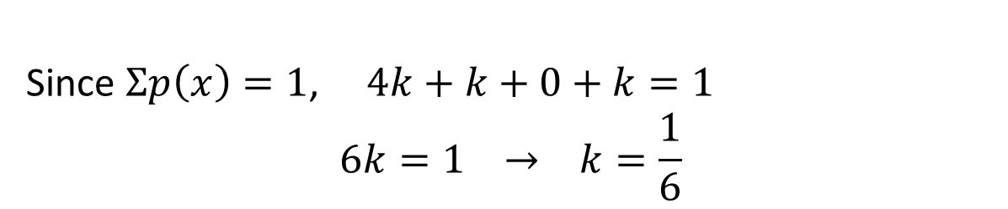
Example Exam Question
(Hint: Use your knowledge that $Σp\left(…\right)=1$)
Edexcel S1 May 2012
$$x$$ | $$−1$$ | $$0$$ | $$1$$ | $$2$$
$$p(x)$$ | $$k{\left(1−−1\right)}^{2}=4k$$ | $$k$$ | $$0$$ | $$k$$
?
?
?
?
Since $Σp\left(x\right)=1$, $4k+k+0+k=1$
$$6k=1 → k=\frac{1}{6}$$
?

Slide 7
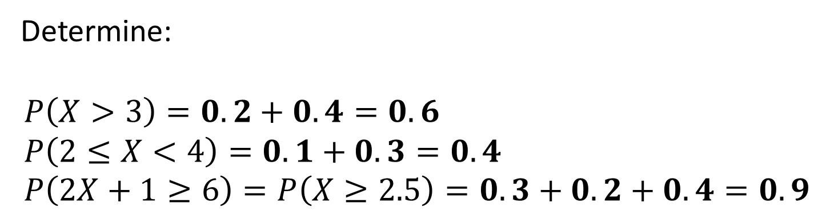
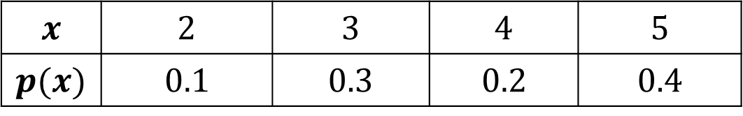
Probability of a Range
$$x$$ | $$2$$ | $$3$$ | $$4$$ | $$5$$
$$p(x)$$ | $$0.1$$ | $$0.3$$ | $$0.2$$ | $$0.4$$
Determine:
$$P\left(X>3\right)=0.2+0.4=0.6 \\ P\left(2≤X<4\right)=0.1+0.3=0.4 \\ P\left(2X+1≥6\right)=P\left(X≥2.5\right)=0.3+0.2+0.4=0.9$$
?
?
?

Slide 8


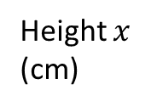


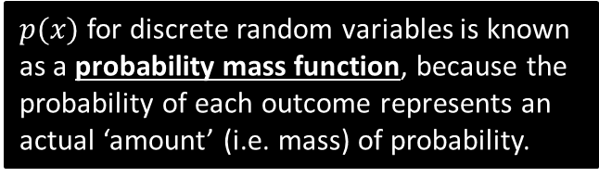

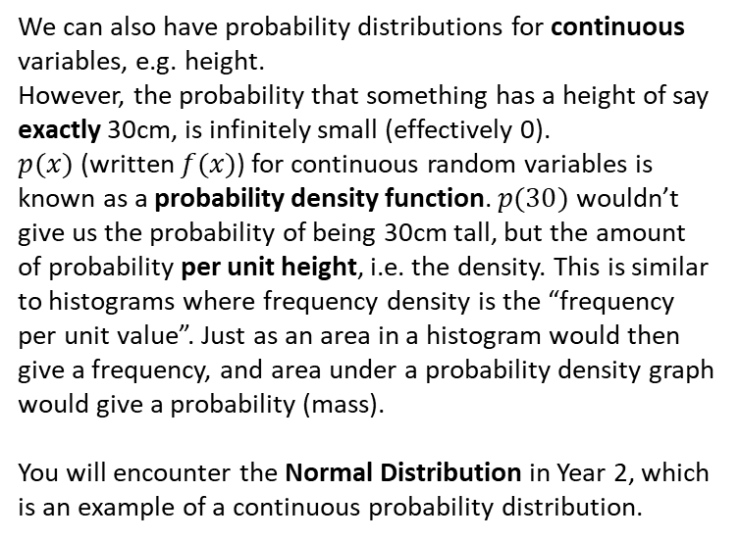







A few last things…
We can also represent a probability distribution graphically:
$$f(x)$$
$$p(x)$$
$$\frac{1}{6}$$
Height $x$
(cm)
$$10 20 30 40 50$$
$$x$$
We can also have probability distributions for continuous variables, e.g. height.
However, the probability that something has a height of say exactly 30cm, is infinitely small (effectively 0).
$p(x)$ (written $f(x)$) for continuous random variables is known as a probability density function. $p(30)$ wouldn’t give us the probability of being 30cm tall, but the amount of probability per unit height, i.e. the density. This is similar to histograms where frequency density is the “frequency per unit value”. Just as an area in a histogram would then give a frequency, and area under a probability density graph would give a probability (mass).
You will encounter the Normal Distribution in Year 2, which is an example of a continuous probability distribution.
$$1$$
$$2$$
$$3$$
$$4$$
$$5$$
$$6$$
! The throw of a die is an example of a discrete uniform distribution because the probability of each outcome is the same.
$p(x)$ for discrete random variables is known as a probability mass function, because the probability of each outcome represents an actual ‘amount’ (i.e. mass) of probability.

Slide 9
Exercise 6.1
Pearson Applied Year 1/AS
Pages 39-40

Slide 10
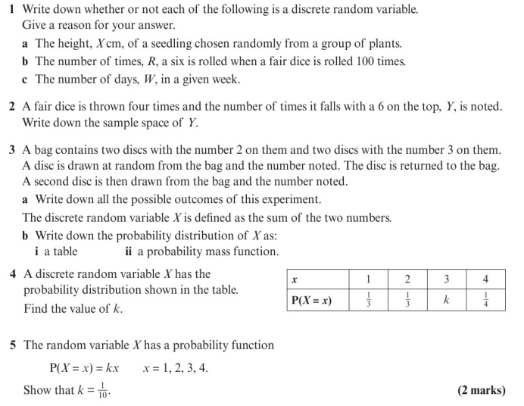
Homework Exercise

Slide 11
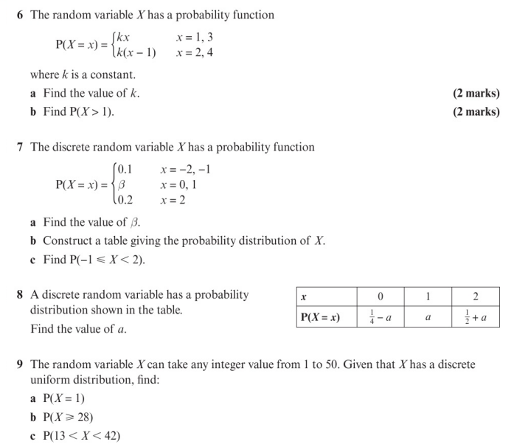
Homework Exercise

Slide 12
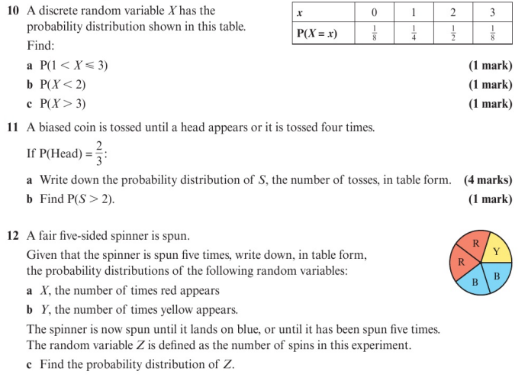
Homework Exercise

Slide 13
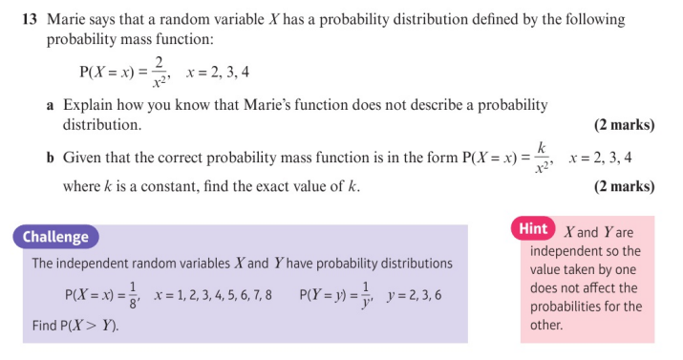
Homework Exercise

Slide 14
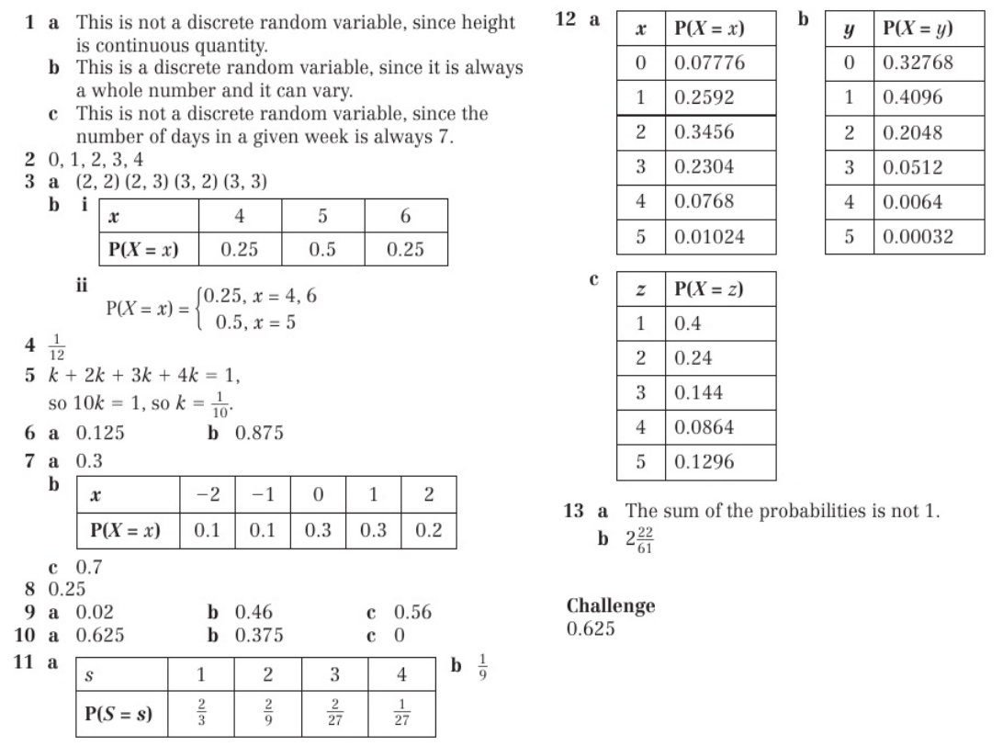
Homework Answers

