Slide 1
P1 Chapter 4: Transforming Graphs Points of Intersection

Slide 2


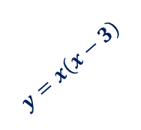



Points of Intersection
In the previous chapter we saw why the points of intersection of two graphs gave the solutions to the simultaneous equations corresponding to these graphs.
If $y=f(x)$ and $y=g(x)$, then the $x$ values of the points of intersection can be found when $f\left(x\right)=g(x)$.
Example: On the same diagram sketch the curves with equations $y=x(x−3)$ and $y=x^{2}\left(1−x\right)$. Find the coordinates of their points of intersection.
?
$$y$$
$$x\left(x−3\right)=x^{2}\left(1−x\right) \\ x^{2}−3x=x^{2}−x^{3} \\ x^{3}−3x=0 \\ x\left(x^{2}−3\right)=0$$ $x=0$ or $x=−\sqrt{3}$ or $x=+\sqrt{3}$
Substituting these values back into either equation, we obtain points:
$$\left(−\sqrt{3}, 3+3\sqrt{3}\right), \\ \left(0,0\right), \\ \left(\sqrt{3}, 3−3\sqrt{3}\right)$$
Note: Cubics generally have 3 solutions. And this seems good news as we have 3 points of intersection.
$$y=x^{2}\left(1−x\right)$$
$$y=x\left(x−3\right)$$
1
3
$$x$$
Tip: A classic mistake is to divide by $x$ to get $x^{2}−3=0$. NEVER divide an equation by a variable, because you lose a solution. Always factorise.

Slide 3
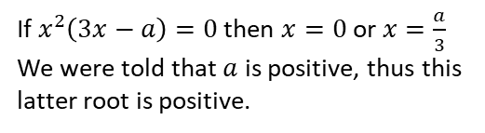


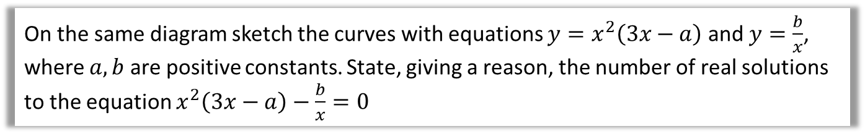
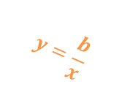
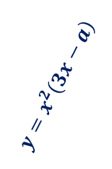



Further example involving unknown constants
On the same diagram sketch the curves with equations $y=x^{2}\left(3x−a\right)$ and $y=\frac{b}{x}$, where $a,b$ are positive constants. State, giving a reason, the number of real solutions to the equation $x^{2}\left(3x−a\right)−\frac{b}{x}=0$
?
If the points of intersection are given by:
$$x^{2}\left(3x−a\right)=\frac{b}{x}$$
then clearly:
$$x^{2}\left(3x−a\right)−\frac{b}{x}=0$$
There are 2 points of intersection, thus 2 solutions to this equation.
$$y$$
$$y=x^{2}\left(3x−a\right)$$
$$y=\frac{b}{x}$$
$$x$$
$$\frac{a}{3}$$
Note: Note that the question is asking for the number of solutions, not the solutions themselves. We’d have to solve a quartic, with roots in terms of $a$ and $b$. While there is a ‘quartic formula’ (like the quadratic formula), it is absolutely horrific.
If $x^{2}\left(3x−a\right)=0$ then $x=0$ or $x=\frac{a}{3}$
We were told that $a$ is positive, thus this latter root is positive.

Slide 4

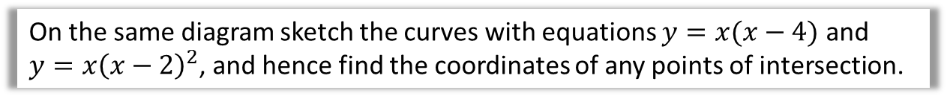


Test Your Understanding
On the same diagram sketch the curves with equations $y=x(x−4)$ and $y=x{\left(x−2\right)}^{2}$, and hence find the coordinates of any points of intersection.
?
$$y$$
Looking at the diagram we expect that $\left(0,0\right)$ will be the only point of intersection (as the cubic will rise more rapidly than the quadratic). But we need to show this algebraically.
$$x{\left(x−2\right)}^{2}=x\left(x−4\right) \\ x\left(x^{2}−4x+4\right)=x^{2}−4x \\ x^{3}−4x^{2}+4x=x^{2}−4x \\ x^{3}−5x^{2}+8x=0 \\ x\left(x^{2}−5x+8\right)=0$$
Thus $x=0$ giving $(0,0)$.
But the discriminant of $x^{2}−5x+8$ is -7, thus there are no further solutions to this equation.
$$y=x{\left(x−2\right)}^{2}$$
2
4
$$x$$
$$y=x\left(x−4\right)$$
Hint: Remember you can use the discriminant to reason about the number of solutions of a quadratic.

Slide 5
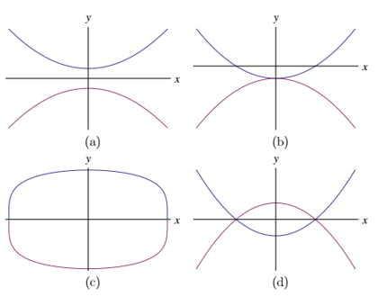

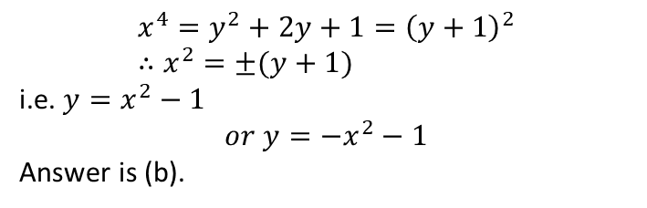
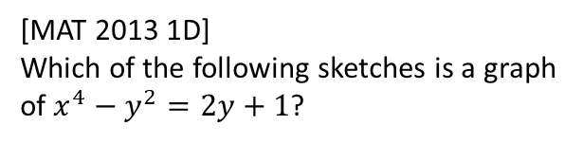
Exercise 4.4
Pearson Pure Mathematics Year 1/AS
Pages 1
Extension
2
[MAT 2013 1D]
Which of the following sketches is a graph of $x^{4}−y^{2}=2y+1$?
1
[MAT 2010 1A] The values of $k$ for which the line $y=kx$ intersects the parabola $y={\left(x−1\right)}^{2}$ are precisely
$k≤0$ B) $k≥−4$
C) $k≥0$ or $k≤−4$ D) $−4≤k≤0$
Equating:
$${\left(x−1\right)}^{2}=kx \\ x^{2}−2x+1=kx \\ x^{2}+\left(−2−k\right)x+1=0$$
Discriminant: $$a=1, b=−2−k, c=1 → k^{2}+4k+4−4≥0 \\ k\left(k+4\right)≥0 \\ k≤−4 or k≥0$$
?
?
$$x^{4}=y^{2}+2y+1={\left(y+1\right)}^{2} \\ ∴x^{2}=±(y+1)$$
i.e. $y=x^{2}−1$ $$or y=−x^{2}−1$$
Answer is (b).

Slide 6
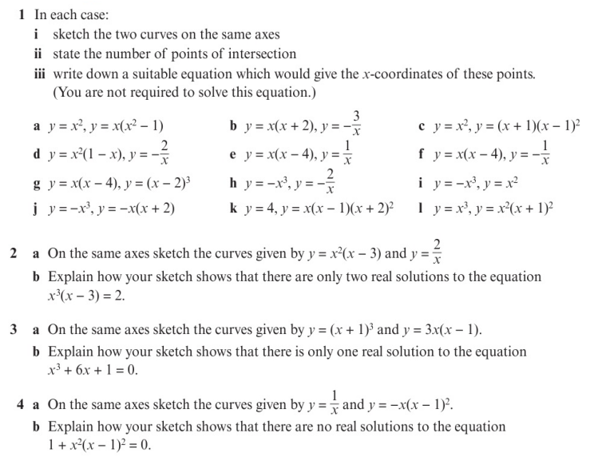
Homework Exercise

Slide 7
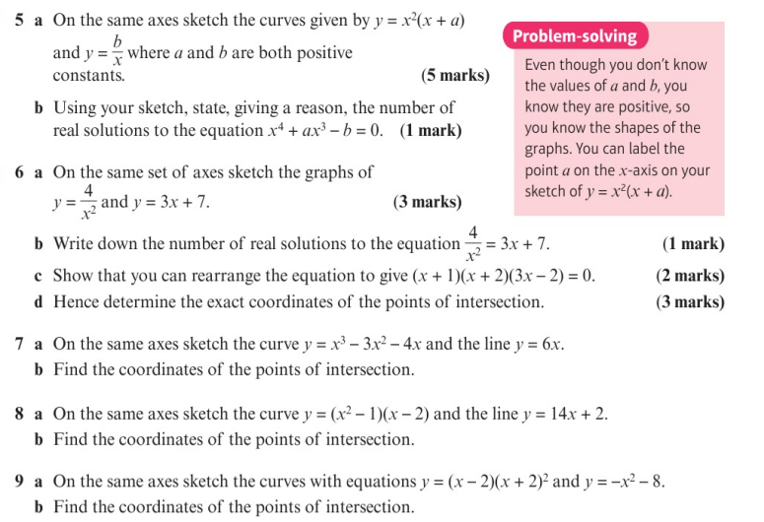
Homework Exercise

Slide 8
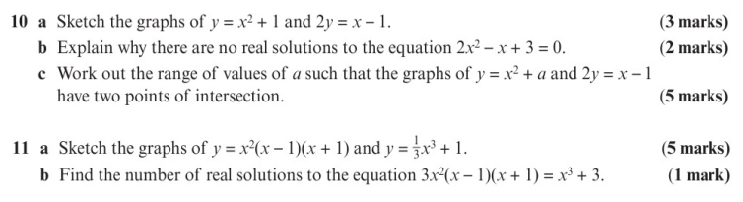
Homework Exercise

Slide 9
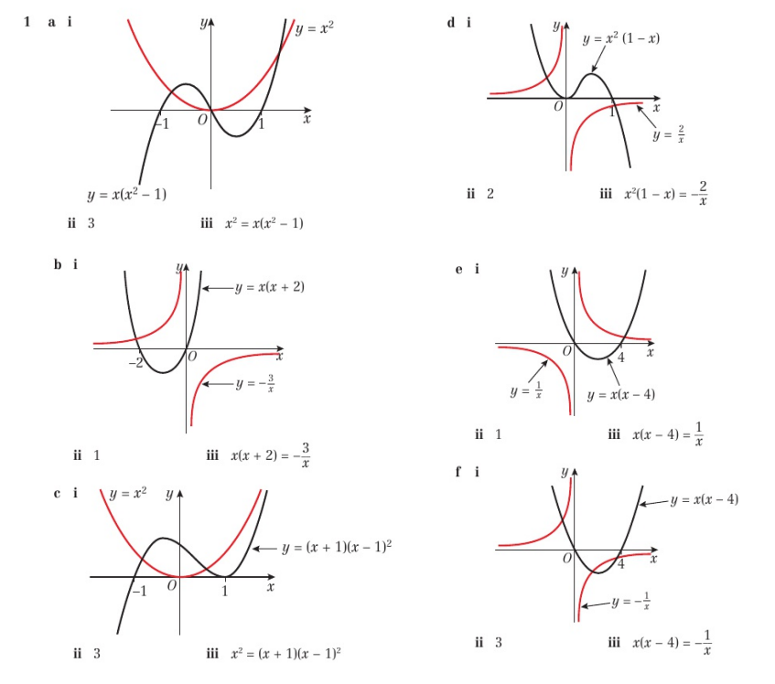
Homework Answers

Slide 10
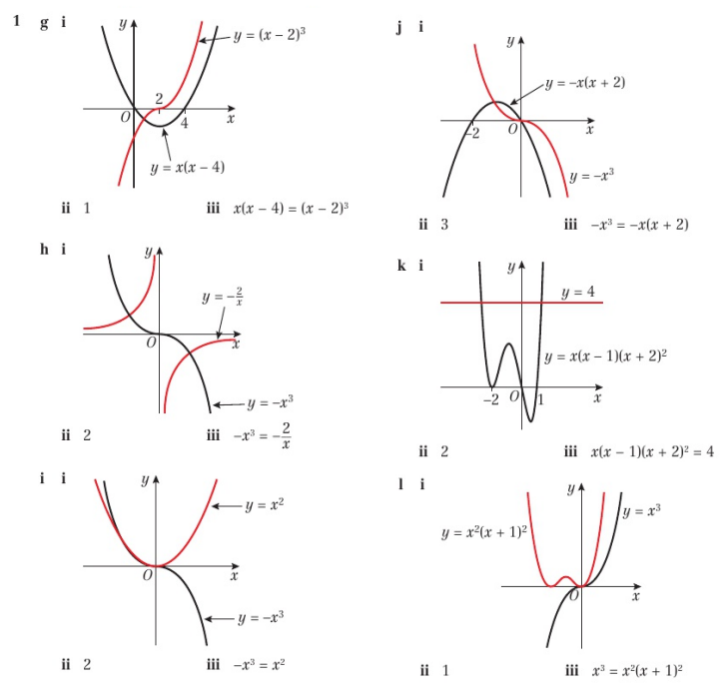
Homework Answers

Slide 11
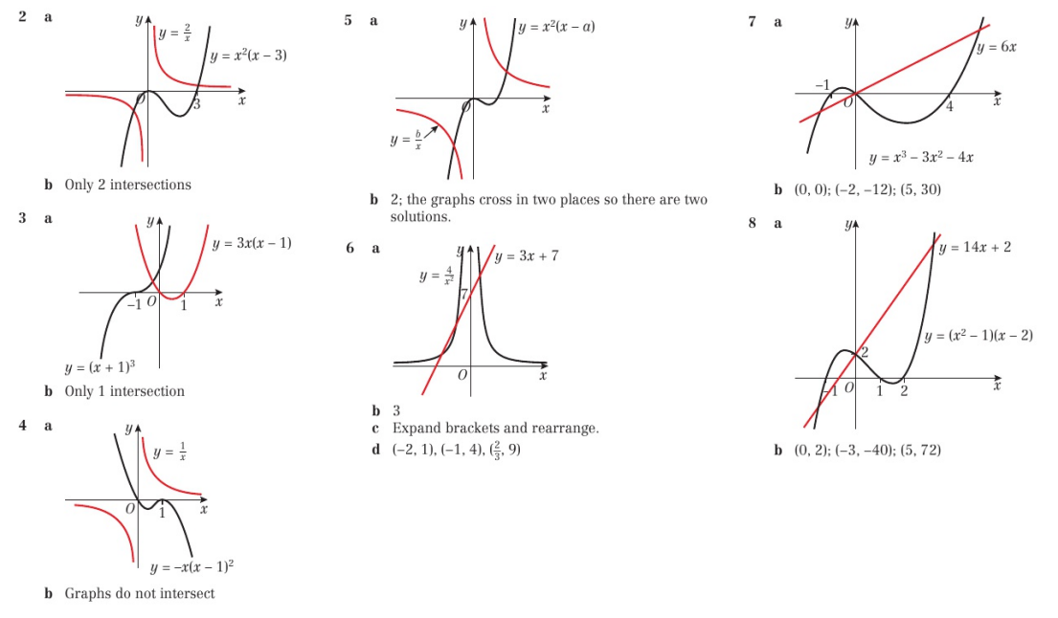
Homework Answers

Slide 12
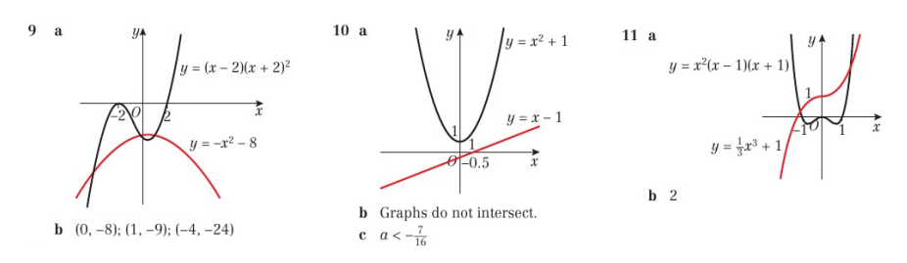
Homework Answers

