Slide 1
Stats Yr2 Chapter 3: Distribution-N Gaussian Probability

Slide 2
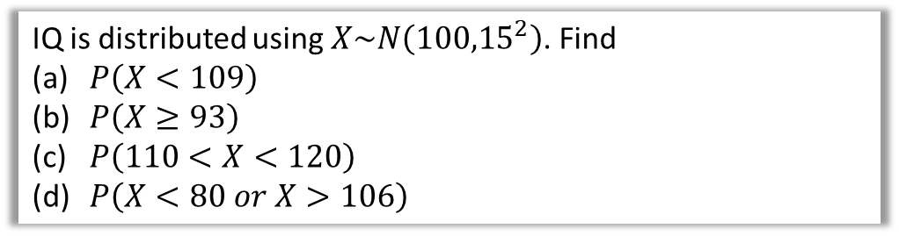
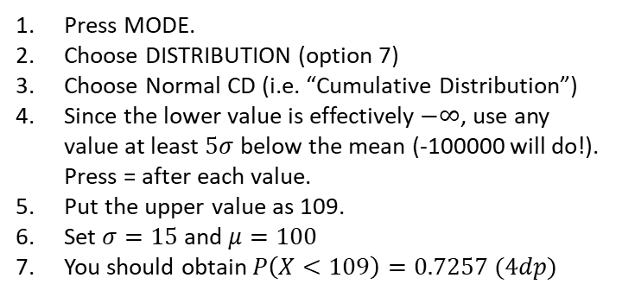
Getting normal values from your calculator
Note:
If for some reason you haven’t got an fx-CG50, buy one now!
These instructions below assume you have a Classwiz. TODO: check andupdate for fx-CG50.
Just like a cumulative frequency graph gives the running total of the frequency up to a given value, a cumulative distribution gives the running total of the probability up to a given value.
IQ is distributed using $X\sim N\left({100,15}^{2}\right)$. Find
$P\left(X<109\right)$
$P\left(X≥93\right)$
$P\left(110<X<120\right)$
$P\left(X<80 or X>106\right)$
A diagram, while not essential, is useful to get a sense of whether our answer is correct. We know the probability must be above 0.5, so 0.7257 sounds about right.
a
Press MODE.
Choose DISTRIBUTION (option 7)
Choose Normal CD (i.e. “Cumulative Distribution”)
Since the lower value is effectively $−∞$, use any value at least $5σ$ below the mean (-100000 will do!). Press = after each value.
Put the upper value as 109.
Set $σ=15$ and $μ=100$
You should obtain $P\left(X<109\right)=0.7257 (4dp)$
100
109
No lower bound, so use -100000

Slide 3
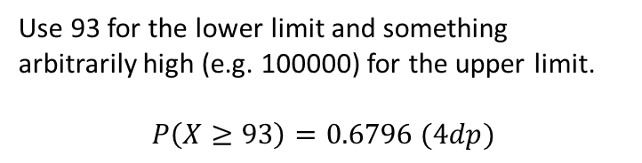

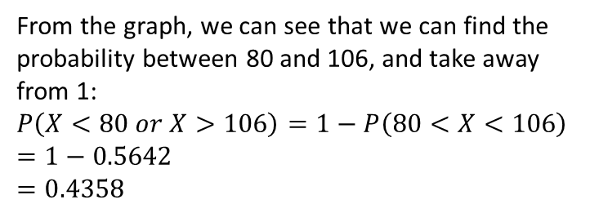

Getting normal values from your calculator
IQ is distributed using $X\sim N\left({100,15}^{2}\right)$. Find
$P\left(X<109\right)$
$P\left(X≥93\right)$
$P\left(110<X<120\right)$
$P\left(X<80 or X>106\right)$
b
?
Fro Note: $≥$ vs $>$ makes no difference as the distribution is continuous.
Use 93 for the lower limit and something arbitrarily high (e.g. 100000) for the upper limit.
$$P\left(X≥93\right)=0.6796 (4dp)$$
93
100
c
?
$$P\left(110<X<120\right)=0.1613 (4dp)$$
d
?
From the graph, we can see that we can find the probability between 80 and 106, and take away from 1:
$$P\left(X<80 or X>106\right)=1−P\left(80<X<106\right) \\ =1−0.5642 \\ =0.4358$$
80
100
106
Froculator Tip: You will need to switch back to normal calculation mode to do the $1−…$.
Note however that the ANS key will store the last result from the Distribution Mode!

Slide 4

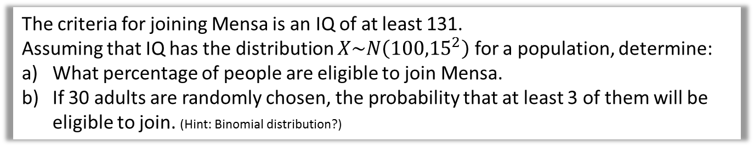
Test Your Understanding
The criteria for joining Mensa is an IQ of at least 131.
Assuming that IQ has the distribution $X\sim N\left({100,15}^{2}\right)$ for a population, determine:
What percentage of people are eligible to join Mensa.
If 30 adults are randomly chosen, the probability that at least 3 of them will be eligible to join. (Hint: Binomial distribution?)
$$P\left(X≥131\right)=0.01938 \left(4sf\right)$$
Let $Y$ be the number of adults among 30 who are eligible to join.
$$Y\sim B(30, 0.0193827)$$
$$P\left(Y≥3\right)=1−P\left(Y≤2\right) \\ =1−0.979986 \\ =0.02001 (4sf)$$
a
?
b
?
Froculator Note: You absolutely can’t use tables in a formula booklet here. You’ll need to use a calculator.

Slide 5
Exercise 3.2
Pearson Stats/Mechanics Year 2
Pages 22-23

Slide 6
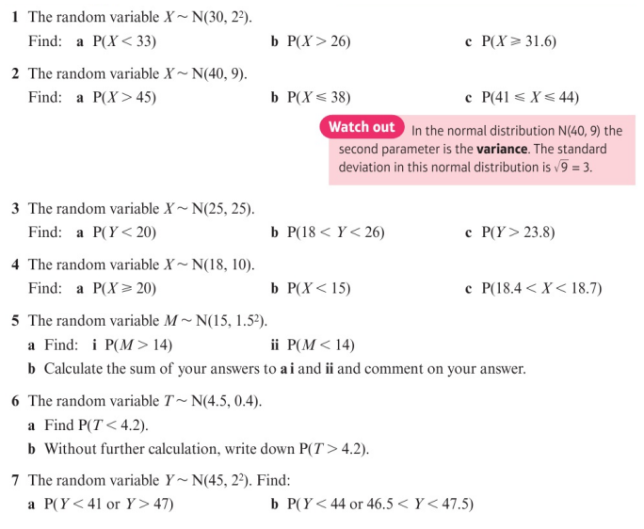
Homework Exercise

Slide 7
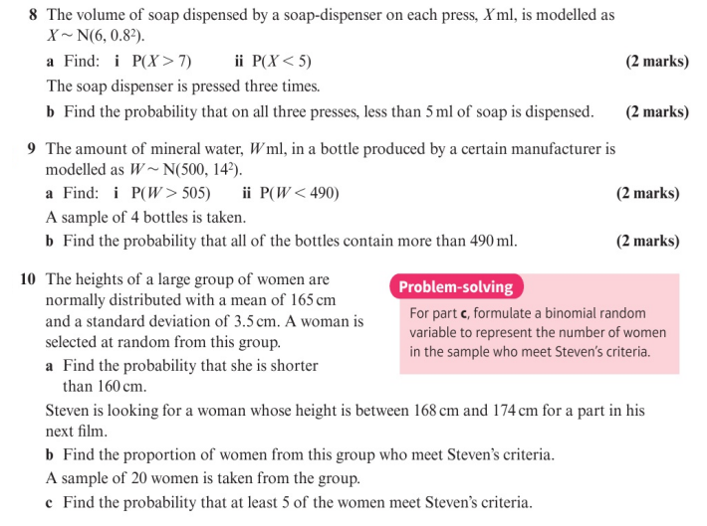
Homework Exercise

Slide 8
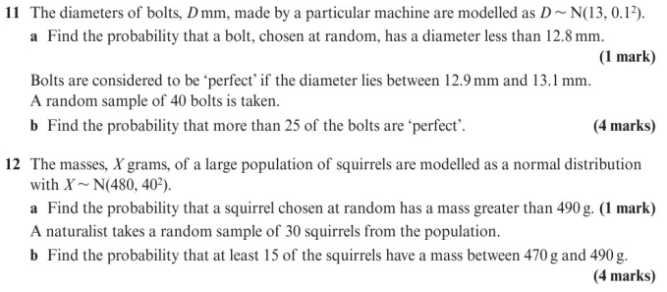
Homework Exercise

Slide 9
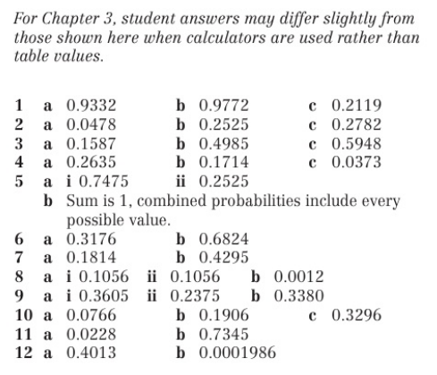
Homework Answers

