Slide 1
P2 Chapter 5: Radians
Small Angle Approximations

Slide 2
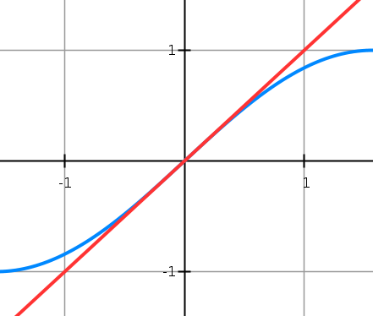
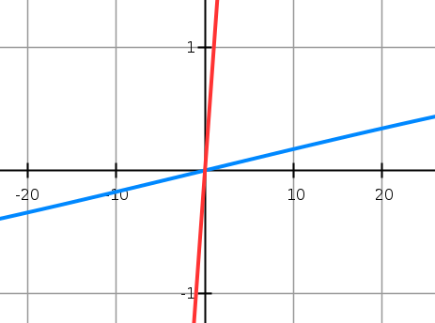




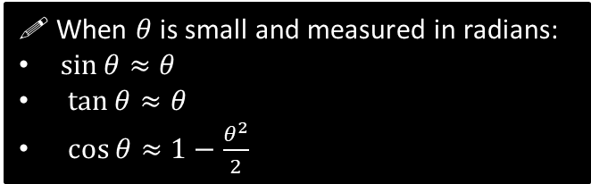
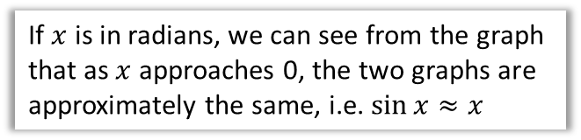
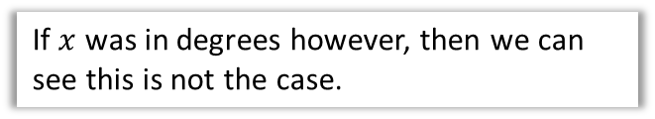
Small Angle Approximations
$$y=x$$
$$y=x$$
$$y=\sin{x}$$
$$y=\sin{x}$$
If $x$ is in radians, we can see from the graph that as $x$ approaches 0, the two graphs are approximately the same, i.e. $\sin{x}≈x$
If $x$ was in degrees however, then we can see this is not the case.
! When $θ$ is small and measured in radians:
$\sin{θ}≈θ$
$\tan{θ}≈θ$
$\cos{θ}≈1−\frac{θ^{2}}{2}$

Slide 3
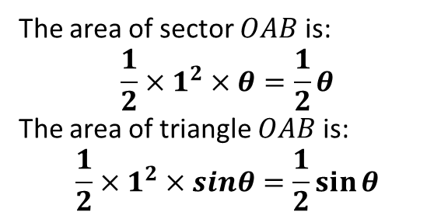




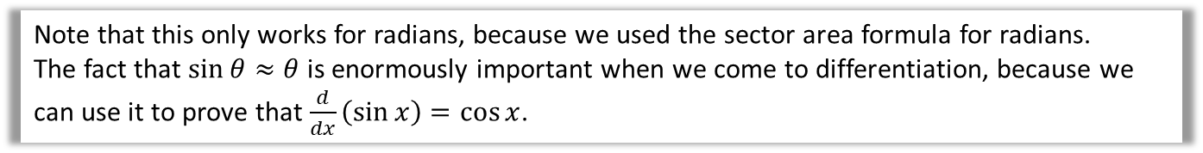








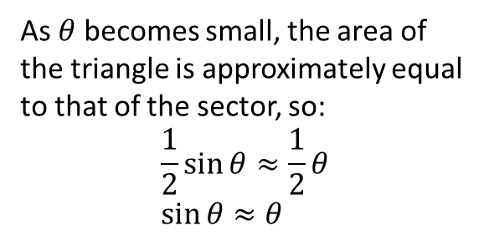

Small Angle Approximations
$$A$$
Geometric Proof that $sin θ≈θ$:
The area of sector $OAB$ is:
$$\frac{1}{2}×1^{2}×θ=\frac{1}{2}θ$$
The area of triangle $OAB$ is:
$$\frac{1}{2}×1^{2}×sinθ=\frac{1}{2}\sin{θ}$$
$$1$$
$$O$$
$$θ$$
$$1$$
$$B$$
As $θ$ becomes small, the area of the triangle is approximately equal to that of the sector, so:
$$\frac{1}{2}\sin{θ}≈\frac{1}{2}θ \\ \sin{θ}≈θ$$
$$A$$
$$1$$
$$O$$
$$θ$$
$$1$$
$$B$$
Note that this only works for radians, because we used the sector area formula for radians.
The fact that $\sin{θ}≈θ$ is enormously important when we come to differentiation, because we can use it to prove that $\frac{d}{dx}\left(\sin{x}\right)=\cos{x}$.

Slide 4

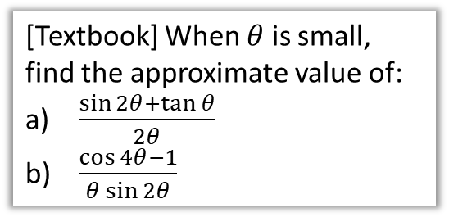

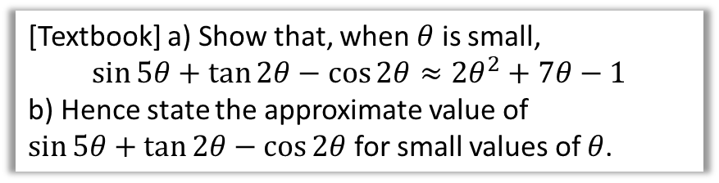
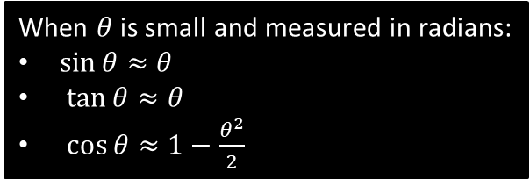
Examples
When $θ$ is small and measured in radians:
$\sin{θ}≈θ$
$\tan{θ}≈θ$
$\cos{θ}≈1−\frac{θ^{2}}{2}$
[Textbook] When $θ$ is small, find the approximate value of:
$\frac{\sin{2θ}+\tan{θ}}{2θ}$
$\frac{\cos{4θ}−1}{θ\sin{2θ}}$
[Textbook] a) Show that, when $θ$ is small,
$$\sin{5θ}+\tan{2θ}−\cos{2θ}≈2θ^{2}+7θ−1$$
b) Hence state the approximate value of
$\sin{5θ}+\tan{2θ}−\cos{2θ}$ for small values of $θ$.
$$\sin{5θ}+\tan{2θ}−\cos{2θ} \\ ≈5θ+2θ−\left(1−\frac{(2{θ)}^{2}}{2}\right) \\ =7θ−1+2θ^{2}$$
b) The $7θ$ and $2θ^{2}$ terms tend towards 0, thus the approximate value is -1.
?
?
$\frac{\sin{2θ}+\tan{θ}}{2θ}≈\frac{2θ+θ}{2θ}=\frac{3}{2}$
$\frac{\cos{4θ}−1}{θ\sin{2θ}}≈\frac{1−\frac{{\left(4θ\right)}^{2}}{2}−1}{θ×2θ}$
$=\frac{1−\frac{16θ^{2}}{2}−1}{2θ^{2}}$
$=\frac{−8θ^{2}}{2θ^{2}}=−4$
?
?

Slide 5
Exercise 5.5
Pearson Pure Year 2
Page 40

Slide 6
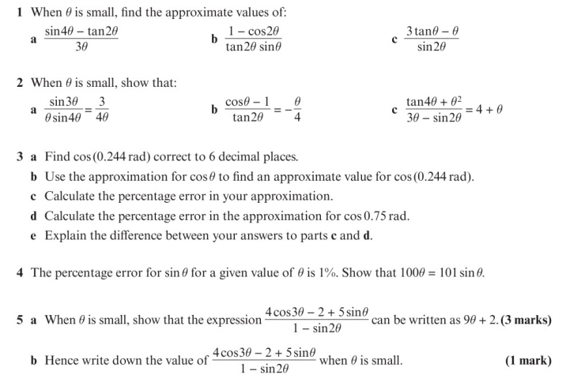
Homework Exercise

Slide 7
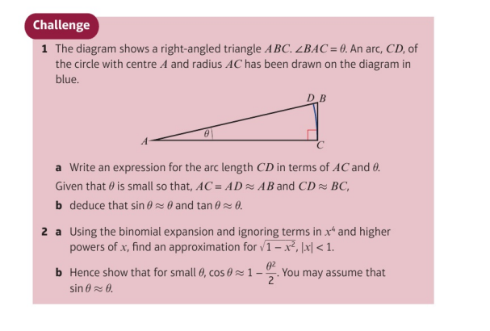
Homework Exercise

Slide 8
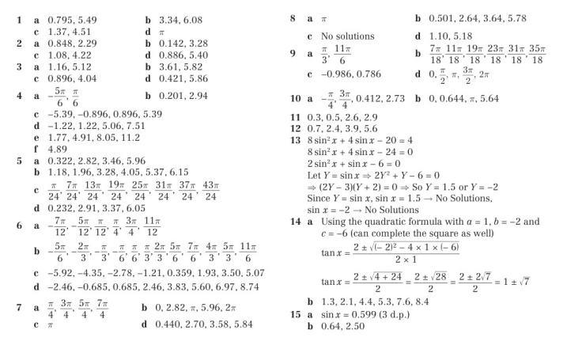
Homework Answers

