Slide 1
P1 Chapter 3: Inequalities Solving Graphically

Slide 2
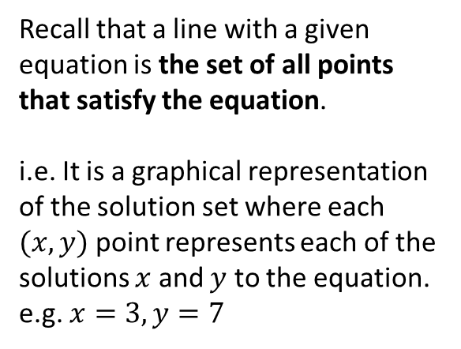
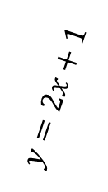
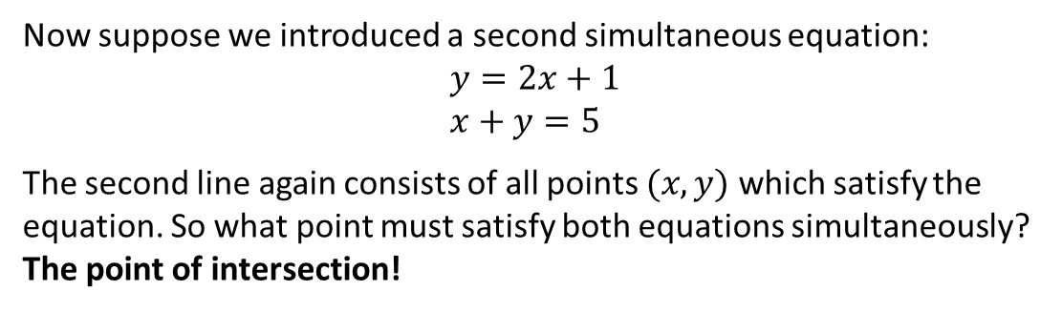
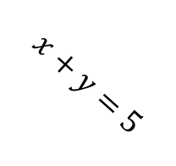
Simultaneous Equations and Graphs
Recall that a line with a given equation is the set of all points that satisfy the equation.
i.e. It is a graphical representation of the solution set where each $(x,y)$ point represents each of the solutions $x$ and $y$ to the equation. e.g. $x=3, y=7$
$$x+y=5$$
$$y=2x+1$$
Now suppose we introduced a second simultaneous equation:
$$y=2x+1 \\ x+y=5$$
The second line again consists of all points $(x,y)$ which satisfy the equation. So what point must satisfy both equations simultaneously?
The point of intersection!
?

Slide 3
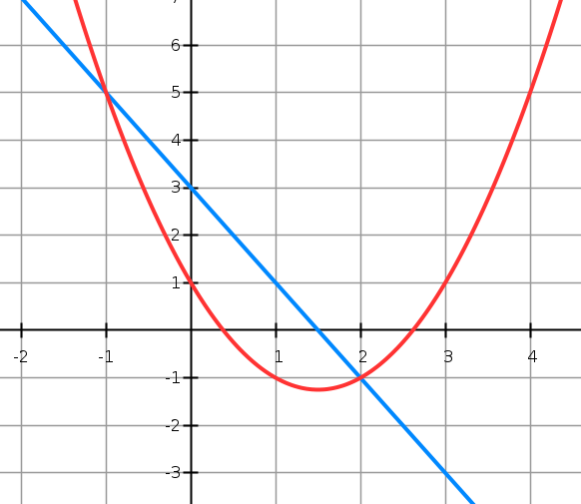
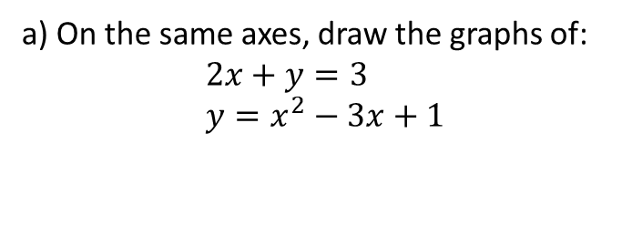

Example
a) On the same axes, draw the graphs of:
$$2x+y=3 \\ y=x^{2}−3x+1$$
b) Use your graph to write down the solutions to the simultaneous equations. $$x=−1, y=5 or \\ x=2, y=−1$$
(We could always substitute into the original equations to check they work)
c) What algebraic method (perhaps thinking about the previous chapter), could we have used to show the graphs would have intersected twice?
Substituting linear equation into quadratic:
$$y=3−2x \\ ∴3−2x=x^{2}−3x+1 \\ x^{2}−x−2=0$$
Since there were two points of intersection, the equation must have two distinct solutions. Thus $b^{2}−4ac>0$
$$a=1, b=−1, c=−2 \\ 1+8=9>0$$ Thus the quadratic has two distinct solutions, i.e. we have two points of intersection.
? b
? a
? c

Slide 4
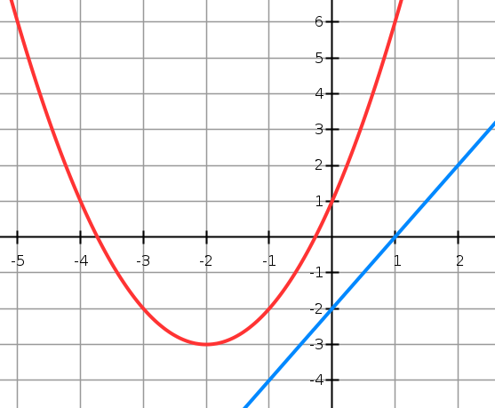
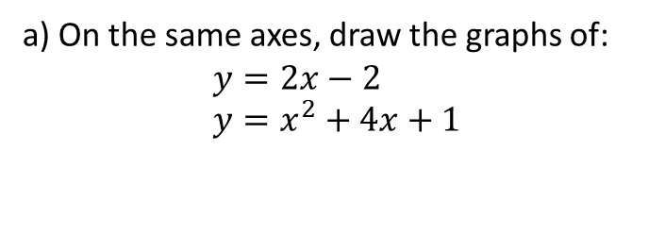

Another Example
a) On the same axes, draw the graphs of:
$$y=2x−2 \\ y=x^{2}+4x+1$$
b) Prove algebraically that the lines never meet.
When we try to solve simultaneously by substitution, the equation must have no solutions.
$$x^{2}+4x+1=2x−2 \\ x^{2}+2x+3=0$$
$$a=1, b=2, c=3 \\ b^{2}−4ac=4−12=−8$$
$−8<0$ therefore no solutions, and therefore no points of intersection.
? b
? a

Slide 5

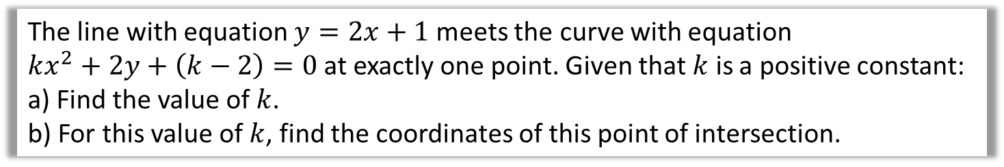
Final Example
The line with equation $y=2x+1$ meets the curve with equation
$kx^{2}+2y+\left(k−2\right)=0$ at exactly one point. Given that $k$ is a positive constant:
a) Find the value of $k$.
b) For this value of $k$, find the coordinates of this point of intersection.
Substituting:
$$kx^{2}+2\left(2x+1\right)+k−2=0 \\ kx^{2}+4x+2+k−2=0 \\ kx^{2}+4x+k=0$$
Since one point of intersection, equation has one solution, so $b^{2}−4ac=0$.
$$a=k, b=4, c=k \\ 16−4k^{2}=0 \\ k=±2$$
But $k$ is positive so $k=2$.
When $k=2$, $2x^{2}+4x+2=0$ $$x^{2}+2x+1=0 \\ {\left(x+1\right)}^{2}=0 → x=−1 \\ y=2\left(−1\right)+1=−1 → (−1,−1)$$
a
? a
We can breathe a sigh of relief as we were expecting one solution only.
? a
b

Slide 6
Exercise 3.3
Pearson Pure Mathematics Year 1/AS
Page 18

Slide 7
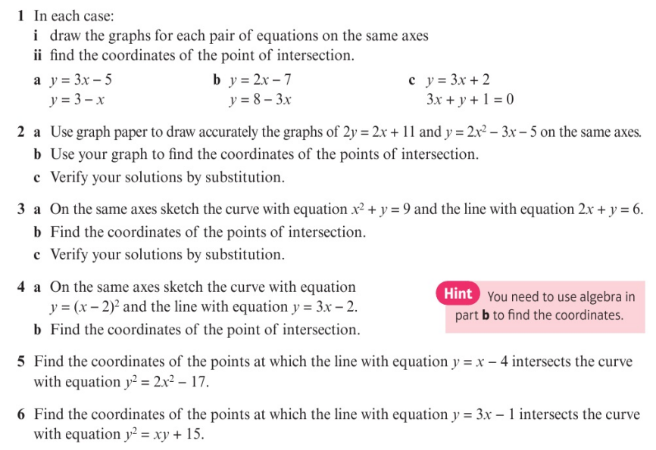
Homework Exercise

Slide 8
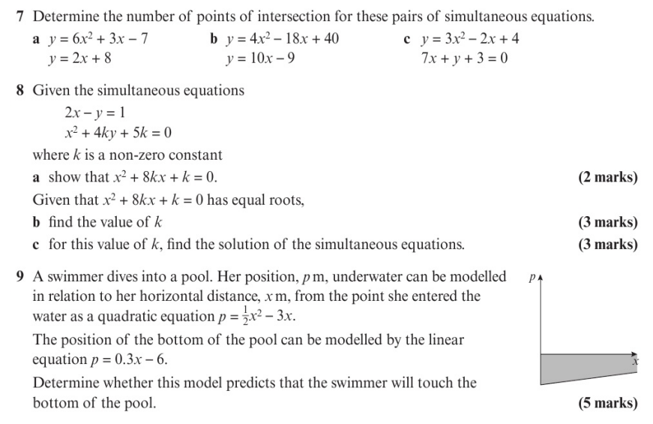
Homework Exercise

Slide 9
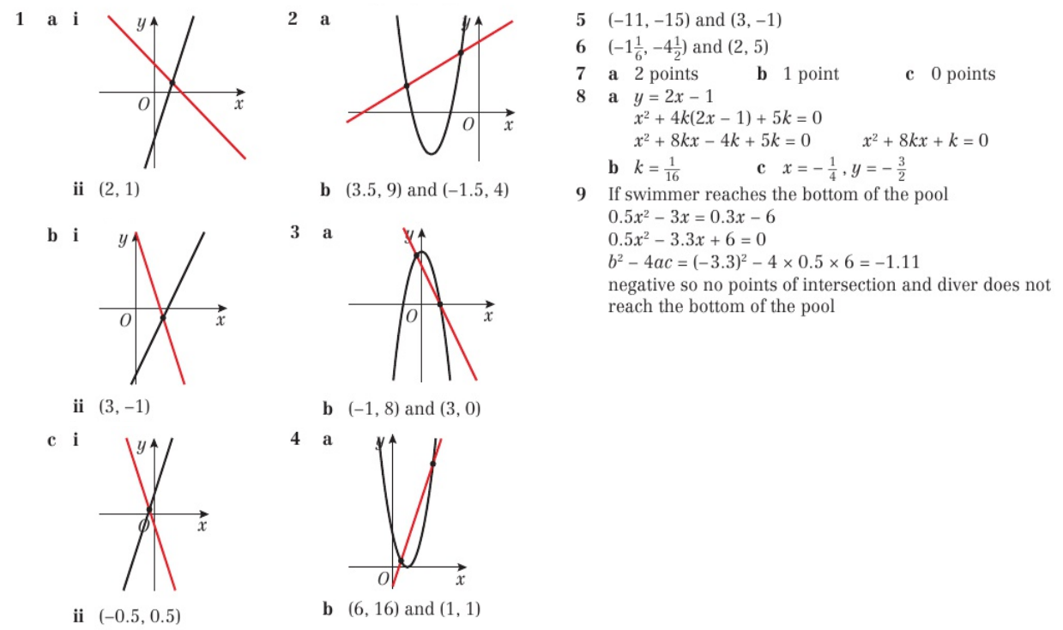
Homework Answers

