Slide 1
Stats Yr2 Chapter 3: Distribution-N The Normal Gaussian

Slide 2
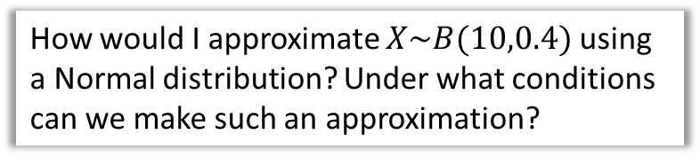
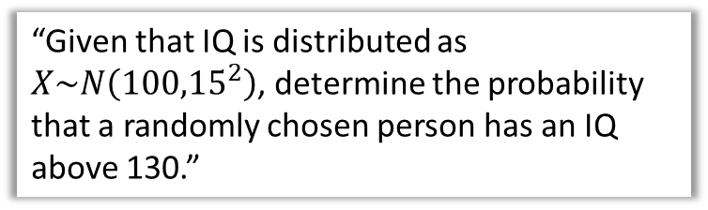

Chapter Overview
1:: Characteristics of the Normal Distribution
2:: Finding probabilities on a standard normal curve.
What shape is it? What parameters does it have?
“Given that IQ is distributed as $X\sim N\left({100,15}^{2}\right)$, determine the probability that a randomly chosen person has an IQ above 130.”
3:: Finding unknown means/standard deviations.
In Wales, 30% of people have a height above 1.6m. Given the mean height is 1.4m and heights are normally distributed, determine the standard deviation of heights.
4:: Binomial $→$ Normal Approximations
How would I approximate $X\sim B(10,0.4)$ using a Normal distribution? Under what conditions can we make such an approximation?
5:: Hypothesis Testing
Teacher Notes: This is a combination of all the old S1 content combined with aspects of S2 (Normal approximations) and S3! (hypothesis testing on the mean of a normal distribution)

Slide 3
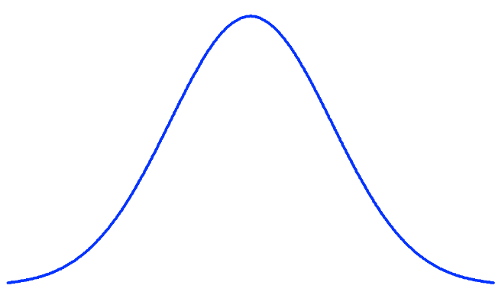



What does it look like?
The following shows what the probability distribution might look like for a random variable $X,$ if $X$ is the height of a randomly chosen person.
We expect this ‘bell-curve’ shape, where we’re most likely to pick someone with a height around the mean of 180cm, with the probability diminishing symmetrically either side of the mean.
$$f\left(x\right)$$
180cm
Height in cm ($x$)
A variable with this kind of distribution is said to have a normal distribution.
For normal distributions we tend to draw the $y$ axis at the mean for symmetry.

Slide 4
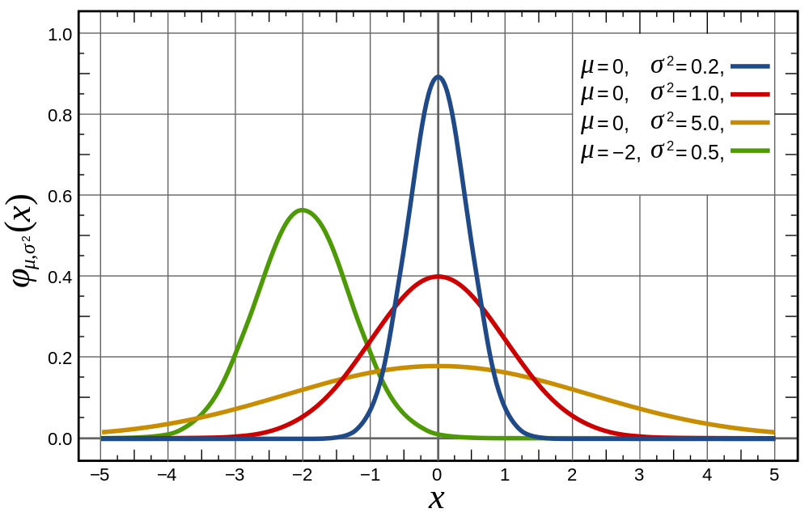


What does it look like?
$$f(x)$$
Compare for example the blue and red curve. If the standard deviation is greater, the data is more spread out, and therefore a randomly chosen thing is less likely to have a value near the mean (hence it being less peaky).
We can set the mean $μ$ and the standard deviation $σ$ of the Normal Distribution. If a random variable $X$ is normally distributed, then we write
$$X\sim N\left(μ,σ^{2}\right)$$

Slide 5
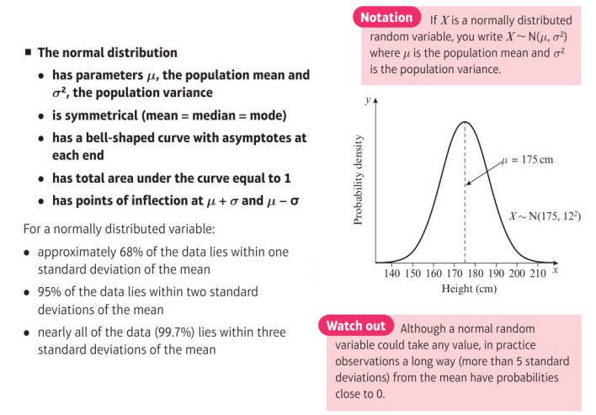
Key Facts

Slide 6



Normal Distribution Q & A
Q1
For a Normal Distribution to be used, the variable has to be:
continuous
With a discrete variable, all the probabilities had to add up to 1.
For a continuous variable, similarly:
the area under the probability graph has
to be 1.
To find $P\left(170<X<190\right)$, we could:
find the area between these values.
Would we ever want to find $P\left(X=200\right)$ say?
Since height is continuous, the probability someone is ‘exactly’ 200cm is infinitesimally small. So not a ‘probability’ in the normal sense.
?
Q2
$$f\left(x\right)$$
?
Q3
?
Q4
?
170cm
180cm
190cm
Height in cm ($x$)
Side Notes: You might therefore wonder what the $y$-axis actually is. It is probability density, i.e. “the probability per unit cm”. This is analogous to frequency density with histograms, where the $y$-value is frequency density area under the graph gives frequency. We use $f(x)$ rather than $p(x)$, to indicate probability density.

Slide 7
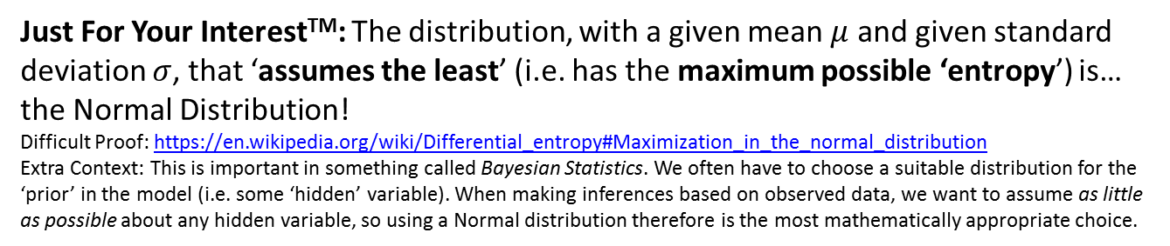


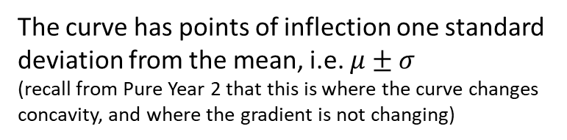


Further Facts
$$f\left(x\right)$$
The curve has points of inflection one standard deviation from the mean, i.e. $μ±σ$
(recall from Pure Year 2 that this is where the curve changes concavity, and where the gradient is not changing)
The Normal Distribution is symmetrical, i.e. mean = mode = median
$$μ−σ$$
$$μ+σ$$
Height in cm ($x$)
Just For Your InterestTM: The distribution, with a given mean $μ$ and given standard deviation $σ$, that ‘assumes the least’ (i.e. has the maximum possible ‘entropy’) is… the Normal Distribution!
Difficult Proof: https://en.wikipedia.org/wiki/Differential_entropy#Maximization_in_the_normal_distribution
Extra Context: This is important in something called Bayesian Statistics. We often have to choose a suitable distribution for the ‘prior’ in the model (i.e. some ‘hidden’ variable). When making inferences based on observed data, we want to assume as little as possible about any hidden variable, so using a Normal distribution therefore is the most mathematically appropriate choice.

Slide 8
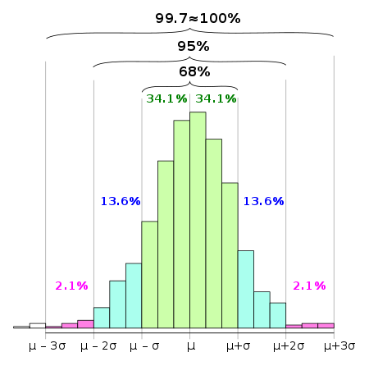
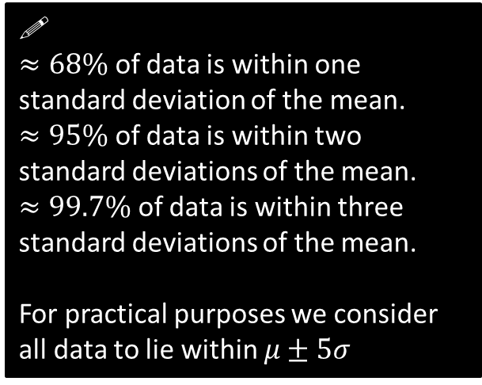
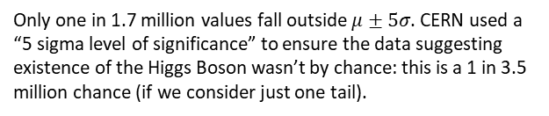
The 68-95-99.7 rule
The 68-95-99.7 rule is a shorthand used to remember the percentage of data that is within 1, 2 and 3 standard deviations from the mean respectively.
You need to memorise this!
!
$≈68\%$ of data is within one standard deviation of the mean. $≈95\%$ of data is within two standard deviations of the mean.
$≈99.7\%$ of data is within three standard deviations of the mean.
For practical purposes we consider all data to lie within $μ±5σ$
The histogram above is for a quantity which is approximately normally distributed.
Source: Wikipedia
Only one in 1.7 million values fall outside $μ±5σ$. CERN used a “5 sigma level of significance” to ensure the data suggesting existence of the Higgs Boson wasn’t by chance: this is a 1 in 3.5 million chance (if we consider just one tail).

Slide 9

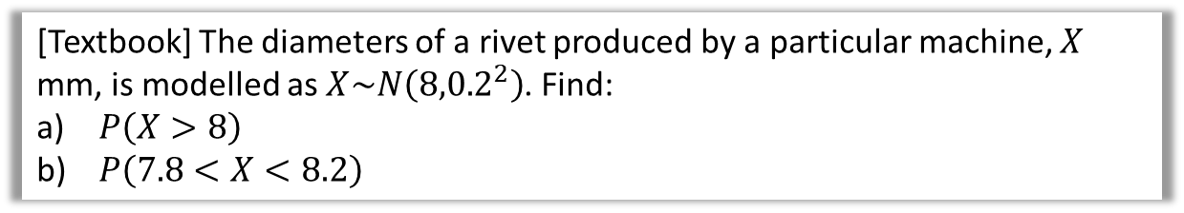
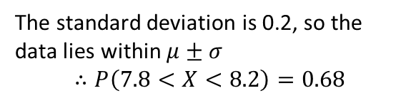
Examples
[Textbook] The diameters of a rivet produced by a particular machine, $X$ mm, is modelled as $X\sim N\left({8,0.2}^{2}\right)$. Find:
$P\left(X>8\right)$
$P\left(7.8<X<8.2\right)$
Fro Tip: Draw a diagram!
?
b
?
a
8
7.8
8
8.2
8 is the mean, so by the symmetry of the normal distribution, 50% of the area lies above the mean.
$$∴P\left(X>8\right)=0.5$$
The standard deviation is 0.2, so the data lies within $μ±σ$
$$∴P\left(7.8<X<8.2\right)=0.68$$

Slide 10

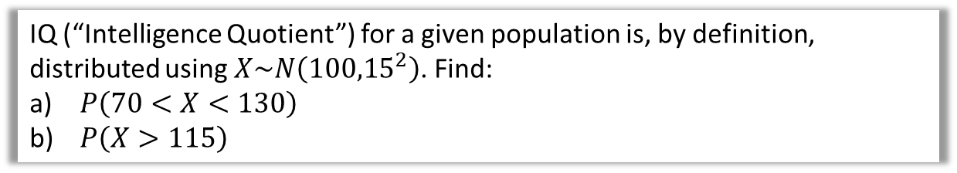
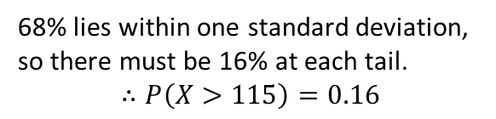
Test Your Understanding
IQ (“Intelligence Quotient”) for a given population is, by definition, distributed using $X\sim N\left({100,15}^{2}\right)$. Find:
$P\left(70<X<130\right)$
$P\left(X>115\right)$
Fro Tip: Draw a diagram!
?
?
a
b
68%
16%
70
100
130
100
115
We know that 95% of data lies within 2 standard deviations of the mean.
$$∴P\left(70<X<130\right)=0.95$$
68% lies within one standard deviation, so there must be 16% at each tail.
$$∴P\left(X>115\right)=0.16$$

Slide 11
Exercise 3.1
Pearson Stats/Mechanics Year 2
Pages 21-22

Slide 12
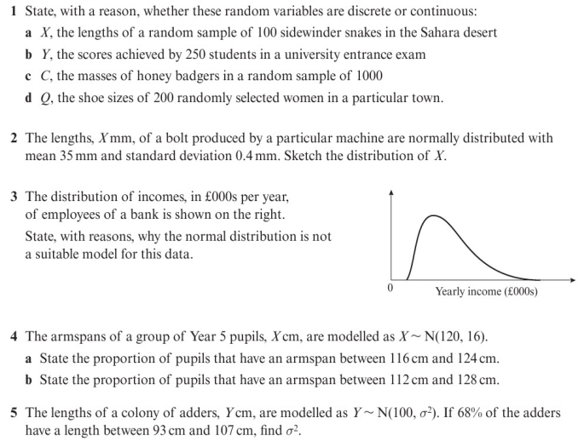
Homework Exercise

Slide 13
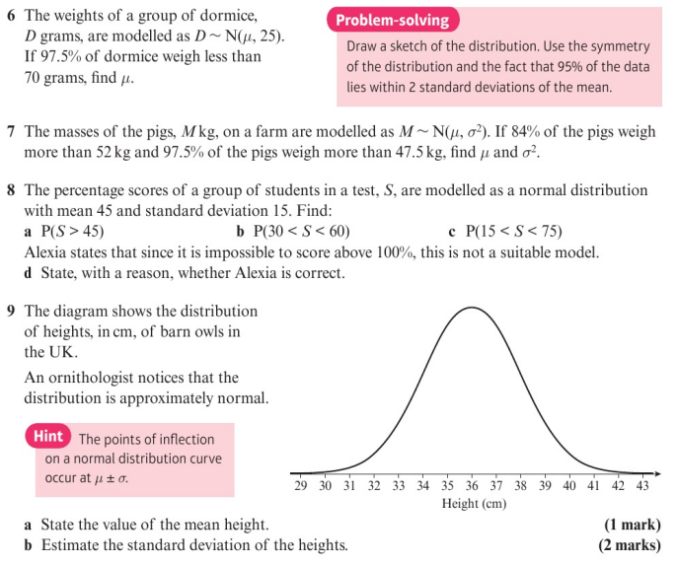
Homework Exercise

Slide 14
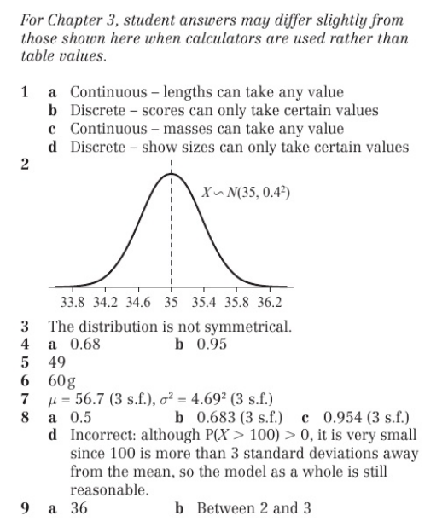
Homework Answers

