Slide 1
P2 Chapter 5: Radians
Solving Trigonometric Equations

Slide 2

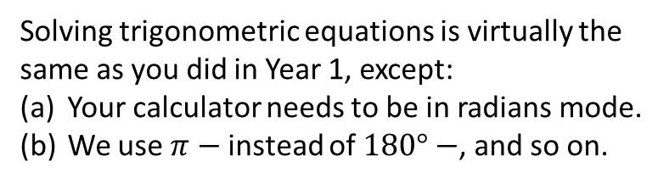

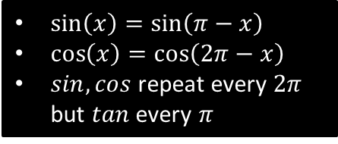

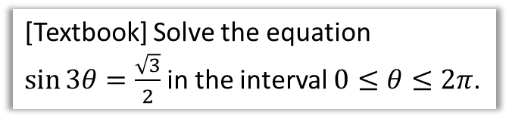

Solving Trigonometric Equations
$\sin\left(x\right)=\sin\left(π−x\right)$
$\cos\left(x\right)=\cos\left(2π−x\right)$
$sin,cos$ repeat every $2π$ but $tan$ every $π$
Solving trigonometric equations is virtually the same as you did in Year 1, except:
Your calculator needs to be in radians mode.
We use $π−$ instead of $180°−$, and so on.
?
[Textbook] Solve the equation
$\sin{3θ}=\frac{\sqrt{3}}{2}$ in the interval $0≤θ≤2π$.
$$0≤3θ≤6π$$
$$3θ=\frac{π}{3},\frac{2π}{3},\frac{7π}{3},\frac{8π}{3},\frac{13π}{3},\frac{14π}{3} \\ ∴θ=\frac{π}{9},\frac{2π}{9},\frac{7π}{9},\frac{8π}{9},\frac{13π}{9},\frac{14π}{9}$$
Adjust interval.
Use $π−$ to get second value in each ‘pair’. Then go to next cycle by adding $2π$ to each value in pair.
Only $÷3$ once all values obtained in range.
?
[Jan 07 Q6] Find all the solutions, in the interval 0 ≤ x < 2π, of the equation
2 cos² x + 1 = 5 sin x,
giving each solution in terms of π. (6)
$$2\left(1−\sin^{2}{x}\right)+1=5\sin{x} \\ 2−2\sin^{2}{x}+1=5\sin{x} \\ 2\sin^{2}{x}+5\sin{x}−3=0 \\ \left(2\sin{x}−1\right)\left(\sin{x}+3\right)=0 \\ \sin{x}=\frac{1}{2} or\sin{x}=−3$$
$$x=\frac{π}{6} \\ or x=π−\frac{π}{6}=\frac{5π}{6}$$

Slide 3
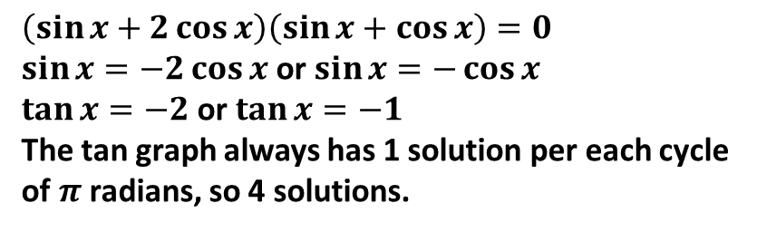
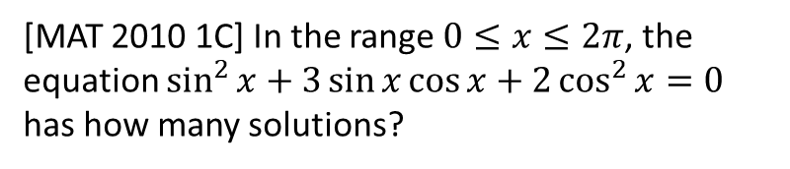
Exercise 5.4
Pearson Pure Year 2
Page 39
Extension
[MAT 2010 1C] In the range $0≤x≤2π$, the equation $\sin^{2}{x}+3\sin{x}\cos{x}+2\cos^{2}{x}=0$ has how many solutions?
?
$$\left(\sin{x}+2\cos{x}\right)\left(\sin{x}+\cos{x}\right)=0$$
$\sin{x=−2\cos{x}}$ or $\sin{x}=−\cos{x}$
$\tan{x}=−2$ or $\tan{x}=−1$
The tan graph always has 1 solution per each cycle of $π$ radians, so 4 solutions.

Slide 4
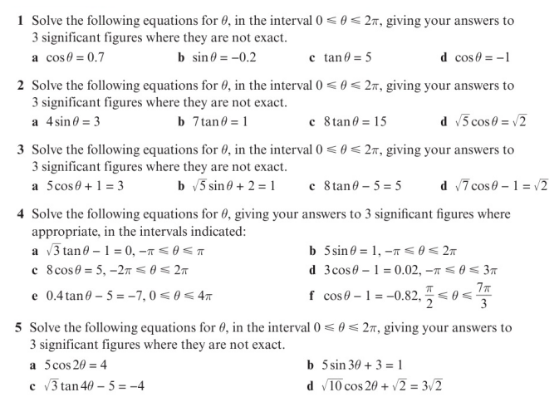
Homework Exercise

Slide 5
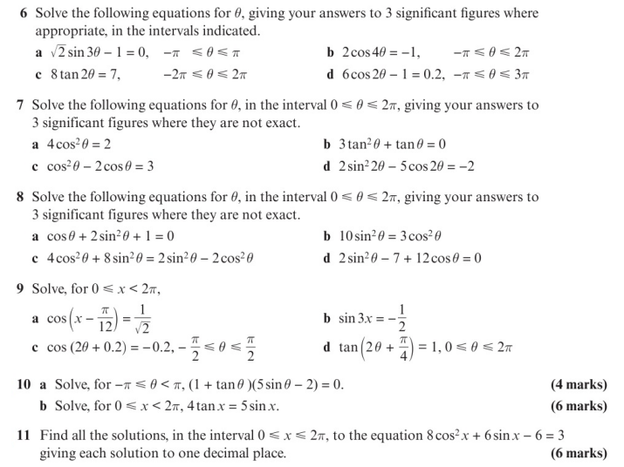
Homework Exercise

Slide 6
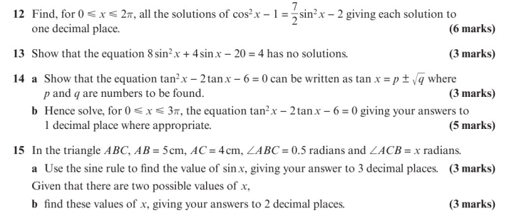
Homework Exercise

Slide 7
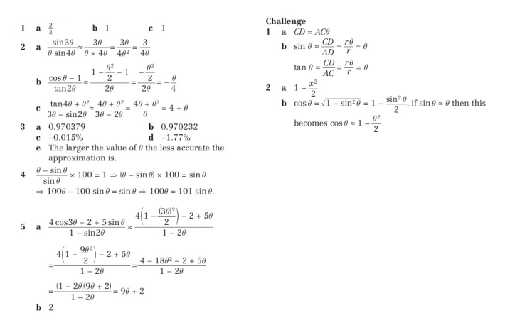
Homework Answers

